Slide 1
Summary
One of the most popular Training Couse (CAT B) on hydrographic Survey is carried out in Japan every year.
All who are interested are welcome to apply the course via diplomatic channel.
Details on your country are available at JICA office in your country (google “JICA country-name”).
RHCs are invited to circulate this information.

Slide 2
Japan International Cooperation Agency (JICA) has been conducting a 6‐month training course for
hydrographic surveyors of developing countries in Japan every year since 1971 in cooperation with
Hydrographic and Oceanographic Department, Japan Coast Guard (JHOD). This course has been recognized by the FIG/IHO/ICA International Board on Standards of Competence for Hydrographic Surveyors and Nautical Cartographers (IBSC) as a training course of International Accredited Category B
for Hydrographic Surveying since 1988.
The present training course is officially entitled “Hydrography for Charting and Disaster Management
(Internationally Accredited Category B)” in the Knowledge Co‐Creation Program of JICA. More than 440 participants from 44 counties has completed the course as of May 2020, and they have been actively involved in hydrographic activities in their countries.
All expenses incurred to participate in the training course are covered by JICA, including tuition fees,
return air ticket, accommodations and per diems.

Slide 3
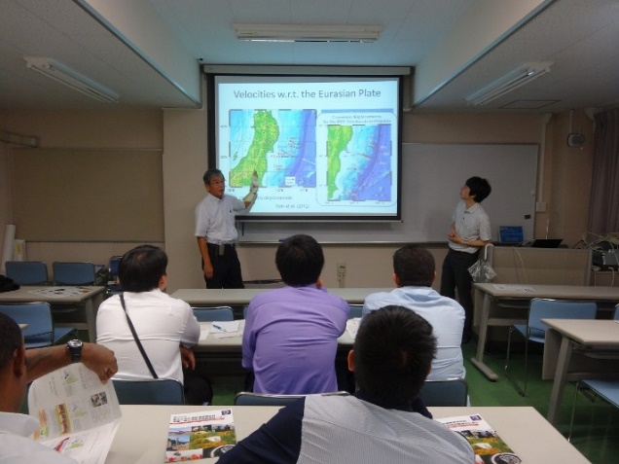
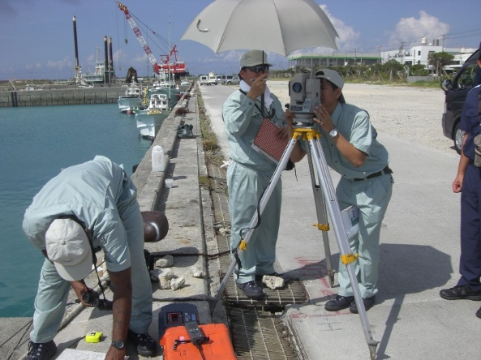
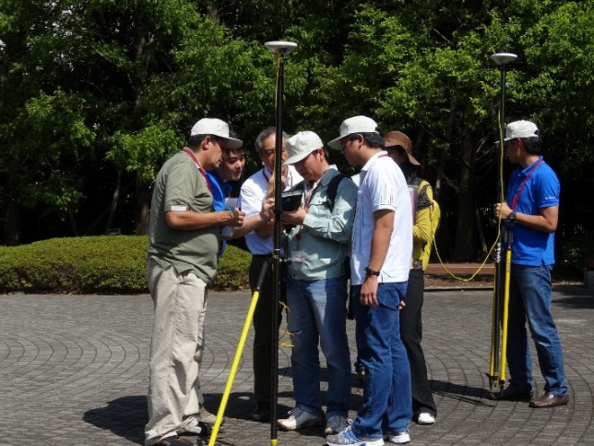
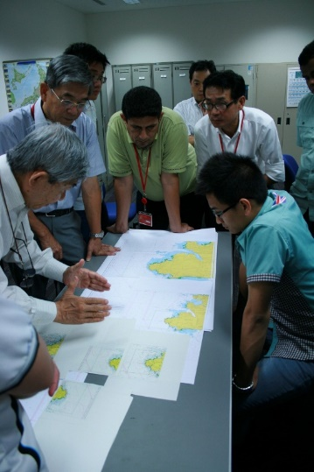
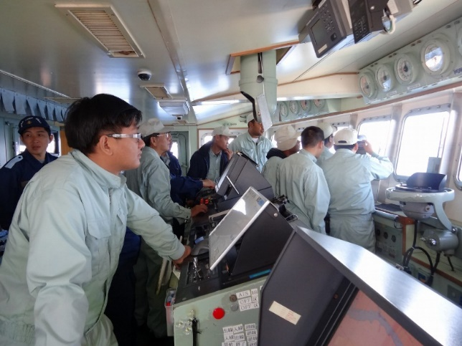
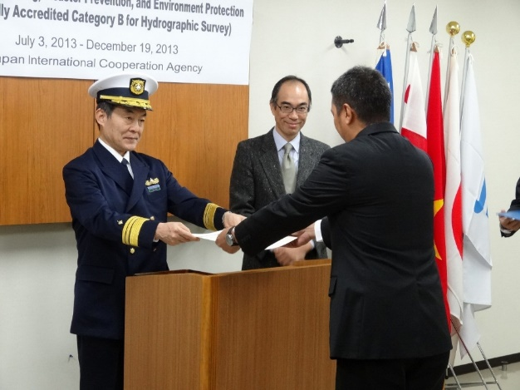
The training course is normally given from the
end of June to the middle of December every
year for up to 10 participants. During the 6
months of the training course, participants learn
the necessary theory, techniques and
skills to plan and carry out hydrographic
surveying and to process the obtained data, and
then they extend the acquired knowledge and
skills through several exercises, such as a one-month
field survey training in port and on‐board
training using a survey vessel of JHOD.
The participants also learn data
processing using GIS software to utilize
hydrographic data, and visit several factories and
research institutes to see state of the art
technology and also visit the damaged areas of
the 2011 tsunami disaster in Japan to see
restoration activities and disaster management
for future disasters.

Slide 4
Call for applicants for the course is conducted around March in the designated countries through
diplomatic channels with the Government of Japan.
These designated countries are determined based on the results of a survey conducted by JICA in the second preceding year to seek countries intending to participate. This survey is called a “needs
survey” to meet the needs of your country and various JICA training courses. Therefore, your organization wishing to participate in our training course for 2021 is recommended to reply to the needs survey conducted this summer (2020) through the diplomatic channels.
If you need more details, please contact JICA office in your Country
https://www.jica.go.jp/english/about/organization/overseas/index.html

Slide 5
Needs survey Flow (JICA Training : Cat B Hydro)
Ministry of Foreign Affairs JICA
Japan
Needs survey
Result of Needs Survey
Embassy and JICA Local Office
List of training programs
Result of Needs Survey
Ministry of Foreign Affairs or Cabinet Secretary or related Ministry
Your Country
List of training programs
Request from your organization
Your Organization

