Slide 1
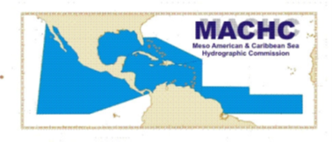
Meso American – Caribbean Sea Hydrographic Commission (MACHC) Report
IHO CAPACITY BUILDING SUB-COMMITTEE
CBSC17
Meso American – Caribbean Sea Hydrographic Commission
(MACHC)
Report to CBSC
Genoa, Italy, 29 -31 May 2019

Slide 2
Meso American – Caribbean Sea Hydrographic Commission (MACHC) Report
Challenges
Rise in the number of all vessels
Hurricane Season
Subsea Volcanic activity
Small Island Developing States (SIDS)
Notes:
There are a number of challenges in this regions such as:
The rise in the number of all types of vessels in this area.
The Hurricane season which extends from June to November and leaves a trail of devastation behind impacting infrastructure and heavily impacting the blue economy
Subsea Volcanic activity in the area impacted shipping in 2018 with an exclusion zone being introduced off Grenada in the shipping route from St Vincent and Grenada for fear of increased gas reducing the buoyancy of ships
Few of the SIDS are IHO Members and they require assistance in developing hydrographic governance often having little hydrographic infrastructure of their own.
These challenges combined with the age and reliability of survey data in the area adds to the risk of transiting the region and highlights the need for well coordinated capacity building in the area.

Slide 3
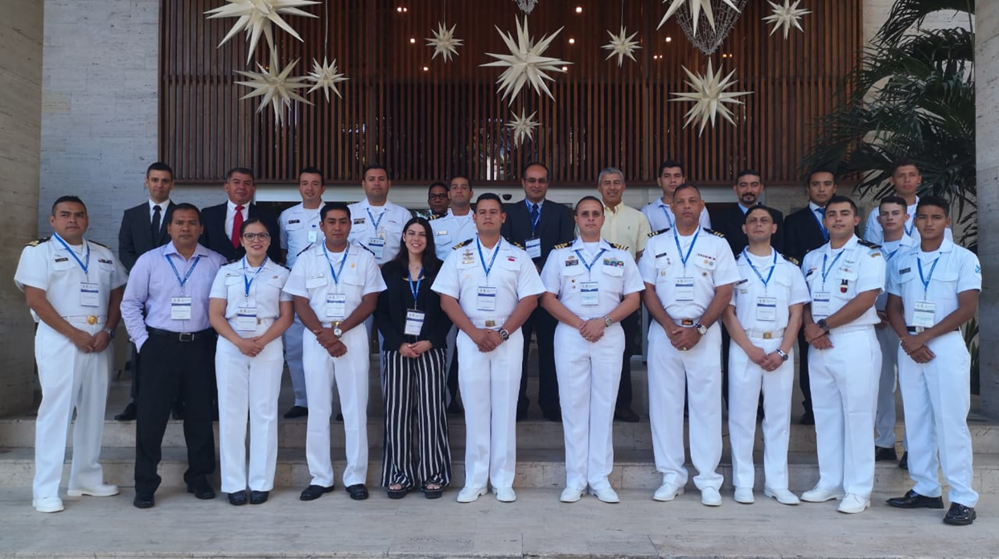
Meso American – Caribbean Sea Hydrographic Commission (MACHC) Report
Activities Completed since CBSC16
MBES Processing Course,
led by CIOH in Cartagena, Colombia
– December 2018
Notes:
IHO funded capacity Building activities that have been completed since CBSC16 are:
A multi beam processing course that was held in Cartagena in December

Slide 4
Meso American – Caribbean Sea Hydrographic Commission (MACHC) Report
Activities Completed since CBSC16
Seminar on Raising Hydrographic Awareness –
Cartagena, Colombia - November 2018
Focus on Disaster Recovery and development of response plans
Technical Visit to Guatemala
March 2019
Notes:
A 2 day Seminar on Raising Hydrographic Awareness that preceded the MACHC annual meeting in Cartagena, Colombia in November 2018.
The seminar was well attended and looked at the roles and responsibilities of the coastal states with a focussed on disaster recovery. A draft response plan that the MACHC will continue to develop was considered. The seminar encouraged the sharing of best practices from the participating states and it is hoped that this can be extended out to other RHCs.
TV to Guatemala was completed in March 2019. The report is in progress but initial findings show that there has been some progress in building their capacity.

Slide 5
Meso American – Caribbean Sea Hydrographic Commission (MACHC) Report
Activities Completed since CBSC16
Port and Shallow water Survey course under the SWAtHC
Workshop on LiDAR technology course with SEPRHC
And included in the MSI Training Course with SWAtHC in October 2018
Notes:
Other capacity Building activities that the MACHC region has benefited from have been these 3 courses which MACHC Members were invited to participate in.:
Port and Shallow water Survey course under the SWAtHC
Workshop on LiDAR technology course with SEPRHC
And included in the MSI Training Course with SWAtHC in October 2018

Slide 6
Meso American – Caribbean Sea Hydrographic Commission (MACHC) Report
Activities Completed since CBSC16
Cat B Hydrographic Survey Programme – ROK (July – Nov 2018)
Colombia & Jamaica successful candidates
Notes:
Colombia and Jamaica were successful in securing places on the higher lvel Cat B hydrographic Survey programme held in Busan, Korea in July – November 2018.

Slide 7
Meso American – Caribbean Sea Hydrographic Commission (MACHC) Report
Activities planned for 2019
Seminar on Raising Hydrographic Awareness
Phase 1 skills course
Notes:
Looking forward to 2019.
Funding will again be made available to encourage membership of the IHO and attendance at the RHC meeting through participation of a 2 day seminar on raising hydrographic Awareness.
And a phase 1 skills course will also be held with non member being encouraged to attend to increase their understanding of the importance of hydrographic services and MSI.

Slide 8
Meso American – Caribbean Sea Hydrographic Commission (MACHC) Report
Achievements
Wider collaboration is enhancing Capacity Building
Guyana became the 90th IHO Member
Notes:
The MACHC is expanding its partnerships with other regional organisations to collaborate and realise resources for capacity building. Organisations such as IOCARIBE and the Central American Marine Transportation Commission (COCATRAM) are co-sponsoring proposed CB activities for the region to support hydrographic surveying and improve regional early warning systems.
To assist in identifying activities of common interest the MACHC is developing a calendar of training opportunities offered by Member States, regional organisations and private sector partners.
It is also important to note that Guyana recently became the 90th IHO member.

