Slide 1





International Hydrographic Organization
Capacity Building Subcommittee
SOUTH EAST PACIFIC REGIONAL HYDROGRAPHIC COMISSION (SEPRHC)
REPORT
Lieutenant Commander Navy of Colombia
NATHALIA MARÍA OTALORA MURILLO
National Hydrographic Service of Colombia (DIMAR-CIOH)
On behalf SEPRHC (chair)
Genoa, ITALIA 29th – 31st May 2019
Notes:
Good morning dear Mr. Chair and distinguished members participating in the CBSC meeting. My name is Nathalía María Otalora Murillo of Colombian Navy, and I’m here on behalf of Sout Est Pacific Regional Hydrographic Commission chair.

Slide 2




Agenda
I
Introduction
II
Capacity Building Activities
III
Proposed 2020 Cap. Building Programmes
IV
Achievements and Lessons Learned
V
Conclusions
VI
Action Required of CBSC
Notes:
We are goint to follow the next agenda.

Slide 3
I. Introduction
04 Member States.
Chair: Colombia.
01 Observer State (Panama).
Notes:
(this hydrographic commissions is integrated by 4 member states, it has the privilege to have panama as observer state) Nevertheless, in this region there are more than 8500 KM of Coast, we have more than 71 between terminals and ports and 3 NAVAREAS among other aspects. In this way and considering the increase of maritime activities in our region, the capacity building program of IHO is a great help to try provide each time better hydrographic products and services.

Slide 4
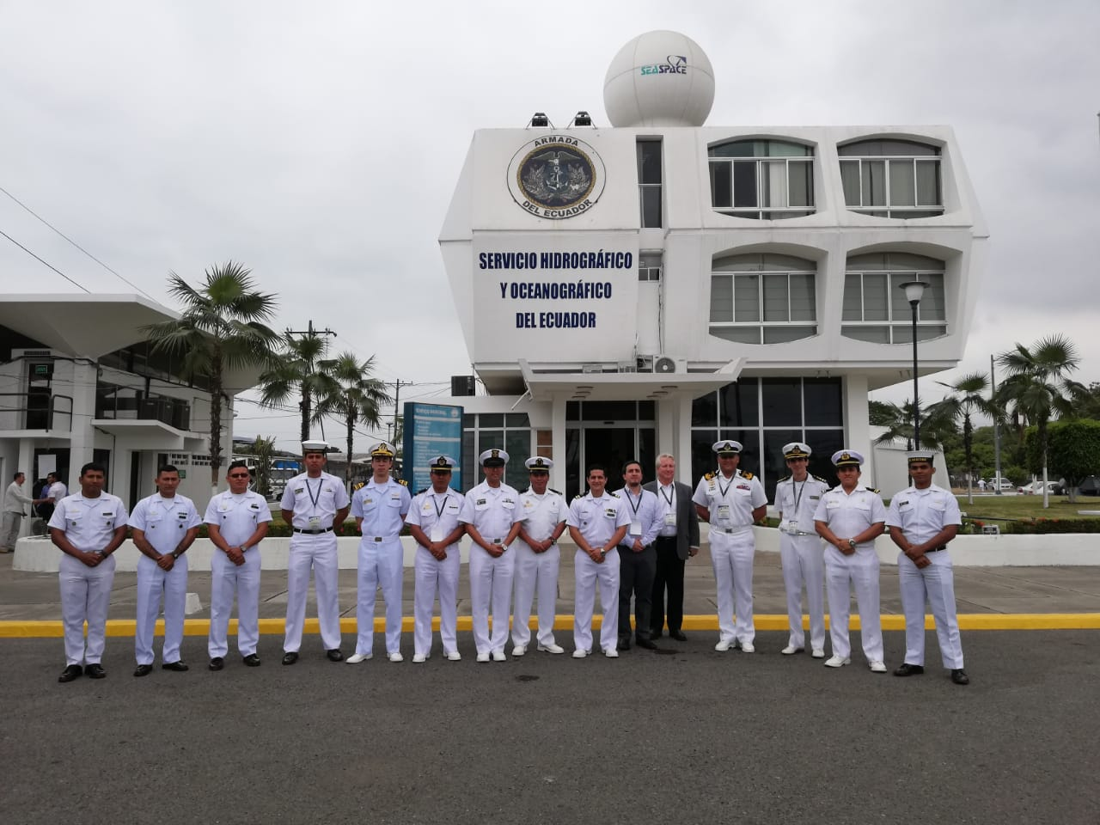
Introduction
South East Pacific Regional Hydrographic Commission (SEPRHC) attended 01 workshop
Notes:
In the name of the Commission, I want to thank to IHO CBSC for Support us, without doubt its has been a valuable Support to promote the maritime development in our region, and this is the feel of all members of this hydrographic commission.

Slide 5
II. Capacity Building Activities
SEPRHC CB Activities since CBSC16
IHO-Funded CB activities
S/N | Title | Venue | Date | Status
1 | P21. Workshop on LIDAR technology and methodology for shallow waters and coastline hydrographic surveys. | INOCAR, Ecuador | October 22-26 2018 | Completed
2 | P23. MBES Processing. MACHC | Cartagena, Colombia | December 10-14 2018 | Completed
3 | P02. ROK Category B Survey Programme (phase 1/2) | Busan, Corea | 12 July to 30 Nov. 2018 | Completed KOA
4 | P20 Workshop Quality Control of ENC production | INOCAR, Ecuador | 2 semester 2019 | Not funded Yet
5 | P23 Workshop on Law of the Sea | Colombia | 2 semester 2019 | Not funded Yet
6 | P28 MSDI | Colombia | 2 semester 2019 | Not funded Yet
Notes:
With CB FUND, during 2018, the workshop in LIDAR was development in Ecuador, the scope of the project was “Acquiring basic knowledge of LlDAR technology applied to bathymetric
surveys in relation to processing of data work flow”, participated 35 Persons, 9 Foreign attendees (06 SEPRHC, 02 SWAtHC and 01 MACHC), 3 Instructors, 16 EC -INOCAR attendees and
07 Industry.
In regional hydrographic coordination, the “P-23 Multybeam Processing” workshop was host in Colombia and 3 countries of SEPRCH can attend
According the circular letter 22/2018, One Petty Officer of SEPRHC attend the Category B survey Programme in Busan Korea
For this year, there are three workshops waiting by the resources. The logistic, agenda, instructors are ready. the Commission are hoping the resources.

Slide 6
II. Capacity Building Activities
Non IHO-Funded CB activities
S/N | Title | Venue | Date | Status
1 | Aids to Navigation Level 1 Manager Course | Colombia | 2018 | Completed
2 | BAP Carrasco. Research on board | Perú | 2018 | Completed
3 | Aids to Navigation Level 1 Manager Course | Colombia | 2019 | Planned
4 | Training to Hydrography Cat. A | Chile | 2019 | On going
5 | Training to Hydrography Cat. B | Peru | 2019 | On going
6 | Training to Hydrography Cat. B | Ecuador | 2019 | On going
7 | Training to Hydrography Cat. A Training to Hydrography Cat B | Colombia | 2019 | On going
Notes:
About the NON IHO FOUNDED CB ACTIVITIES, the countries continue working in organize and develop CB events. For example you can see in the slide one workshop developed in Colombia during 2018, with the honorable visit of Mrs. Gerardine De La Noye IALA, Peru offered the new research ship BAP Carrasco. This opportunity was used by one official(member) of Ecuador Hydrographic Service. All MS are continuing development the programs of hydrographic in Cat A and Cat B, Category

Slide 7
III. Proposed 2020 Capacity Building
Activities
SEPRHC activities
S/N | Title | Venue | Date | Status
1 | Workshop on MSI | Colombia | 2020 | Planned
2 | Workshop “Coast line” | Ecuador | 2020 | Planned
3 | Workshop on Crowdsourced Bathymetry | Colombia | 2020 | Planned
4 | Workshop Caris Composer | Peru | 2020 | Planned
Notes:
About the SEPRHC activities we are planning some activities for the next year . We are considering aspects in MSI, Coast Line, Crowdsourced bathymetriy and Caris Composer.

Slide 8
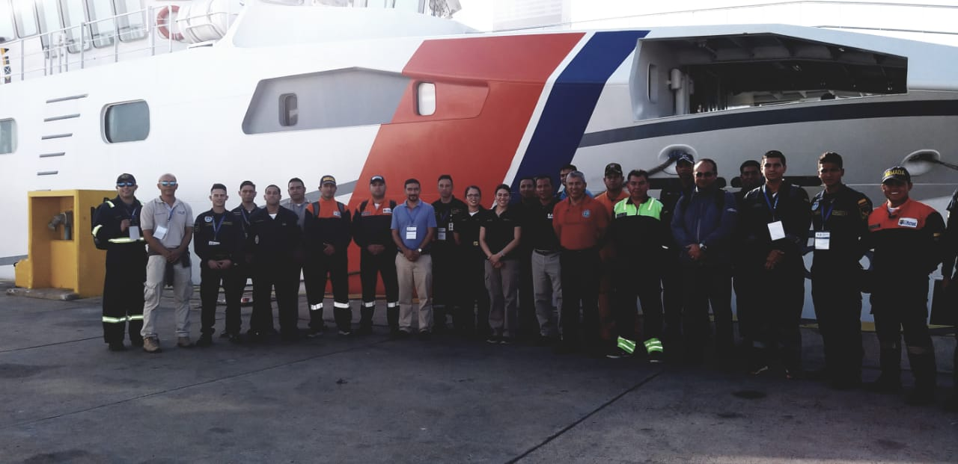
IV. Achievements and Lessons Learned
The workshops allow to learn new technologies, to know the hydrographic development of other countries, to demonstrate the advantages of be member of IHO and the best, to create bonds of friendship that shorten distances and streamline process.
Notes:
The workshops also allow to learn new technologies, to know the hydrographic development of other countries, to demonstrate the advantages of be member of IHO and the best, to create bonds of friendship that shorten distances and streamline process.

Slide 9
V. Conclusions
SEPRHC thanked to CB-IHO to select to Ecuador for participate in UKHO for the 11th course of Nippon Foundation CHART project. CL IHO 22/2019.
The MS SEPRHC are development Capacity building with itself resources, especially in Cat A and B hydrographic program.
Peru continued offering the BAP Carrasco as research platform
Notes:
It´s important consider that each day there are more hydrographic requirements, from National and international organizations, and other agencies. Then is very important strengthen this program.

Slide 10
VI. Action required of CBSC17
The CBSC is invited to take note of this report.
The SEPRHC respectfully requests consider the approval of resources to carry out the workshops.
To carry out the Workshops considered in the 2019 CB Program

Slide 11
International Hydrographic Organization
Capacity Building Subcommittee
SOUTH EAST PACIFIC REGIONAL HYDROGRAPHIC COMISSION (SEPRHC)
Thanks
Lieutenant Commander Navy of Colombia
NATHALIA MARÍA OTALORA MURILLO
National Hydrographic Service of Colombia (DIMAR-CIOH)
On behalf SEPRHC (chair)
Genoa, ITALIA 29th – 31st May 2019

