Slide 1
CBSC-17
Eastern Atlantic Hydrographic Commission (EAtHC)
Report to CBSC
Genoa, Italia, 29 – 31 May 2019

Slide 2
Activities completed since CBSC16 (1/2)
Regional Awareness Seminar “The provision of hydrographic services” & “New IT technologies: MSI & MSDI” [CBWP 2018: Action P-04].
15-16 October 2018, Lagos Nigeria,
France/Shom (IMO, IALA , UK, Ghana … involved)
Support provided by the CB funds, allowed a broad attendance at the 15th EAtHC conference.
African countries would have been much underrepresented at the EAtHC conference without the organization of the sponsored seminar.
The organisation of a seminar/workshop before the plenary conference should be renewed, in particular for this region where many coastal states are facing budgetary difficulties to participate in the conference.
Notes:
The organization of this type of seminar, with the support provided by the CB funds to help a large number of EAtHC African countries to participate, allowed a broad attendance at the 15th EAtHC conference. It is certain that African countries would have been much underrepresented at the EAtHC conference without the organization of the sponsored seminar. The organisation of a seminar/workshop before the plenary conference should be renewed, in particular for this region where many coastal states are facing budgetary difficulties to participate in the conference;

Slide 3
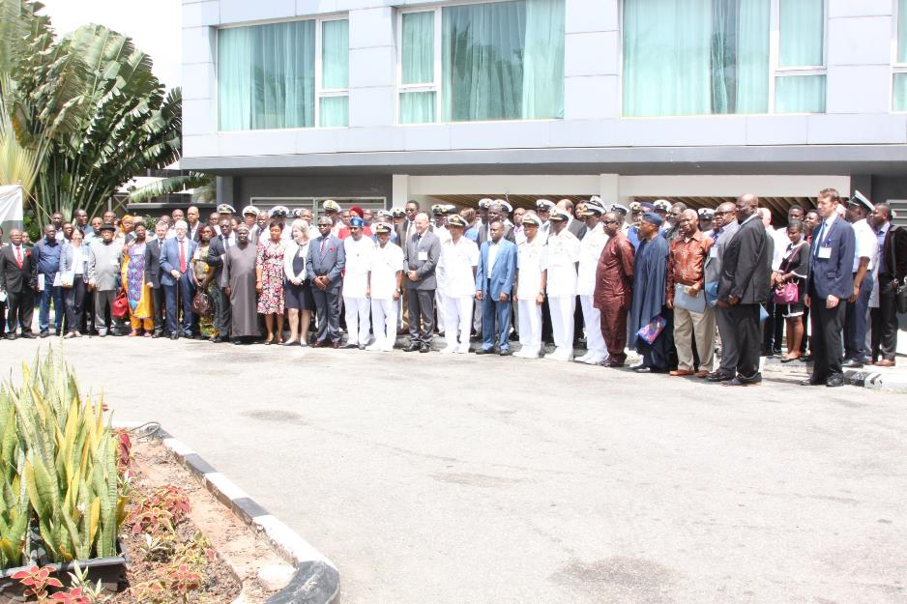

Slide 4
Activities completed since CBSC16 (2/2)
Training Centre Visit and Technical Visit
10-13 February 2019, Libreville Gabon,
Shom [CBWP 2019: Action A-10].
Training Centre Visit and Technical Visit
13-16 February 2019, Douala Cameroon
Shom [CBWP 2019: Action A-10].
Training Centre Visit
24-28 March 2019, Accra Ghana,
University of Southern Mississippi [CBWP 2019: Action A-10].

Slide 5
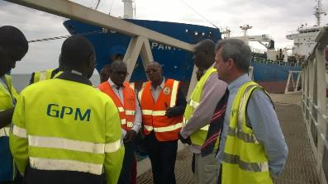
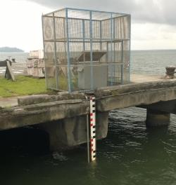
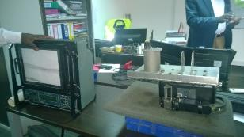
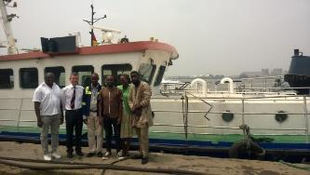
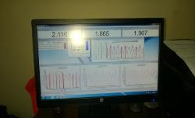
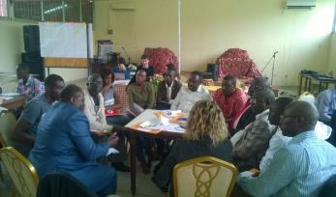
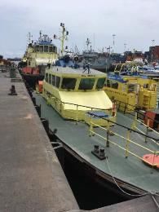
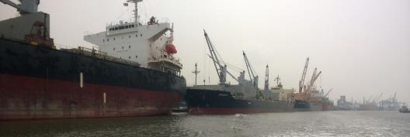
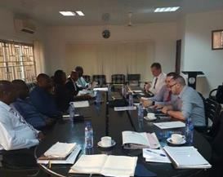
Training center visit and technical visit: Shom, USM
Gabon
Gabon
Gabon
Gabon
Cameroon
Cameroon
Ghana
Ghana
Cameroon

Slide 6
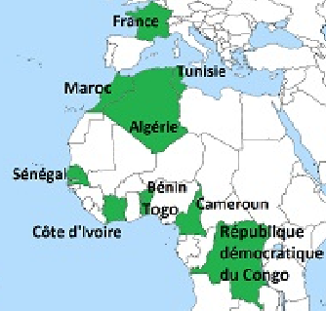
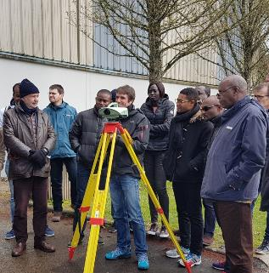
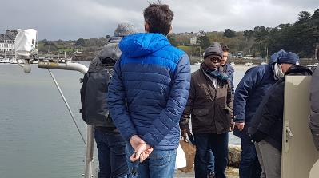
Seminar and training on tides
(France March-April 2019)

Slide 7
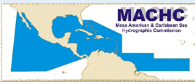
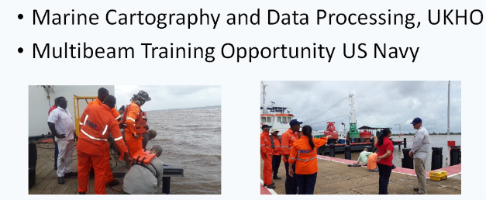
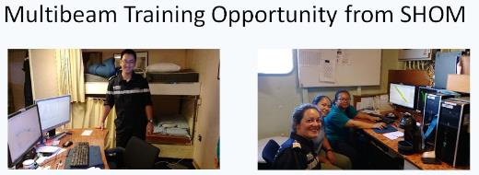
On job training in Suriname
(Suriname National report - MACHC)

Slide 8
Activities planned for 2019 (1/2)
Joint IALA-IHO workshop for capacity building in hydrography and marine aids to navigation:
Risk Assessment/Survey Specifications /AtoN Maintenance.
Rabat- Morocco - 21-24 October 2019
[CBWP 2019: Action P-11]
Technical Visit
End 2019
Lomé Togo, Shom
[CBWP 2019: Action A-04]

Slide 9
Activities planned for 2019 (2/2)
Activities postponed:
Technical Visit to Congo [CBWP 2019: Action A-06].
MSI E-learning guided session [CBWP 2019: Action P-05] (contact with OceanTeacher)
Activities to be confirmed
Technical Visit to Gambia [CBWP 2019: Action A-05].
Activities cancelled:
Survey specification e-learning guided session [CBWP 2019: Action P-06] (this topic will be addressed quickly at the next EAtHC seminar in October 2019)

Slide 10
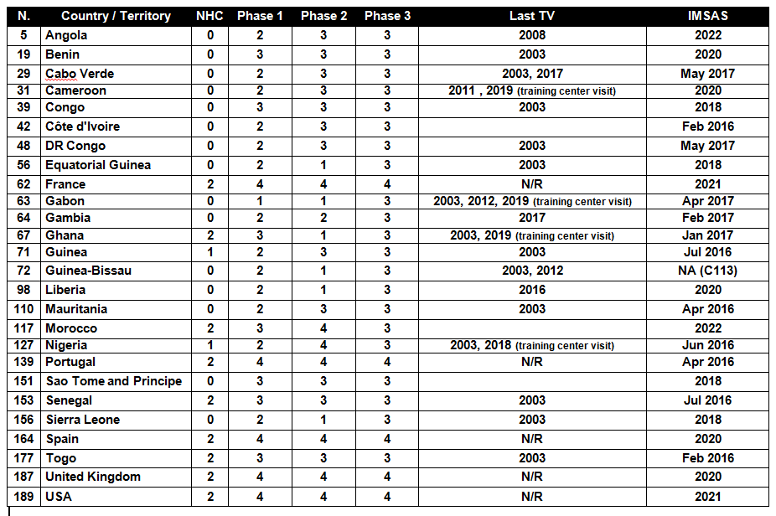
Procedure 11: EAtHC self-assessment

Slide 11
CBWP submissions for 2020
2020: CB submissions for EAtHC
Based on current implementation of the CB strategy in the EAtHC
MSI & MSDI seminar [back2back with the next EAtHC in Lisbon Portugal (Sept – Oct 20)]
Technical Visit to Congo
Technical Visit and regional training center visit to Ivory Coast
Technical Visit to Sierra Leone
Evaluation (with Cameroon and Nigeria) of satellite images processing method for maritime (ie: oil platforms) detection (MSI collection)
Data rescue promotion (digitization hydrographic archives – to be freely available)

Slide 12
Difficulties encountered and challenges yet to be addressed
Challenges in the WCA sub-region (except Morocco & Nigeria) remain considerable
Ever-growing needs in term of maritime geospatial knowledge
Hydrographic services remain very limited

Slide 13
Achievements/Outputs/Conclusions
Hydrographic capacity development in the EAtHC region remains a real challenge, with most of the Central & Western African coastal states lacking hydrographic infrastructure and relying on another state to provide hydrographic services and fulfill their SOLAS obligations.
The CB efforts of the IHO and some Member States (acting as Primary Charting Authority in that region), supported by other organizations (IALA, OMI…) to support coastal states in the sub-region have resulted in limited progress.

Slide 14
Achievements/Outputs/Conclusions
With this in mind, efforts must therefore be continued with greater involvement of the Coastal States primarily concerned by the development of their hydrographic services in order to meet their SOLAS obligations, of the IHO and the IHO Member States.
Nigeria and Morocco, which have succeeded in developing considerably their hydrographic capacities, can in particular play a key role, by sharing their experience and providing training and education opportunities to other coastal states in the sub-region.

Slide 15
Actions Required of CBSC17
Please note this report
Take any action consider appropriate.

Slide 16
Thank You

