Slide 1
EAHC Report
IHO-CBSC17
Genoa, Italy May, 2019
Agenda-05.1E
29th June 2019
Peter YOU
EAHC CB Coordinator
Notes:
구글 지도로 바꾸기

Slide 2
Overview of Session
1. Introductions
2. Assessment of Capacity Building Phase Stage
3. Activities completed since CBSC16
4. Activities planned for 2019
5. Lessons Learnt & Action required
1/6

Slide 3
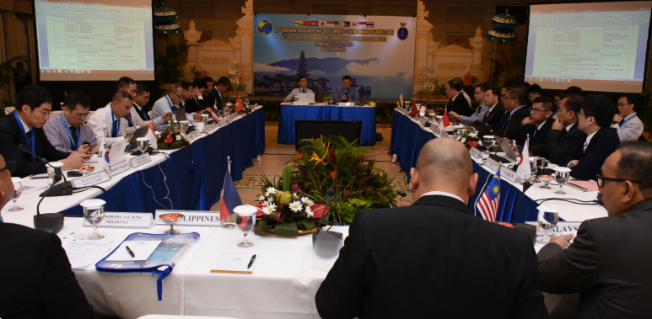
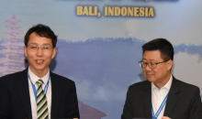
1. Introductions
EAHC
Steering Committee
CHC
Charting and Hydrography Committee
MSDIWG
Marine Spatial Data Infrastructure WG
TRDC
Training, Research and Development Centre
RECC
Regional ENC coordination Committee
Roll of TRDC-BOD
Systematically and sustainably build up training courses in the East Asia region
Review and feedback of CB activities
Updating the Long-term, 5 year and 3 year plans
Face-to-face to discuss their contributions, synergies, strengths,
challenges and weaknesses.
2/6

Slide 4
2. Assessment of CB Phase Stage
Country/Territory |  | NHC/NHCC | Phase 1 | Phase 2 | Phase 3 | Last TV
1 | Brunei Darussalam | 0 | 1 | 1 | 1 | 2014
2 | China | 1 | 4 | 4 | 4 | 0
3 | Democratic People’s Rep. of Korea | -1 | -1 | -1 | -1 | 0
4 | Indonesia | 1 | 4 | 4 | 4 | 0
5 | Japan | 2 | 4 | 4 | 4 | 0
6 | Malaysia | 2 | 4 | 4 | 4 | 0
7 | Philippines | 1 | 4 | 4 | 4 | 0
8 | Republic of Korea | 2 | 4 | 4 | 4 | 0
9 | Singapore | -1 | 4 | 4 | 4 | 0
10 | Thailand | -1 | 4 | 4 | 2 | 2004
11 | Cambodia* | 0 | 0 | 0 | 0 | 2016
12 | Timor-Leste* | 0 | 0 | 0 | 0 | 2016
13 | Viet Nam** | -1 | 1 | 1 | 1 | 2014
* Impending IHO MSs / ** IHO MS but impending EAHC MS
3/6

Slide 5
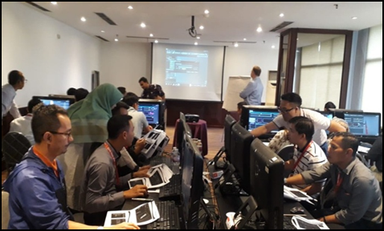
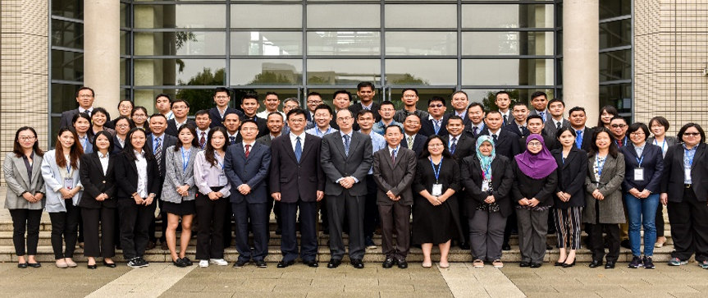
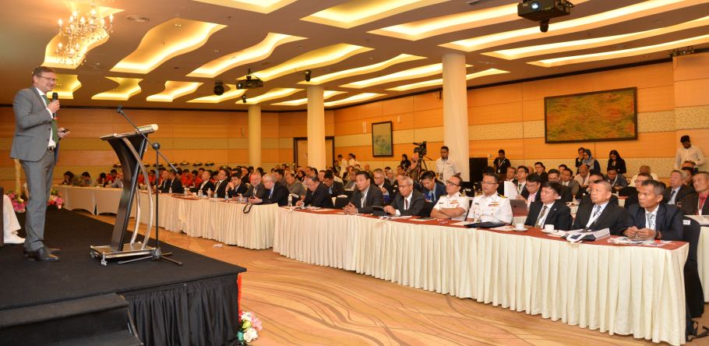
3. Activities completed since CBSC16
IHO CB Activities
No. | Title | Venue | Date |  | Participants
1 | Use of GNSS for Tide Correction For Survey | Indonesia | 9 – 13 July. 2018 |  | 18 / 10 MSs
2 | Carto Production DB System Development Workshop | China | 22-26 October. 2018 |  | 50 / 11 MSs
Non-IHO CB Activities
No. | Title | Venue | Date | Participants
1 | Hydrographic South East Asia (Hydro SEA) Conference and Exhibition | Malaysia | 19 – 20 Sep. 2018 | 57 / 14 MSs
4/6

Slide 6
4. Activities planned for 2019
IHO CB Activities
No. | Title | Venue | Date (plan)
1* | Maritime Safety Information (MSI) Course | Indonesia | 19 – 23 Aug. 2019
2* | Management of MSI DB workshop
3 | Risk Assessment for hydrographic surveys and charting management for the safety of navigation | Brunei Darussalam | Oct./Nov. 2019
4 | Technical Visit to Cambodia | Cambodia | Aug. 2019
* Not EAHC MSs but NAVAREA XI countries should also
be invited (E.g. Vietnam, Palau and Marshall Islands)
5/6

Slide 7
5. Lessons Learnt & Action required
Lessons & Learnt
TRDC-BOD meeting has been useful for coordinating and feedbacks
There is still a significant level of technology gap among the 10 MSs
S-100 and MSDI are expected to be a valuable CB activity for East Asian countries to prepare for the future.
EAHC MSs try to expand CB activities even through limitation of CB fund
Action required
note the report
6/6

Slide 8
Thank You
Ubuntu

