Slide 1
CBSC17
Genoa, Italy, 29 - 31 May 2019
IHO Secretariat Report

Slide 2
IHO Assembly and Council
Preparations started for:
• The second session of the IHO Assembly (A-2) will be held in Monaco from 21 to 24 April 2020.
• The third meeting of the Council will take place in Monaco, from 15 to 18 October 2019.
Several points of interest for Capacity Building will be addressed, including the review of the IHO Strategic Plan

Slide 3
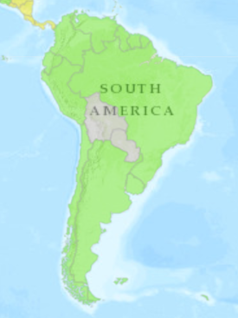
Status of Membership of the IHO
Bulgaria and Guyana became the 89th and 90th member of the IHO during the report period. This has been achieved with strong support of the CBSC and the CBWP.
Serbia, Syria and Congo remain suspended.

Slide 4
Publicity and Outreach
World Hydrography Day 2019:
Hydrographic information driving marine knowledge
International Hydrographic Review

Slide 5
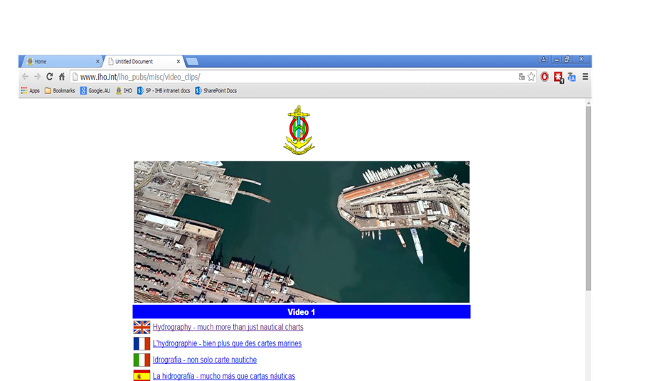
Publicity and Outreach
Interesting videos to promote Hydrography have been posted in the IHO website, including historical ones.

Slide 6
CB Programme
Current status of the CB Fund reported at doc. CBSC17-09.2

Slide 7
IHO Secretariat Infrastructure
Established the position of CB Assistant. Ms Sandrine Brunel was assigned to the post from 1 January 2018 on a permanent basis.
Created an email group cbsc@iho.int for the communication of CB related activities

Slide 8
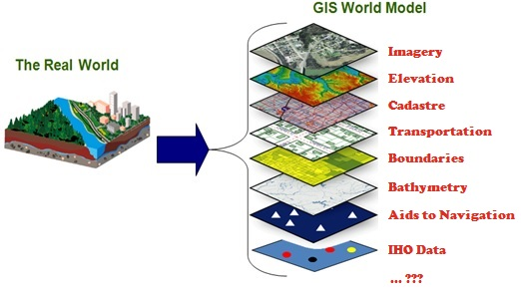
IHO Secretariat Infrastructure
CB Management System (doc CBSC17-08.2)
IHO Geographical Information System (GIS)
IHO Country Information System (CIS)
In-kind contribution from ROK and Japan

Slide 9
Actions requested of CBSC:
The CBSC is invited to:
note this report
take any action as appropriate

Slide 10
IHO Secretariat, here to help you! www.iho.int alberto.neves@iho.int

