Slide 1
15th South West Pacific Hydrographic Commission Conference 21 – 22 February Nadi, Fiji
Francesca Pradelli
Policy and Legal Officer / Pacific Safety of Navigation Project Manager
GeoScience, Energy and Maritime (GEM) Division – Pacific Community (SPC)

Slide 2
International Maritime Organization (IMO)
What does it do?
Maritime Safety
Marine Environment
Maritime Security
Human element
Facilitation
Technical Cooperation
IMSAS

Slide 3
IMSAS: Background and Purpose
Scope
Actors
IMO role in monitoring and enforcement
Background and Evolution of IMSAS
Audit Standards

Slide 4
IMSAS: Background and Purpose
ACTORS in ensuring compliance with international maritime standards
1. IMO - develop technical safety, security and pollution prevention standards related to maritime transport;
2. GOVERNMENTS - have the duty to implement and enforce these standards;
3. RECOGNIZED ORGANIZATIONS - have a duty to be impartial and
exercise due diligence;
4. SHIPPING COMPANIES - responsible for applying the same standards to individual ships; and
5. SHIPBOARD PERSONNEL - have the task of putting into operation the various safety and anti-pollution measures applicable to the ship.

Slide 5
IMSAS: Background and Purpose
IMO role in monitoring and enforcement
The IMO Convention does NOT contain any provision that gives the Organization an enforcement and monitoring role
With the drive for greater transparency and accountability, it has often been said that IMO needs teeth to ensure compliance
How to achieve that, is emerging gradually

Slide 6
IMSAS: Background and Purpose
Background and evolution of IMSAS
From 2002 IMO has been working on approaches for performance measurement through VIMSAS (2005-2013) when the scheme was then voluntary, and starting from January 2016 it has become mandatory and known as IMSAS
Two main documents to be used in IMSAS
(i) The Audit Framework and Procedures - Res. A.1067(28)
(ii) IMO Instruments Implementation Code (III Code) – Res. A.1070(28)
Supporting reference document
(iii) 2015 Non-exhaustive list of obligations under III Code – A.1105(29)

Slide 7
Framework & Procedures (Resolution A.1067(28))
1. FRAMEWORK
1. Purpose
2. Application
3. Audit Standard
4. Vision Statement
5. Objective
6. Principles
7. Scope
8. Responsibilities
9. Technical Cooperation

Slide 8
Framework & Procedures (Resolution A.1067(28))
1. FRAMEWORK
Purpose - to describe the objective, principles, scope, responsibilities and capacity-building aspect of the IMO Member State audit, which together constitute the strategy for the audit scheme.
This Framework is supported by the Procedures for the IMO Member State Audit and the IMO Instruments Implementation Code (III Code)

Slide 9
Framework & Procedures (Resolution A.1067(28))
7. Scope
IMO Instruments - the applicable IMO instruments related to the areas listed below;
(i) safety of life at sea,
(ii) prevention of pollution from ships,
(iii) standards of training, certfication and
watchkeeping for seafarers ,
(iv) loadlines,
(v) tonnage measurement of ships, and
(vi) regulations for preventing collisions at sea.

Slide 10
Framework & Procedures (Resolution A.1067(28))
7. Scope
Obligations & Responsibilities - those contained in the applicable IMO instruments provided such instruments have entered into force for the Member State, in its capacity as a flag, port and coastal state.
Areas to be covered by the audit -Member State’s implementation and enforcement of applicable IMO instruments in its legislation, the effectiveness of its control and monitoring mechanism, etc…………………..

Slide 11
Audit Scheme Sequence of Activities
Activity | Responsible | Procedures Reference
1. All MS informed of overall audit schedule | SG | 4.1.1
2. PAQ sent to MS | SG | 5.1
3. Completed PAQ returned to IMO | MS | 5.4
4. Selection of Auditors by IMO | SG | 4.4
5. Notification of auditors to MS | SG | 4.5.5
6. Final selection of audit team | SG + MS | 4.4.1.; 4.5.5
7. Developing and negotiating the MoC, including authorization release of the audit reports to the public or MS | SG + MS | (FW 8.2.4) 4.2.1 ; 4.2.3
8. MoC finalized and signed | MS + SG | 4.2.2
9. Preparation for the audit by the audit team | ATL | Section 5 (various ref)
10. Agreeing the Audit Plan | ATL + MS | 4.2.4 ; 4.2.5 ; 5.7

Slide 12
Activity | Responsible | Procedures Reference
11. Opening Meeting between Audit Team and MS | ATL + MS | 6.3
12. The Audit | AT | 6.4
13. Audit Closing Meeting | ATL + MS | 6.5
14. Draft Interim Report and draft Executive Summary Reports sent to MS for comments | ATL | 7.1.3 ; 7.2.2 ; 7.3.1 ; 7.3.2
15. Review of draft IR and draft ESR, including comments by MS | ATL + MS + IMO | 7.1.3 ; 7.2.3; 7.2.4 ; 7.3.1
16. Agreed IR and ESR sent to MS | ATL | 7.2.1 ; 7.3.1
17. Executive Summary Report released | SG | (FW 6.3.3 ; 6.3.4) 7.3.1
18. Member State’s Corrective Action Plan as appropriate sent to ATL and IMO | MS | 7.2.1 ; 7.4.1 ; 8.4
19. Draft Audit Final Report sent to MS and IMO | AT | 7.4.2 ; 8.5
20. Member State’s comments on the progress of implementation of Corrective Action Plan sent to IMO | MS | 7.5.1
21. Audit Team Leader’s Mission Report sent to IMO | ATL | 7.6.1
22. Feedback from MS sent to IMO | MS | 7.7.1
23. Corrective Action Plan presented to ADT and SG within 90 days after receipt of agreed Audit Interim Report | MS | 8.4
24. Corrective Action Plan released | SG | 8.5
26. Audit Follow Up, as appropriate | SG | 9.1

Slide 13
III Code (Resolution A.1070(28))
The Code is divided into 4 Parts;
Part 1 – Common Areas
Part 2 – Flag States
Part 3 – Coastal States
Part 4 – Port States

Slide 14
III Code (Resolution A.1070(28))
Part 1 – Common Areas
1 : Objective (para 1 – 2)
Enhance global maritime safety and protection of the marine environment
An Administration is only bound by the instruments to which it is Party
Different circumstances in different States

Slide 15
III Code (Resolution A.1070(28))
Part 1 – Common Areas
2 : Strategy (para 3)
A State is recommended to:
Develop an overall strategy to ensure that its international obligations and responsibilities are met;
Establish a methodology to monitor and assess that the strategy ensures effective implementation and enforcement of relevant international mandatory instruments; and
Continuously review the strategy to achieve, maintain and improve the overall organizational performance and capability

Slide 16
III Code (Resolution A.1070(28))
Part 1 – Common Areas
3 : General (para 4-5)
Treaty law (UNCLOS) is not an IMO mandatory instrument, it is an "umbrella convention"
The Audit is to be carried out against relevant mandatory IMO instruments and NOT against UNCLOS

Slide 17
III Code (Resolution A.1070(28))
Part 1 – Common Areas
4 : Scope (para 6)
The Code seeks to address those aspects necessary for a Contracting Government or Party to give full and complete effect to the provisions of the applicable international instruments to which it is a Contracting Government or Party, pertaining to:
safety of life at sea;
prevention of pollution from ships;
standards of training, certification and watchkeeping for seafarers;
load lines;
tonnage measurement of ships; and
regulations for preventing collisions at sea.

Slide 18
Part 2 – Flag States
Part 3 – Coastal States
1 : Implementation
2 : Delegation of authority
3 : Enforcement
4 : Flag State surveyors
5 : Flag State investigations
6 : Evaluation and review
1 : Implementation
2 : Enforcement
3 : Evaluation and Review
Rights, obligations and responsibilities may include, inter alia:
radiocommunication services
meteorological services
search and rescue services
hydrographic services
ships' routeing
ship reporting systems
vessel traffic services
aids to navigation
Part 4 – Port States
1 : Implementation
2 : Enforcement
3 : Evaluation and Review

Slide 19
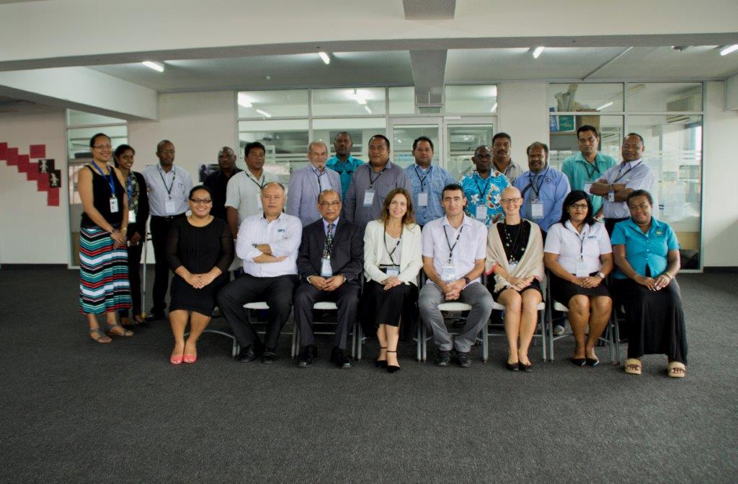
SPC Regional Assistance IN PREPARATION FOR IMSAS
first Regional Workshop on the Implementation of IMSAS – Suva (Fiji), 21 to 25 September 2015
attended by representatives from Cook Islands, Fiji, Kiribati, Papua New Guinea, Samoa, Solomon Islands, Tuvalu and Vanuatu
main objective
outcome: roadmap to facilitate PICs effective preparation for IMSAS (19 steps)

Slide 20
National Assistance
IMSAS Awareness workshop
2015/2016/2017 countries: Tuvalu, Vanuatu, Kiribati, Solomon Islands, Samoa
outcome: national roadmaps towards IMSAS
Strategy to implement international instruments
Upon official request, SPC assisted Vanuatu, Kiribati, Solomon Islands and Samoa in developing their own national Strategy
Maritime Transport Policy
Upon official request SPC assisted Vanuatu, Kiribati, Palau in develop their own national MTP
Legal gap analysis in the scope of IMSAS
4 Spreadsheets developed taking into account IMO Resolution A.1105(29) 2015 Non-Exhaustive list of obligations under instruments relevant to the IMO Instruments Implementation Code
Upon official request SPC conducted legal gap analysis in Vanuatu, Tuvalu, Kiribati, Samoa

Slide 21
VINAKA VAKALEUVU

