Slide 1
CARNIVAL AUSTRALIA
UPDATE ON Activities IN the
south west pacific

Slide 2
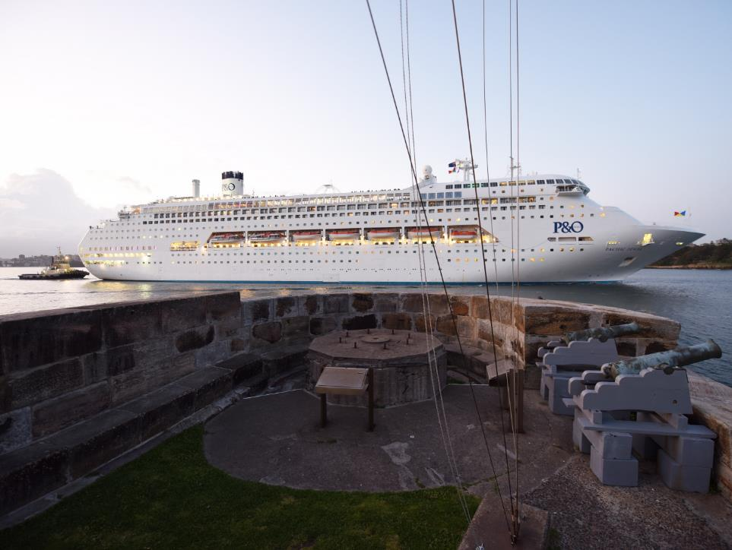
objectives
General update since Noumea, SWPHC14 November 2016
Overview of some operational experiences with ENC in the region

Slide 3

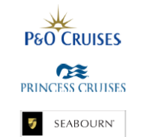
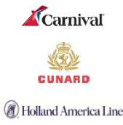
Regional subsidiary of Carnival Plc.
7 brands within Carnival Corporation operate in the region
Only cruise Corporation to remain year round in Australia
1 of 7 brands operated ( ISM Document of compliance) from Australia - P&O Cruises
Australia is the highest penetration source market globally
3rd largest market growth in 2016 behind New Zealand and China

Slide 4
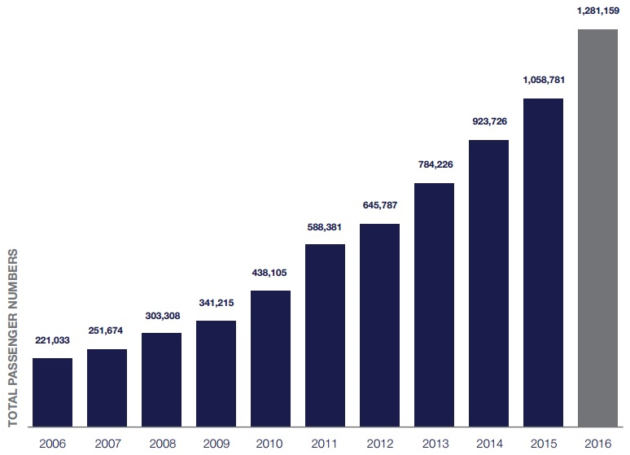
YEAR ON YEAR AUSTRALIAN PASSENGER GROWTH
More Australians cruise per capita than any other nation
Passenger numbers increased by 21% from 2015 to 2016
Double digit growth for over 10 years
2 million passengers expected by 2020

Slide 5
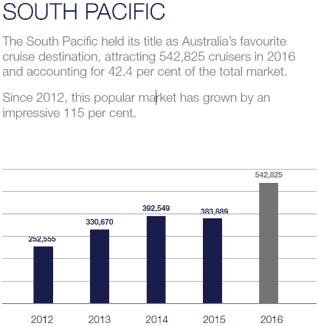
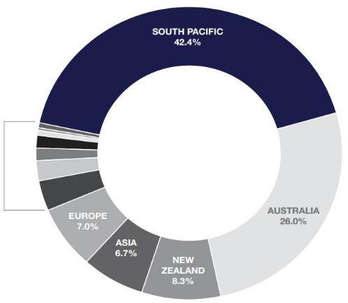
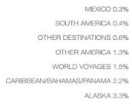
SOUTH pacific market PENETRATION FROM AUSTRALIA
-The south pacific remains Australia's favourite cruise destination
- 542,825 passengers travelled to south pacific in 2016 by cruise ship
- 41% increase from 2015
-Expanding footprint of destinations

Slide 6

Regional market share
Increased Trade
 | 2015 | 2016
FIJI | 55 | 73
NEW CALEDONIA | 318 | 379
PNG | 51 | 94
SOLOMONS | 2 | 8
VANUATU | 178 | 213
TOTAL | 604 | 767
Enhanced customer experience
Repeat Cruising
Shore Stay

Slide 7
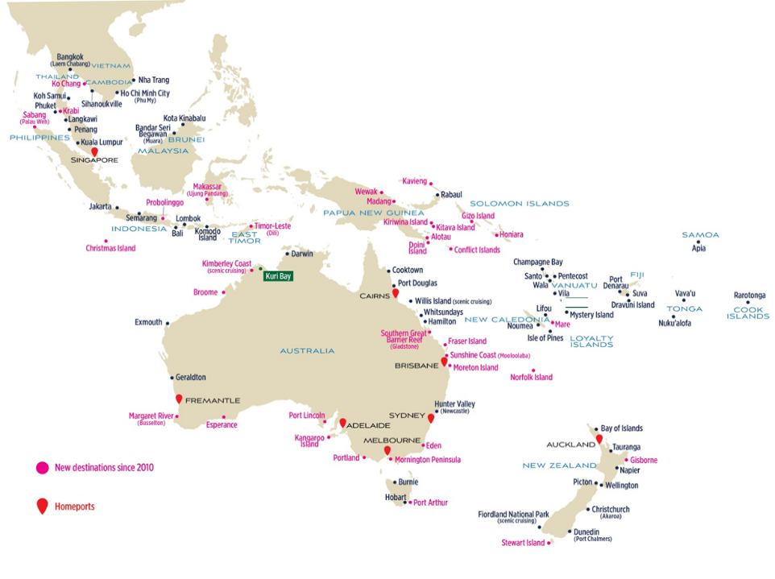

Regional area of operation

Slide 8
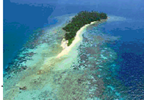
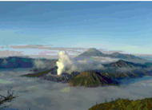
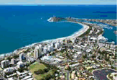
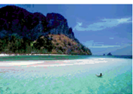
DESTINATION GROWTH IN RECENT YEARS
THAILAND
- Ko Chang & Krabi
PNG
- Conflict Islands
INDONESIA
- Sabang & Probollingo
- Benoa Alongside
- Bengsal / Lombok
AUSTRALIA
- Fraser Island
- Gladstone
- Kuri Bay
- Mooloolaba (QLD)
- Mornington & Portland (VIC)
NEW ZEALAND
- Stewart Island
SOLOMON ISLANDS
- Gizo & Honiara
EAST TIMOR
- Dili

Slide 9
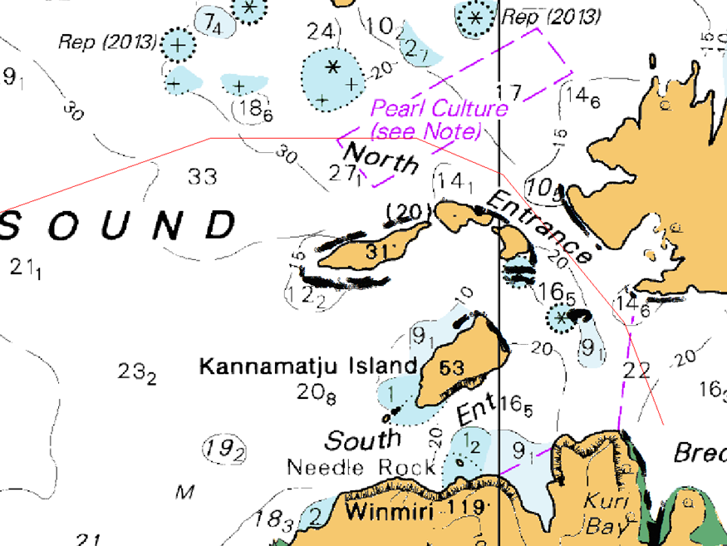
Kuri Bay (Kimberley)
Requested swept path submitted as part of aho hydroscheme
THE EVOLUTION OF A NEW DESTINATION

Slide 10
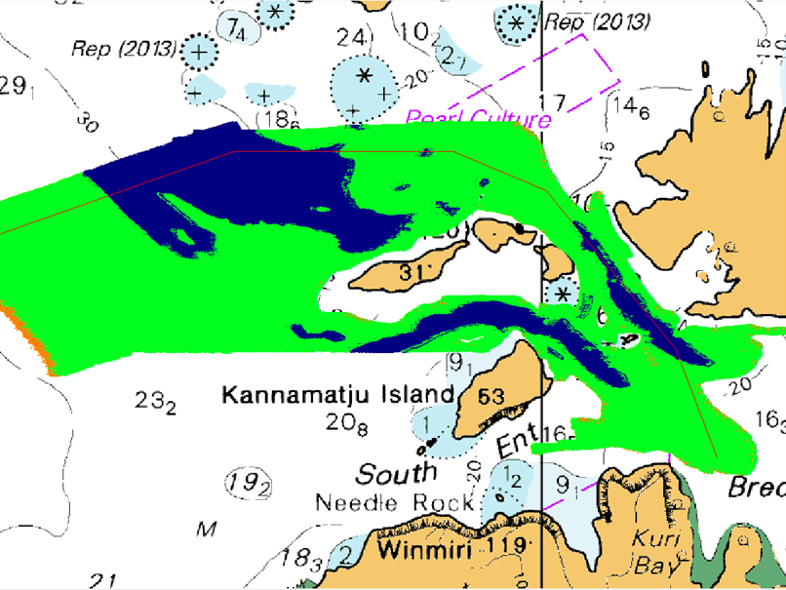
Preliminary data captured

Slide 11
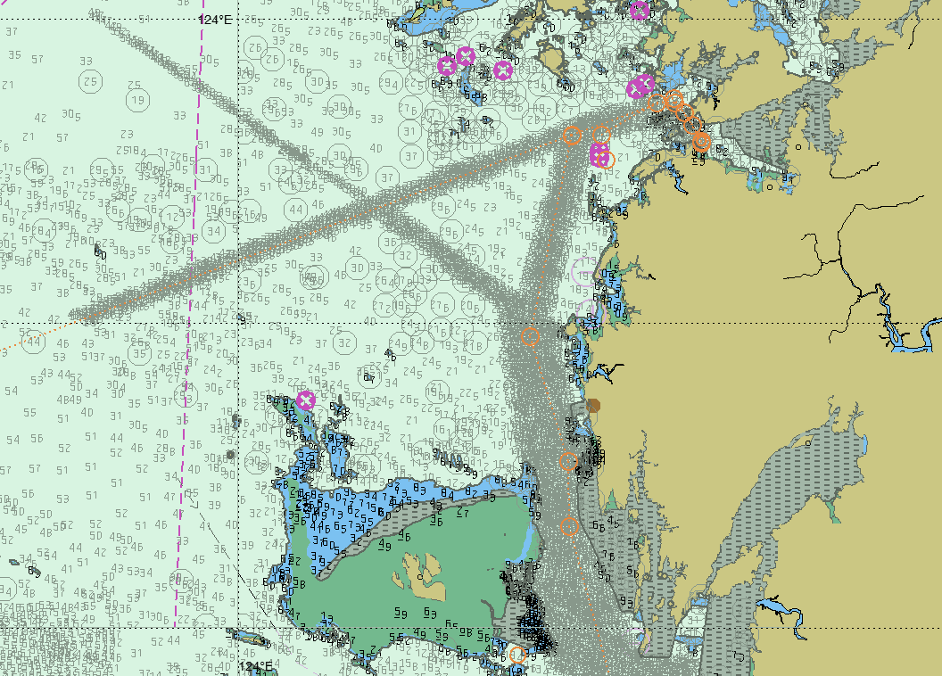
Camden sound (Kimberley) chart updated

Slide 12
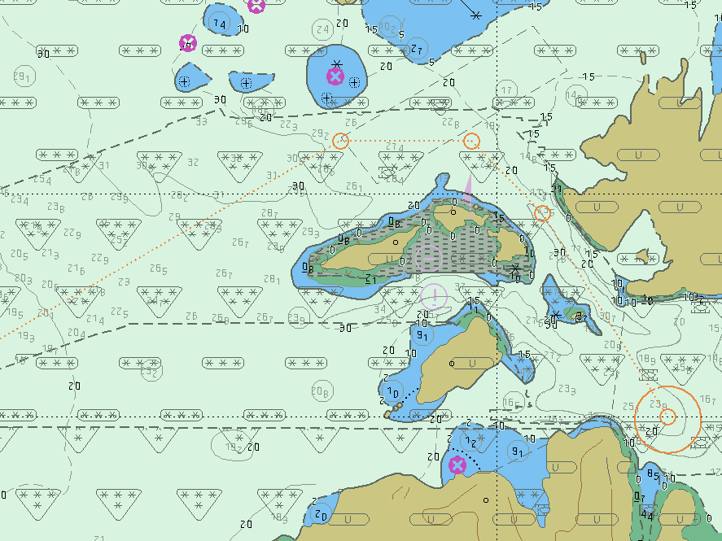
Kuri Bay (Kimberley) now safely accessible by large vessels

Slide 13
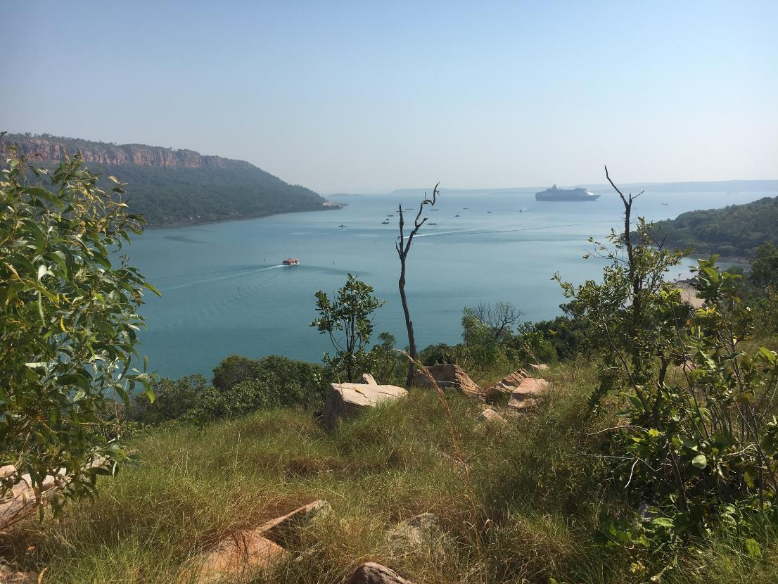

Slide 14
Increased government engagement
Close engagement with Australian Department of Foreign Affairs (DFAT) regarding expanding operations into Solomon's
PNG government and Australian DFAT regarding APEC Port Moresby November 2018
New Caledonian Government regarding ongoing operations in Noumea and around the country
- Indonesian Government to extend tourism footprint ex Bali
Corporate partners Save the Children and impact on remote areas; Vanuatu and Solomon’s. Health care facilities
Reversing urban drift in remote communities

Slide 15
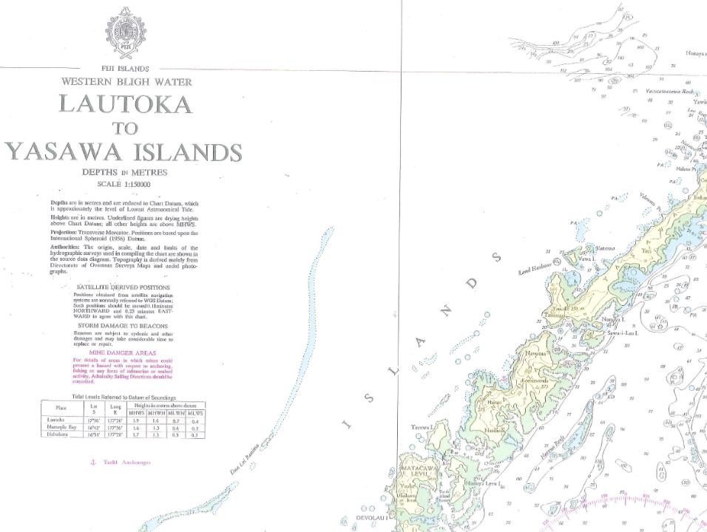
F5
The lack of
adequate charts in
many Pacific Islands is a
barrier to considering those islands for ship visits.
Aids to Navigation
and Marine Safety
Information is
inadequate.

Slide 16
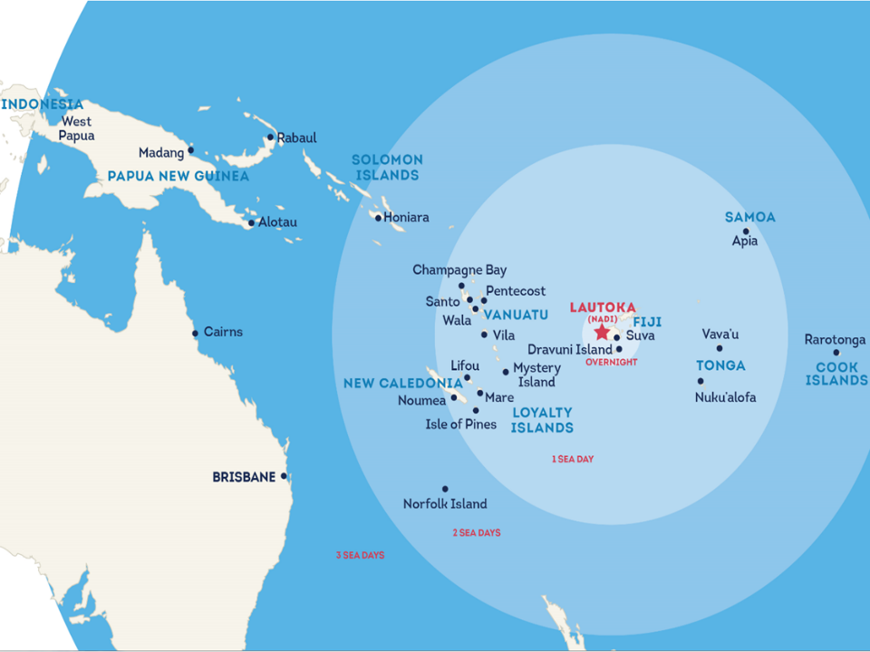
ASPIRATIONS AND OPPORTUNITY
SPICE ISLANDS
ALI ISLAND
TAVANIPUPU
ONTONG JAVA
BANKS AND
TORRES ISLANDS
SAVAII
YASAWAS
TANNA
HAAPAI
LAU GROUP
VANUA BULAVU

Slide 17
Operational experience
Challenges relating to navigational awareness of archipelagic baselines ( MARPOL). The consistency & prominence of baselines on ENC and ensuring adequate proximity alert (unintentional discharges)
Symbology and context of danger ( Isolated Danger symbol may not be sufficient in all cases)
Feedback from Hydrographic Notes/ Marine Safety Information generated from onboard ships
Timely update of Sailing Directions & Port Information
Good News ; bathymetric ENC & ZOC U is reducing in regional ENC

Slide 18
Baseline challenges
MARPOL “Nearest Land”
  “Nearest land" means from the baseline from which the territorial sea of the territory in question is established in accordance with international law.
  For the purposes of our operations, “nearest land” impacts where was can discharge sewage (Annex IV) & food (Annex V).
From the UN Convention on the Law of the Sea (UNCLOS)
Except where otherwise provided in these articles, the normal baseline for measuring the breadth of the territorial sea is the low-water line along the coast as marked on large-scale charts officially recognized by the coastal State.
UNCLOS has provisions allowing coastal States to claim baselines away from shore (straight or archipelagic baselines)
Over 100 countries (coastal states) have filings with the UN for such claims

Slide 19
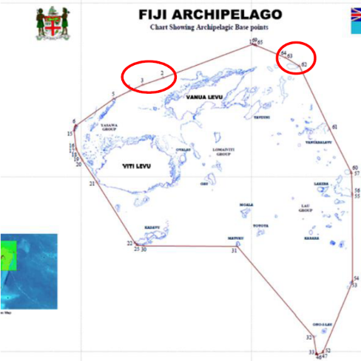

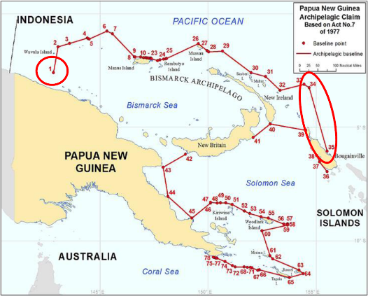
Baseline visibility
Currently not marked on all charts, disputed in some instances

Slide 20
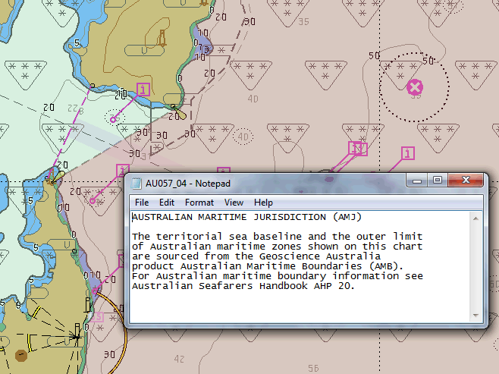

Slide 21

ISOLATED DANGER MARKS
Isolated Dangers- “Generally, rocks, wrecks and obstructions may be displayed as the isolated danger symbol depending on the safety setting in the ECDIS combined with the encoding of the object” (NP 5012)
Generally the isolated danger symbol will display for submerged rocks, wrecks and obstructions where the depth is shoaler than or equal to the contour or where the exact depth is unknown (NP 5012)
Solomon's Airways Magazine (Issue 61); Kavachi “Thirteen miles to the seaward of Gatokae and Vangunu Islands the volcano spends most of its time just below the sea, erupting on a totally unpredictable but frequent basis, ranging from once a day to every two to three minutes…… “

Slide 22
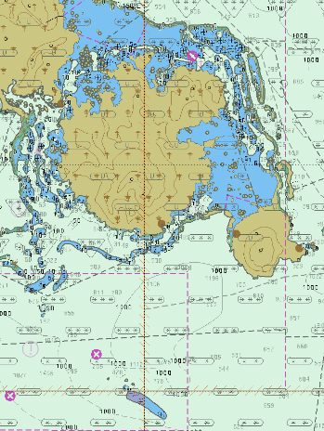
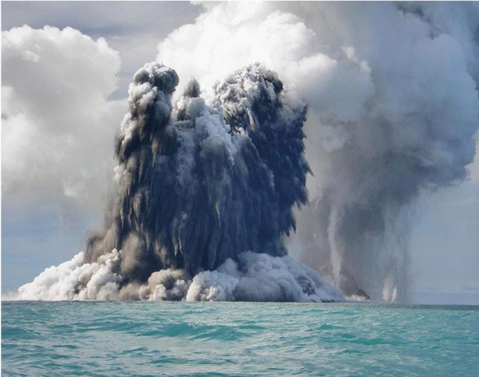
ISOLATED DANGER MARKS
Does this SYMBOL provide context of danger to navigation ?

Slide 23
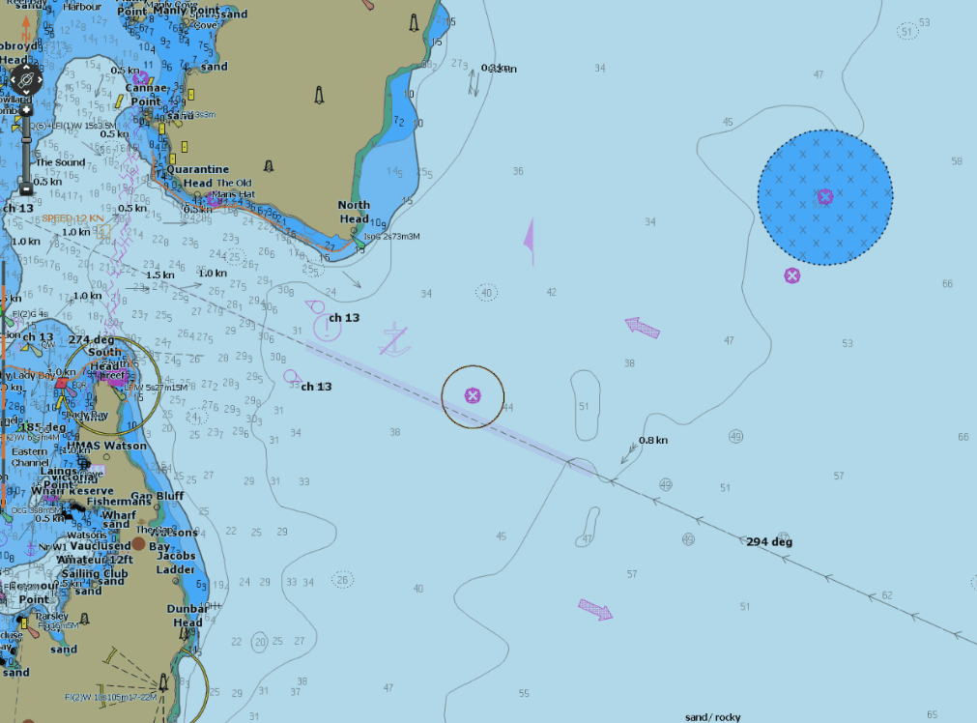
Is the symbol too general ?

Slide 24
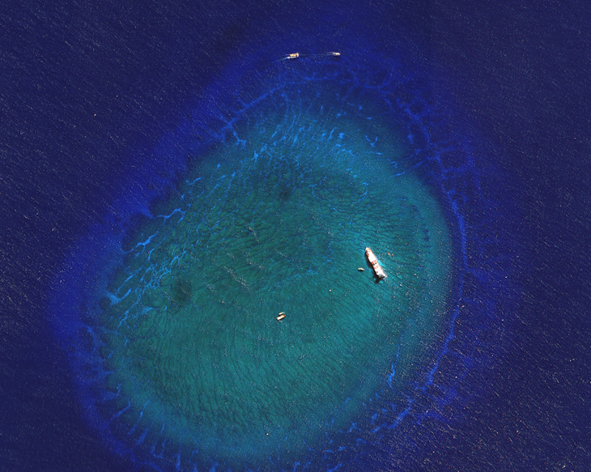

Kea TRADER

Slide 25
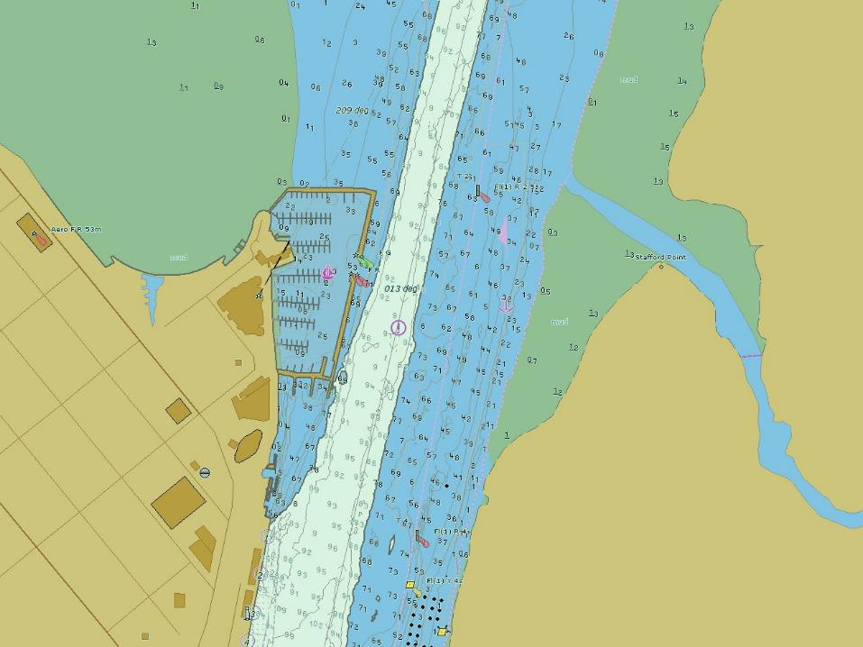
8m CONTOUR shows WIDER CHANNEL Than maintained depth
BATHYMETRIC / High density port ENC (benc)

Slide 26
bENC allow for eNhanced safety of Navigation in some tight ports
SIMULATION OF BENOA:
Now an alongside call for vessels under 220m as opposed to an
unreliable anchorage
SIMULATION OF CAIRNS:
Controlled environment study and risk assessment carried out
for larger vessel class access and increased situational
awareness in a tight channel
FRASER ISLAND:
Precise control of UKC when passing over Urangan sand bar

Slide 27
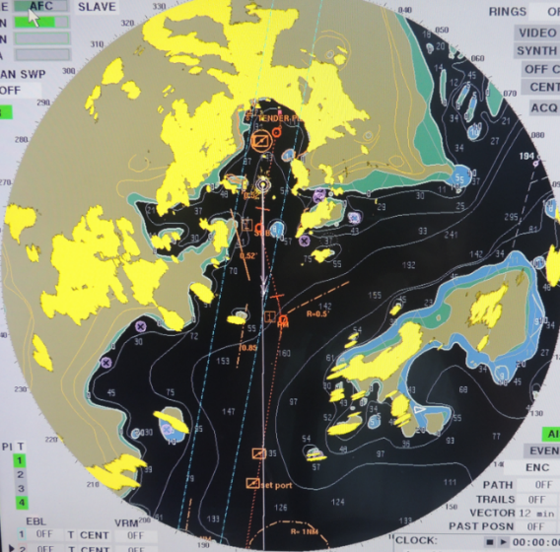
Enc coverage issues
KOMODO ISLAND
ARCS 3756 - 1:87,300
used for primary navigation with equivalent BA paper chart and risk assessment
Also supplemented with Indonesian Paper chart 297
Scale 1:50,000
No suitable scale ENC exists
ID300295 1:180,000

Slide 28
Summary
  Economic benefit increasing as cruise tourism expands in SW Pacific
  Appropriate charts & Aids to Navigation will enhance this further
  Government engagement with the cruise sector is increasing
  Hydrography as “critical infrastructure” requires constant reinforcement with Government and Aid Agencies
  Scope for improvement and communication from end user to Hydrographic Office(s) & Competent Authorities
THANK YOU
Notes:
https://www.youtube.com/watch?v=HdDjip123h8

