Slide 1
15th South West Pacific Hydrographic Commission Conference 21-22 February 2018 Nadi, Fiji

Slide 6
15th South West Pacific Hydrographic Commission Conference

Slide 13
15th South West Pacific Hydrographic Commission Conference

Slide 14
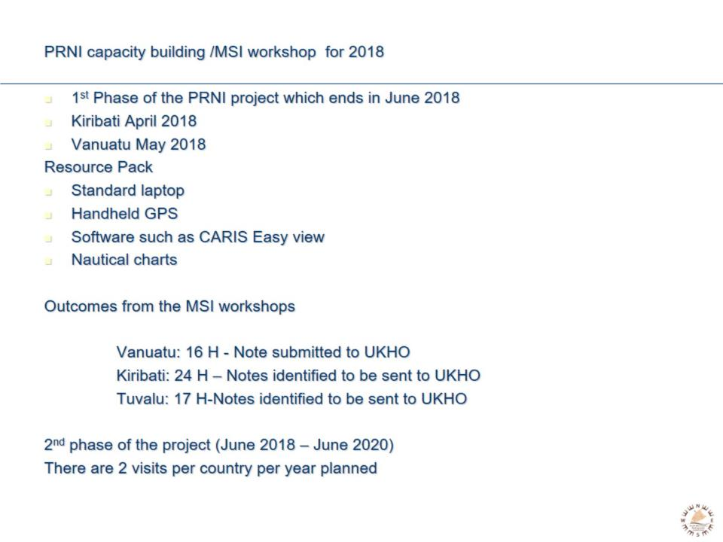

Slide 16
15th South West Pacific Hydrographic Commission Conference

Slide 24
Why? The Regional Picture

Slide 25
What do we do?

Slide 26
How do we do it?

Slide 27
Recent Achievements

Slide 28
Recent Achievements

Slide 29
Recent Achievements

Slide 30
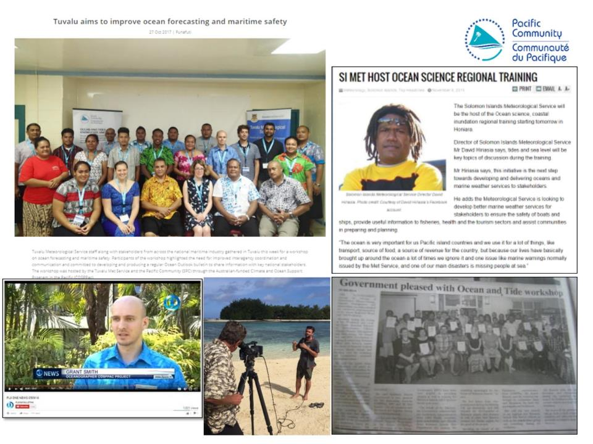

Slide 34
Pacific Safety of Navigation Project

Slide 35
Pacific Safety of Navigation Project

Slide 36
Pacific Safety of Navigation Project

Slide 37
Pacific Safety of Navigation Project

Slide 38
15th South West Pacific Hydrographic Commission Conference

