Slide 1
15th South West Pacific Hydrographic Commission Conference 21-22 February 2018 Nadi, Fiji
NATIONAL REPORT FOR KIRIBATI
21-22 February, 2018
Nadi

Slide 2
15th South West Pacific Hydrographic Commission Conference
OUTLINE
1.Introduction
2.Kiribati Maritime Organization
3.Responsibilities of the Marine Division
4.Current Status on Hydrography
5.Kiribati Nautical Charts
6.Capacity Building Trainings
7.IMSAS Audit in Kiribati
8.National Priorities- Way Forward

Slide 3
15th South West Pacific Hydrographic Commission Conference
1. Introduction
Kiribati is an island nation in the Central Pacific Ocean and has three Groups of islands:
Kiribati Group
Line Group
Phoenix Group
Total number of islands 33
The total land area mass total 811 km² (313 sq mi). It includes three island groups
Current Population is 114,300
About 90% live in the Kiribati Group
A Member State of the IMO and a Signatory to SOLAS
Associate Member to SWPHC
Not yet Member to IHO

Slide 4
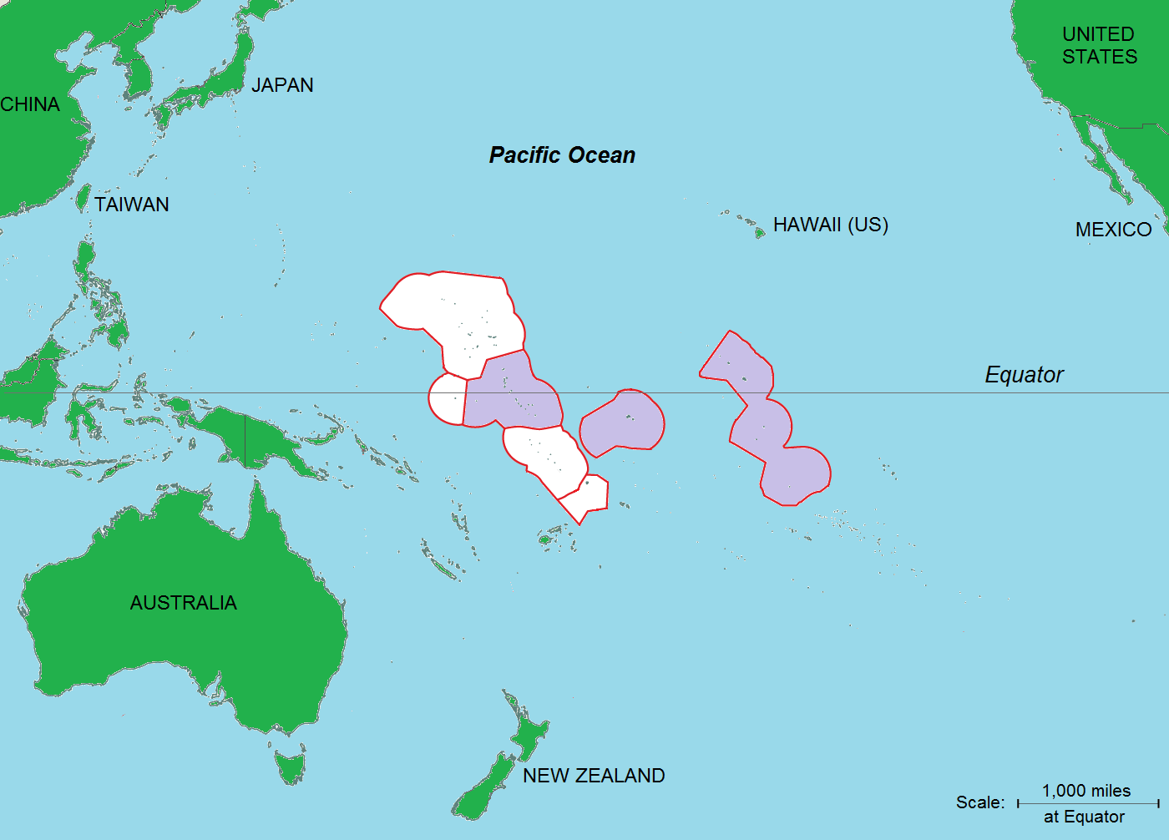
15th South West Pacific Hydrographic Commission Conference
2.Kiribati Maritime Organization
Gilbert Group Line Group
Phoenix Group

Slide 5
15th South West Pacific Hydrographic Commission Conference
3. Responsibilities of the Marine Division
Provision, operation and maintenance of marine aids to navigation, for example buoys and beacons
Administering the certification of Seafarers - Qualification and Licensing
Coordinating SAR Services
Flag State and Port State Inspection
Advising Government in ensuring that Maritime Conventions are being complied
Boat Passage upgrading
Marine Pollution & Accident Investigation
Ships registration – seaworthiness and trading
The Marine Department does promulgate coastal warnings and information broadcasted locally by Coast Radio Station (Marine Guard)

Slide 6
15th South West Pacific Hydrographic Commission Conference
4. Current status on Hydrography
MSI Coordinator has been appointed
No Hydrography Legislation in place
No Authority (Authority remains under the Marine Division – MICTTD)
No Office for Hydrography Service
No Hydrographer
MSI broadcasted locally by Coast Radio Station (Marine Guard)
Maritime Transport policy in place
No Facilities – lack of infrastructure, no work boat and etc
Application for IHO membership is in progress.

Slide 7
15th South West Pacific Hydrographic Commission Conference
5. Kiribati Nautical Charts
UKHO as PCA
total of 14 Charts covering the whole of Kiribati published by UKHO at varying scales,
Charts - published in the 1950s and 1960s from surveys with data obtained around 1943 and earlier with some have been removed and updated
Charts being updated are:
BA 729 (Plan in the Gilbert islands) DoP: Mar 2015,
BA 730 (Maiana to Marakei) DoP: Apr 2015
BA 731 (Gilbert Group) DoP: Apr 2015

Slide 8
15th South West Pacific Hydrographic Commission Conference
6. Capacity Building Trainings
IALA Vice Dean Mr Stephen Bennett and SPC team visiting Kiribati in Nov 2016 for AtoN assessment and Training.
Training in Busan, South Korea for Level 1 AtoN Manager 1st -29th July 2017
SPC PRNI workshop held in Tarawa on Promoting awareness of importance to hydrography and MSI workshop 8th – 9th Aug 2017
SPC PRNI will visit in April 2018 to hold another PRNI workshop on MSI

Slide 9
15th South West Pacific Hydrographic Commission Conference
6. IMSAS Audit in Kiribati
The Kiribati Marine division has been audited by IMO audit team on 14th May – 05th June 2017.The team comprises Mr Abdul Hannan ( Team Leader) and Capt Nurur Rhaman and Mr Suresh Kumar Nair.
Findings by audit team : The State did not establish nautical and hydrographic services in order to prepare and issue sailing directions, lists of lights, tide tables and other nautical publications, where applicable, satisfying the needs of safe navigation. In addition, no surveys of the coastline of the three groups of islands of the State had been carried out in the past 50 years in order to keep all nautical information necessary for safe navigation up-to-date (SOLAS 1974, regulation V/4; SOLAS 1974, regulation V/9; III Code, paragraph 47).
Corrective Action Plan had been sent to IMO on 16th January 2018.

Slide 10
15th South West Pacific Hydrographic Commission Conference
7. National Priorities – Way Forward
establishing nautical and hydrographic services in order to prepare and issue sailing directions, lists of lights, tide tables and other nautical publications, where applicable, satisfying the needs of safe navigation;
planning and conducting surveys of the coastline of the three groups of islands of the State (which haven’t been carried out in the past 50 years) in order to keep all nautical information necessary for safe navigation up-to-date; and
determining, approaching and requesting potential donor countries and organizations to provide:
capacity building and assistance in setting up these services;
training and expertise in preparing and issuing such publications;
and funding and/or in kind assistance for planning and conducting surveys of the coastline of the three groups of islands of the State in order to keep all nautical information necessary for safe navigation up-to-date,
and take appropriate action in these respects accordingly.
The State is planning to become member of IHO and request associated capacity building assistance from that organization and/or donor countries.
Require Hydrographic TA

Slide 11
15th South West Pacific Hydrographic Commission Conference
Continuous awareness to Government/ Public on obligations for the provision of Hydrographic Services
Hydrography Governance
Provision of Hydrographic Services
Hydrography Risk Assessment
Developing a bi-lateral agreement with PCA (UKHO) & with other national hydrographic authorities

Slide 12
15th South West Pacific Hydrographic Commission Conference
THANK YOU FOR YOUR TIME.

