Slide 1



15th South West Pacific
Hydrographic Commission Conference
20-22 February 2018
Nadi, Fiji
Office of Coast Survey
National Oceanographic & Atmospheric Administration
Naval Meteorology and Oceanography Command
United States Navy
Maritime Safety Office
National Geospatial-Intelligence Agency
United States of America
National Hydrography Report
Rear Admiral Shepard M. Smith, NOAA

Slide 2
15th South West Pacific Hydrographic Commission Conference
U.S. Government Agencies with hydrographic responsibilities
in the South West Pacific Region
National Oceanic and Atmospheric Administration (NOAA) conducts hydrographic surveys and produces nautical charts and related hydrographic information within the nation’s Exclusive Economic Zone (EEZ).
National Geospatial-Intelligence Agency (NGA) provides nautical charts and related hydrographic information outside of the U.S. EEZ and is the mapping and charting authority for the US Department of Defense and commercial mariners in areas outside the US where the US is designated as the charting authority.
The U.S. Navy conducts oceanographic, bathymetric, and hydrographic surveys worldwide to satisfy US Navy requirements.

Slide 3
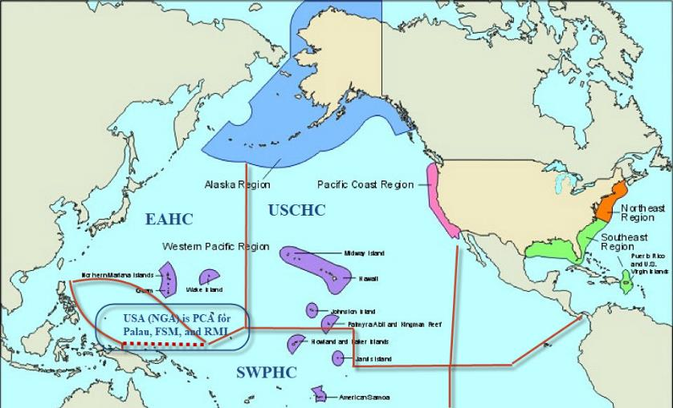
15th South West Pacific Hydrographic Commission Conference

Slide 4
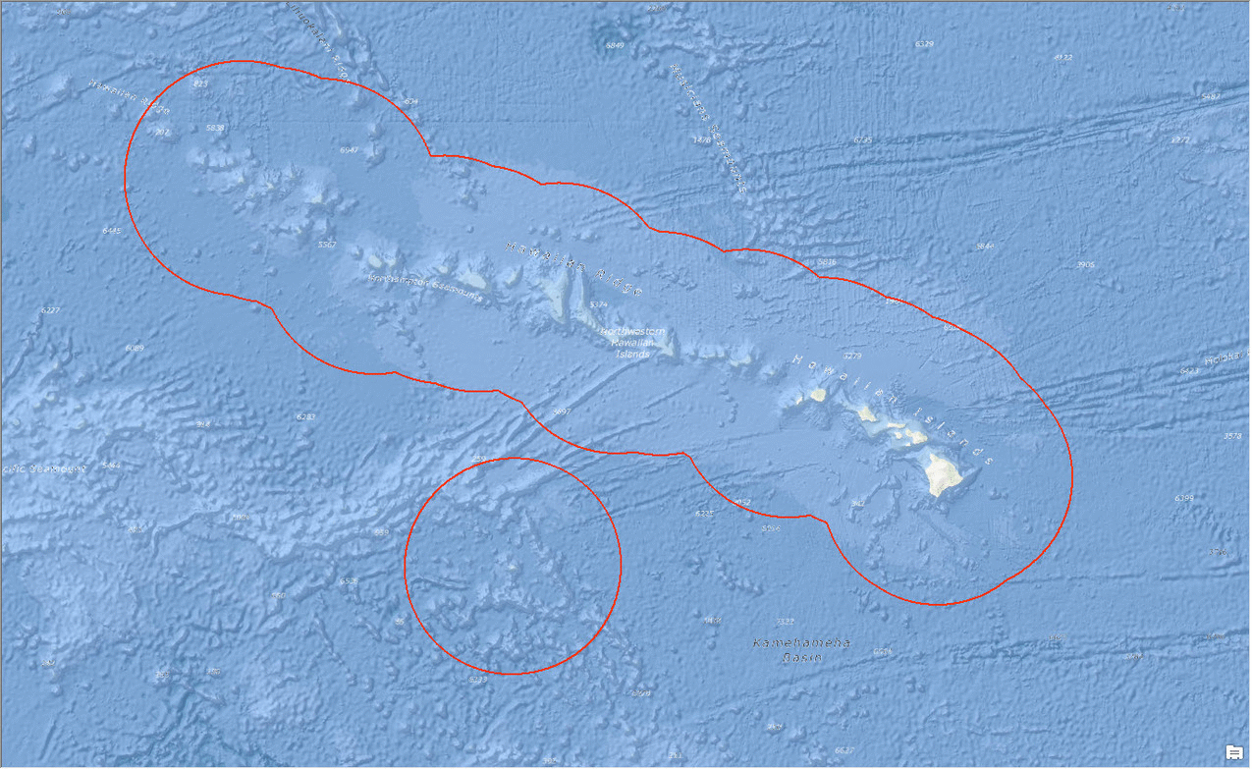
15th South West Pacific Hydrographic Commission Conference
Charts & Updates
ENC – NGA & NOAA Partnership = 6 new ENC cells to complete coverage in Palau Waters.
ENC – NOAA’s National Charting Plan = Rescheming the ENC bands and scales, from 131 current scales to 10 for improved clarity, consistency, and alignment with IHO recommendations.

Slide 5
Palau and Micronesia
The U.S. (NGA) is responsible for producing ENC cells in areas where the U.S. functions as the Prime Charting Authority outside U.S. domestic waters. NGA recently produced Six (6) ENCs within the SWPHC region in the waters surrounding the Palau Islands.

Slide 6
15th South West Pacific Hydrographic Commission Conference
Surveys: External Source Data
Extensive holding of bathymetric data available.
While it will take time to assess and apply these data holdings, US charts will see substantial improvements in the SWPHC region in the coming years.
The South Pacific is an ideal location for early implementation of ESD policies, such as in American Samoa and around Palmyra Atoll.

Slide 7
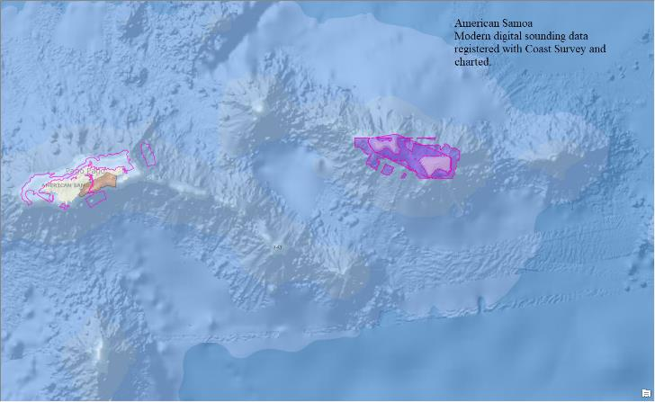
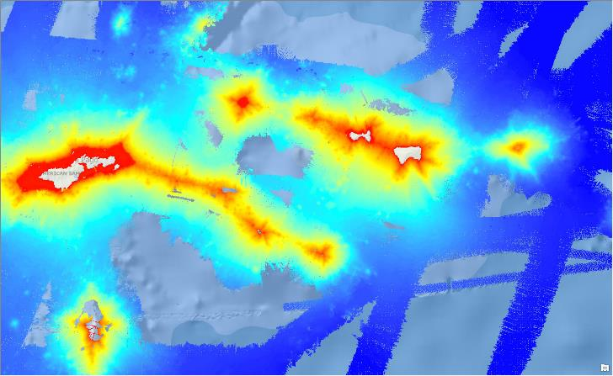
15th South West Pacific Hydrographic Commission Conference
Surveys: American Samoa

Slide 8
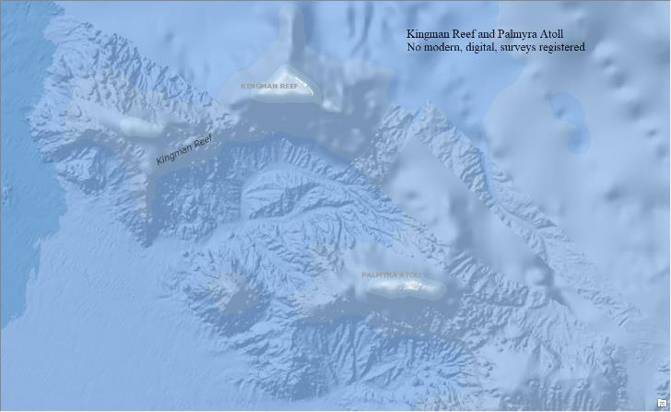
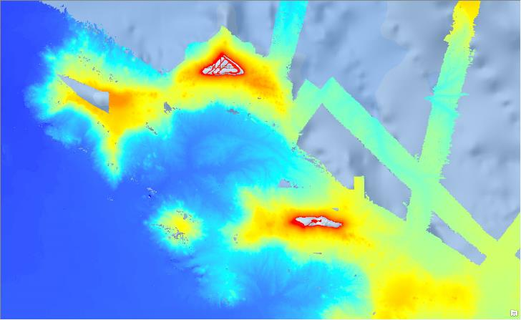
15th South West Pacific Hydrographic Commission Conference
Surveys: Kingman Reef and Palmyra

Slide 9
15th South West Pacific Hydrographic Commission Conference
Capacity Building
Training opportunities are available at various institutions in the United States.
Two Category A certified hydrographic programs are available through:
  The University of Southern Mississippi (in partnership with the US Navy)
  The University of New Hampshire (in partnership with NOAA)
Offer of and/or Demand for Capacity Building

Slide 10
15th South West Pacific Hydrographic Commission Conference
Capacity Building
Two Category B programs are available through:
U.S. Navy
  COMNAVMETOCCOM offers a six-month category B International Hydrographic Management and Engineering Program and mobile training via its Naval Meteorology and Oceanography Professional Development Center in Gulfport, Mississippi.
NOAA
  A Category-B Competence Training for Nautical Cartography is currently conducting its first class of 11 students, with 13 registered for 2019
Offer of and/or Demand for Capacity Building

Slide 11
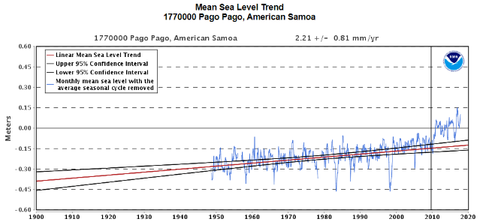
15th South West Pacific Hydrographic Commission Conference
Other Activities
NOAA’s Tidal Gauge Network
6 active sensors, one in American Samoa, two in Guam, one in the Republic of the Marshall Islands, one on Midway Island and one on Wake Island.
Data is usable for both near real time control of hydrographic surveys, as well as long term trend analysis.

Slide 12
15th South West Pacific Hydrographic Commission Conference
Other Activities
Gravity Surveys
Hawaii and the Pacific Islands are planned for Phase II, Part 4 of the GRAV-D Project Plan. Current terrestrial gravity stations are extremely sparse throughout the region and no modern geoid or gravity products are currently available. In Hawaii, each island currently uses its own local vertical datum. Once the GRAV-D products are available, the entire State of Hawaii will be on the same datum for the first time, and modern geoid products will be available for Guam, the Northern Marianas Islands, and American Samoa.
Notes:
Hawaii and Pacific Islands aren’t yet marked as having their flights planned, but the whole project is slated to be done by 2022.

Slide 13
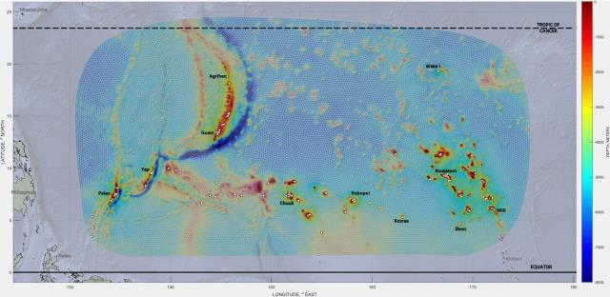
15th South West Pacific Hydrographic Commission Conference
Other Activities
Storm Surge Modeling
On February 13, 2018, a new ESTOFS-Micronesia system became operational in the tropical West Pacific. Hourly forecasts, 7 days out, refreshed every 6 hours.
Notes:
Gulf Coast example follows, 8 hour jumps to show change better

Slide 14
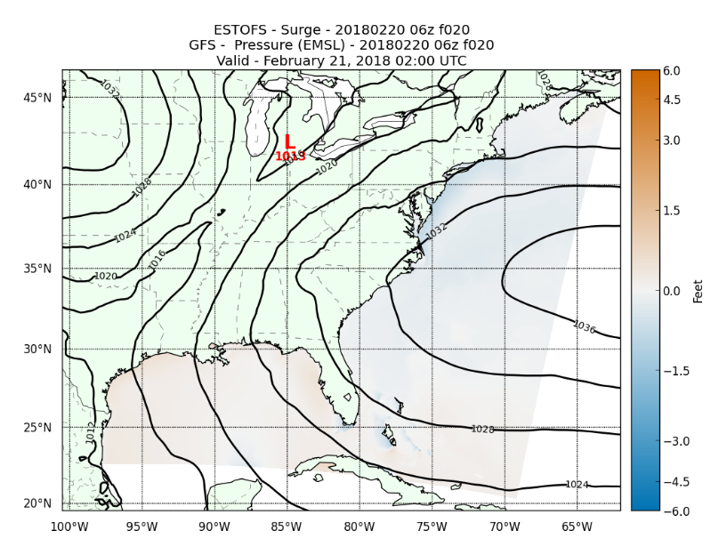
15th South West Pacific Hydrographic Commission Conference

Slide 15
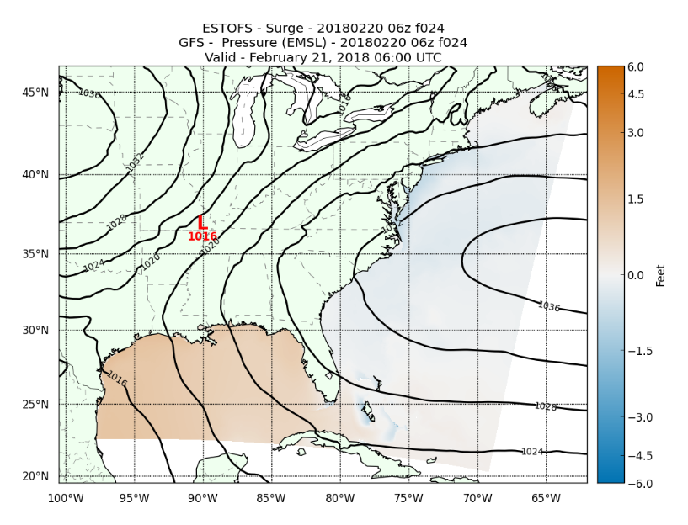
15th South West Pacific Hydrographic Commission Conference

Slide 16
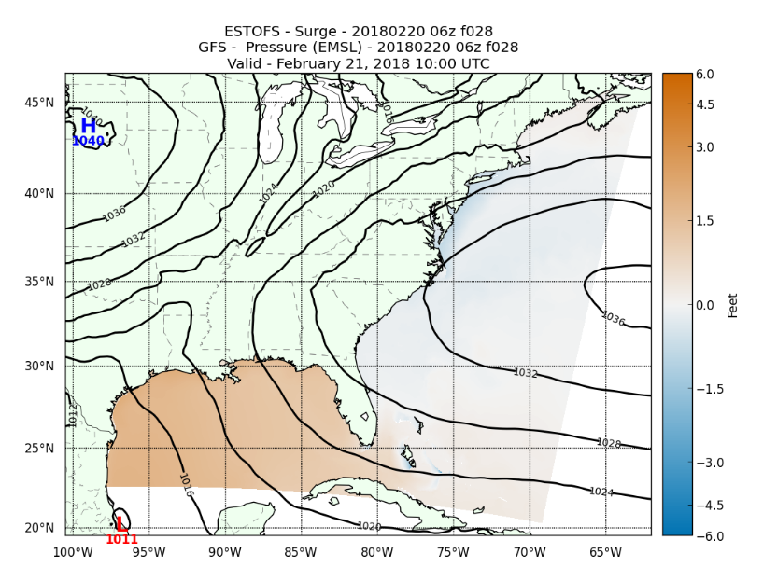
15th South West Pacific Hydrographic Commission Conference

Slide 17
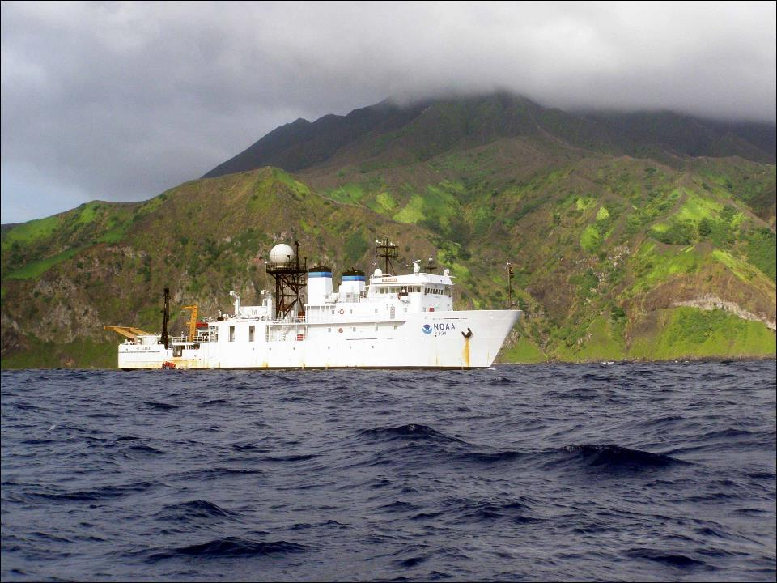
Thank you
NOAA Ship Hi’ialakai off the island of Anatahan in the Commonwealth of the Northern Mariana Islands

