Slide 1
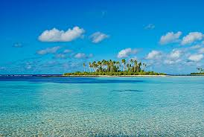
KIRIBATI
National Report
14th South West Pacific Hydrographic Commission (SWPHC) Meeting
NOUMEA, NEW CALEDONIA
30th November to 02nd December 2016
Prepared by Director of Marine

Slide 2
Presentation Outline
Facts about Kiribati
Role of Marine Division (MD) in Kiribati
Overview of MD Structure – Before and After Independence
Establishment of New Units within MD
PCA, Nautical Charts & Ports
Nautical Charts in Order of Priority
Assistance from IHO, SWPHC, SPC, IALA, AHS, UKHO
Work Done
Priorities & Way Forward

Slide 3
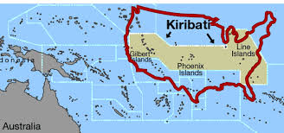
1. Facts about Kiribati and its Maritime Organization
33 islands over 3.5 million sq.km

Slide 4
Kiribati, like most small island states in the Pacific, is a Country
in need of assistance
GDP is the lowest in the region and the economy is heavily dependent on government spending.
Economic situation is constrained by its small population and land area, its remoteness, its scattered population centers and its lack of infrastructure and no capability to Hydrography Services.
Almost no natural resources and industry and employment options are very limited.
Heavily dependent on foreign aid and a net importer, it is economically vulnerable to fluctuations in the A$ and increases in food and fuel prices.
Only about 8% of the populations are economically active with many limited to subsistence fishing.

Slide 5
2. ROLE OF MARINE DIVISION WITHIN MICTTD
Maritime Authority for GoK – Coastal State, Flag State & Port State
Regulator for Maritime Safety – SOLAS, MARPOL, MLC 2006
Marine Pollution & Accident Investigation
Seafarers Registrar – STCW 78 (as amended) and STCW F
Ships Registrar – Conventional & Non-Conventional vessels
SAR Coordinator
MSI Coordinator
Hydrography & Nautical Chartings
Channel Upgradings – Dredging & Escavating
AToNs & maintenance on Aids to Nav
Adviser to GoK on all Maritime matters including IMO & ILO Compliance

Slide 6
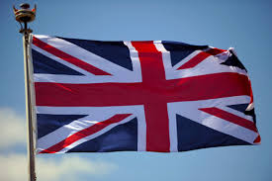
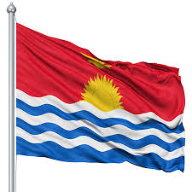
3. Overview of MD STRUCTURE - Before & After Independence
BEFORE INDEPENDENCE
AFTER INDEPENDENCE TIL 2015
Structure:
1 DoM
1 MS
1 MO
Structure
1 DoM
1 MS
1 MO

Slide 7
DIRECTOR OF MARINE
Marine Surveyor
Marine Officer
1 Beaconing Supervisor
SECRETARY
Honourable Minister
SHIP & SEAFARER CLERK
1 SMRO TARAWA
MARINE RADIO OPERATORS TARAWA
Beaconing Leading Hand
Beaconing Hand
1 SMRO KIRITIMATI
MARINE RADIO OPERATORS KIRITIMATI
STRUCTURE OF MARINE DIVISION
AFTER INDEPENDENCE 1979 TO 2015

Slide 8
DIRECTOR OF MARINE
1 Marine Surveyor
Marine Officer 1
SECRETARY
Honourable Minister
1 Data Base Officer
Marine Officer 2
Marine Officer 3
1 Ship & Seafarer Clerk
1 SENIOR MARINE RADIO 0FFICER TARAWA
MARINE RADIO OPERATORS
1 BEACONING SUPERVISOR
1 BEACONING LEADING HAND
2 BEACONING HANDS
1 SENIOR MARINE RADIO OFFICER KIRITIMATI
MARINE RADIO OPERATORS
3 POSTS APPROVED IN 2015
MANNED MID 2016
2016

Slide 9
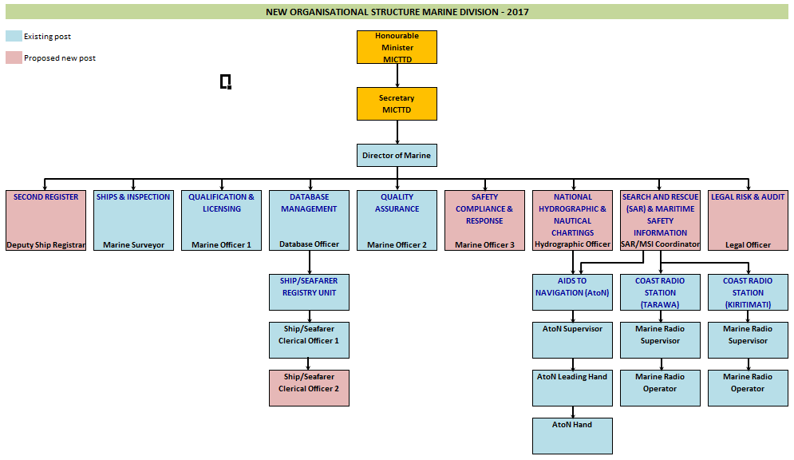
2017
NEW MARINE DIVISION STRUCTURE
ANOTHER 5 ADDITIONAL POSTS
2017

Slide 10
4. Establishment of the following Units within Marine Division
MSI Unit,
SAR Unit,
Hydrography Unit
Database Unit and
Renaming of Beaconing Unit to AToN Unit

Slide 11
5.. PCA, Navigational Charts & Kiribati Ports
UKHO is GoK PCA
Nearly all nautical charts in Kiribati are outdated
total of 14 Charts covering the whole of Kiribati published by UKHO at varying scales,
Published in the 1950s and 1960s from surveys with data obtained around 1943 and earlier, only BA 731 (Gilbert Group) published in 1994
3 international sea ports
Betio Port
Kiritimati Port &
Tabuaeran
Kanton – will be build as main port of entry in the PIPA Group

Slide 12
5.1. Kiribati Nautical Charts in order of Priority
Tarawa and Port Betio (BA3269, BA700)
Kiritimati Atoll (Christmas Island) (BA2867, BA2995)
Tabuaeran Atoll, formerly called Fanning Island (BA2971)
Aba-Riringa Island (Kanton) (BA184, BA1451)
Survey work by RAN and SPC in 2009 and 2015 respectively:
New Edition for Betio Port Chart – 2015 (BA 3269)

Slide 13
6. Assistance from SPC, UKHO, IALA, IHO, SWPHC & AHS
2015 – SPC & AHS in collaboration with ESAT and PRNI Project Funds
Surveying of Betio Port by SPC and AHS to upgrade Betio Approaches Nautical Chart
- SPC and UKHO
CB - assess the progress made against the recommendations made in the associated report done by IHO in 2011.
2016 – SPC
Gap Analysis in Kiribati existing Acts – in compliance to International Maritime Conventions
Development of Maritime Transport Policy
– SPC & IALA & UKHO
AToN
SOP for Domestic Vessels
SON – SON Project which Kiribati will be included
CME Programme

Slide 14
7. Work Done
New Quality Management System in place
3 Posts approved - 2016
5 additional Posts approved for 2017
New Maritime Act in place
New legislations adopted as per IMSAS IMO
SOLAS
MARPOL
STCW 78 as amended
MLC 2006

Slide 15
Work Done – cont
Loadline Regulation
Tonnage Regulation
Collision Regulation
Agreements with RO’s
Transfer of Maritime Authority – to Marine Division
New Maritime Transport Policy in place
Development of the Kiribati National Maritime Transport Committee – KNMTC (NHCC)
Designation of Kiribati MSI Coordinator

Slide 16
8. Kiribati Priorities - Way Forward
Continuous awareness to Government/Public on obligations for the provision of Hydrographic Services
CB for Hydrography Unit staff
Hydrography Governance,
Development - Legislation on SOLAS Chapter V - Hydrography
Provision of Hydrographic Services
Hydrography Risk Assessment
Provision of MSI – to PCA and the regional radio navigational warnings coordinator
Developing a bi-lateral agreement with PCA (UKHO) & with other national hydrographic authorities
In future - keen to be a full member of SWPHC and IHO

Slide 17
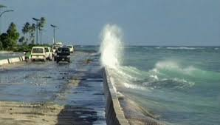
THANK YOU

