Slide 1
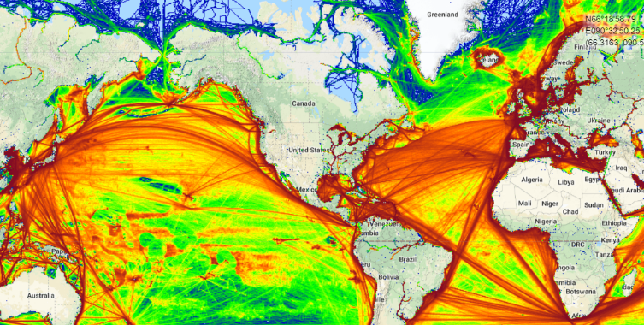
Economic Assessment of Risks in Maritime Navigation across the Greater Caribbean Region (GCR)
Presenter: Shivani Dawn Seepersad
Department of Geomatics Engineering and Land Management
The University of the West Indies
PACIFIC OCEAN
ATLANTIC OCEAN
Notes:
My presentation is based on conducting an Economic Assessment of Risks in Maritime Navigation across the Greater Caribbean Region, also known as the GCR. This image shows the density of vessel traffic across the Atlantic and Pacific Oceans, with the red areas showing the most travelled routes and it’s clear that due to the geopolitical location of the GCR, it is a hub for vessel traffic from tankers, cargo vessels, cruise ships etc. Maritime navigation is important to the economy of the GCR, particularly the SIDS.

Slide 2
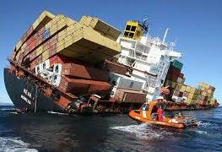
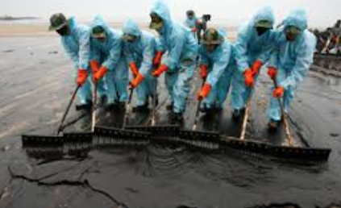
Introduction to this Study
Maritime navigation is important to the Greater Caribbean Region (GCR) because it facilitates economic expansion.
However, the environment, economy and culture of the region are at risk of unwanted events which can have short or long term consequences.
This study therefore involves an economic assessment of risk in maritime navigation across the GCR.
Notes:
However, maritime navigation places the environment, economy and culture at risk of unwanted events. For example, 60% of fishing takes place in the Gulf of Paria, if there were to be a ship based oil spill in the Gulf, there would be long term consequences which can negatively impact our fisheries, the livelihood of fishermen and our economy. This study therefore involves an economic assessment of risk in maritime navigation across the GCR.

Slide 3
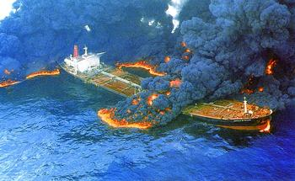
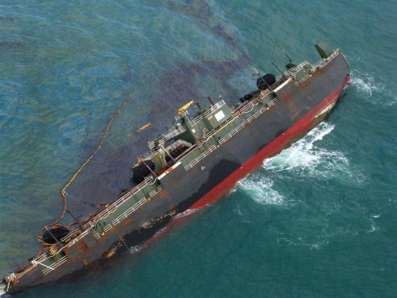
Structure of the Presentation
Introduction
Significance
Strategies tested
Preliminary results
Method being formulated
Conclusion & ongoing research
Notes:
This presentation would be delivered as follows: I would give an introduction to the study, followed by the significance, strategies tested, preliminary results, we would look at the method that is being formulated then conclusions and ongoing research

Slide 4
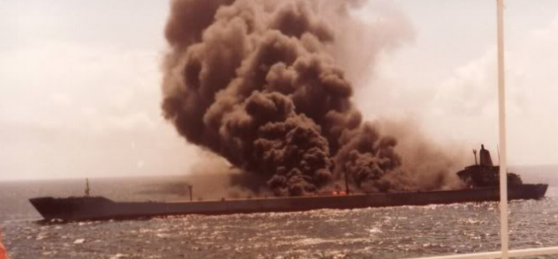
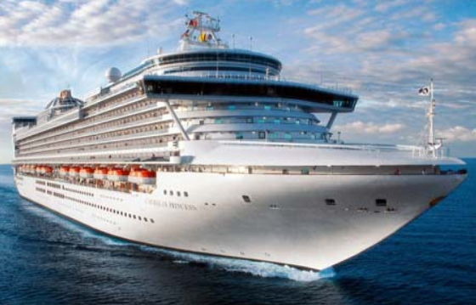
History of Maritime Accidents across the GCR
Fifty eight accidents were reported across the GCR over the last 16 years including:
8 collisions
10 fires or explosions
5 foundered
4 mechanical damage
3 mechanical & technical failure
10 groundings
The World’s largest ship based oil spill took place within Trinidad & Tobago’s EEZ !!
Notes:
Not all accidents are reported however, of those that were reported over the last …….. Years, there were…………..
Due to the expansion of the panama canal to facilitate the new panamax vessels, the frequency and size of vessels transiting the GCR are expected to increase.
In 2017 this cruise vessel carrying 3000 passengers crossed the new Panama Canal and visited several islands, if there were an accident involving a vessel of this size because our waters are unsafe for navigation, there would be catastrophic long term consequences, particularly to SIDS

Slide 5
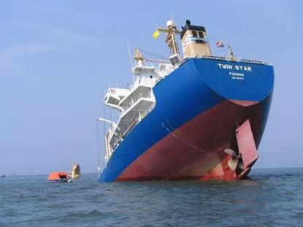
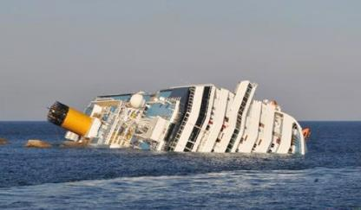
Significance of the Study
The results will contribute to the monitoring and management of maritime navigation by supporting the:
Prioritization of resources
Reduction of risk
Improved security of the marine environment
Expansion of international trade opportunities
Notes:
The results of this study would therefore contribute to the much needed monitoring and management of maritime navigation across the region by supporting the prioritization of resources to reduce risks and therefore facilitate economic expansion

Slide 6
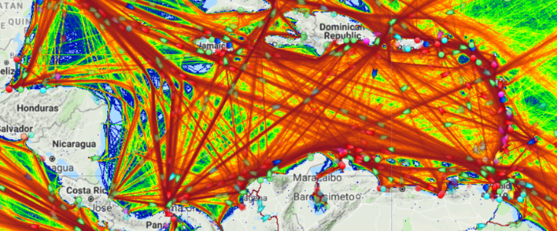
Aim and Objectives
Aim:
To conduct an economic assessment of risks in maritime navigation across the Greater Caribbean Region (GCR)
Objectives:
Formulate a risk assessment strategy
Generate an economic model to estimate losses associated with maritime accidents
Caribbean Sea
Source: Marine Traffic
Marine traffic density across the GCR
Notes:
The aim of my study is therefore to conduct an economic assessment of risks in maritime navigation across the Greater Caribbean Region (GCR)
And the objectives of my research are to formulate a risk assessment strategy and generate an economic model to estimate losses associated with maritime accidents

Slide 7
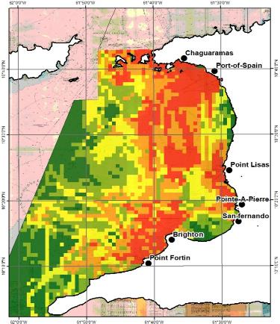
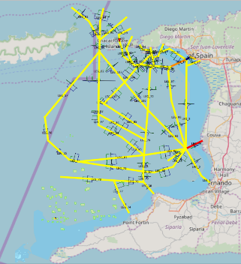
Commonly Used Strategies for Conducting Risk Assessments
Strategies for risk assessment were developed by maritime departments including:
IALA Waterway Risk Assessment Programme (IWRAP)
Land Information New Zealand (LINZ)
Canadian Hydrographic Service
Arctic Region Hydrographic Commission
National Oceanic and Atmospheric Administration
IALA considers traffic flow while the others used traffic density.
Notes:
Strategies for risk assessment have been developed by several maritime departments. The strategies developed by The International Association of Marine Aids to Navigation and Lighthouse Authorities and Land Info NZ have been tested within my research because these methods are available within the public domain. LINZ who’s focus is on charting, made their strategy available through comprehensive documents and IALA who’s interest is in maritime safety through adequate aids to navigation and lighthouses has made their strategy available through a software called IWRAP which means the waterway risk assessment programme. I applied both strategies to the GOP and found that there are limitations in applying these strategies to the GCR. As a result, I am developing a method for conducting an economic assessment of risks in maritime navigation that is specific to the GCR. Let us now take a look at these strategies

Slide 8
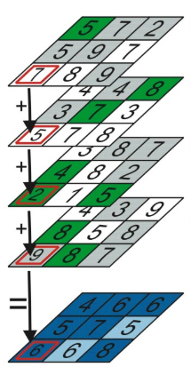
General Outline of the Hydrographic Risk Assessment Strategy developed by Land Information New Zealand (LINZ)
Applies data from satellite or terrestrial automatic identification systems.
Applies a weighted modelling approach –
The scores are acquired from expert judgement.
3. Represents the relative level of risk on a heatmap.
Notes:
In my first seminar I presented the LINZ strategy and its results from a pilot study I conducted across the Gulf of Paria.
The LINZ strategy uses both satellite and terrestrial AIS data to identify vessel position and characteristics along with the location of factors that are likely to cause a maritime accident and be affected by a maritime accident. The datasets are assigned a weight based on their relative level of risk in maritime navigation, the weights are then combined to produce a heatmap. These weights were acquired for the GCR using questionnaires and interviews with experts however this introduced subjectivity in the datasets.

Slide 9
Results of the Hydrographic Risk Assessment developed by Land Information New Zealand
There is risk in maritime navigation across the GOP.
Levels of Risk in Maritime Navigation
 | Catastrophic
 | High
 | Moderate
 | Low
 | Insignificant
Projection:
WGS 84 Zone 20 N
Under the LINZ strategy, no units are associated with the risk value.
Notes:
A pilot study using the LINZ strategy was conducted across the Gulf of Paria and the results show that there is risk in maritime navigation across the region and risk control options should be considered to reduce the risk. Decision makers tend to take action to implement these RCOs when it is expressed in potential dollars lost per year however under the LINZ strategy, potential economic losses are not estimated

Slide 10
General Outline of the Strategy Developed by the IALA Waterway Risk Assessment Programme (IWRAP)
IWRAP calculates the probability of grounding, allision or collision based on:
The average number of potential accidents (near misses), assuming that no evasive action is taken (blind navigation).
Then adjusts this number by multiplying it with the probability that an evasive action fails.
Probability an evasive action fails
Condition | Causation Factor
Head on collision | 0.5 X 10⁻⁴
Overtaking collision | 1.1 x 10⁻⁴
Crossing collision | 1.3 X 10⁻⁴
Collisions in bend | 1.3 X 10⁻⁴
Collisions in merging | 1.3 X 10⁻⁴
Grounding – forgot to turn | 1.6 X 10⁻⁴
Notes:
Let us now take a look at the strategy developed by IALA. IALA has developed a computer programme known as IWRAP that employs statistical data relating to vessels (often with AIS inputs), navigational methods and channel conditions to produce results relating specifically to collisions and groundings. Just about one week ago, I attend a workshop in Japan where I acquired a license to this software and applied the software to the GOP. Let us now take a look at the results

Slide 11
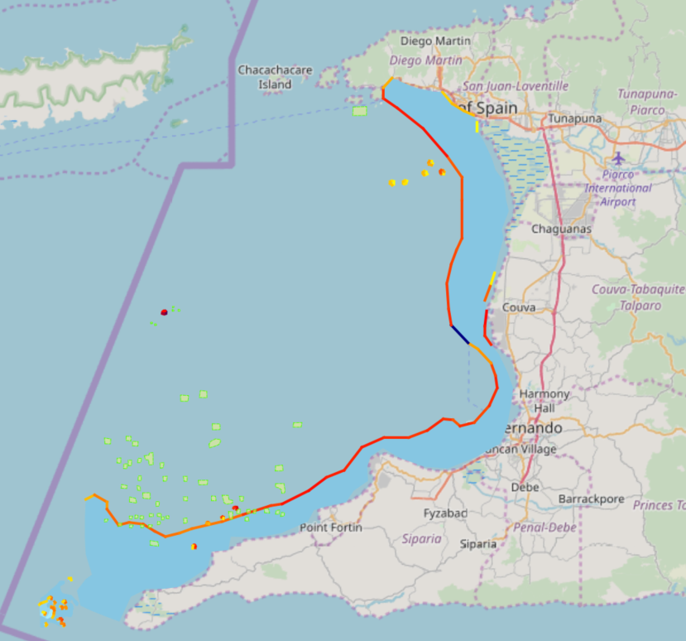
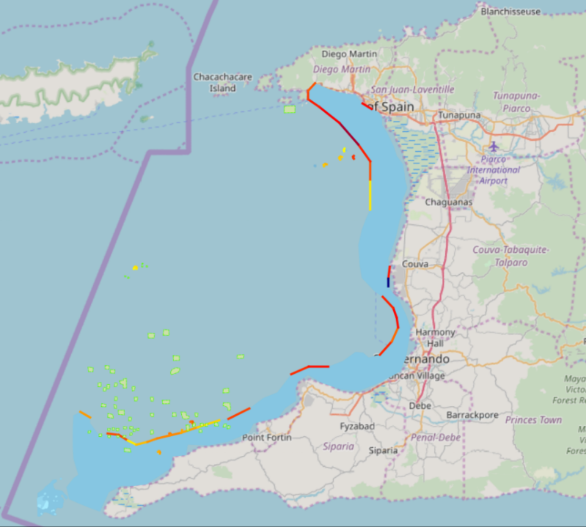
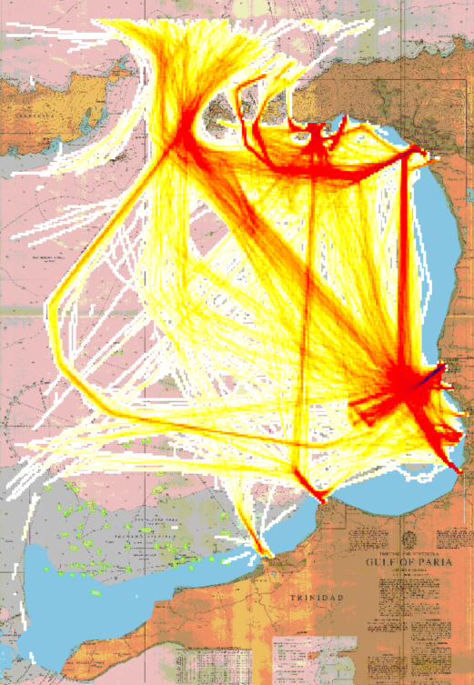
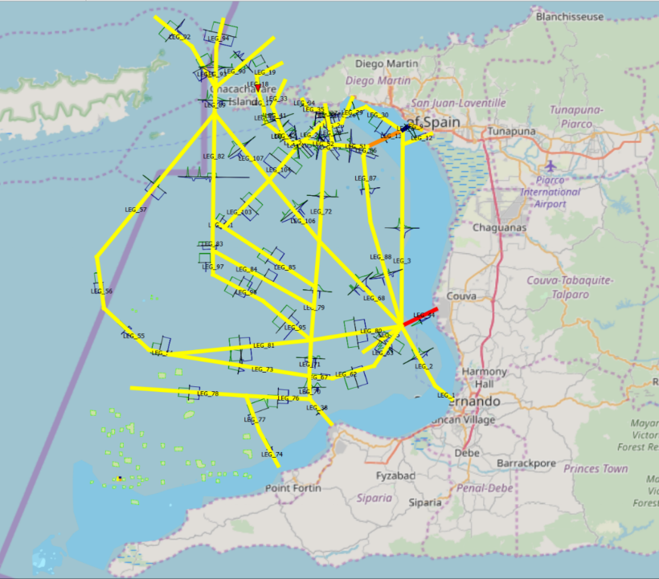
Results of the Strategy Developed by the IALA Waterway Risk Assessment Programme (IWRAP)
Collisions are expected to occur every 149 years
Drifting grounding is likely to occur every 345 years
Powered grounding is likely to occur every 24 years
Traffic density
Port of Spain
Port of Spain
Port of Spain
Point Lisas
Point Lisas
The approach channels to Port of Spain and Point Lisas are at risk in maritime navigation
There is pilotage in these areas
Point Lisas
Point Lisas
Notes:
Density map
Drifting grounding – draught of vessels transiting the area in relation to the depth of water, also further offshore there is debris from an oil rig, vessels are likely to come in contact with this
Powered grounding – is likely to occur in the port of spain and couva areas. The risk is higher for powered grounding because when the engine is on, the vessel tends to squat therefore decreasing clearance between the vessel and the seabed
Collisions are expected to occur along the approached to POS and Couva.
It is clear that the approaches to POS and Couva have a higher level of risk however there is compulsory pilotage in these channels

Slide 12
Major Limitations of IWRAP Risk Model
Major Limitations of LINZ Risk Model
Likelihood of accidents:
Does not model dynamic vessel characteristics for e.g.: rate of change of speed or course
Does not use satellite AIS data
Consequences of accidents:
Does not model consequences of accidents
Risk Value:
Does not include a measure of consequences
Limits on how much data can be processed.
Likelihood of accidents:
Does not model dynamic vessel characteristics for e.g.: direction of transit, rate of change of speed and course
Based on subjective weights
Consequences of accidents:
Does not measure consequences as an economic loss per year
Risk Value:
Provides a relative risk value with no units
This method is also time consuming.
Notes:
There are limitations to apply the LINZ and IWRAP strategies to the GCR.
When considering the likelihood of accidents occurring, IWRAP does not consider dynamic vessel characteristics. This is important to consider because when there is a significant change in the speed or course of the vessel, it is likely that something is wrong. IWRAP uses only T-AIS data because there is a higher frequency of readings for vessel position information than S-AIS however, very few C’bean territories have T-AIS. This leads to another limitation of IWRAP, the higher the frequency of readings, the larger your dataset and there is a limit to the size of data that could be imported in IWRAP. IWRAP does not model the location of sensitive coastal resources that are likely to be affected by an accident or the potential economic losses. The main limitation of their final risk value is that it does not include a measure of consequences.
Let us now take a look at the limitations of the LINZ risk model. Similarly, LINZ does not model dynamic vessel characteristics, the strategy is applies on subjective weights based on feedback from the experts. While this strategy includes the location of sensitive resources, it does not measure potential consequences as economic losses per year, this is particularly important because presenting decision makers with a scientific assessment of risk and economic losses per year gives reliable information needed to make decisions. The LINZ strategy provides a relative risk value which is useful for prioritizing resources however, the risk value has no units so you do not know the quantitative level of risk. This method is also very time consuming. I spent 5 months at LINZ to conduct the risk assessment for the small island of Niue however, I attend a workshop in Japan and learnt was able to get results from IWRAP within one day.

Slide 13
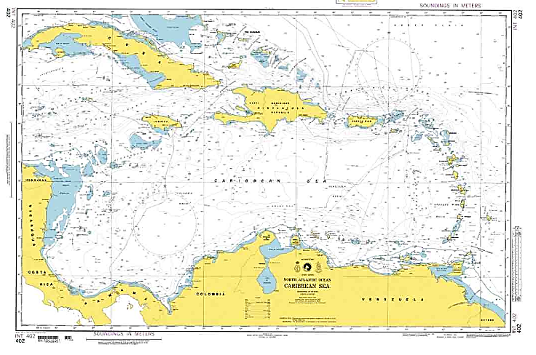
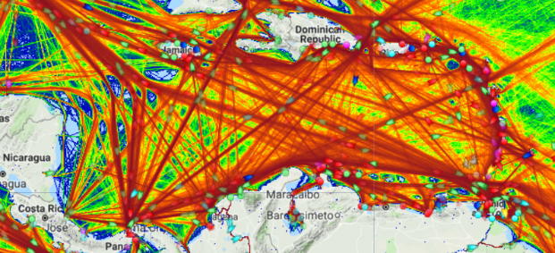
Economic Assessment of Risks in Maritime Navigation
Area of study:
Greater Caribbean Region
Main datasets being applied:
Vessel position and characteristics from satellite and terrestrial automatic identification systems
Information represented on nautical charts for e.g.: bathymetry and the location of wrecks
Risk Value = Likelihood x Consequence
Software:
Python programming, ArcGIS Pro
Source: Marine Traffic
Notes:
Due to limitations of applying these methods to the GCR, my aim is to apply the knowledge gained from these strategies to develop strategy for conducting an economic assessment of risks in maritime navigation specific to the environment of the GCR. In this study, the main datasets that would be applied are AIS data and information represented on nautical charts such as bathymetry and the location of wrecks. The formula for calculating risk value would be applied which is ……. And python programming within ArcGIS Pro is being used.

Slide 14
Strategy to Estimate the Likelihood of Groundings and Collisions across the GCR
1. Calculate the likelihood of grounding, per unit area:
Model ship domains based on vessels’ characteristics and seabed characteristics
Assess near misses between ship domain and the seabed
2. Calculate likelihood of collision, per unit area:
Dynamic ship domains based on: likely environmental conditions and vessels’ characteristics for eg: rate of change of speed and course of vessel
Assess frequency of near misses between ships’ domains and between domains and obstructions
Ship Domain - 3D operational zone around the ship which should not be encroached
SHIP
SEAFLOOR
Notes:
The strategy would calculate the likelihood of grounding and collision using dynamic ship domains. A dynamic ship domain is a 3D operational zone around a ship which changes in size based on the characteristics of vessels. To calculate the likelihood of grounding per unit area, I would model the ships dynamic domain in relation to bathymetry and assess near misses between the ship and the seafloor. To calculate the likelihood of collision between vessels per unit area I would model the dynamic domain of each vessel and assess the extent and frequency of overlap between ship’s domains

Slide 15
Strategy to Estimate the Likelihood of Groundings or Collisions across the GCR
3. Categorize the likelihood values as measures of incidents per year
The likelihood of grounding and collision are summed per unit area and quantile data distribution is applied to categorize the likelihood values using a five point scale.
Risk in Maritime Navigation
5 | Catastrophic
4 | High
3 | Moderate
2 | Low
1 | Insignificant
Notes:
The likelihood of grounding and collision are then summed per unit area to calculate the likelihood of incidents per year and the quantile data distribution method is applied to divide the likelihood into five groups to which a score would be assigned with the score of 1 being an insignificant likelihood and 5 being a catastrophic likelihood

Slide 16
Strategy to Estimate the Economic Consequences of Groundings and Collisions per year, across the GCR
1. Estimate the value of sensitive coastal resources based on the following techniques:
Market valuation - the value of an asset based on the price that would be paid for it, if it were sold at a certain time.
Non-market valuation – how much people would be willing to pay to protect the resource
Notes:
The consequences of a maritime accidents can be determined by estimating the amount of money that would be lost if a resource were to be negatively affected.
In some cases, the money that would be lost is reflected in the market price. For example, tourism in T & T is largely based on marine activity, and based on historical evidence, if an oil spill affects a beach in Trinidad regional and international tourists are likely to avoid T & T as a whole. To estimate how much would be lost from our tourism industry as a result of an oil spill, we can look at the contribution of tourism to our GDP
In some cases, the value of a good or service is not directly reflected in a market price and non-market valuation methods are applied, this is done by asking person’s how much they are willing to pay to protect a particular resource.

Slide 17
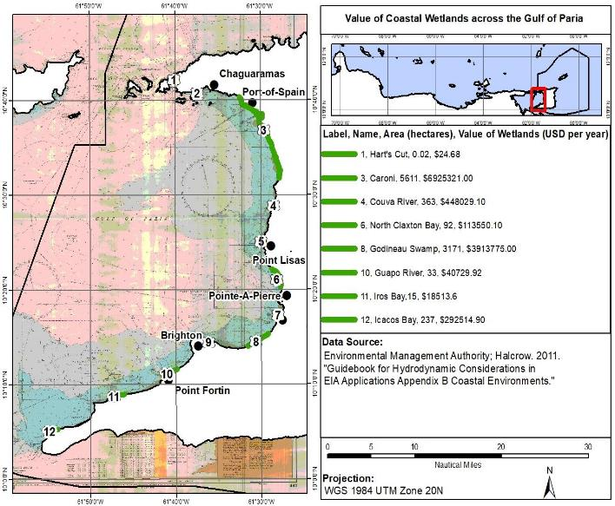
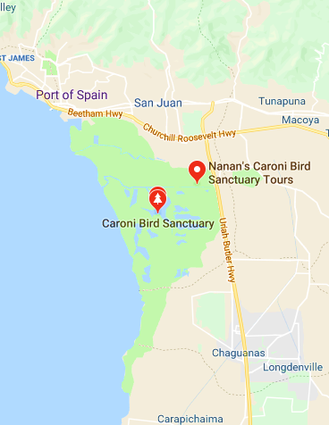
Example of Results from the Strategy to Estimate the Financial Consequences of Groundings and Collisions per year, across the GCR
Residents of Trinidad and Tobago are willing to pay US$ 1,234 / ha / year to protect the Caroni Swamp
Caroni Swamp valued at US$ 10 mn / year
Caroni Swamp valued at $10 mn USD per year
Department of Agricultural Economics and Extension, The University of the West Indies
Notes:
For example, residents are willing to pay 1,200 USD per hectare, per year to protect the nariva swamp which means that one hectare of the swamp. The nariva swamp is a similar environment to the caroni swamp therefore the benefit transfer method can be applied to calculate the value of the caroni swamp. Multiplying the value of one hectare of the nariva swamp by the area of the caroni swamp values the caroni swamp at 7 mn USD per year. Therefore we can lose up to 7mn USD per year if the Caroni Swamp is affected by an oil spill. This is not unlikely because the largest ship based oil spill occurred within our territorial waters however impact studies were not carried out so we do not know the effects of the spill

Slide 18
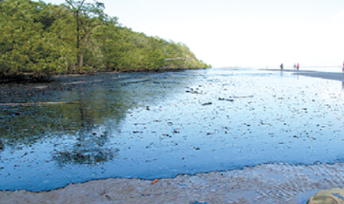
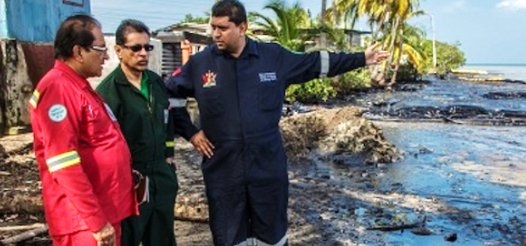
Strategy to Estimate the Financial Consequences of Groundings and Collisions per year, across the GCR
2. Assign a consequence score (in economic losses per year), using a five point scale:
Create buffers around coastal resources where potential accidents may have a negative impact.
Assign a consequence score per unit area using a five point scale.
Notes:
After the value of sensitive coastal resources are estimated buffers are created around the resources across the area where potential accidents may have a negative impact. Then the quantile data distribution method is used to assign a consequence score is assigned to each grid cell

Slide 19
Assigning a Score for Consequences Per Unit Area
Severity of Impact/Consequence Score |  | Service Disruption Criteria | Economic Criteria (USD)
1 | Insignificant | No significant disruption | Losses less than $1,000
2 | Minor | Some loss of services | Losses $1,000 - $50,000
3 | Severe | Sustained (24h) disruption | Losses $50 K to $5M
4 | Major | Sustained (1 – 30day) disruption | Losses $5M – $50M
5 | Catastrophic | Closure of facility for months | Losses in excess of $50M
Source: IALA
Notes:
For example, an area with potential losses of 1,000 USD can be assigned a score of 1 which is insignificant
And area with potential losses over 50 mn USD can be assigned a score of 5 which is catastrophic
Bear in mind that this is just an example, the financial criteria may vary

Slide 20
Calculating the ‘Risk Value’
Risk Value = Likelihood (Probability) score x Consequence score
For example:
Classification of Risk Value
Low (1-4) | Low (1-4)
Moderate (5-8)
High (9-12)
Very High (15-25)
insignificant probability (2)
x
severe consequence (3)
= risk value of 6
Notes:
Once you have the likelihood score and the consequence score, you can calculate the risk value
For example……

Slide 21
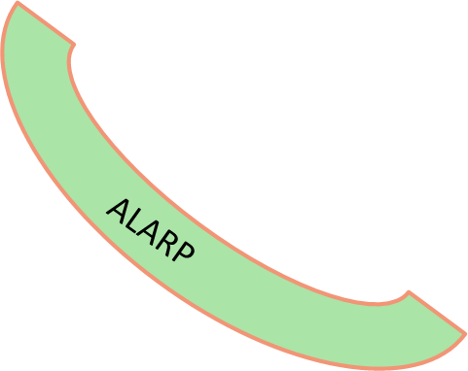
RISK VALUE MATRIX |  | LIKELIHOOD
 |  | Very Rare (1) | Rare (2) | Occasional (3) | Frequent (4) | Very frequent (5)
CONSEQUENCE | Catastrophic (5) | 5 | 10 | 15 | 20 | 25
 | Major (4) | 4 | 8 | 12 | 16 | 20
 | Severe (3) | 3 | 6 | 9 | 12 | 15
 | Minor (2) | 2 | 4 | 6 | 8 | 10
 | Insignificant (1) | 1 | 2 | 3 | 4 | 5
Moderate Risk
Reduce to As Low As Reasonably Practicable (ALARP) level using Risk Control Options.
Source: IALA
Notes:
A value of 6 lies within the region of moderate risk and based on international recommendations, moderate risk is too high therefore risk control options should be implemented to reduce risk within the range of 1 – 4 which is ALARP

Slide 22
Ongoing Immediate Objectives
Develop a robust and repeatable script using Python and ArcGIS Pro to:
Calculate the likelihood of grounding and collision then categorize the values in incidents per year using a five point scale.
Create buffers around coastal resources where potential accidents may have a negative impact. Next, assign a consequence score in economic losses per year based on market and non-market valuation techniques to estimate the value of the coastal resources
Calculate the final risk value per unit area.
Notes:
Lastly, my ongoing immediate objectives are to continue applying market and non-market valuation techniques to estimate the value of coastal resources across the Greater Caribbean Region and develop a robust and repeatable script to calculate the calculate the final risk value per unit area

Slide 23
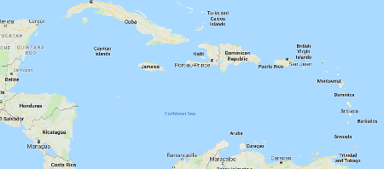
Data Required from Nautical Charts in a GIS Format across the Greater Caribbean Region
Age & Quality of nautical charts
Bathymetry
Coastline
Maritime boundaries
Obstructions on the seafloor
Ports
Aids to navigation
Protected areas
Tide and current
Fisheries
Offshore and coastal installations
Designated areas (for example spoil grounds & oil wells)
Underwater cables
Recreational areas
Area of Study –
Greater Caribbean Region
Notes:
Here is a list of the data required in a GIS format from the nautical charts. I spent several weeks digitizing these datasets for T&T and the area of study for my research is the GCR. Digitizing all these layers for the GCR would take a long time. It would therefore be beneficial to make these layers available in GIS format in a web based msdi

