Slide 1
19th Meeting of the Meso America – Caribbean Sea Hydrographic Commission National Report by
Antigua and Barbuda

Slide 2
Main achievements during the year
Port redevelopment project
West Indies Oil Company night berthing project
Global ports management

Slide 3
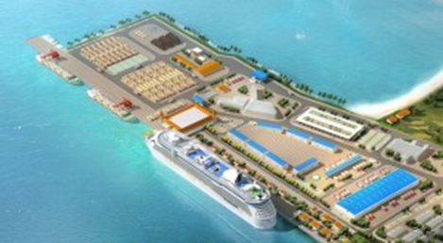
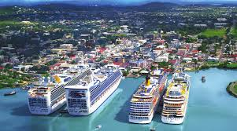
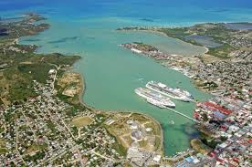
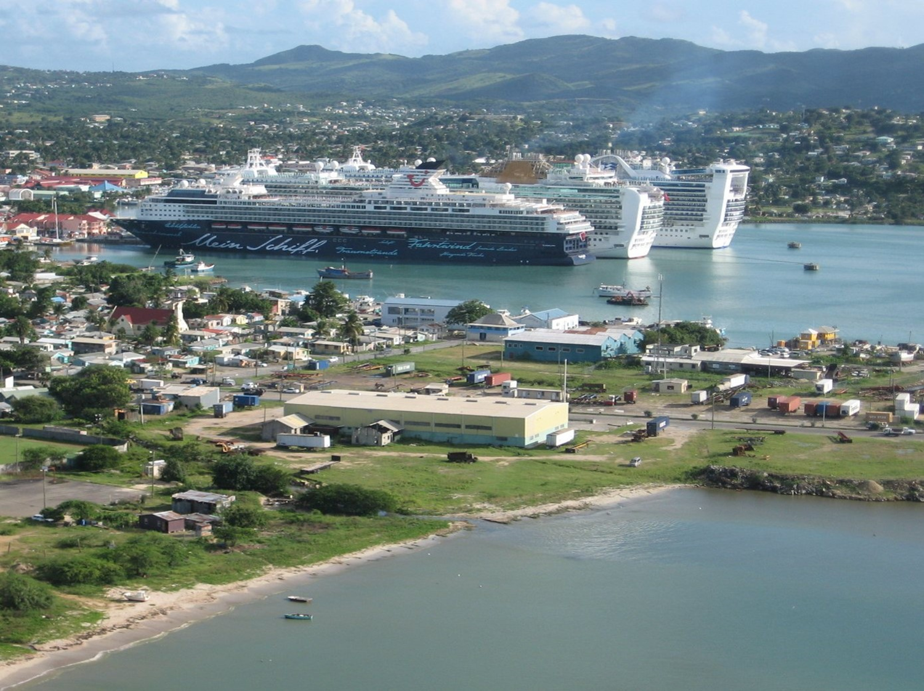
Notes:
Antigua and Barbuda Acts, and regulations;
Where the Acts and regulations do not provide guidance on “to the satisfaction of the administration” in any case, reference is made to IMO Circulars, guidance, resolutions and unified interpretations;
Where the IMO publications do not provide clarity on the correct interpretation reference is made to the Unified Interpretations agreed by IACS; and
Where the IACS unified interpretations do not provide guidance on interpreting “to the satisfaction of the administration” in any particular case reference is made to established industry best practice in the area concerned.

Slide 4
Main challenges and/or obstructions
Management of coastal and marine environments
Safety and security
Hydrographic coordination and data collection
Natural and environmental disasters
Training and capacity building

Slide 5
Plans that affect the region
CME Programme - Provision of Seabed mapping equipment and Training
World Port Index and Sailing Directions inputs/changes

