Slide 1
Council-2 Readout MACHC19 November 29, 2018
Chair Rear Admiral Shepard M. SMITH (USA)
Vice-Chair Adm (Ret) Luiz Fernando PALMER Fonseca (Brazil)
Secretariat Dr. Mathias JONAS, Secretary-General (IHO Secretariat)

Slide 2
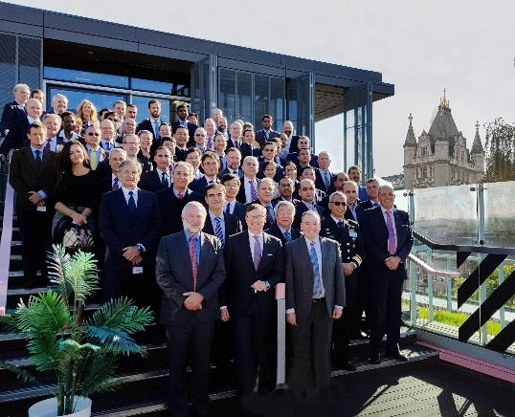
Overview
Council-2
October 9-11, 2018, London
28 Council Members and 10 IHO MS Observers
(MACHC participants: Brazil, Columbia, France, Netherlands, UK, USA)
Key Agenda items
Strategic Plan Review Working Group Report
S-100 Product Provision
Crowdsourced Bathymetry Working Group Guidelines
Seabed 2030
Preparations for Council-3 and Assembly-2
Other

Slide 3
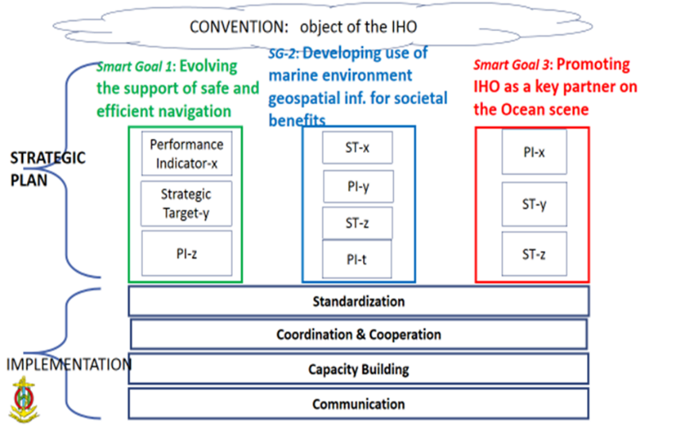
Strategic Plan
July 2019
proposed new Strategic Plan submitted for Council 3
Notes:
The report of the SPRWG Chair and subsequent discussions were important elements of the Council 2 meeting. The Council needed to come out of the C-2 with sufficient guidance to the SPWRG so that it could progress its task on behalf of the Council as requested by Assembly-1.
After good discussion, the C-2 adopted 3 SMART Goals around which to organize a drafting effort. THe ultimate plan is intended to be fairly short- on the order of 3 pages or so and very high level.
A Management Plan was adopted with an associated timeline of actions. The SPRWG will meet in late January to begin drafting the plan, the IRCC and HSSC Chairs will be invited to weigh in on performance measures and targets, the Chair of the IHO was added to the membership of the SPRWG. The document will be reviewed again over the summer in connection with the IRCC and HSSC meetings. See C2-6.1
A proposed draft revised plan will be submitted to Council-3 in July/August. C-3 will deliberate and if accepted, the plan will be finalized for consideration at Assembly-2. For that, the plan will need to be submitted in December 2019, in advance of A-2 in April 2020.
We have a ways to go. States from the MACHC region on the SPRWG include: Brazil, Netherlands, UK, USA (NEED TO DOUBLE CHECK)
Chair: bruno.frachon@shom.fr
Vice Chair: shigeru.nakabayashi@jodc.go.jp
Secretariat: douglas.brunt@dfo-mpo.gc.ca

Slide 4
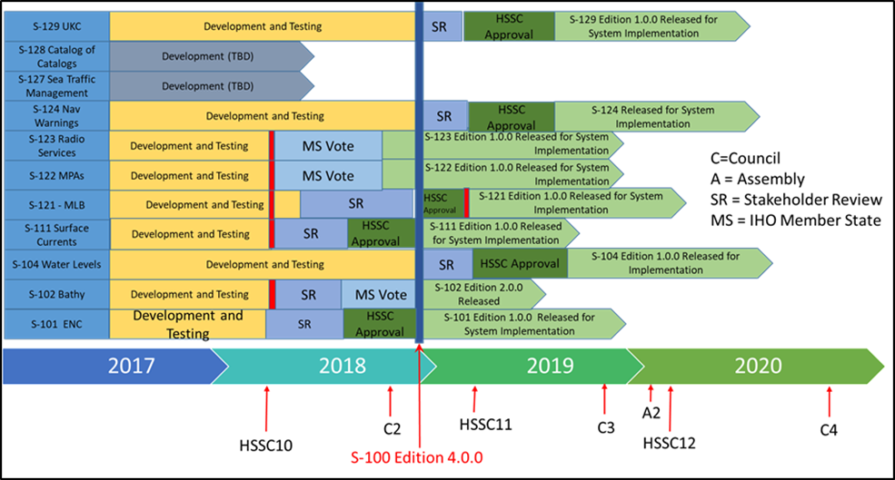
Development and Future Provision of S-100 Products
Notes:
Action C2/31:
Council, HSSC, IRCC Chairs and Secretary-General to draft an implementation strategy aiming to the regular and harmonized production and dissemination of S-100 based products for further discussion at A-2 and for the preparation of the 2021-2023 IHO Work Programme. (deadline C-3 in preparation for A-2)
Action C2/30:
IRCC to instruct and provide guidance to the WENDWG in order to investigate the applicability of the WEND-like Principles to the production and dissemination of S-101 ENCs and the first generation of S-100 based products and to report back at C-3. (deadlines: Dec. 2018, C-3)

Slide 5
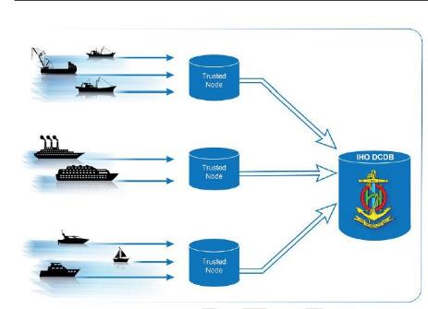
Crowdsourced Bathymetry
B-12 - IHO Guidelines on Crowdsourced Bathymetry Edition 1.0.0 Adopted
Further work is needed for depicting the data flow (sensor, coastal States information, DCDB) before these guidelines can come into force with full effect. Action to IRCC

Slide 6
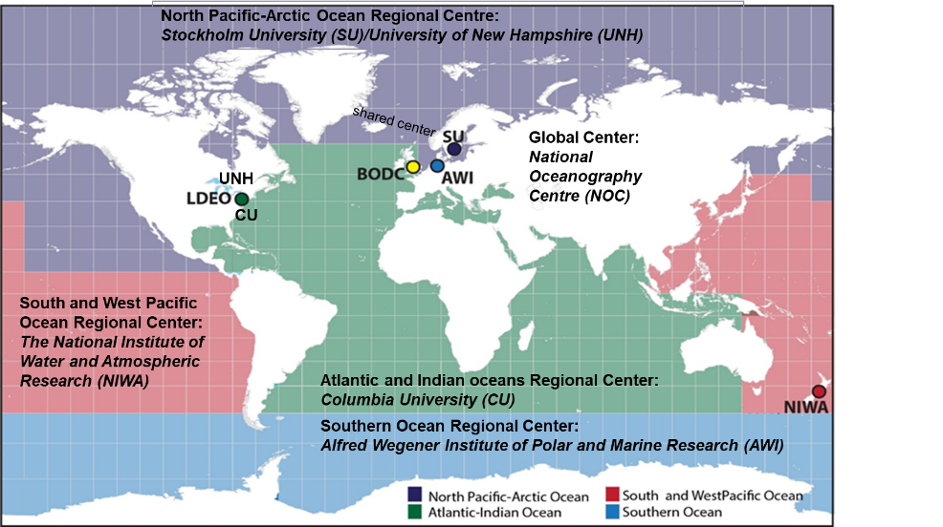
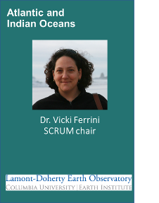
Seabed 2030
RHCs are an important and key resource to achieve the Seabed 2030 vision
MACHC area in three RDACs
Notes:
A high level overview. THis topic will be addressed later in more detail in the agenda. Note Vicki Ferrini is with us today and representeds the green portions of the map, covering much of MACHC area.

Slide 7
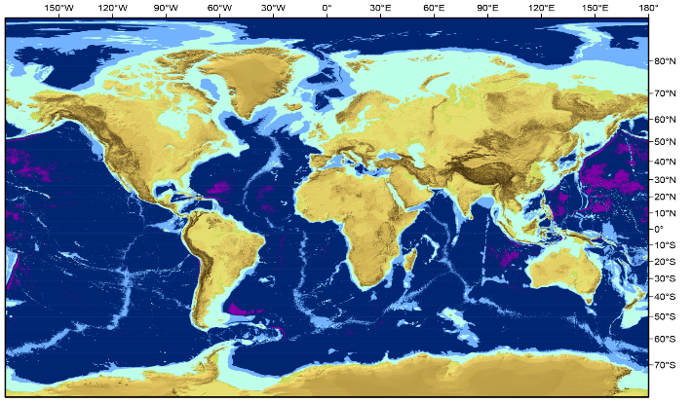
Target GEBCO Grid Variable Resolution
100x100 m
200x200 m
400x400 m
800x800 m
Depth Range | Resolution | % of ocean
0–1500 m | 100 × 100 m | 13.7
1500–3000 m | 200 × 200 m | 11
3000–5750 m | 400 × 400 m | 72.6
5750–11,000 m | 800 × 800 m | 2.7
Depth-dependent, variable resolution
Additional Details: See C2-7.3 INF and Meeting Summary

Slide 8
IHO Communications
New logo
Revamping of website and IHR
IHO-100 Centenary
Social media (LinkedIn, YouTube, etc…)
World Hydrography Day 2019:
“Hydrographic information to drive marine knowledge”
Notes:
RES 2/2007, 1/2005, 2/1997 (RHCs), 6/2009 (IHR), 1/2018 (ENC Overlaps)
Council Rules of Procedure/Protocols of Convention
Work Program and Budget adopted
Not addressed in this summary:
IRCC and HSSC Work Program, ROPs, and priorities (covered by others)
Updated of selected Resolutions (to be raised elsewhere in the MACHC agenda)
RES 2/2007, 1/2005, 2/1997, 6/2009, 1/2018

Slide 9
Specifically for the MACHC,
Strategic Plan: review and contribute to the drafting process
Seabed 2030: next steps for the MACHC
Full Council Reports
Summary Report on the Council-2 Meeting Site
CL 51/2018 “Outcome of the Second Meeting of the IHO Council”
Notes:
The Strategic Plan rewrite is proceeding. Please be aware the revision and drafting is going on- a meeting of the SPRWG is slated for January 30-31 at the Bureau and we expect a draft revision to be submitted to Council-3 in July. If approved at C-3, it will go to the Assembly for decision.
And, we need to understand from the Seabed 2030 project how the RHCs can contribute to the project. I hope this will be discussed in the context of the SB 2030 portion of the agenda in light of the presentation of Dr. Ferrini.

Slide 10
Countdowns for HSSC, IRCC, Council, Assembly by 2020
May/June 2019
July 2019
*See C2 meeting document (C2.7)
HSSC11, IRCC11
Report/Prop. to C-3
Aug. 2019
Oct. 2019
Nov. 2019
Red Book C-3
Council-3
Report/Prop. to A-2
21 Oct. 2019
21 Dec. 2019
21 Feb. 2020
21 Apr. 2020
Prov. Agenda A-2
Proposals to A-2
Rev. Prov. Agenda&
Red Book A-2
Assembly-2
Notes:
This is a graphic offered by the IHO at Council-2. I offer it as illustrate of the tight timelines we have coming up in 2019 in preparation to Assembly-2. Robust preparations, deliberations, and reports and recommendations from IRCC, HSSC, and Council will be the key to a timely preparation for Assembly 2.

Slide 11
Thank you

