Slide 1

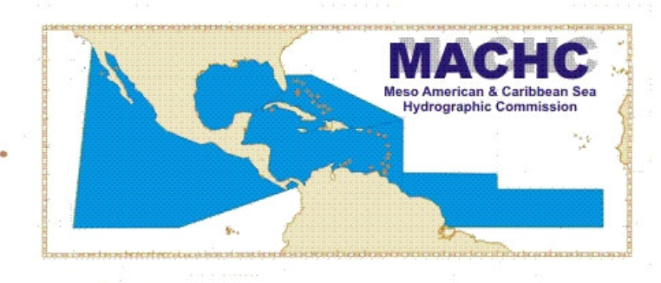
19th MACHC Conference
Workshop Maritime Disasters : Session 8
Netherlands experiences and recommendations

Slide 2
Content
IHO resolution 2/1997 versus 1/2005
Case study passage of Hurricane Matthew
Identify lessons and way forward

Slide 3
IHO resolution: 2/1997 versus 1/2005 (1)
Resolution 2/1997: ESTABLISHMENT OF REGIONAL HYDROGRAPHIC COMMISSIONS (RHC).
Resolution 1/2005: IHO RESPONSE TO DISASTERS.
Both being rewritten.

Slide 4
IHO resolution: 2/1997 versus 1/2005 (2)
RHC iaw 2/1997: “are intended to provide regional co-ordination with regard to nautical information, hydrographic surveys, production of nautical charts and documents, training, technical cooperation and hydrographic capacity building projects”.
MACHC statutes: “Commission shall have an advisory, scientific and technological character; it shall not exert any authority over the Hydrographic Services …”
  “Is to promote cooperation in hydrographic surveying, marine cartography and nautical information”.
  Has no executive remit.
  Chair as a function has no Command & Control role.

Slide 5
IHO resolution: 2/1997 versus 1/2005 (3)
IHO resolution 1/2005 (currently).
  Has seemly overlapping responsibilities of Coastal state, RHC and IHO secretariat.
  What form does “responsibility for co-ordinating the actions needed within the Region” take.
    A disaster reaction organisation with a structured, C2 type, organisation or a organic cooperation structure?
Rewrite recognizes comments made during A1.
  Proposal was too prescriptive and contained descriptions beyond the roles and/or scopes of RHCs and the IHO.
  Rewrite encourages support activity by RHCs but with a strong responsibility for the coastal state to invoke them.

Slide 6
Case study passage Matthew: NL survey Haiti
Survey operations in support of humanitarian relief operations after hurricane Matthew.
Main objective: accessibility of ports and landing spots for loading and unloading of relief goods.
Hydrographic capacity:
  Two qualified hydrographic officers and one boat driver
  Rhib equipped with integrated multi beam system, SSS, SV profiler.
    Use of Ellipsoid Referenced Surveying (ERS).
Notes:
Eventuele voettekst
6

Slide 7
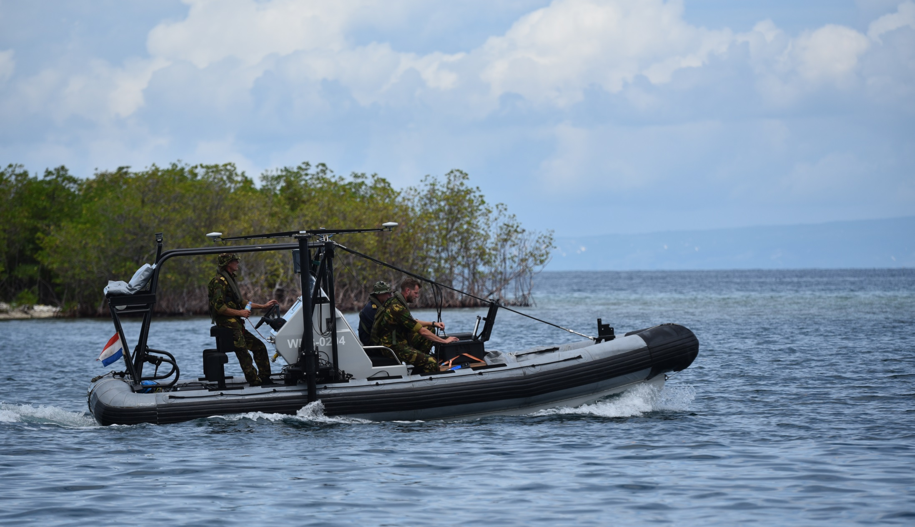
Notes:
RHIB in action in Miragoane
On starboard side the survey pole, with MBES, integrated MRU and double GNSS antennas.
Eventuele voettekst
7

Slide 8
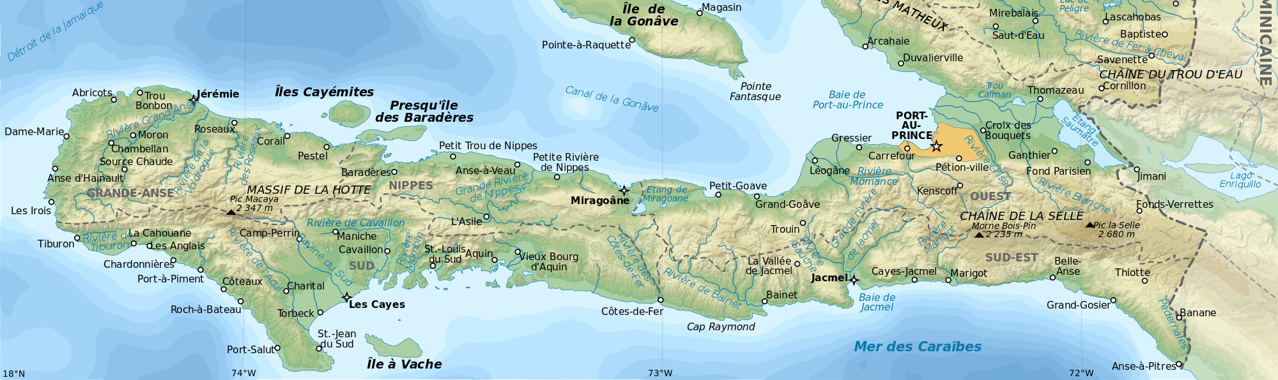
Haiti Surveys
Surveyed ports / landing spots
Les Cayes
Ans d’Hanaught
Port Jeremy
Miragoane
Port au Prince
Notes:
All surveyed places in Haiti
Eventuele voettekst
8

Slide 9
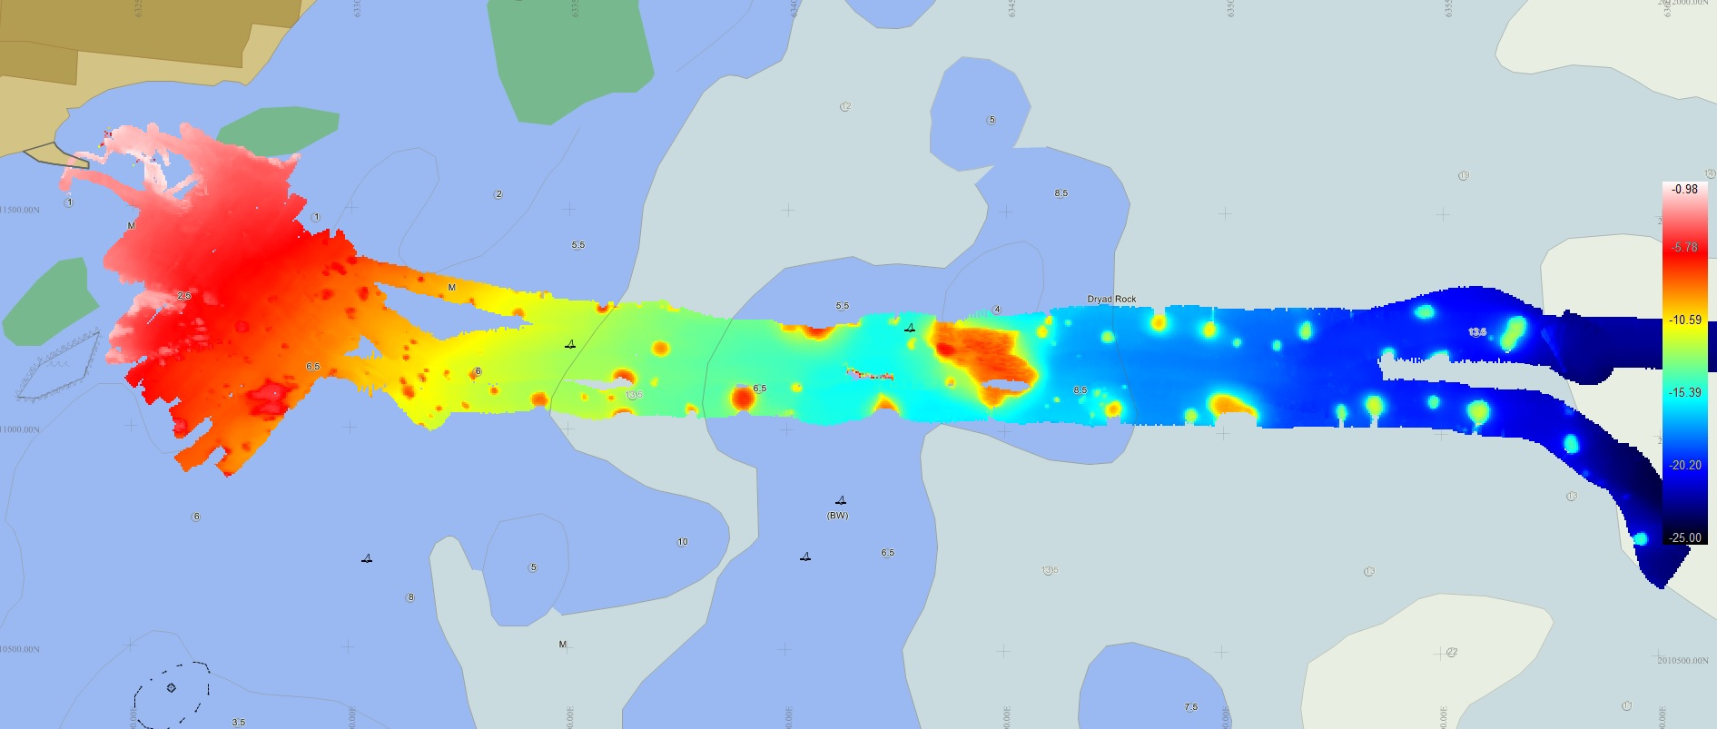
Haiti Surveys
les Cayes approach, anchorage and quayside
Notes:
The approach to Les Cayes with 7-8 m coral bumps
Eventuele voettekst
9

Slide 10
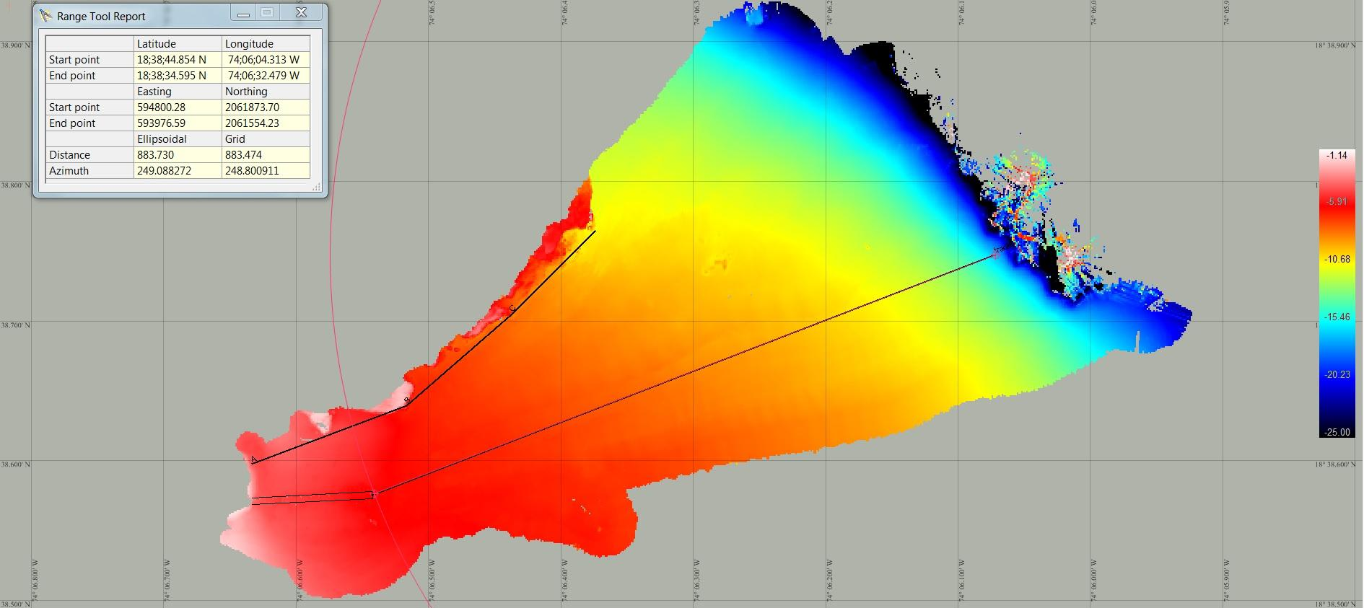
Haiti Surveys
Safe approach to Jeremy quayside
Notes:
Approach to Jeremy,
On the left the quay with a safe approach line
Left top a limiting danger line for a coral reef
3 hour survey
Eventuele voettekst
10

Slide 11
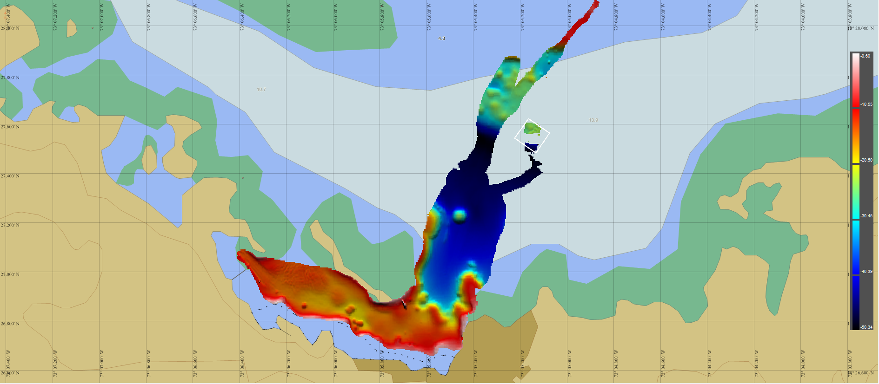
Haiti Surveys
Miragoane
Notes:
Miragoane approach and bay
3 hours survey
Eventuele voettekst
11

Slide 12
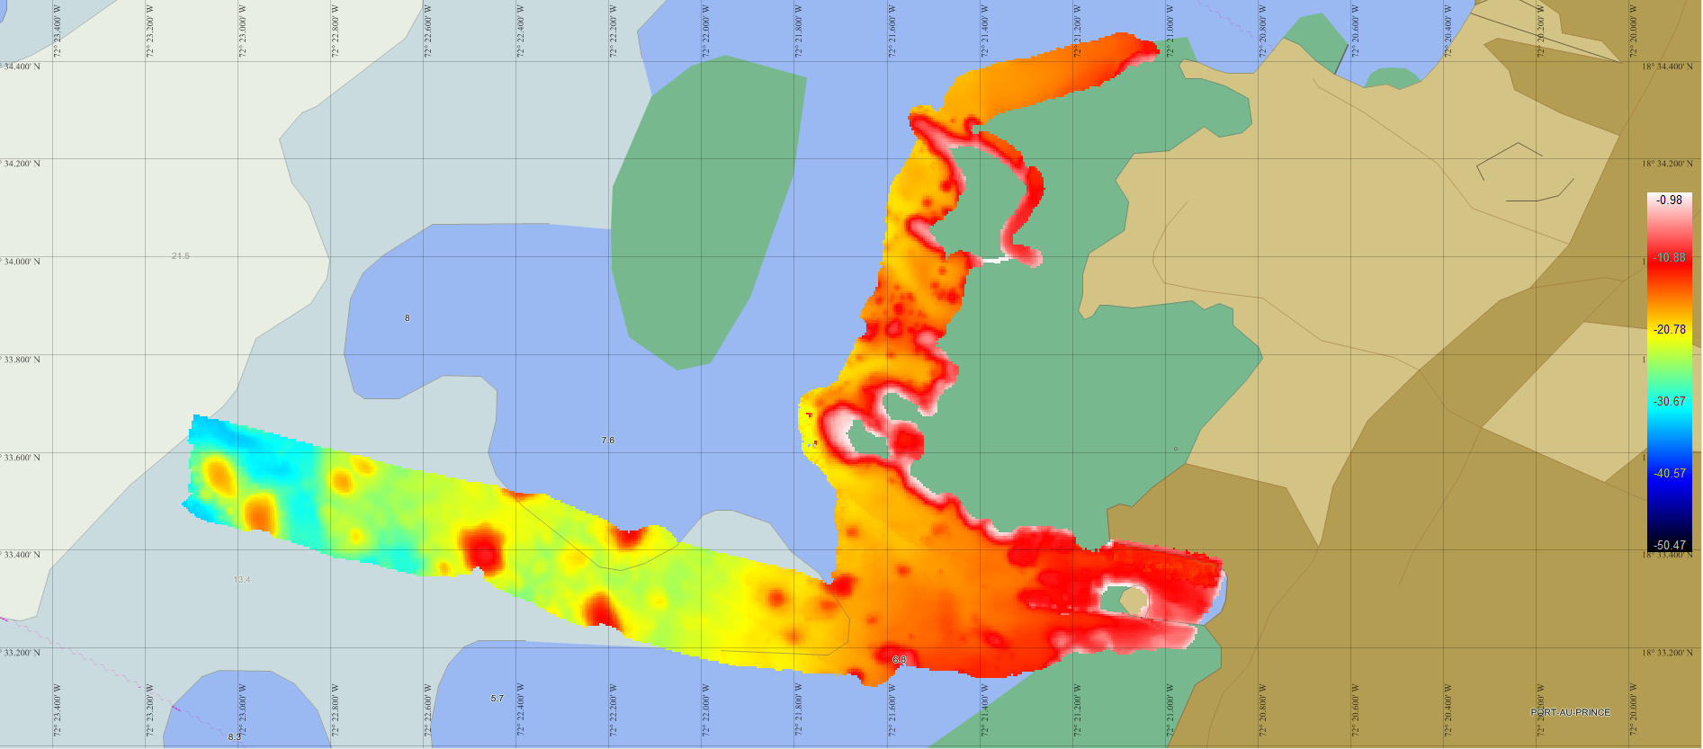
Haiti Surveys
Port au Prince new commercial harbour
Notes:
Port au Prince
On the left the buoyed approach channel.
On the right the newly developed commercial harbour with modern quayside
On top the coral reefs blocking the coast
6 hour survey
Eventuele voettekst
12

Slide 13
Haiti Surveys
Survey results in retrospect:
Most frequently used system MBES.
SSS less used due to the expeditionary character.
ERS provided a stable height reference.
Coupling of ERS reference to chart datum via predicted tide.
Good SV profile is vital for small vertical uncertainty
Bathymetry within special order standard.
All survey results have been made available for Haiti authorities.
Notes:
Eventuele voettekst
13

Slide 14
Chair activity: Hurricane Matthew
Provide narrative for common situational awareness.
  Dependant on input for the members.
  No own active data collection.
Facilitate as and where required.
  Investigate and promulgate relief demand of affected countries.
  Collect availability of potential capacities for disaster response in theatre.
Means: e-mail.
  Sitrep and direct.

Slide 15
Identified lessons: Hurricane Matthew (1)
Set realistic ambitions for remit MACHC
  Restrict coordination/cooperation to Hydrography.
  Do not assume executive responsibilities of others, eg. NAVAREA coordinator.
Role is that of broker for demand and supply.
  Input of support requirement by coastal state essential.
    What do you need?
  Chair is facilitator and provides the shared narrative.
    Who is doing what?
The Chair cannot absorb MS responsibilities for Diplomatic clearance to deploy hydrographic assets.

Slide 16
Identified lessons: Hurricane Matthew (2)
Adapt a phased approach.
  Immediate disaster response. Main focus is supporting other activities as an enabler.
  Recovery response. Main focus is updating charts and hydrographic information.
‘Civil’ communications are paramount:
  E-mail,
  Telephone,
  Website, including a “common coordination area’’.
Organisation was ad hoc and organic.
  No direct insight in activities of IOs and NGOs.

Slide 17
X-check IHO resolution 1/2005
Aim: have procedures and guidelines in place to enable immediate and appropriate response.
Procedures and guidelines | MACHC
Immediate assessment of damage wrt. safety of navigation | …
Immediately inform of damage and dangers wrt. navigational hazards | …
Re-establish the basic key maritime transport routes | …
Ensure chart and Hydrographic information is updated ASAP | …

Slide 18
Identify lessons: IHO resolution 1/2005
Procedures and guidelines | Role MACHC ?
Immediate assessment of damage wrt. safety of navigation | Coastal States/IO/NGO
Immediately inform of damage and dangers wrt. navigational hazards | WWNWS
Re-establish the basic key maritime transport routes | As enabler for Immediate disaster relief
Ensure chart and Hydrographic information is updated ASAP | For recovery phase

Slide 19
Way forward (2016)
Include the principles of MACHC disaster response in the Statutes of the MACHC based on lessons identified.
Include as particular aim in the Statutes:
    “To examine the role hydrography can play in disaster risk reduction, for instance by capacity building.”
Do not write a priori detailed a MACHC ‘Disaster action plan’.
IHO secretariat consider to ensure hydrographic ‘plug ins’ in contingency plans of standing Disaster relief organisations as UN OHCA, IRC, WHO, OXFAM, etc.
√
√
√,
but
?

Slide 20
Way forward (2018)
Do not write a priori detailed a MACHC ‘Disaster action plan’. But:
  Preparatory frame work (GIS, etc)
  Communications/Complan
    Contact details al relevant parties: HO, MIL-CIV, IO, NGO etc
  Insight in potential available capacity MS

