Slide 1
Maritime disasters; virtual and mobile aton
Gerardine DELANOYE
Programme manager; IALA World-Wide Academy

Slide 2
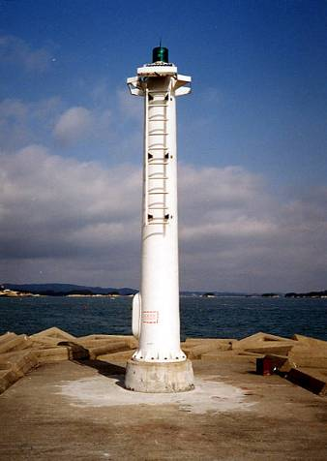
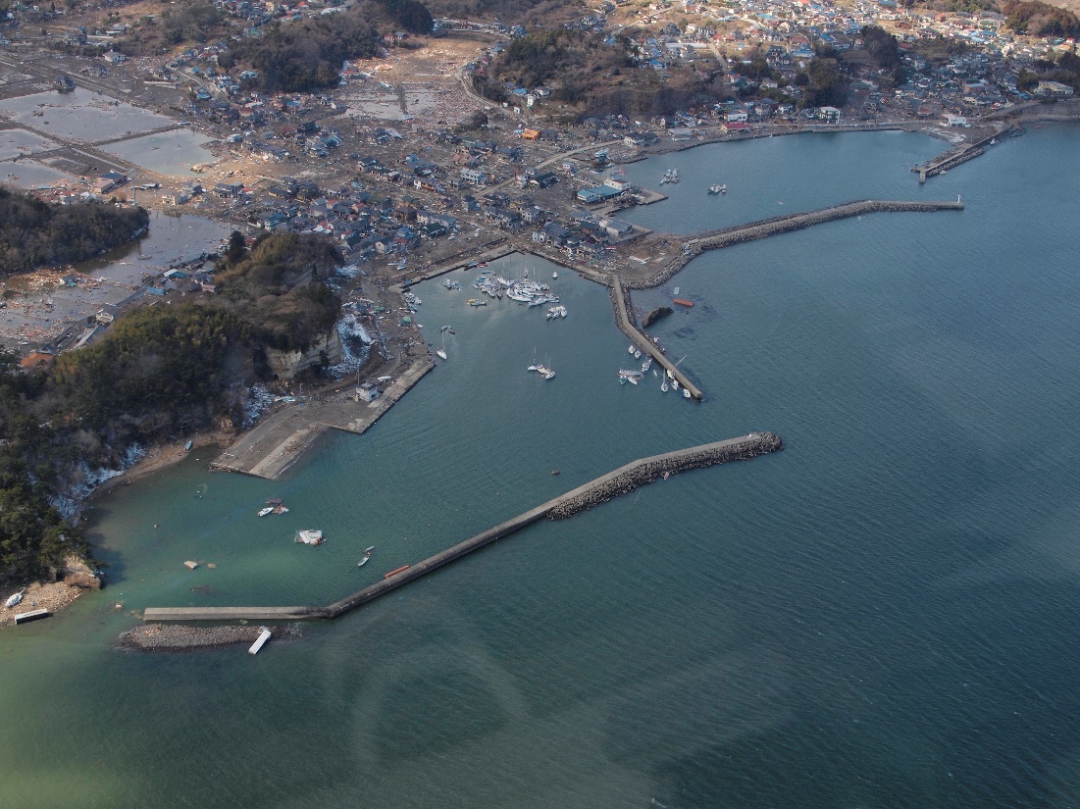
Lost of structure (Shiogama Kohama, Japan)

Slide 3
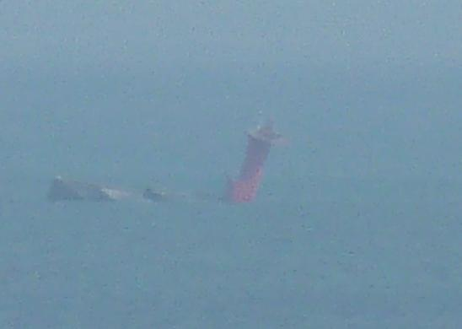
Tilting structure
Kamaishi-ko wan-ko North BW LH
Rikuchu-Funakoshi East BW LH

Slide 4
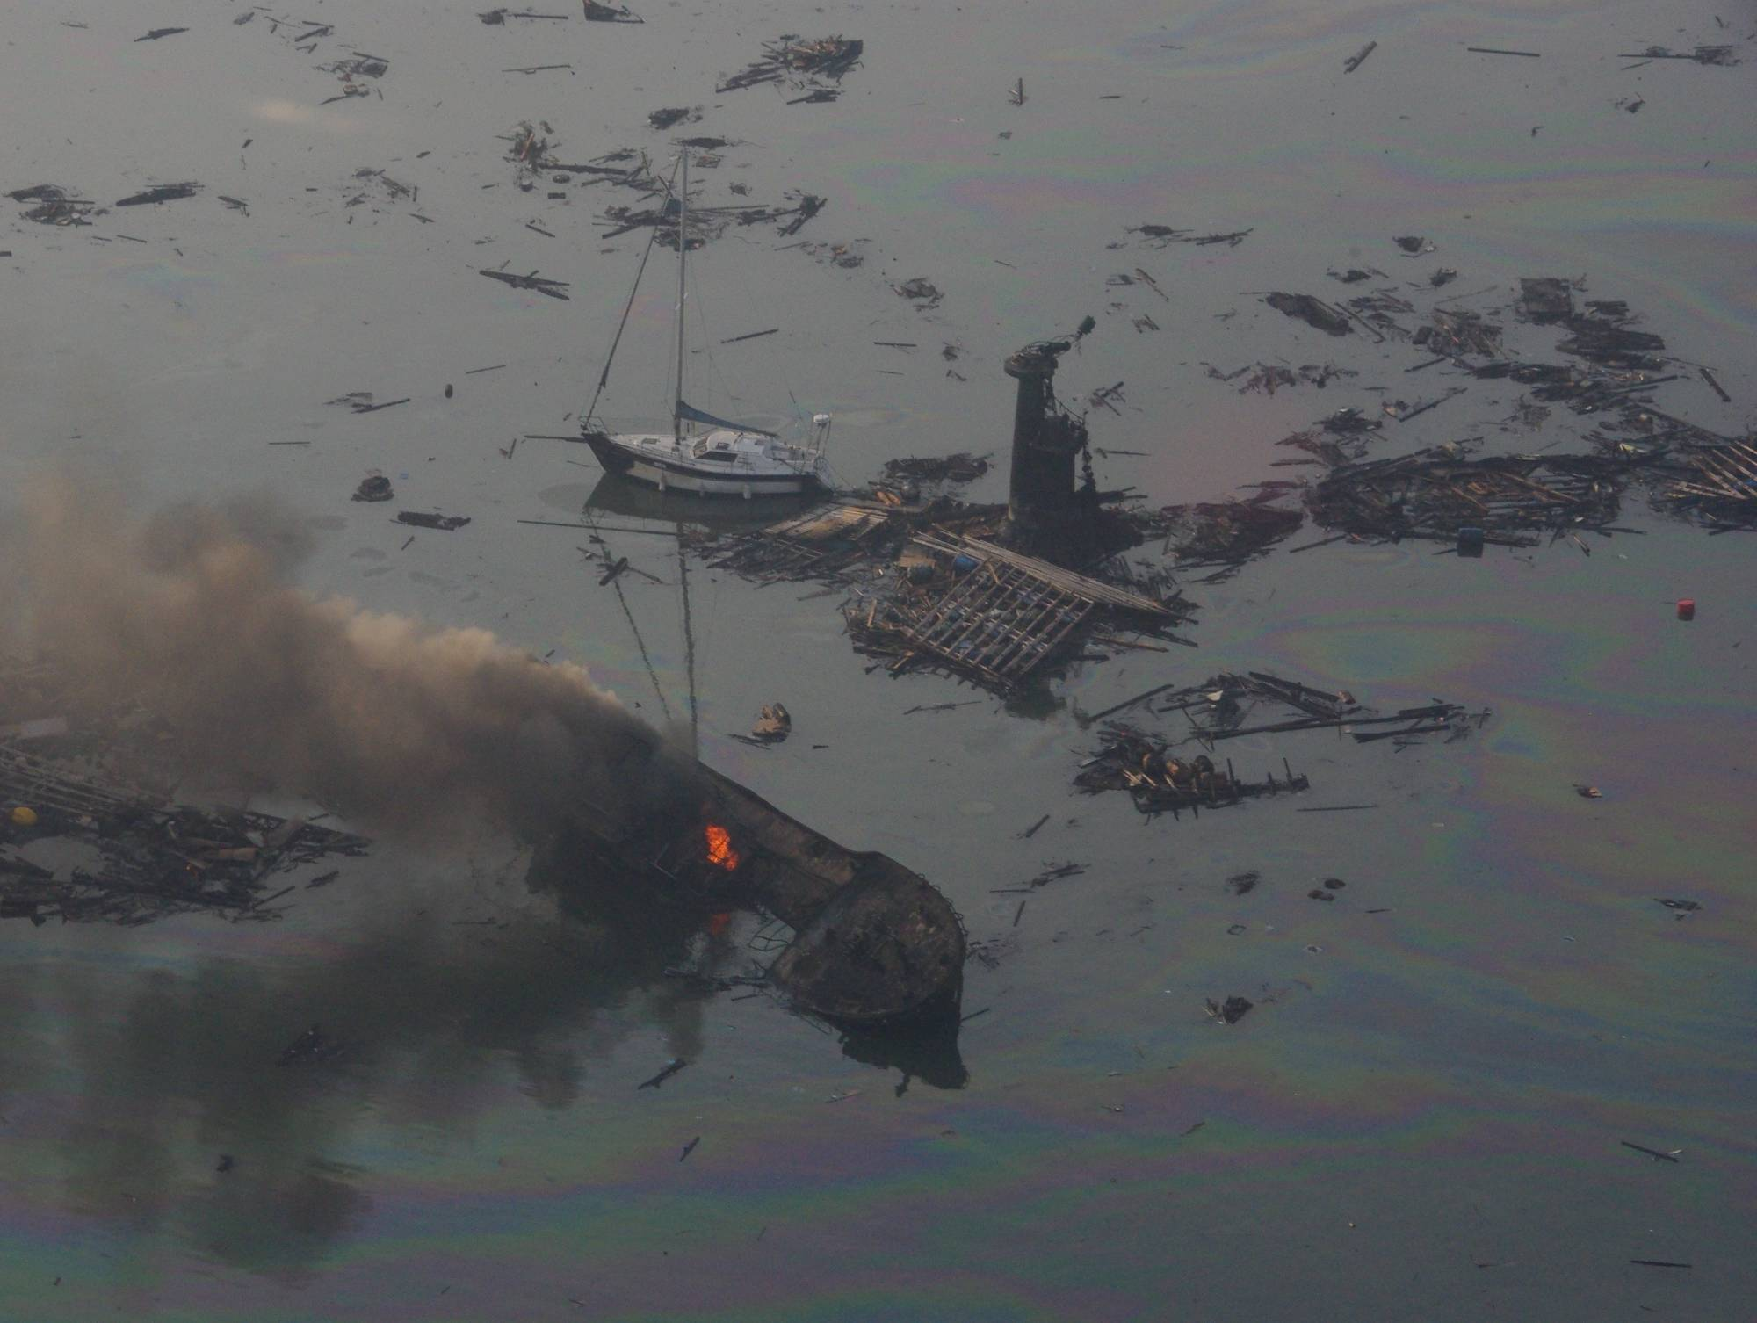
Burned (Banshone Light Beacon)

Slide 5
IMO Nairobi Convention
MATAIN Accreditation Project

Slide 6
IMO Nairobi Wreck Convention
“legal basis for States to remove, or have removed, shipwrecks that may have the potential to affect adversely the safety of lives, goods and property at sea, as well as the marine environment.”
“liability of the owner for the costs of locating, marking and removing ships and wrecks “
The Nairobi International Convention on the Removal of Wrecks, 2007

Slide 7
What is a wreck?
“Wreck”, following upon a maritime casualty, means:
- a sunken or stranded ship
- any part of a sunken or stranded ship, including any object that is or has been on board such a ship
- any object that is lost at sea from a ship and that is stranded, sunken or adrift at sea
- a ship that is about, or may reasonably be expected, to sink or to
strand, where effective measures to assist the ship or any property in danger are not already being taken.

Slide 8
IMO Nairobi Wreck Convention
“Convention area” means the exclusive economic zone of a State Party, established in accordance with international law or, if a State Party has not established such a zone, an area beyond and adjacent to the territorial sea of that State determined by that State in accordance with international law and extending not more than 200 nautical miles from the baselines from which the breadth of its territorial sea is measured.”

Slide 9
IMO policy on the use of AIS Aids to Navigation
An AIS AtoN is a digital aid to navigation (AtoN) promulgated by an authorized service provider using AIS Message 21 "Aids to navigation report" that is portrayed on devices or systems (e.g. Electronic Chart Display and Information System (ECDIS), radar or Integrated Navigation System (INS)).
1 Physical AIS AtoN: a Physical AIS AtoN is an AIS Message 21 representing an AtoN that physically exists; and
2 Virtual AIS AtoN: a Virtual AIS AtoN is transmitted as a Message 21 representing an AtoN that does not physically exist.
MSC.1/Circ.1473

Slide 10
IMO policy on the use of Virtual AtoN
Virtual AIS AtoN should not be used for permanently marking an object for which Physical AtoN would be possible, but, may be considered for marking an object or feature where it is difficult or economically unreasonable to establish a Physical AtoN due to environmental constraints e.g. deep water, harsh sea conditions. Another case of the permanent application of Virtual AIS AtoN is for example marking a shoal that changes with time due to current or weather effects; and, where the object or feature is impossible to maintain as charted because of changes that occur over.
The permanent usage of Virtual AIS AtoN should be included in ENCs, paper nautical charts and nautical publications, and should, in general, not be duplicated as a multiple layer by AIS AtoN;

Slide 11
IMO policy on the use of (Virtual) AIS AtoN
AIS AtoN could enhance the mariner's awareness on Maritime Safety Information (MSI) since AIS AtoN have the possibility to bring information almost immediately to the attention of the mariner
It is highly important that mariners know how to interpret, understand and use AIS AtoNs before any decision of establishment or deployment is made

Slide 12
IALA Publications
Publications under IALA Standard 1010: AtoN Planning and Service Requirements
MATAIN Accreditation Project

Slide 13
IALA Publications
IALA Guideline G1120 – Disaster Recovery (informative)
IALA Recommendation R1015 Marking of Hazardous wrecks (normative)
IALA Guideline 1046 on the Response Plan for the Marking of New Wrecks (normative)
IALA Recommendation R1016 Mobile Marine Aids to Navigation (normative), guideline under development
IALA Guideline 1081 – Provision of Virtual Aids to Navigation (informative)

Slide 15
Questions?

