Slide 1
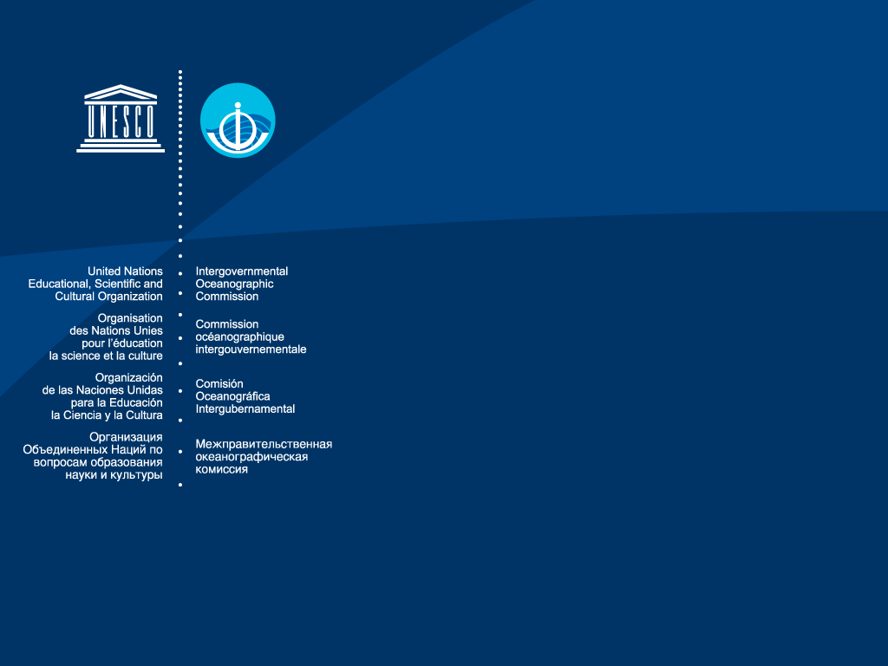

IOCARIBE
IOC of UNESCO Subcommission for the Caribbean and Adjacent Regions
MACHC Seminar
Hydrographic Governance and
Maritime Disasters
26-27 November 2018 Cartagena Colombia
Dr. Cesar TORO

Slide 2

The Intergovernmental Oceanographic Commission (IOC) of UNESCO
The Intergovernmental Oceanographic Commission of UNESCO (IOC-UNESCO), established in 1960 as a body with functional autonomy within UNESCO, is the only competent organization for Ocean Sciences within the UN system.
IOC promotes international cooperation and coordinates programmes in marine research, services, observation systems, hazard mitigation, and capacity development in order to understand and effectively manage the resources of the ocean and coastal areas and to apply that knowledge for the improvement of management, sustainable development and protection of the marine environment and the decision-making process of its Member States.

Slide 3
The Intergovernmental Oceanographic Commission (IOC) of UNESCO
IOC is promoting knowledge and capacity for protecting and sustainably managing the ocean and coasts
Main Priorities
Scientific understanding of ocean and coastal processes bolstered and used by Member States to improve the management of the human relationship with the ocean.
Risks and impacts of ocean-related hazard reduced, climate change adaptation and mitigation measures taken, and policies for healthy ocean ecosystems developed and implemented by Member States;
Member States’ institutional capacities reinforced to protect and sustainably manage ocean and coastal resources

Slide 4
Latin America and the Caribbean
Continental Coastal Latin-American countries and the Caribbean SIDS are two distinct regions from the ocean sciences capacity and economic development point of view. Nevertheless, both are greatly depending on the ocean and coastal resources.
Caribbean Island countries are classified as middle income countries and most are Small Island Developing States (SIDS). This situation is indeed unique and brings a different set of dimension and challenges in-terms of ocean sciences.
Caribbean Island countries principal features - smallness in geographical size and population; insularity; low resilience and high vulnerability to natural and human-made disasters and the impact of the global climate change; and high dependence on tourism.

Slide 5
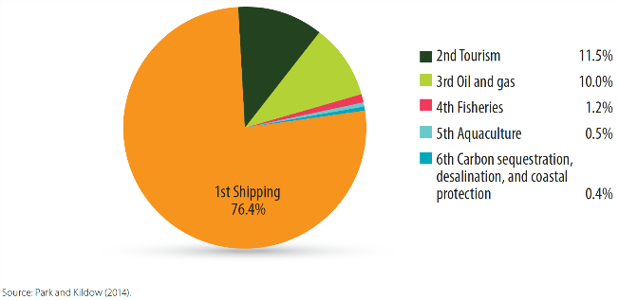
The (Measurable) Ocean Economy of the Caribbean in 2012 is dominated by Shipping, Tourism, and Oil and Gas Industries
The annual economic value of the ocean economy in the Caribbean in 2012 was on the order of US$407 billion. This consists almost entirely of market-based activities, since the non-market values of many ecosystem goods & services are not easily valued monetarily.

Slide 6
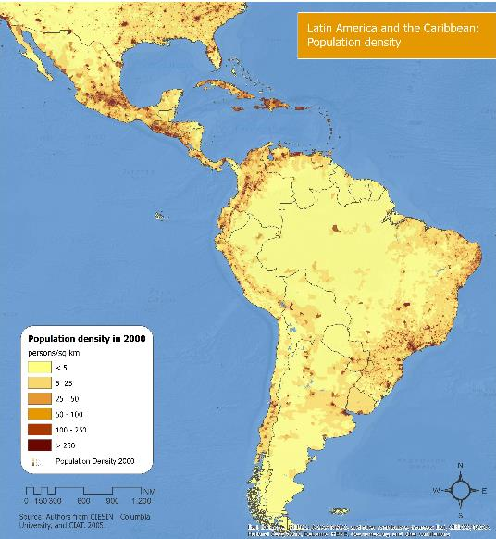
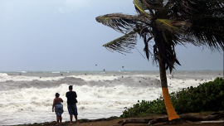
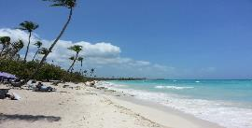
Tourism is a source of development that generates about 235 million jobs worldwide, contributes an average of 5% of the World GDP (WTO).
In 2015 the Caribbean reached 28.7 million visits. World 1st tourist destination
Most Caribbean countries tourism contributes about 30% to their GDP.
Sint Maarten - 83.4%
Aruba - 88.1% (2016)

Slide 7
Maritime Transport: The ocean is the highway where 80% of goods worldwide and 90% of the raw materials of the vast majority of industries and sectors of the world is transported.
Growth of maritime transport, has been boosted Panama Canal expansion and international trade agreements.
Foreign trade in GDP is 78% in the Caribbean and 25% in Latin America.
Container cargo at ports in Latin America and the Caribbean grew 1.7% in 2015, with a total volume of 48 million TEUs.

Slide 8
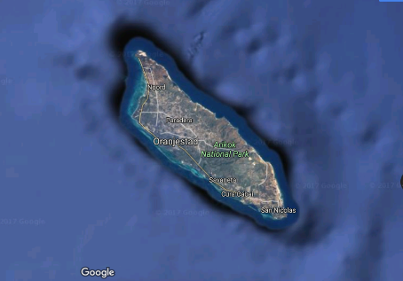
Aruba
Flat at low altitude - vulnerable to sea level rise.
Most important infrastructures / assets are located near the shore or close by the shores.
The airport, government buildings, parliament, hospital, hotels, schools, water & power plant, and main transport routes; harbor and marinas.
Aruba area – 190 km2
Coastline – 68.5 km
GDP (2014) – 2.664 Billion USD
1 coastline km contributes with ca. 40 mill USD
A small area of about 10km2 near the western and southern shores contributes to almost the entire GDP.
This small area is highly vulnerable to natural hazards.
1.7 million visitors 2014

Slide 9
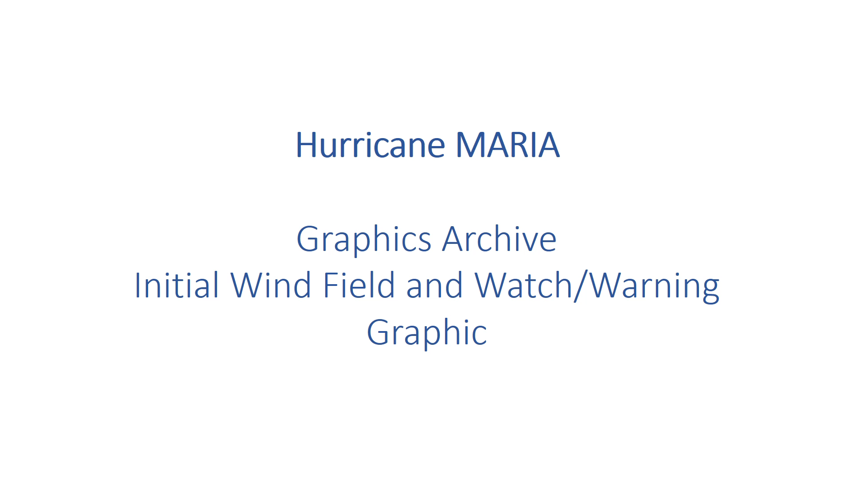
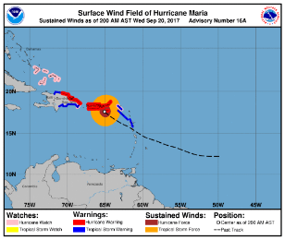






Notes:
Progress on programme implementation since the last Assembly
The Coastal Inundation Forecasting Demonstration Project for the Caribbean (CIFDP-C) held its 3rd meeting in Santo Domingo, Dominican Republic, on 15th November 2017 in ONAMET. The project is entering its 4th phase and it should be finalized in 2018. The cooperation with CARIBE-EWS and IOCARIBE-GOOS was discussed and the meeting recommended strengthening the hydrological component.
The 7th Session of the GOOS Steering Committee, and GOOS regional Workshop for Latin and South America was held in Santa Marta, Colombia 12-15 June 2018. The Steering Committee recommended to strengthen and build links across South American ocean observing stakeholders: scientific community, observing networks, industry, navies, and GOOS Regional Alliances (GRAs).
As part of the World Oceans Day activities IOCARIBE on 8th June 2018 the Caribbean Marine Atlas CMA2 was simultaneously launched by INVEMAR, Barbados, Jamaica and Trinidad & Tobago.
The Caribbean Marine Atlas held a Workshop “Indicators and Thematic Data” held 15-16 February 2018 in Santa Marta Colombia. Experts from Barbados, Belize, Colombia, Dominican Republic, Guatemala, Jamaica, Mexico, Trinidad & Tobago and Venezuela participated. The IODE Steering Group for the Caribbean Marine Atlas (Phase 2) project held its Session on 16-18 May 2018 in Brussels Belgium immediately after the FUST Ocean event that took place on 14 and 15 May 2018. The FUST event showcased the impact of collaboration between the Government of Flanders and UNESCO and its Intergovernmental Oceanographic Commission (IOC) related to ocean and coastal areas.
In this period, CARIBE-EWS Tsunami and Other Coastal Hazards Warning System for the Caribbean and Adjacent Regions held three meetings including the Thirteenth Session 24 - 27 April 2018, Willemstad, Curacao, the CARIBE WAVE 2018, 15 March 2018 and seven training workshops, short courses, with a general participation of 153 participants.
The meeting of the Caribbean and North Brazil Shelf Large Marine Ecosystems Project Executive Group (CLME+ PEG) was held 2-4 October, 2017 Miami USA. The 2017 Development Objective Rating for the CLME+ Project was Satisfactory (“project is on track to fully achieve its end-of-project targets by project closure”), the same rating received in 2016. With regard to the Implementation Progress Rating, the project was scored as moderately satisfactory. However, there is some concern that without an acceleration in project implementation progress, the CLME+ Project could receive a moderately unsatisfactory rating in 2018.
A CLME+ SOMEE (State of the Marine Environment and associated Economies in the CLME+ region) Report Development Workshop was held in Cartagena, Colombia 1 – 2 February, 2018. The over-arching objective was to kick-start the 2018-2019 CLME+ SOMEE reporting process, by achieving agreement on the way forward among key agencies and organizations that are expected/invited to contribute to its development, adoption and institutionalization.
Two courses were developed focused on education to improve ocean literacy i) “Ocean Literacy and Story Telling Maps Training Course” 27 - 30 November 2017; ii) and open access to digital asset management (“Digital Repositories: the pathway from Open Access to Digital Asset Management” 13 - 15 September 2017) at OTGA INVEMAR Santa Marta, Colombia.
IOCARIBE, IODE, CARIBE-EWS and the Marine Policy and Regional Coordination Section have carried out a series of Workshops during May 2017- June 2018 period in the Region. Particularly at the OTGA Regional Training Center INVEMAR in Santa Marta Colombia: 1) Marine Spatial Planning (MSP) and Integrated Coastal Area Management (ICAM) 11-14 July 2017; 2) workshop on marine biogeographic data management for enhancing OBIS use 12-16 June 2017; 3) Ocean Literacy and Story Telling Maps Training Course 13 - 15 September 2017; Digital Repositories: the pathway from Open Access to Digital Asset Management 27-30 November 2017.
During the period 2014-2018 there were carried out 50 training activities (including Workshops, seminars, post-graduate courses in HABs, Tsunami and other coastal hazards, ICAM & MSP; IODE, GIS, GODAR, OBIS, Disaster Risk reduction, Marine Scientific Research within UNDOALOS framework, mapping) and a total of 1022 persons from 31 countries were trained (2014: 120; 2015: 294; 2016: 364; and 2017:331; 2018: 20), including 302 at INVEMAR and 27 at NSU.
Emerging issues/challenges Oil Spills / Sargassum (Ref to the draft proposal) Acidification
Special Regional Event on Ocean Acidification Santa Marta Colombia, 19th – 21st March 2018 organised by the Ocean Acidification international Reference User Group (OAiRUG) in partnership with INVEMAR and the International Atomic Energy Agency’s Ocean Acidification International Coordination Centre. The purpose of the workshop was to explore the impacts and implication of ocean acidification alongside other major changes to the ocean across Latin America and the Caribbean.
IOCARIBE-GOOS outlined a pilot project to support an integrated approach to monitoring concentrations of Sargassum weed and oil spills – both significant regional water-borne threats. In May 2-4 2018 in Mexico City, Mexico IOCARIBE organised jointly with GEO Blue Planet Initiative and hosted by the Ministry of Education of Mexico and Mexico National Council of Sciences the Workshop Sargassum and Oil Spills Monitoring Pilot Project for the Caribbean Sea and Adjacent Regions where forty experts from various United Nations organisations, academia, governments, private industries and international initiatives discussed the development of a region-wide system for monitoring and forecasting sargassum and oil spills.
Potential contributions to and opportunities from the UN Decade
The IOCARIBE Medium Term Strategic Science Plan (2017-2026) is the main guidance document to design IOCARIBE Member States plan for contributing to the UN Decade of Ocean Science for Sustainable Development. IOCARIBE SSP objectives are to i) Support strategic planning of IOCARIBE Member States in relation to the development of marine sciences, oceanic observations and associated services; ii) Facilitate a coherent management of regional programmes related to the marine-coastal environment and its resources; and iii) Strengthen scientific basis supporting regional programmes. IOCARIBE SSP Lines of Action are: i) Oceans and Climate ii) Ocean Science, technology and sustainable use of Coastal and Ocean Resources with special emphasis on Large Marine Ecosystems and Integrated Coastal Area Management; iii) and Extreme Natural Hazards.

Slide 10





Coastal Inundation Forecasting Demonstration Project-C
Forecasting and
Warning sytems
Policy / Management
Seismic Obs.
Tsunamis
Coastal Flooding
Storm Surges
Sea Level Observations
Extreme Waves
Real-time Data transmisison + dissemination of products
Modelling
(Forecasting / Hindcasting)
Wind, hydrometeorological Observations
Post-event survey, Mapping
Socio-economic analyses
Regulations / Policy
DEM, Bathymetry
Adaptation
Planning
Tides
Sea Level Rise / Climate Change
Hydrological Flooding
ICAM MSP
Notes:
Regardless the difference in scale, required observations and mode of operation,
Common requirements re. observing networks, data transmission, and process.
→ multi-hazard approach (particularly for sea-level related coastal hazards)
10

Slide 11
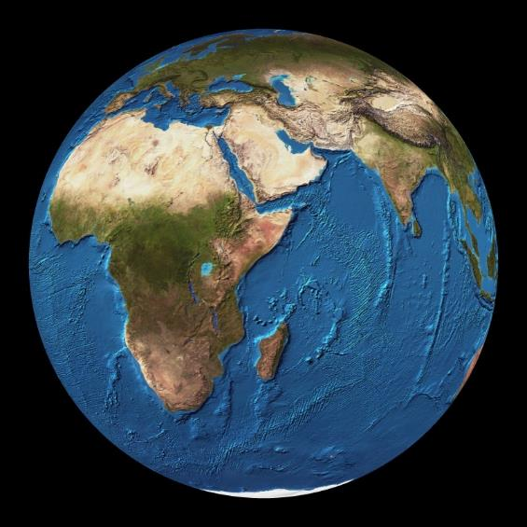
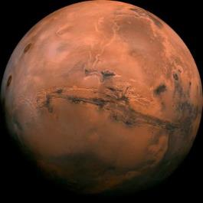
InSight NASA Mission to Mars 26 November 2018 successful landing
USD 150 Million
Ocean Science accounts for only between 0,04% and 4% of total research and development expenditures worldwide

Slide 12


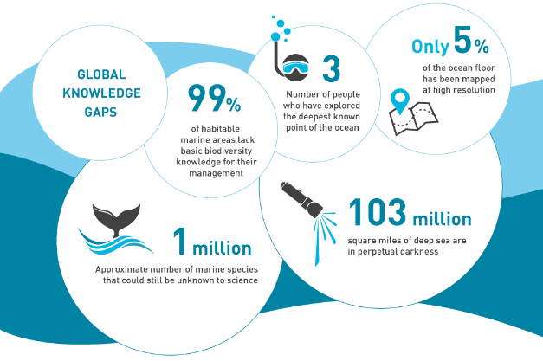
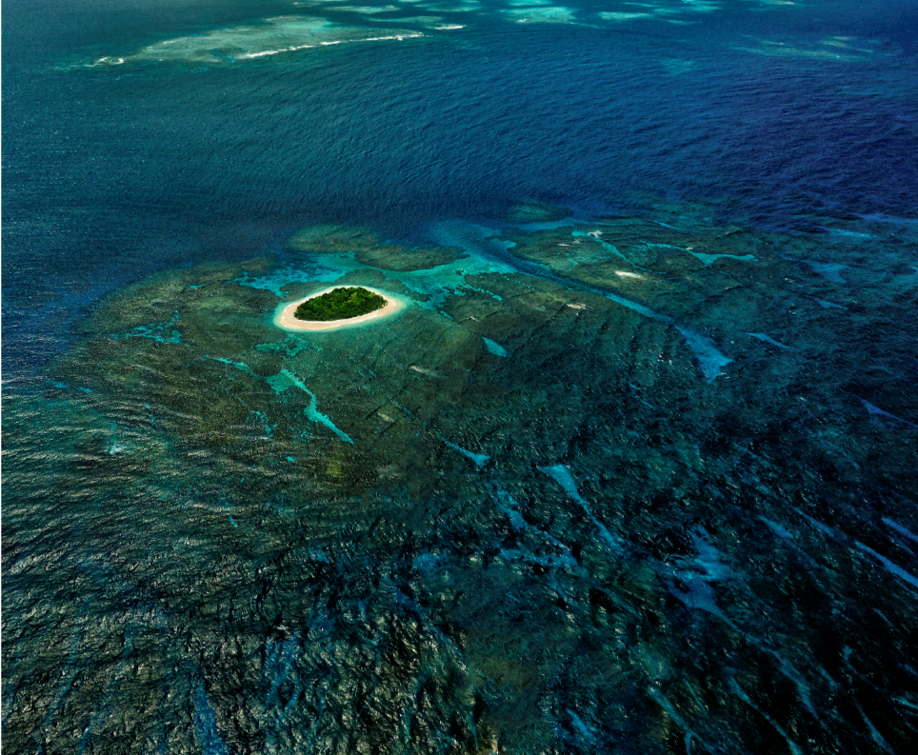
A global collective
research
and investment
framework
to close the
knowledge gaps
Vavau © Stuart Chape
Notes:
When it comes to 71% of our planet, several gaps in our knowledge remains despite great advancements in the last fifty years in ocean research and observations.
The Decade will aim to address identified knowledge gaps and strengthen the conduct of the World Ocean Assessment as well as other global and regional assessments, by providing a coordinated framework for conducting collaborative and integrated research across scientific fields.
The Decade will help to mobilize partnerships and increase investment in priority areas where actions are urgently needed, far beyond the current level of investment (the Global Ocean Report found that, at the national level, Ocean Science accounts for only between 0,04% and 4% of total research and development expenditures worldwide).
For example, the International Polar Year (2007-2009) led to a doubling of Norwegian spending on polar research, which remains at a high level to date. Imagine what a decade can do for global opposed to very geographically limited oceanography.

Slide 13
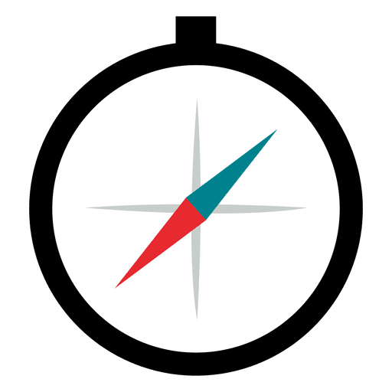







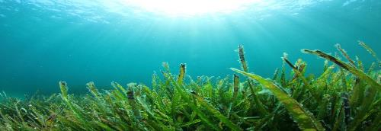

Research & Development Priority Areas
Map the entire ocean floor and processes
Bolster ocean observation systems in all basins
Conduct an inventory of ecosystems and their functioning
Develop a data and information portal
Establish an integrated multi-hazard warning system
Include ocean in earth-system observation
Strengthen capacities and
accelerate technology transfer and ocean literacy
Vavau © Stuart Chape
Notes:
The six strategic objectives are general.
Decisive and fast progress in a number of thematic areas is necessary to achieve them.
These initial priority areas of research and development areas are interconnected but allow focused design and planning. Once the progress in these areas is achieved and is communicated to potential beneficiaries, it will stimulate the variety of ways for sustainable use of the ocean.

Slide 14
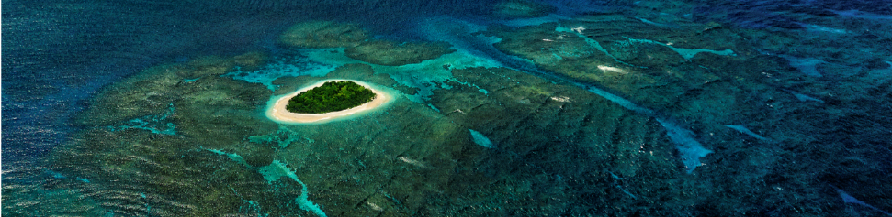
Research & Development Priority Areas
Map the entire ocean floor and processes
Bolster ocean observation systems in all basins
Conduct an inventory of ecosystems and their functioning
Develop a data and information portal
Establish an integrated multi-hazard warning system
Include ocean in earth-system observation
Strengthen capacities and
accelerate technology transfer and ocean literacy
SeaBed 2030
IBCCA
CARIBE-EWS
CIFDP-C
SARGASSUM
OIL SPILLS
HAB
Vavau © Stuart Chape
Notes:
The six strategic objectives are general.
Decisive and fast progress in a number of thematic areas is necessary to achieve them.
These initial priority areas of research and development areas are interconnected but allow focused design and planning. Once the progress in these areas is achieved and is communicated to potential beneficiaries, it will stimulate the variety of ways for sustainable use of the ocean.

Slide 15


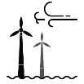
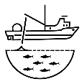





Key Applications
Marine
Spatial
Planning/
Blue economy
Coastal zone
management
and adaptation
Establishment of
Marine Protected
Areas
Nationally
Determined
Contributions
to UNFCCC
Development of
national ocean
policies
Fishery
management
Development of
national R&D
strategies
Regional and
national capacity
development
planning
Early warning
systems
Notes:
This Decade will empower decision-makers with Science solutions.

Slide 16
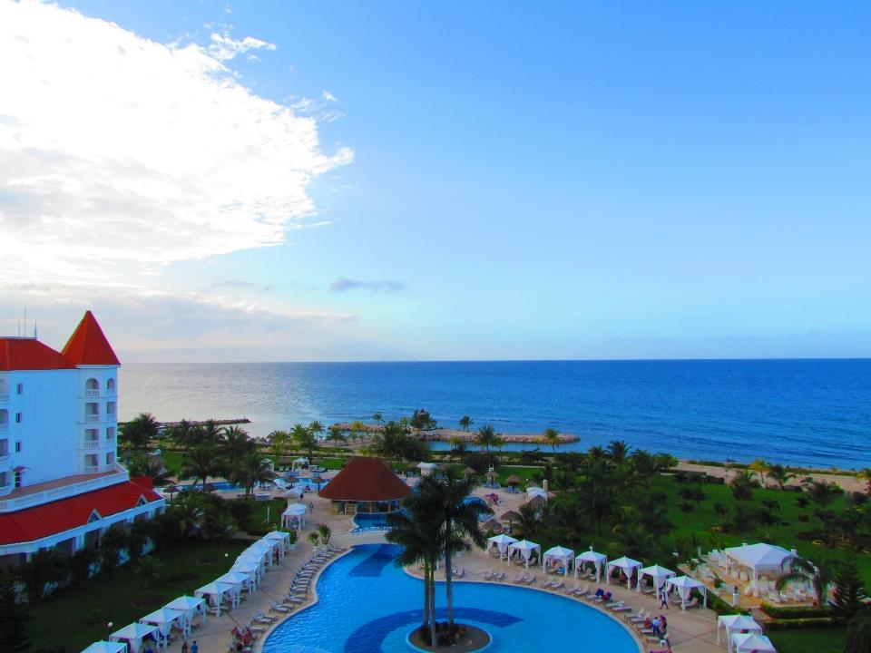
ioc.unesco.org
iocaribe.ioc-unesco.org/
c.toro@unesco.org
감사합니다!
¡Muchas gracias!
Merci beaucoup!
Thank you!
شُكْرًا
Спасибо
谢谢

