Slide 1
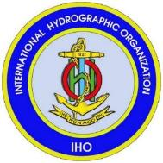
Hydrographic Awareness and Its Economic Benefits
Mustafa Iptes,
Director, IHO

Slide 2
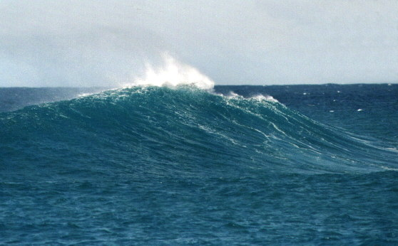
Hydrography provides the fundamental backdrop
for almost everything that happens in, on or under the sea

Slide 3
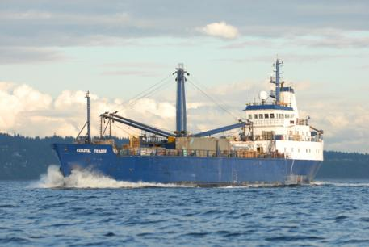
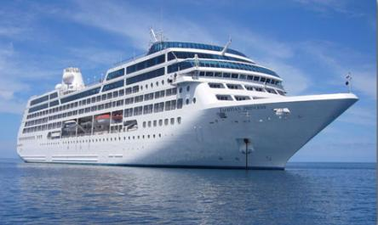
… without hydrography -
- no ship sails

Slide 4
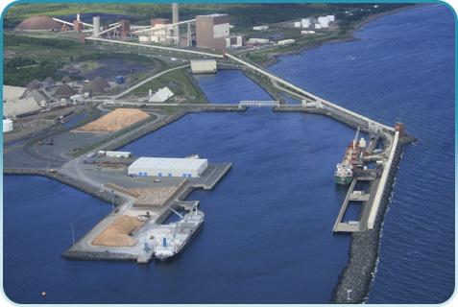
… without hydrography -
- no port is built

Slide 5
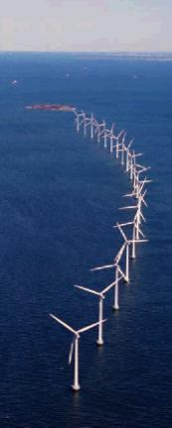
… without hydrography -
- no offshore infrastructure is developed

Slide 6
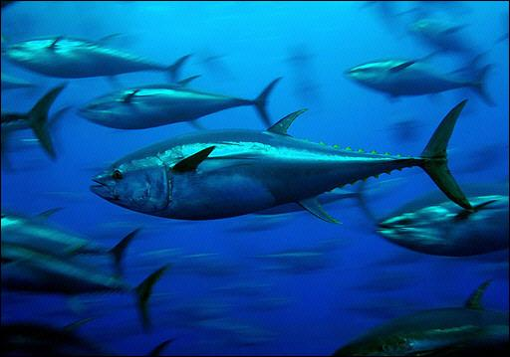
… without hydrography -
- no environmental plan is implemented

Slide 7
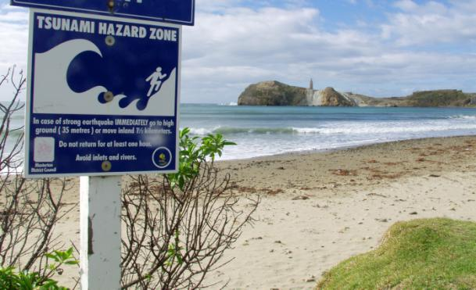
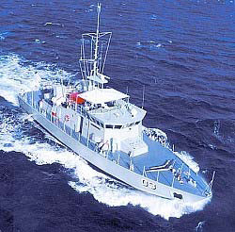
… without hydrography -
- no shore is defended, no island protected

Slide 8
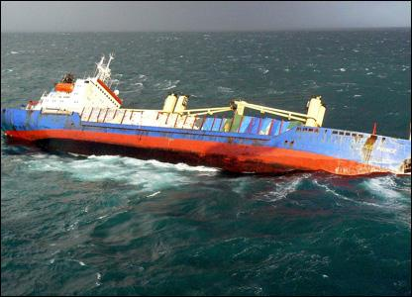
… without hydrography -
- no rescue is attempted

Slide 9
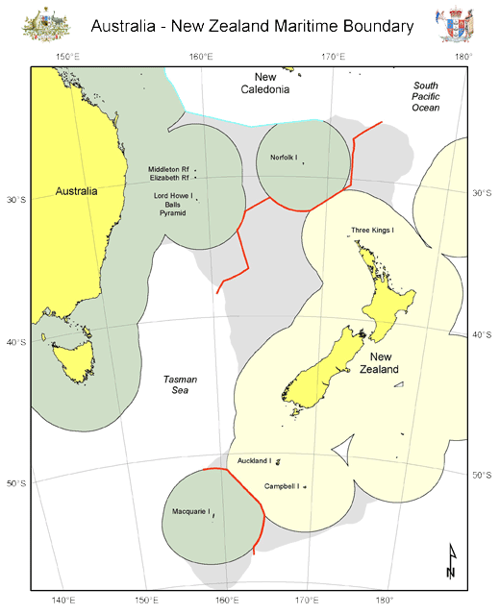
… without hydrography -
- no maritime boundary is delimited

Slide 10
Hydrography
National Uses and Benefits

Slide 11
Hydrography supports :
Safety of navigation
Protection of marine environment
National infrastructure development
Coastal zone management
Marine exploration
Resource exploitation – minerals, fishing
Maritime boundary delimitation (UNCLOS, others)
Maritime defence and security
Disaster management

Slide 12
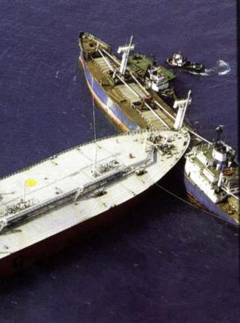
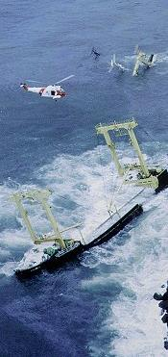
… Safety of Navigation

Slide 13
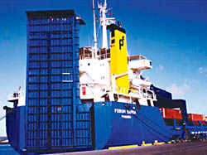
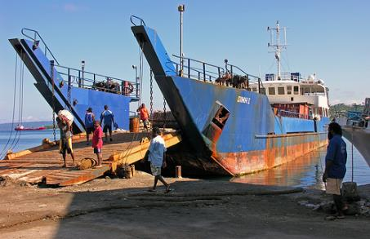
… Transport
98% goods by volume

Slide 14
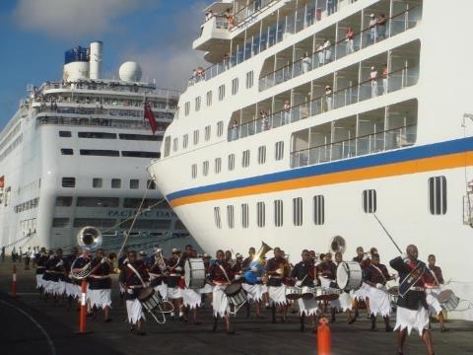
… Tourism
a growing market
larger ships
new destinations

Slide 15
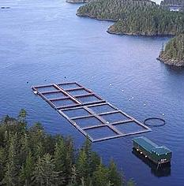
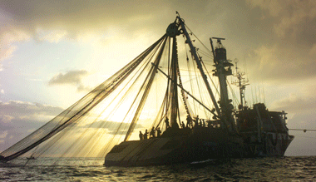
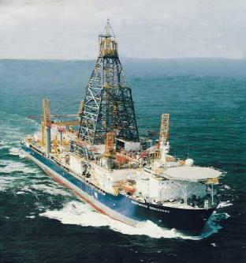
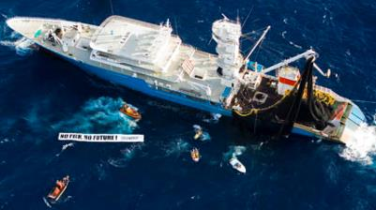
… Natural resources
fishing
seabed

Slide 16
… Security and defence
Maritime patrol and military operations
Fishery protection
Surveillance
Disaster Relief
Search and Rescue (SAR)

Slide 17
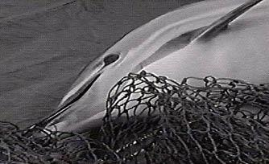
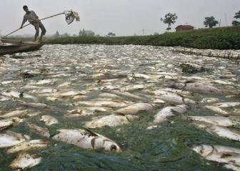
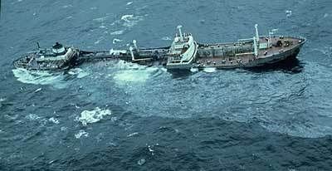
… Protection of the marine environment
dumping
oil spill
industrial pollution

Slide 18
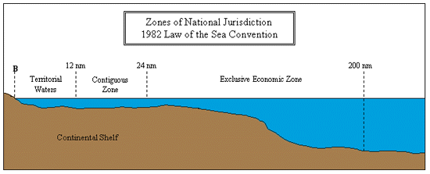
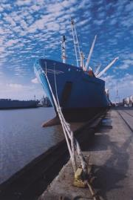
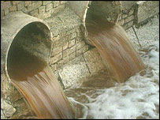
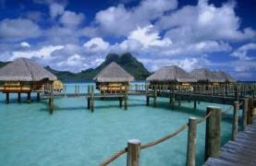
… Coastal zone management
resource management
industrial pollution
port development
areas of national jurisdiction

Slide 19
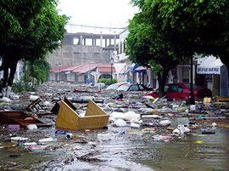
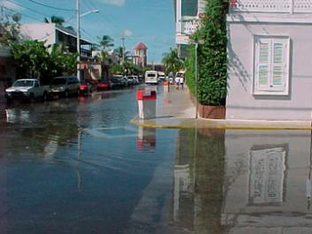
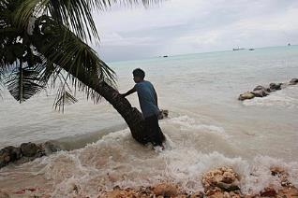
… Natural disaster management
inundation modelling
sea level rise
tsunami
relief planning

Slide 20
Inadequate hydrography means:
risk of marine accidents increases
environmental pollution
loss of life
shipping lacks confidence in ports and routes
international trade is limited
missed economic opportunities
environmental impacts
potential liability and litigation

Slide 21
What is the cost of:
under-developed ports?
using complex and hazardous shipping routes?
lack of fundamental planning data for the coast and seas?
imprecise disaster planning models?
limited sea room for patrol vessels?

Slide 22
Blue Economy
The term “blue economy” is being heard more and more. It is an expression used to describe all the economic activity associated with the oceans, seas, harbours, ports, and coastal zones.
Underpinning all that activity, is hydrography.

Slide 23
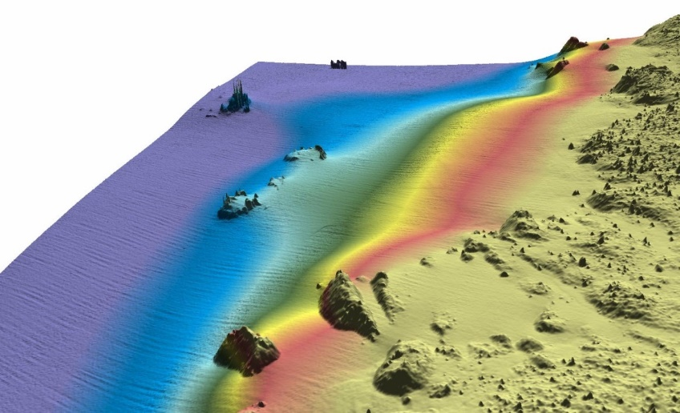
Blue Economy
Every human activity conducted in, on or under the sea depends on knowing the depth and the nature of the seafloor, the identification of any hazards that might exist and an understanding of the tides and the currents.

Slide 24
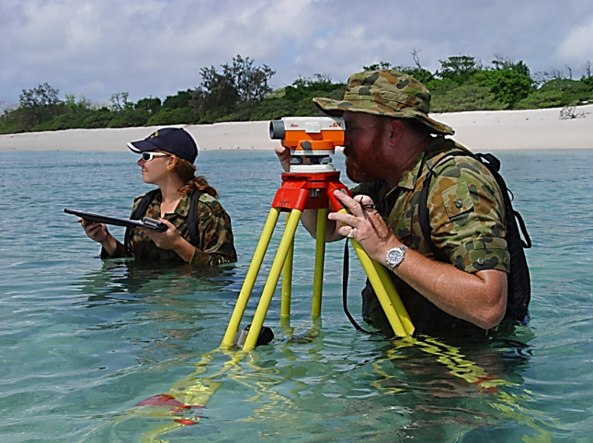
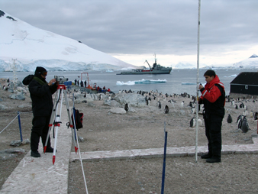
Blue Economy
Obtaining and disseminating this hydrographic knowledge is the role of the world’s hydrographers..

Slide 25
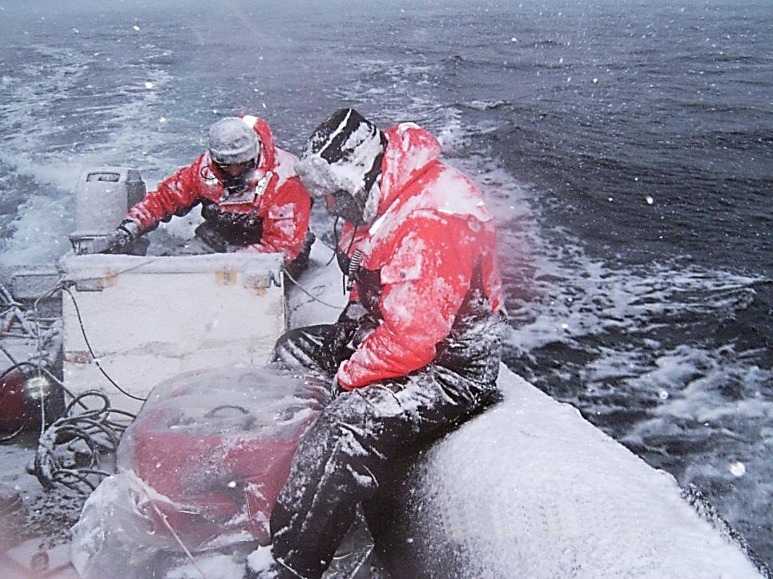
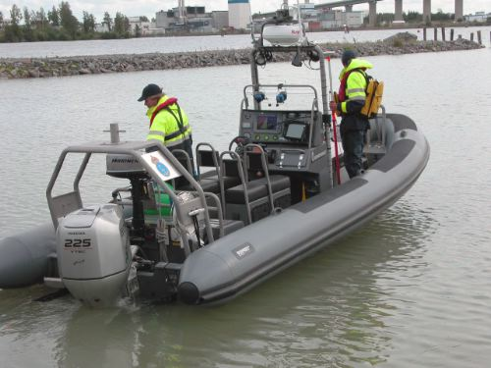
Blue Economy
Their work is the most fundamental of all the enablers required to develop and sustain the Blue Economy.

Slide 26
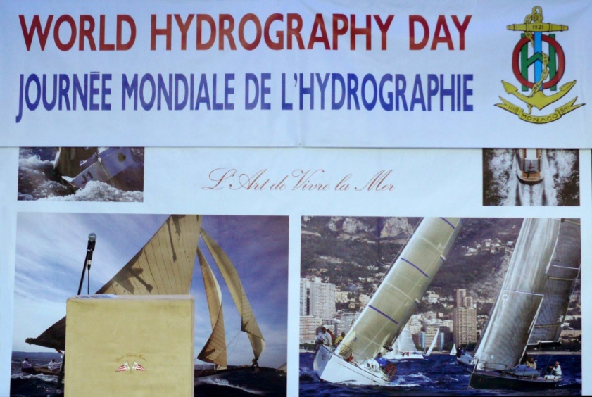
Blue Economy
WORLD HYDROGRAPHY DAY- (21 June)
*Hydrography-underpinning blue economy
(2013)
*Hydrography- much more than just
nautical chatrs (2014)

Slide 27
Some Facts about Blue Economy
Well over 95% of the world’s intercontinental data and telephone traffic passes through undersea cables.

Slide 28
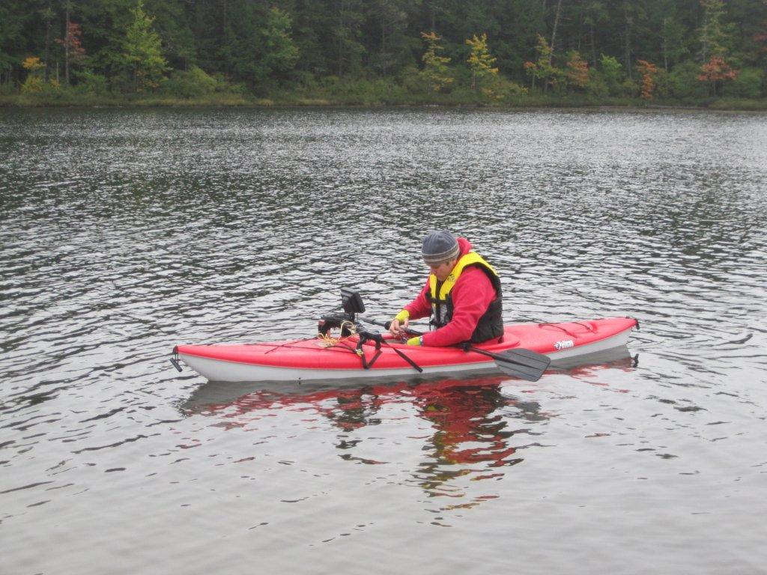
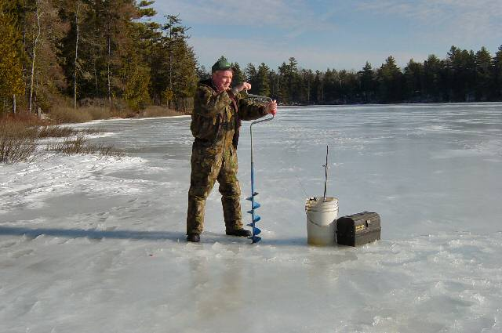
Some Facts about Blue Economy
Economic studies show that the cost: benefit ratio for national investment in hydrography and nautical charting is always positive and can be better than 1:10.

Slide 29
Some Facts about Blue Economy
For most ships, 30cm extra depth of navigable water allows at least 2,000 tonnes more cargo to be carried.

Slide 30
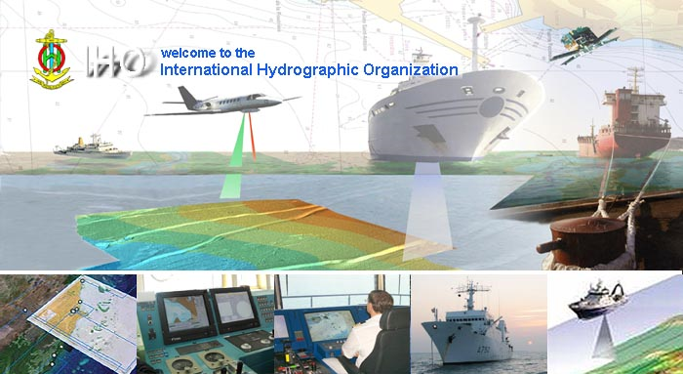
Questions?
www.iho.int

