Slide 1
National Hydrographic Coordinating Committee (NHCC) Adapted from the presentation prepared by LINZ for the SWPHC Seminar (28-29 November 2016)
EAtHC Awareness Seminar

Slide 2
National Hydrographic Coordinating Committee (NHCC)
Contents
Why have an NHCC?
Who makes up the NHCC?
The role of the NHCC

Slide 3
National Hydrographic Coordinating Committee (NHCC)
Key references
SOLAS Chapter V
IHO Publication M-2 (The Need for Hydrographic Services)
IHO Publication M-3 (IHO Resolutions)
IHO Capacity Building Strategy

Slide 4
National Hydrographic Coordinating Committee (NHCC)
Phase 1 – IHO Capacity Building Strategy
Establish national governance structure for Hydrography
Establish MSI service
Establish capability for collection of nautical information to maintain existing charts and publications

Slide 5
National Hydrographic Coordinating Committee (NHCC)
Hydrography governance
Essential - Establish national hydrographic governance structure – embed this is national legislation
Determine how to best meet hydrographic obligations
Assign Responsibilities
Appoint National MSI Coordinator
Establish communication/working arrangements with regional MSI coordinator
Form a National Hydrographic Committee

Slide 6
National Hydrographic Coordinating Committee (NHCC)
Why have an NHCC?
Many Ministries and organisations have an interest in the maritime domain
Need a coordinated approach to avoid duplication of effort
Stakeholders have an interest in a national hydrographic programme
NHCC provides framework for stakeholders to contribute to long term plans

Slide 7
National Hydrographic Coordinating Committee (NHCC)
Who makes up the NHCC?
Extract from the IHO Publication M-2

Slide 8
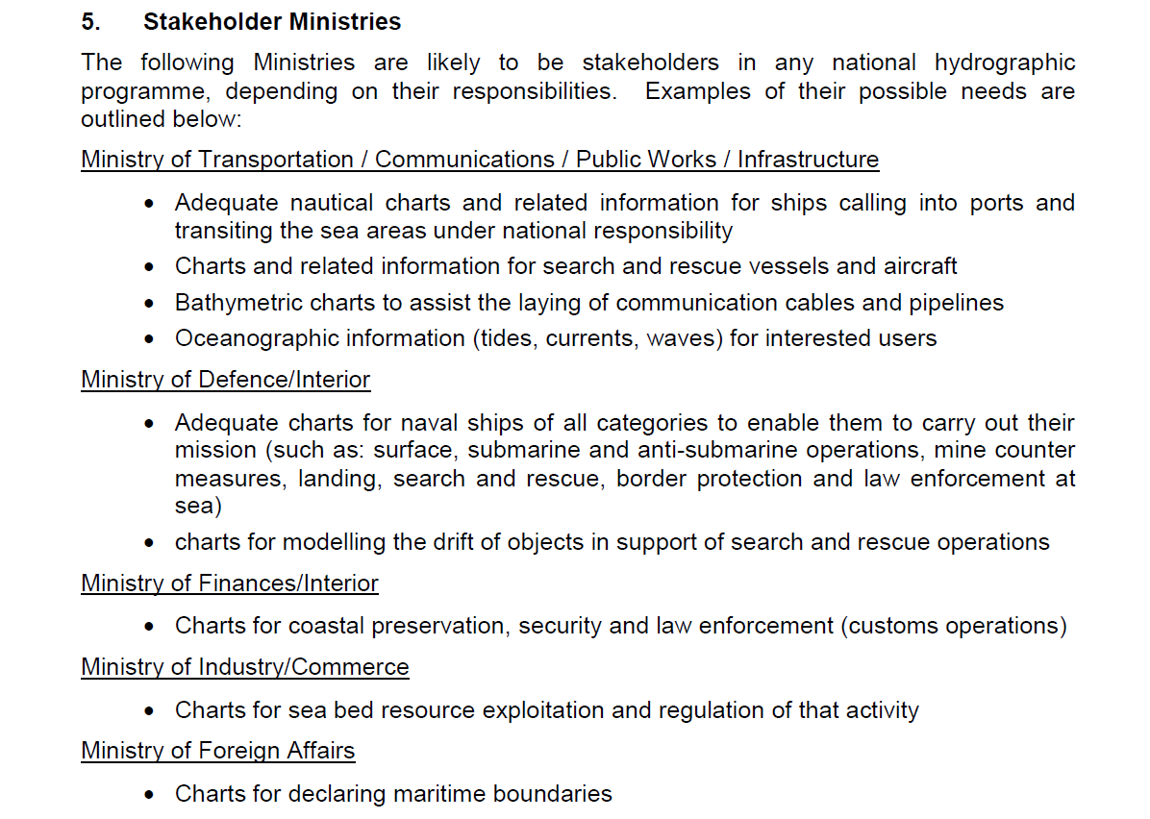
National Hydrographic Coordinating Committee (NHCC)
Who makes up the NHCC?

Slide 9
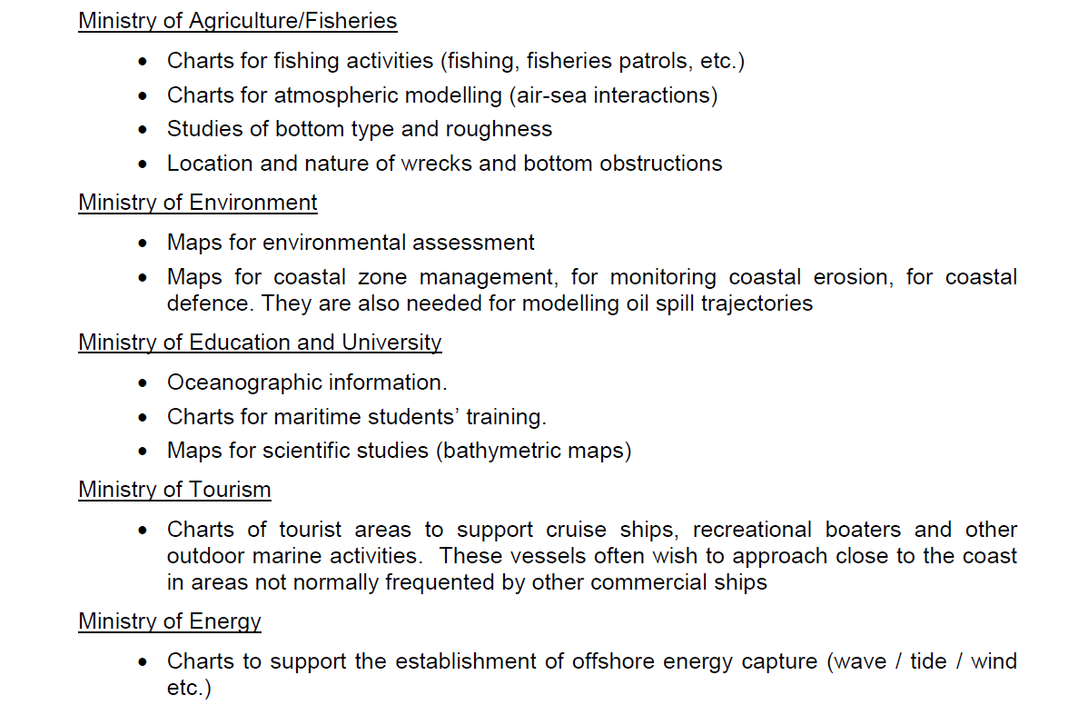
National Hydrographic Coordinating Committee (NHCC)
Who makes up the NHCC?

Slide 10
National Hydrographic Coordinating Committee (NHCC)
Role of the NHCC?
Understand the need to meet international obligations
Understand the need for hydrography to meet a nations needs
Safety of navigation
Protection of the marine environment
Economic growth (maritime trade, exploitation of seabed minerals)
Provide governance for establishing priorities for a hydrographic survey programme
Coordination of stakeholder requirements and needs
Maximize the use of the resources
Share information
Understand the “value of Hydrography”

Slide 11
National Hydrographic Coordinating Committee (NHCC)
Questions?

