Slide 1
The Role of a Primary Charting Authority
MACHC Hydro Awareness Seminar, 26 November 2018
Lucy Fieldhouse, UKHO International Training & Capacity Building Manager

Slide 2
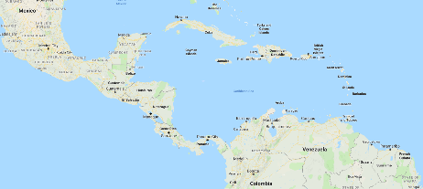
Overview
What is a Primary Charting Authority (PCA)
Who are the MACHC PCAs here?
Framework for the PCA
What can a PCA do for you?
Case Study – Tuvalu
Conclusions

Slide 3
What is a PCA?
There is no internationally accepted definition of a Primary Charting Authority
However, functionally the term refers to the role that an established hydrographic office, or charting authority can fulfil for another nation
The functions provided by the PCA are based on the need of the other nation
Quite often these are formalised by some kind of agreement.
Notes:
So a question for you… what is a Primary Charting Authority?

Slide 4
Who are the PCAs for the MACHC region?
PCA | Responsible for
France | St Martin, St Barts, Guyane Francaise, Guadeloupe, Martinique
The Netherlands | Bonair, Aruba, Sint Maarten, Curacao, St Eustatius, Saba
United States | Costa Rica, Dominican Republic, El Salvador, Guatemala, Haiti, Honduras, Panama, Puerto Rico, Nicaragua
United Kingdom | Antigua & Barbuda, Bahamas, Barbados, Belize, Dominica, Grenada, Guyana, Jamaica, Saint Lucia, St Kitts & Nevis, St Vincent & the Grenadines, Trinidad & Tobago
Notes:
Here are the PCAs for the MACHC region,
Although there is no definition of a PCA there are some points that allude to what a PCA is and what they should achieve.
It is important to remember that any country that is a SOLAS signatory and has a PCA will be subject to IMO audits.
A link for the audit schedule can be found on the IHO Capacity Building website

Slide 5
Framework for the PCA
SOLAS Chapter V Regulation 2:
"Nautical chart" or "nautical publication" is a special-purpose map or book, or a specially compiled database from which such a map or book is derived, that is issued officially by or on the authority of a Government, authorized Hydrographic Office or other relevant government institution and is designed to meet the requirements of marine navigation.

Slide 6
Framework for the PCA
IHO Publication S4
B-611.7 – Notice to Mariners (NM) originated by authorities concerning waters which are not their national charting responsibility should not normally be acted upon without obtaining corroboration from the national charting authority, if there is one. In certain circumstances, another hydrographic office may act as the ‘primary’ charting authority, for example where:
• there is no national hydrographic office; or
• where the responsible national agency, which does not itself produce charts, has agreed.
In such cases, NM issued by the primary charting hydrographic office in those waters may be regarded as authoritative.
Notes:
Explain what S4 is

Slide 7
Framework for the PCA – INT Charts
IHO Publication S11
Article 3.11.1 - In most cases, the allocation of Producer Nations for INT charts will be a fairly straightforward process. For most medium- and large-scale INT charts, the Producer Nation will be the IHO Member State with responsibility for charting the waters covered by these charts. There will, however, be some exceptions. (For further information, see S-4 A-203).
IHO Publication S4
A-203 PRODUCERS A-203.1 Producers of medium- and large-scale international charts will normally be the hydrographic offices with a national responsibility for the waters concerned.
Notes:
Explain S 11
INT charting will be discussed further during the MICC meeting on Wednesday currently US are Chair

Slide 8
What does/can a PCA do for you?
Assist in meeting SOLAS obligations for hydrographic services
Provide charting services
Provide hydrographic surveying services
Provide technical assistance and advice
Advocate for support
However, the above is only possible with 2 way Communication!
Notes:
Linger on SOLAS Reg 4 & 9 next slide what are the SOLAs obligations and National Obligations
This is what a PCA can do for you….

Slide 9
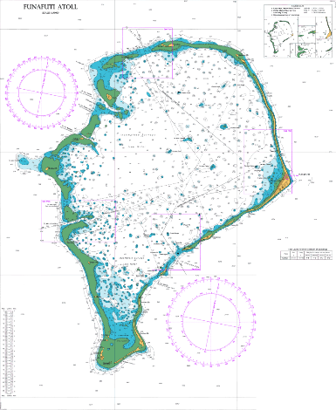
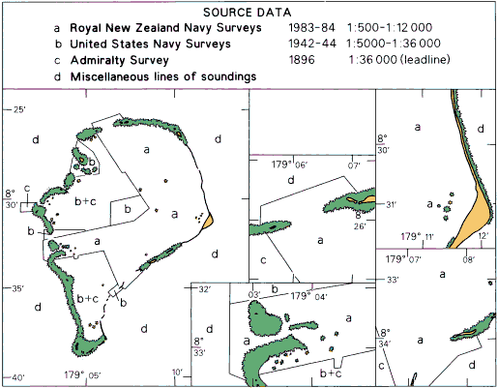
Case Study: 2016 tech assessment visit to Tuvalu
Conducted in Early November in conjunction with the IHO, SPC, and NZ MFAT
Aim: to assess survey priorities and hydrographic governance weaknesses
Notes:
SPC – Secretariat of the Pacific Community.
NZ Ministry of Foreign Affairs
Unless the information is passed to the PCA it will not be published and the mariner will be unaware.
The Rolls Royce solution is that you inform your PCA before the work happens

Slide 10
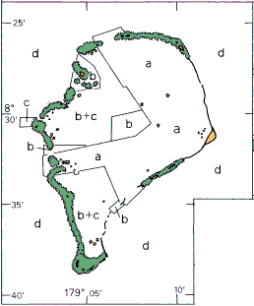
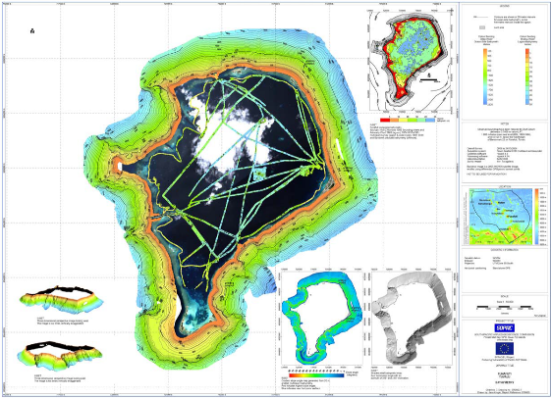
Case Study: 2016 tech assessment visit to Tuvalu
What appeared to be a lack of data, turned out to be a lack of communication!

Slide 11
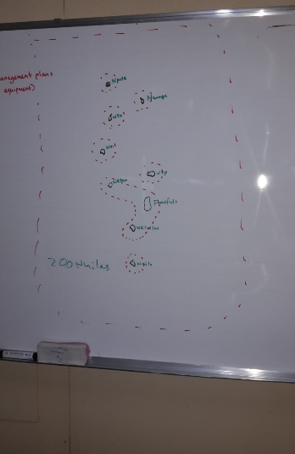
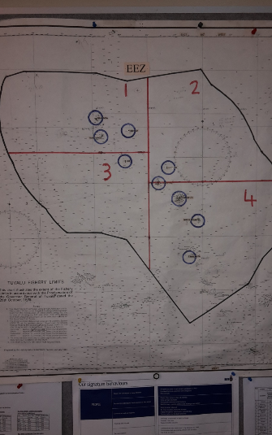
Case Study: 2016 tech assessment visit to Tuvalu
Notes:
We didn’t know wat they needed and they were struggling to manage their fisheries and their EEZ.
Your PCA can work with you to help develop innovative ways of working

Slide 12
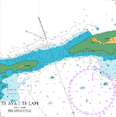
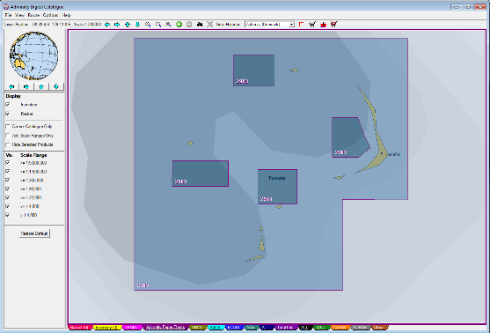
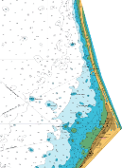
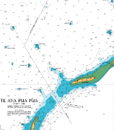
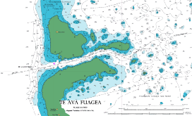
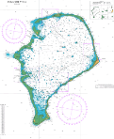
Case Study: 2016 tech assessment visit to Tuvalu
Is this coverage fit for purpose?
Notes:
Is the coverage fit for purpose? - Your PCA doesn’t know if you don’t tell them!!

Slide 13
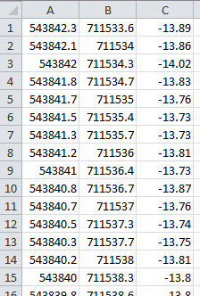
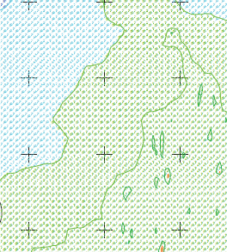
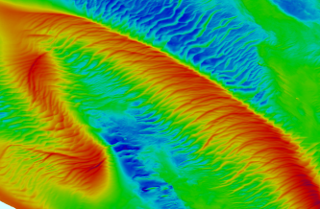
What data should be shared with your PCA?
Data exchange - Bathymetric data &
Bathymetric surveys

Slide 14
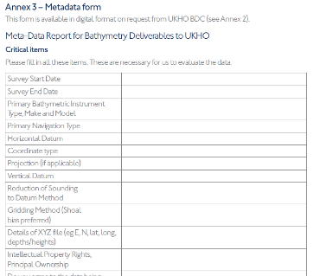
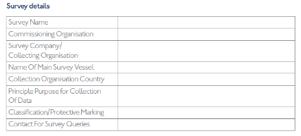
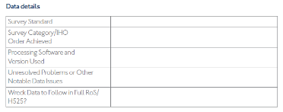
What data should be shared with your PCA?
Data exchange – Format of bathy data & survey support

Slide 15
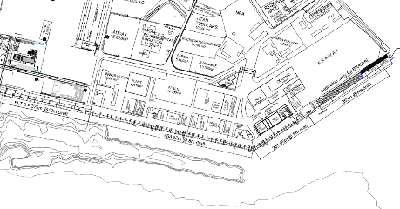
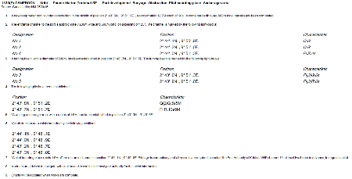
What data should you share with you PCA?
Data exchange – Port Developments

Slide 16
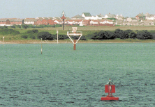
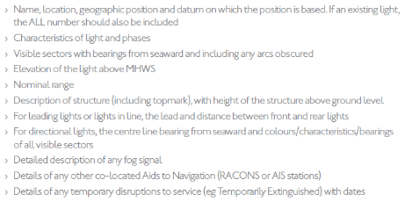
What data should you share with your PCA?
Data exchange - Aids to Navigation (AtoNs): Fixed and floating navigational light, buoyage and fog signals

Slide 17
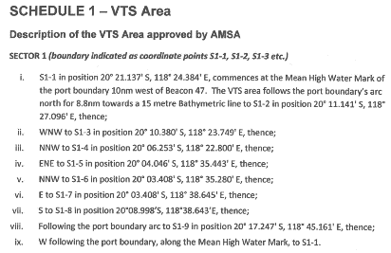
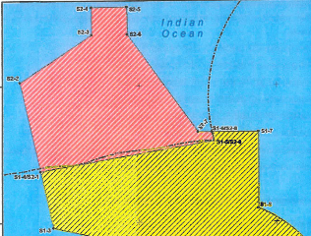
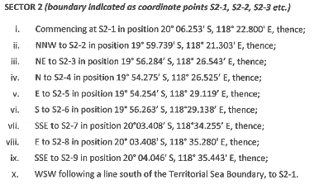
What data should you share with your PCA?
Data exchange – Pilot services, VTS and port operations
Notes:
RSDRA2015000155386 Pilbara Ports Authority Port Hedland – Vessel Traffic Services 08 July 2015

Slide 18
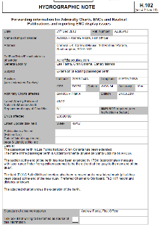
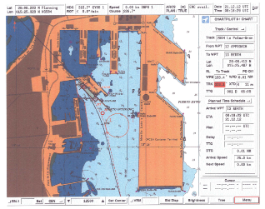
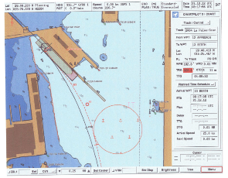
What data should you share with your PCA?
Data exchange – Sailing Directions (‘Pilots’)

Slide 19
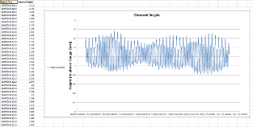
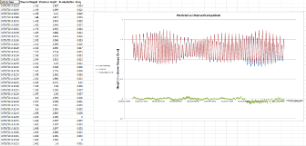
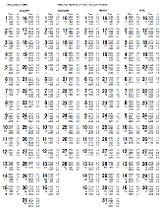
What data should you share with your PCA?
Data exchange – Tidal Data

Slide 20
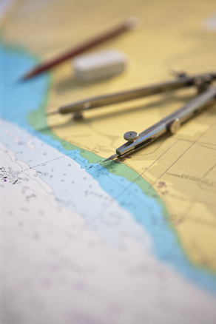
What data should you share with your PCA?
Data exchange –
Topographic information
Data sent through hydrographic notes

Slide 21
Conclusions
A PCA can assist a nation in meeting obligations, but does not absolve the nation of those obligations
Determine what is needed and establish formal arrangements through a bilateral to establish accountability framework – review as necessary
Use your PCA and engage with them actively
A good PCA arrangement should reflect a partnership

Slide 22
Thank You
Supplying the right data in the correct format helps the PCA keep your charts and publications up to date whilst ensuring you are meeting international treaty obligations

