Slide 1
The Role of Data Governance in Risk Management and Security Planning and Responding to Disasters and Incidents John Pepper & Mike Osborne – OceanWise Richard Rowland – State21

Slide 2
Who are we?
OceanWise – Primary provider of marine information systems to ports, energy and government sectors. Our customers include:
State 21 – Ex military and maritime senior police officers providing resilience management, advice and guidance to ports, harbours and coastal authorities

Slide 3
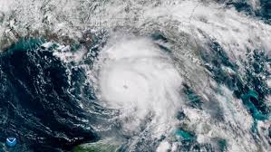
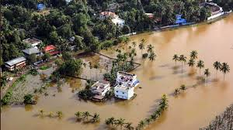
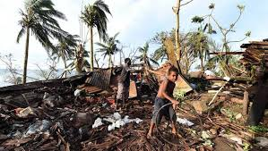
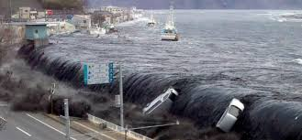
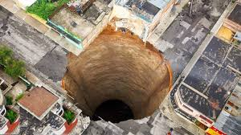
Natural Disasters

Slide 4
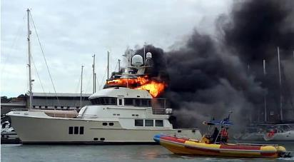
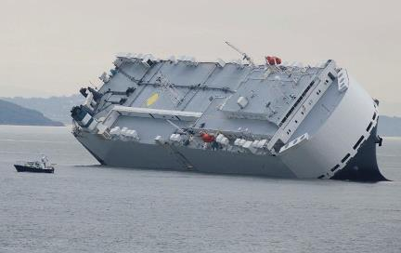
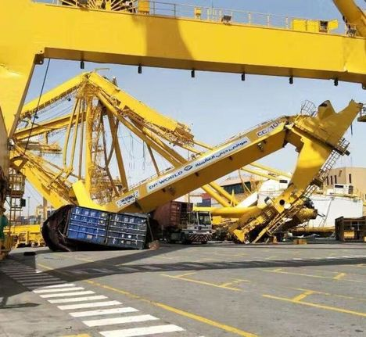
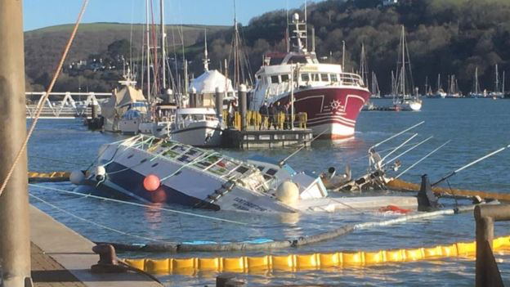
Accidents & Incidents
Notes:
1) Luxury yacht sunk at its moorings on the Isle of Wight after being destroyed by fire. Fire service spent 10 hours tackling the blaze, which sent plumes of black smoke across Cowes. It was reported at 13:00 GMT on Tuesday and, at its height, there were more than 30 firefighters at the marina. The fire service later confirmed that the vessel was submerged and the incident was handed to the harbour master.
2) Ship - the Hoegh Osaka - in Southampton Water and
3) Crane collapsed. Several injuries but fortunately none fatally.
4) French fishing boat which was manned by a crew of five, sank on March 10 as it berthed on Dart Harbour.
All of these were of course unexpected, involved many contributing and overlapping factors, and multiple agencies in their response and aftermath. In all cases, having the right data to hand and inter agency communication was of paramount importance.

Slide 5
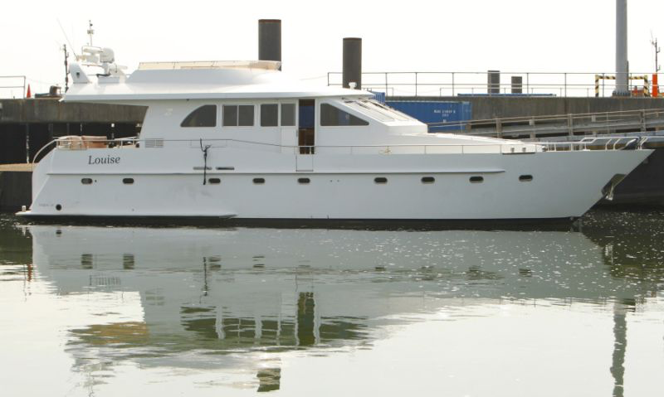
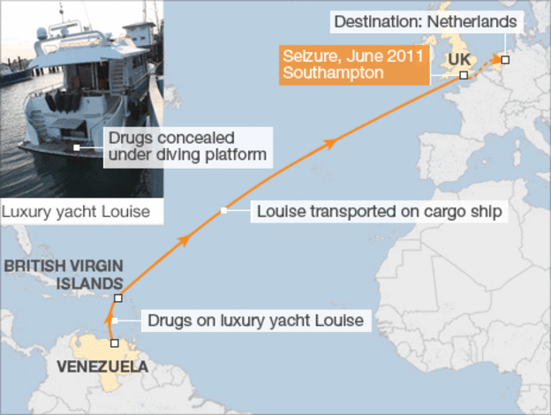
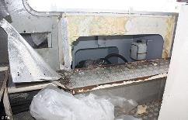
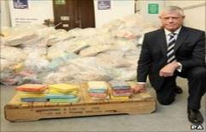
Drug Smuggling
MV Louise in Southampton: 1.2 Tonnes of 90% Pure Cocaine worth £300m
Notes:
THE RISKS

Slide 6
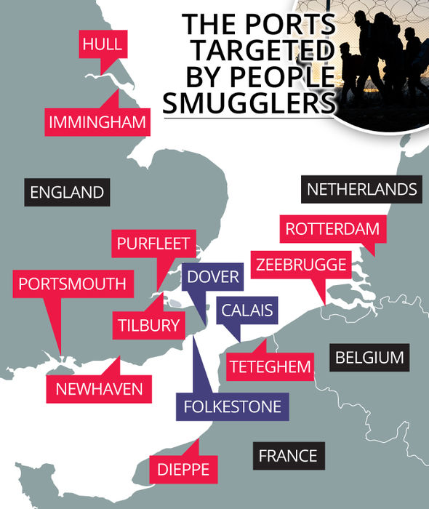
People Smuggling

Slide 7
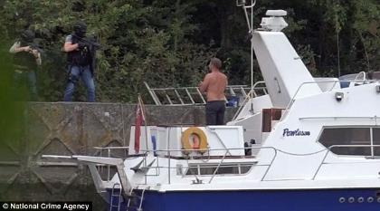
Weapons

Slide 8
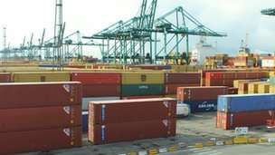
Cyber Security
Drug traffickers recruited hackers to breach IT systems that controlled the movement and location of containers
Malicious software being emailed to staff over a two-year period
Hid cocaine and heroin among legitimate cargoes
Entire containers disappearing from ports without explanation

Slide 9
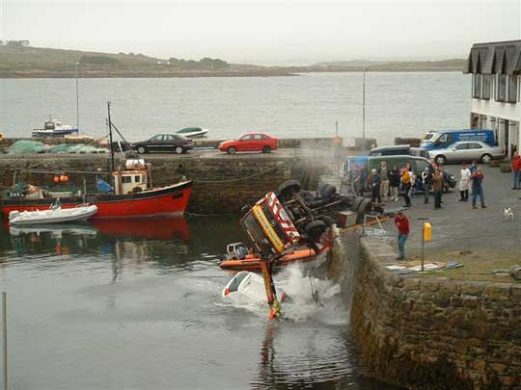
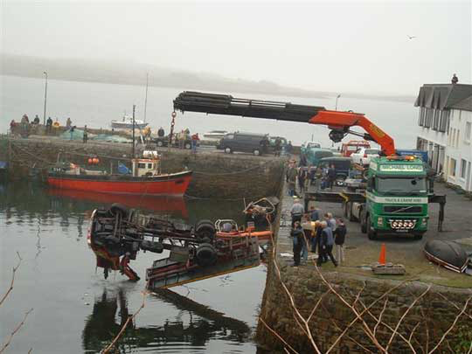
Majority of disasters that happen involve multiple agency response
Notes:
Majority of incidents that happen involve multiple agencies, either at the planning, response or investigation stage, and mostly all three.

Slide 10
Disaster Management - Planning
Preparation phase
Implementation phase following a disaster
Determine what data/information is required
Where and by whom the data is held?
Document available resources (data and information).
Provide access to data/information needed to handle and respond to the emergency

Slide 11
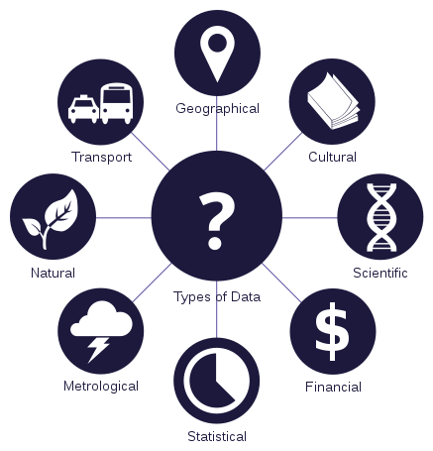
Data – a Gift and a Curse
It can inform
It can overload
It can defend your decisions
It can damn you
It can be stolen
It can drive your business
Either way, once you have it, you can’t ignore it …
Image by João Batista Neto

Slide 12
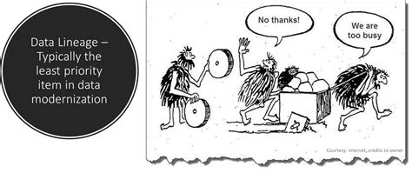
Do not Leave Data Management to Chance
Notes:
Y

Slide 13
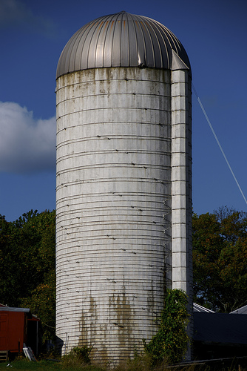
A Common Problem
Data exists in silos within departments
Or
Embedded in applications
Resulting in -
Inconsistency
Replication
Inefficiency
Confusion
Making data sharing -
Difficult and
Time Consuming
Sales
Despatch
Operations
Finance
Notes:
Data exists in silos within departments or Tied Embedded in applications resulting in Inconsistency, replication, Inefficiency, Confusion Data sharing is difficult and time consuming.

Slide 14
Data Centricity - Governance
Sales
Operations
HR
Finance
CUSTOMER DATA
FINANCE DATA
OPERATIONAL DATA
EMPLOYEE DATA
Notes:
Data is an important business asset – equal to your people – so treat your data as such. Define your critical datasets – known as master datasets – and manage them centrally. Take back control. This is known as data centricity and makes common sense.

Slide 15
Business Management
Policies and Systems for
Quality ✓
Environment ✓
Health & Safety ✓
So why not Data?
Notes:
Data is NOT an IT problem. IT alone will not solve it. Data is a business problem and requires a business solution. You will have policies and procedures – and accreditation – for QHS&E, so why not data?!

Slide 16
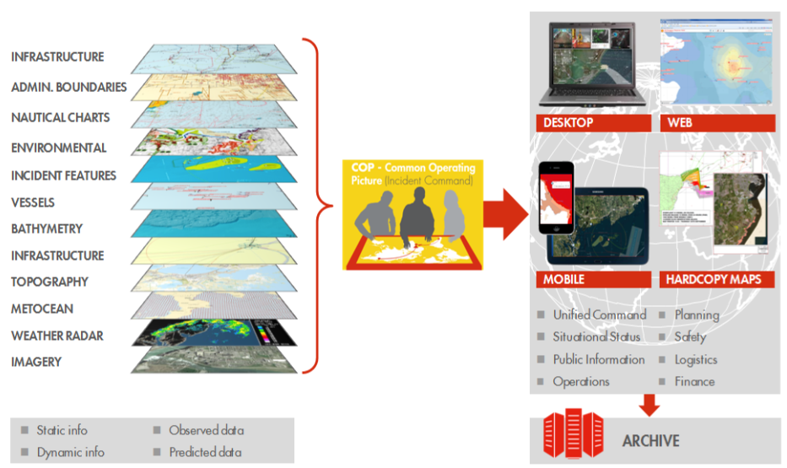
The Result – Common Operating Picture (COP) The data you need easily accessible in one place
International Petroleum Industry Environmental Conservation Association

Slide 17
BUT …
For every data layer:
What is the source?
Provenance?
Data Quality?
Update / Lifecycle?
Pre-preparation?
Plan for improvement?
i.e. Requires Data Management!
Notes:
This is all very well. BUT those nice looking data layers – how

Slide 18
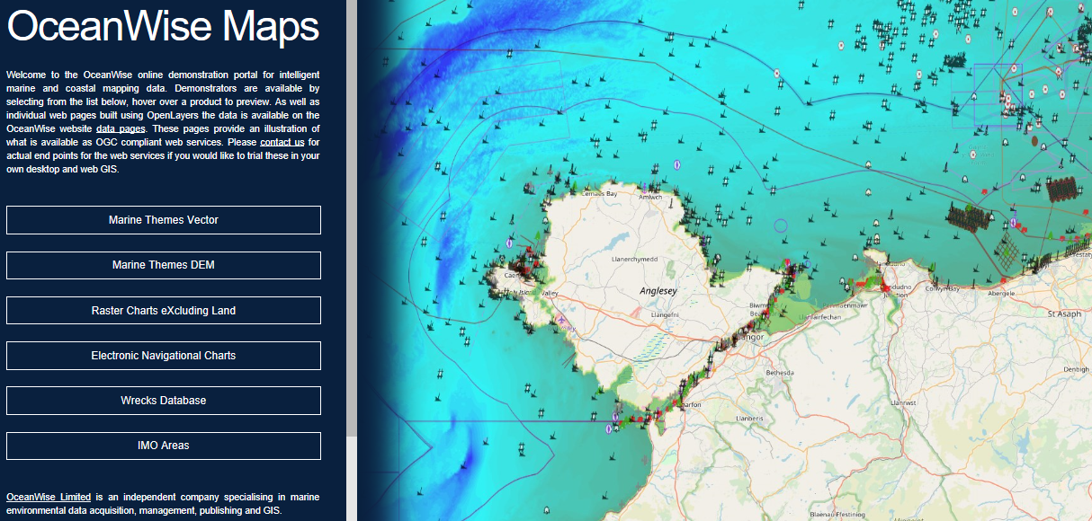
Look at the number of wrecks?
A Marine Map (with land mapping)
https://maps.oceanwise.eu/

Slide 19
Port-Log On-Line Display

Slide 20
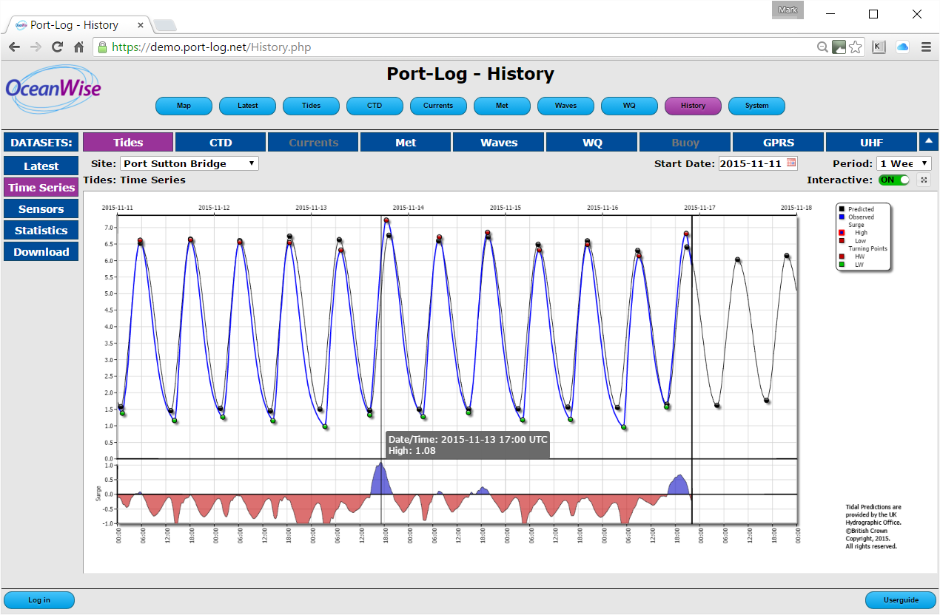
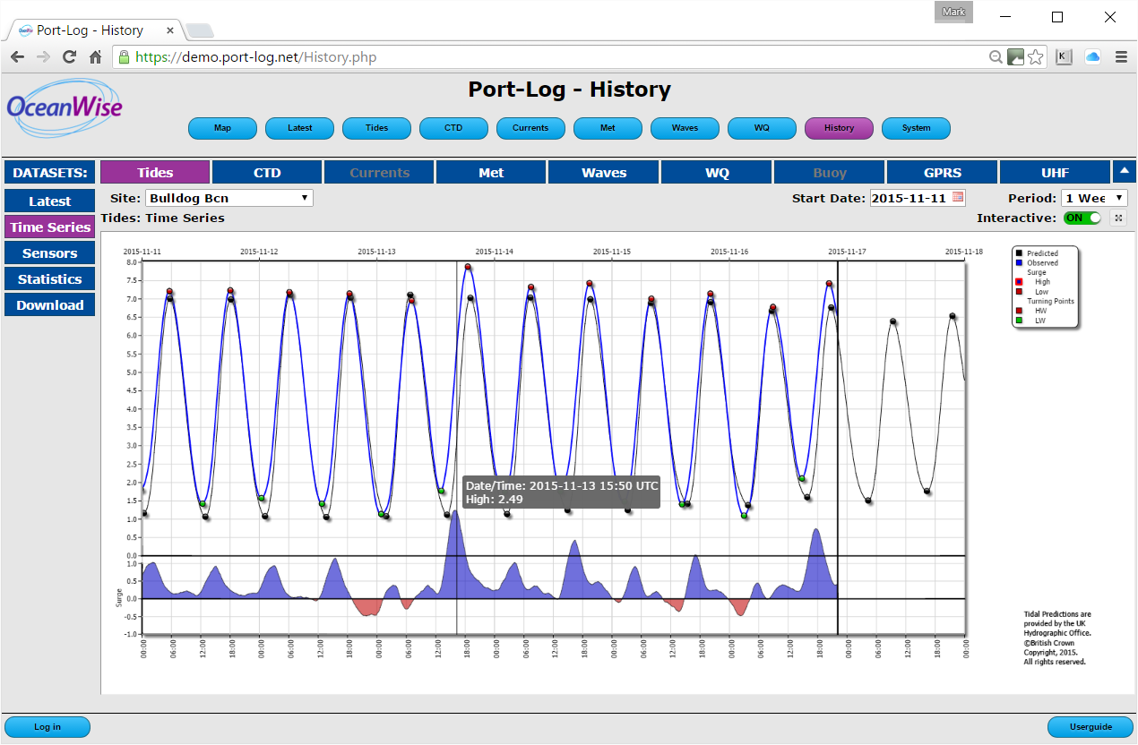
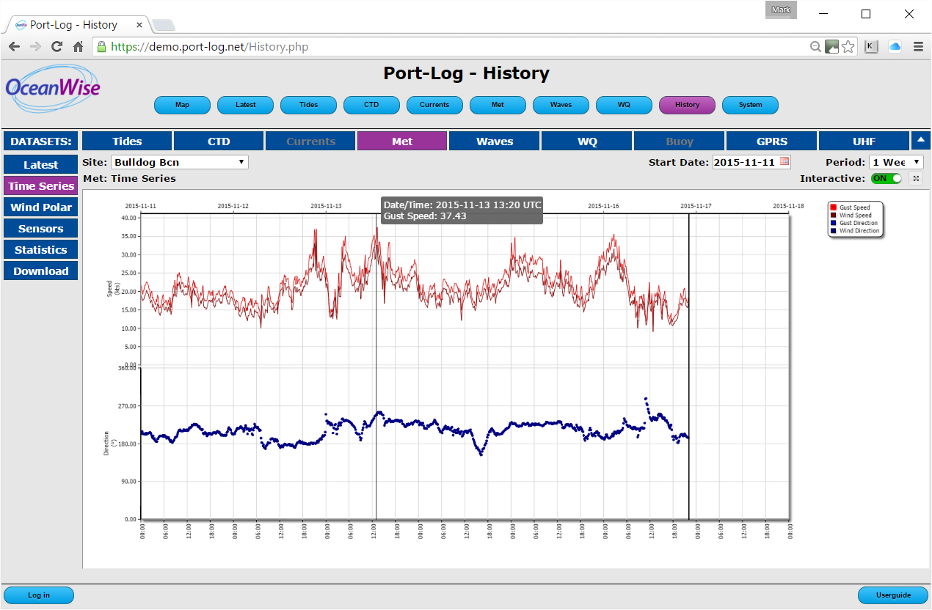
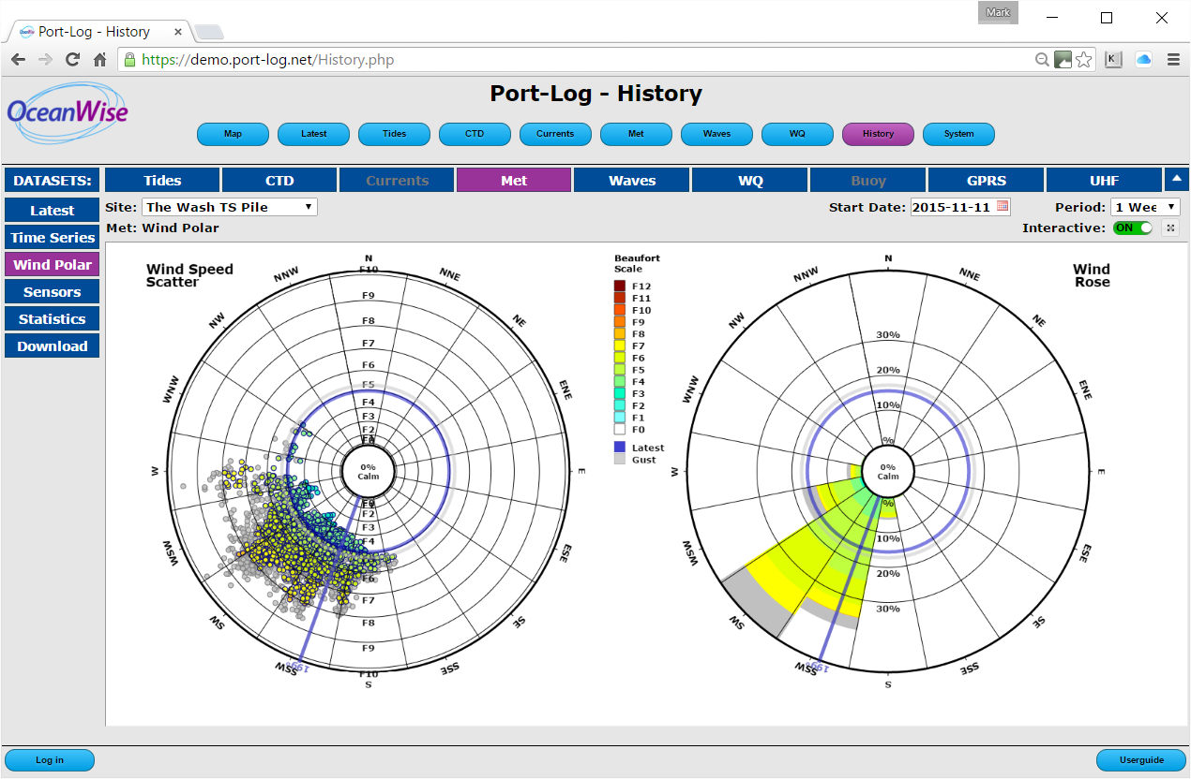
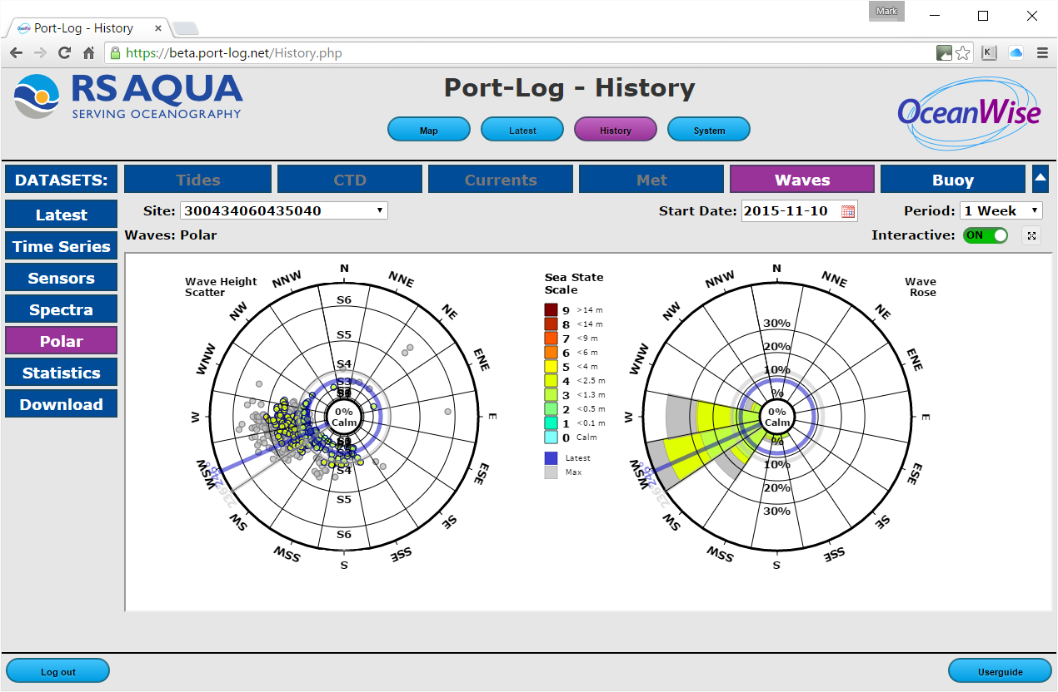
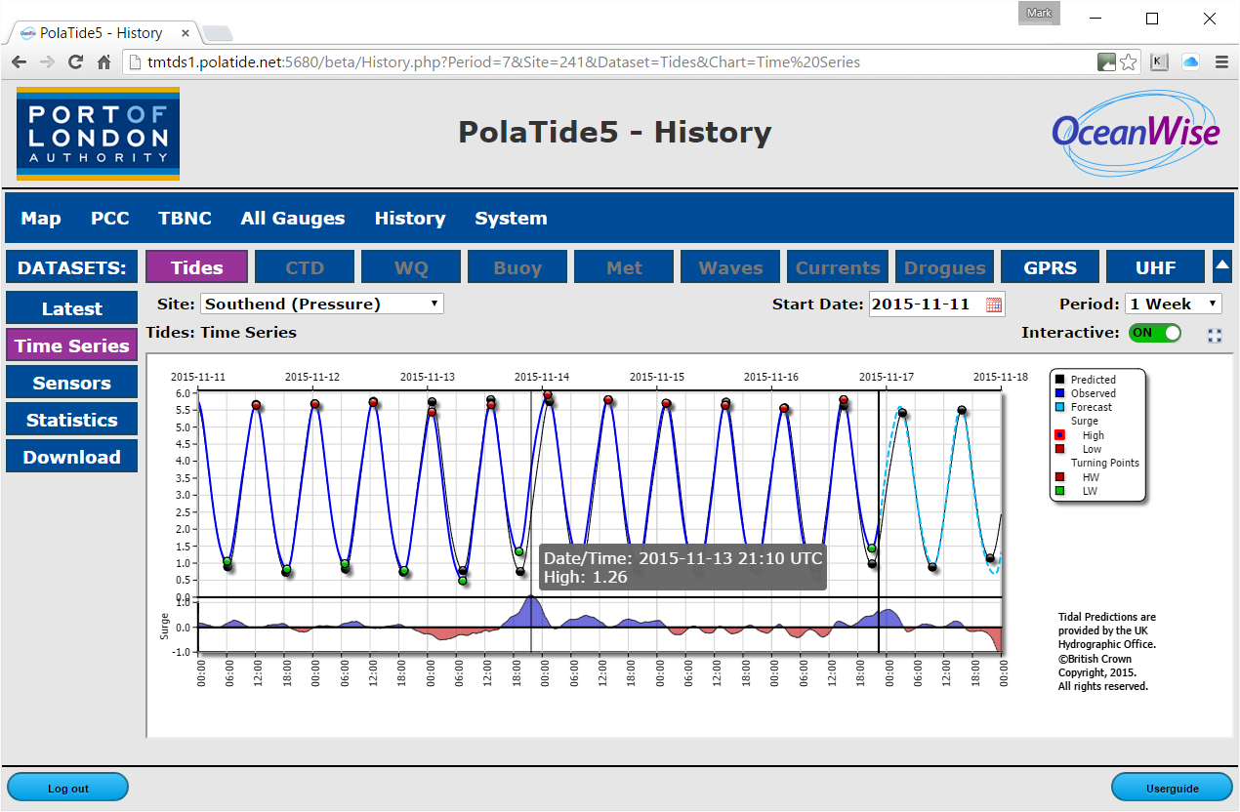
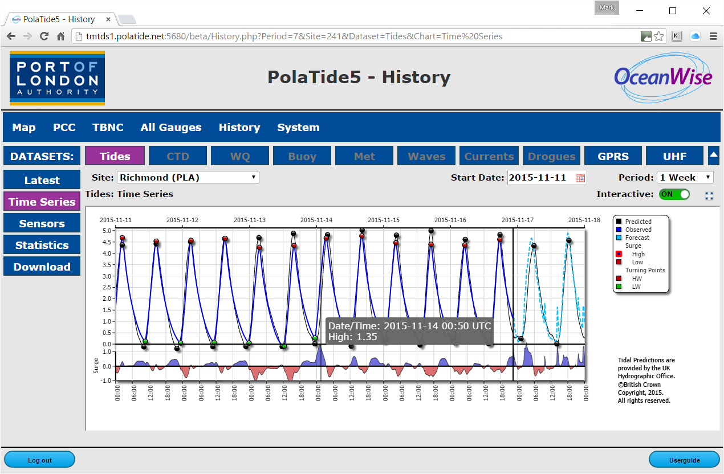
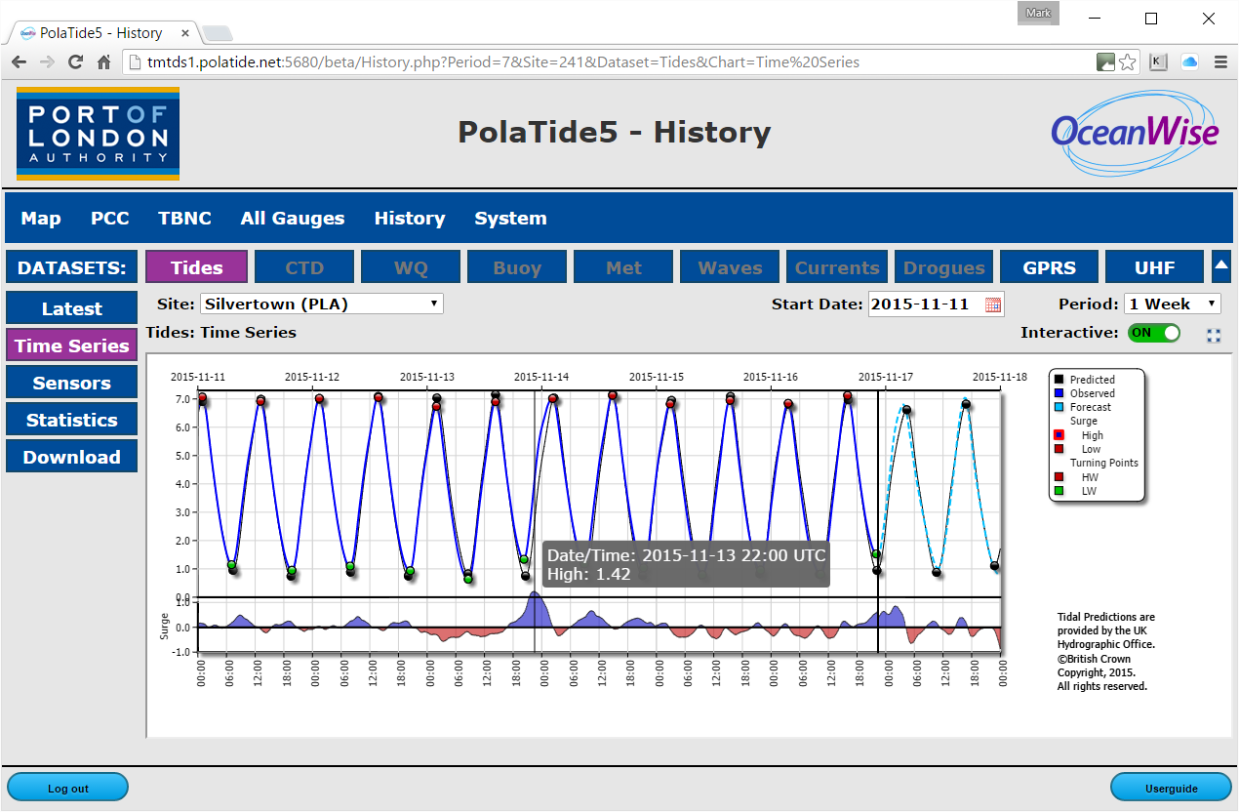
Severe Storm Abigail

Slide 21
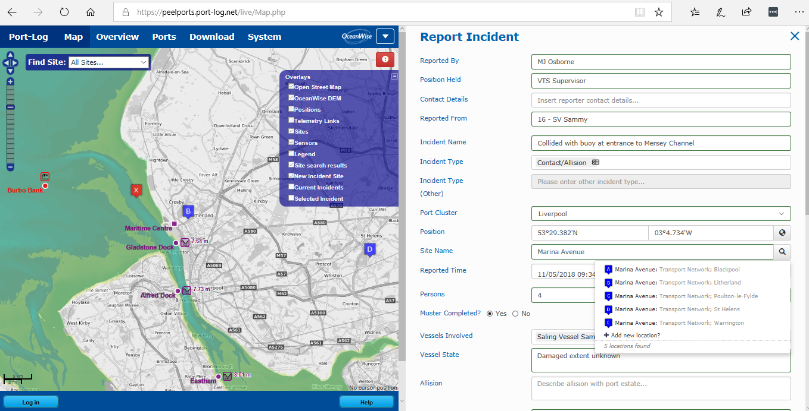
Incident Management System
Search for location or click on base map
Turn on and off different base maps and data layers

Slide 22
Making Defensible Decisions
What did you know?
What should you have known?
What decision did you make?
Why did you make that decision?
Where was it recorded?
Could it have been tampered with?

Slide 23
Being Better Prepared
Business and information systems
Emergency response plans
Post incident reviews (near-miss)
Health and safety assessments
Security arrangements
Exercises and drills
Build confidence in your teams
Grow professionalism
Improve inter-agency communication
Port of Blyth Harbour Master:
“As a growing Port it is vital our systems, plans and procedures to deal with emergencies are fit for purpose. State 21’s assistance with testing our readiness, contingency and business continuity planning was invaluable and ensured that all potential eventualities were tested and the Port’s protocols for such scenarios remain both robust and effective.”

Slide 24
Responding to Disasters and Incidents
Do you know what data and information you have?
Do you know where it is held?
Who is responsible for it?
Can it support immediate assistance?
Is it readily accessible?
Is it georeferenced?
Can it be easily assimilated/used (e.g. in a GIS) ?
Can it be easily shared with other organisations responding to the emergency?
Do you know what data your partner responders hold?

Slide 25
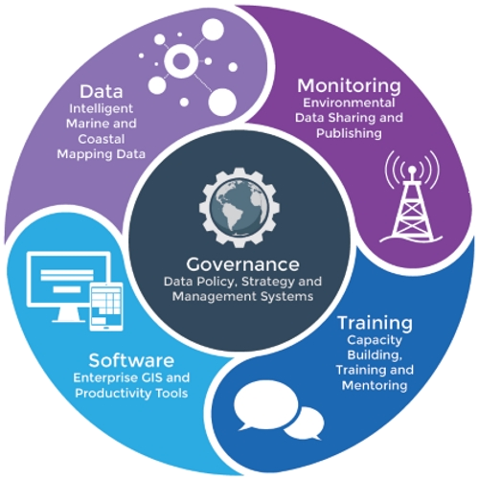
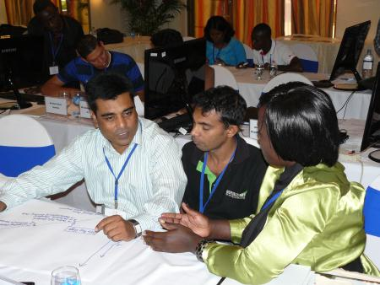
We can assist you improve your data management to ensure you are better able to make the right decisions
If not?
Data Management & Governance,
Information Systems (GIS)
Training, Mentoring & Professional Advice
Marine Data Management Workshop Colombo 2015

Slide 26
Thank you for listening
www.oceanwise.eu
https://maps.oceanwise.eu/
John.pepper@oceanwise.eu

