Slide 1
Haiti Follow up Visit (CBWP Event A-06/2017)
DIRECTORATE OF HYDROGRAPHY AND NAVIGATION/BR ACTION LIST ITEM 15.6.2.3
Meso-American - Caribbean Sea Hydrographic Commission (MACHC)

Slide 2
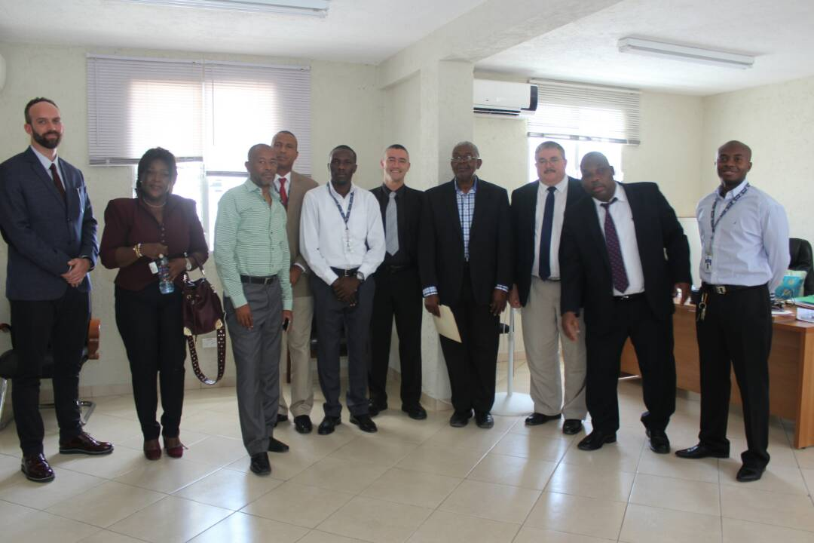
Haiti follow up visit 2017 - Overview
Notes:
James Rogers, Technical Executive from the United States of America National Geospatial Intelligence Agency (NGA) Maritime Safety Office; Eric Langlois, Head of External Relations Division at the French Navy Hydrographic and Oceanographic Service (SHOM); and Paulo Pereira Oliveira Matos, Head of the Planning Division at the Brazilian Directorate of Hydrography and Navigation (DHN), undertook a technical assessment visit to Haiti from 19 - 23 June 2017 on behalf of the International Hydrographic Organization (IHO).

Slide 3
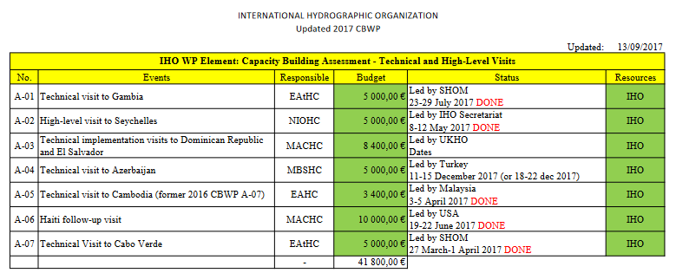
Haiti follow up visit 2017 - Overview

Slide 4
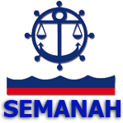
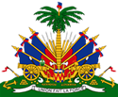
Haiti follow up visit 2017 - Chronology
Centre National de l'Information Géo-Spatiale (C.N.I.G.S)

Slide 5
Haiti follow up visit 2017 - Achievements
Hydrographic point of view:
Correlated subjects (mapping) falls under different ministries. Need to establish discussions so as to do a joint work.
Good cooperation with other institutions (ANP – survey boats).
The Assistant Minister (MTPTC) expressed that Haiti needed support with the administration of Aids to Navigation in Haiti (IALA would be welcome).
Haiti looks to establish a Maritime Training Center.
Haiti needs to designate a national authority to serve as a repository for all hydrographic survey data collected within Haitian waters. SEMANAH would be the likely candidate to do that for Haiti (CNIGS plays the role for land).
Need for hydrographic equipments (CG bases could also provide a stable location for the placement of tide gauges throughout Haiti).

Slide 6
Haiti follow up visit 2017 - Achievements
Political point of view:
After the visit, Prime Minister ordered the Ministry of Foreign Office to send to the Parliament the “explanatory statement” together with the IHO Convention for ratification.
All the visited institutions showed interest in the IHO membership. Prime Minister showed personal commitment.
SEMANAH felt the Delegations presence was important in highlighting the Hydrography in Haiti and was beneficial in Haiti’s formal induction into IHO.

Slide 7
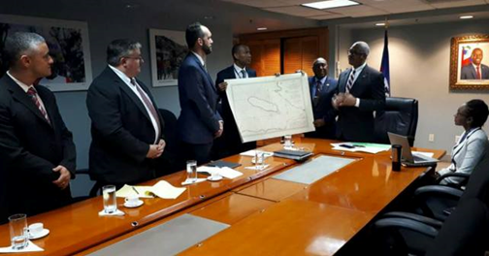
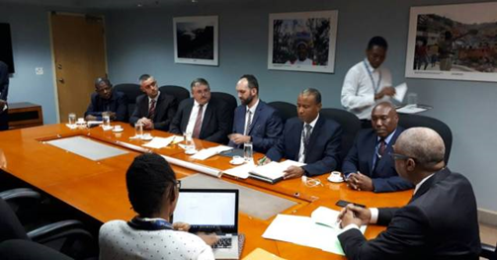
Haiti follow up visit 2017 - Achievements
Haiti Prime Minister
Dr. Jack Guy Lafontant

Slide 8
Haiti follow up visit 2017 - Recommendations
Still under construction:
The Gov’t of Haiti to submit the “Letter of Accession” to formally join IHO as a full member. Additionally, they should establish the mechanism to pay the IHO dues once the finalized rate is calculated based on Haiti’s ship tonnage.
The Gov’t of Haiti to form a National Hydrographic Committee to coordinate national hydrographic requirements, recruiting all stakeholders.
The Gov’t of Haiti to enact a law establishing an org as repository for all hydrographic information collected in Haiti. This could also include a centralized authorization process for conducting hydrographic surveys.
…

Slide 9
Haiti follow up visit 2017 - Benefits
After the visit, the Government sent the Maritime Code of Haiti to the Parliament, being it ratified in Sep2017. It has been pending for 8 years (Maritime Code has the provision to all maritime activities including Hydrography).
The Government edited a Decree and updated the Act of Creation of SEMANAH in Sep2017 (new services created since the creation, ex. Hydrographic Service).
SEMANAH with more visibility and priority within the Haiti Gov’t.
SEMANAH took the visit to commemorate the World Hydrographic Day for the first time in Haiti. Many representatives from society attended.

Slide 10
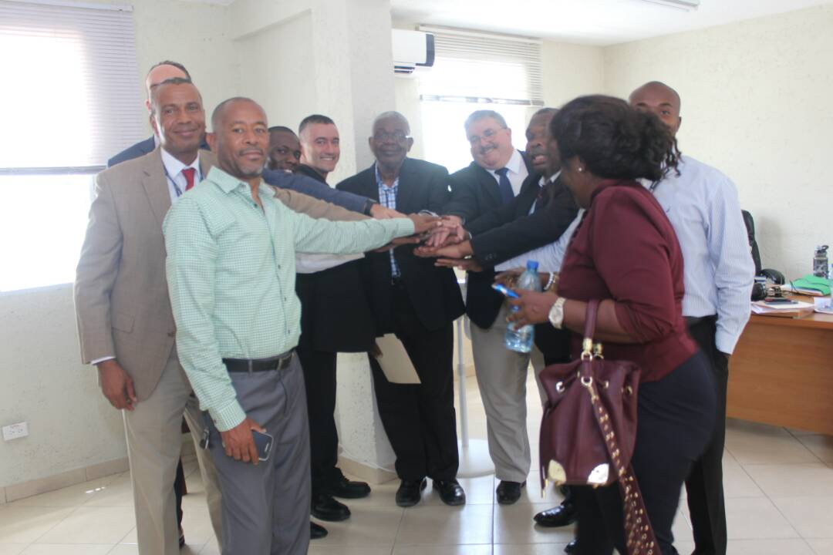
Action requested of CBSC/MACHC
Note this report.

