Slide 1
UK National Report 18th Meso American and Caribbean Sea Hydrographic Commission (MACHC) VARADERO, CUBA , 27th November - 2nd December 2017
Submitted by the United Kingdom of Great Britain and Northern Ireland

Slide 2
UK ACTIVITY 2016/17
Chart Production
Primary Charting Activity
Survey Activity
UK Overseas Territories
Capacity Building
UKHO Transformation

Slide 3
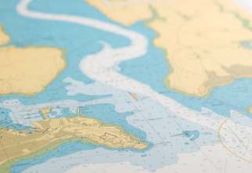
Paper Chart Production
47 New Editions and New Charts
1 Mariners’ Routeing Guide

Slide 4
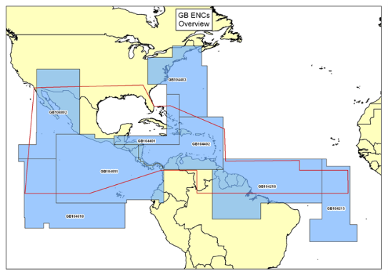
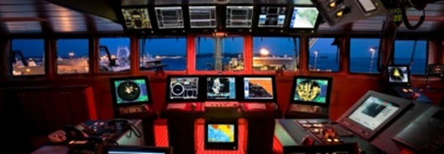
ENC Production
UKHO has published 193 ENC cells in the MACHC region.

Slide 5
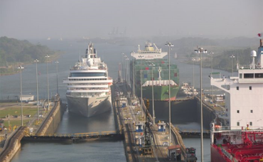
Publications and Products
3 Port Approach Guides published 2017/18
Containing information from ::
Standard Navigation Charts
Sailing Directions
Tidal Publications
Radio Signals
Lights
Digital products, to support mandation:
Admiralty Digital Publications (ADLL, ADRS, ATT)
E-Nautical Publications

Slide 6
Support to Coastal States
UKHO acts as the Primary Charting Authority (PCA)
UKHO provides assistance to states to deliver SOLAS Chapter V, Regulation 9
‘hydrographic and nautical information is made available on a worldwide scale as timely, reliably and unambiguously as possible.’

Slide 7
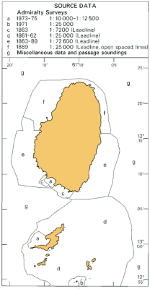
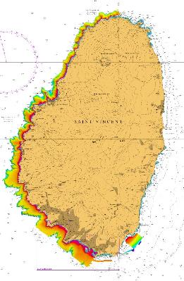
Survey Activity
Commonwealth Marine Economies Programme:
Year 1 - Original £5.6 million invested
Year 2 - further £8 million allocated

Slide 8
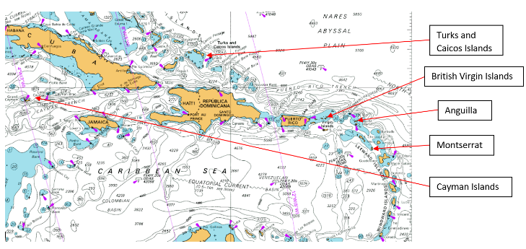
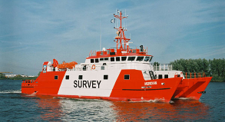
UK Overseas Territories

Slide 9
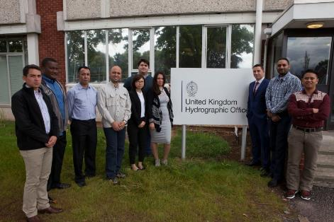
Capacity Building
NIPPON Foundation sponsored course

Slide 10
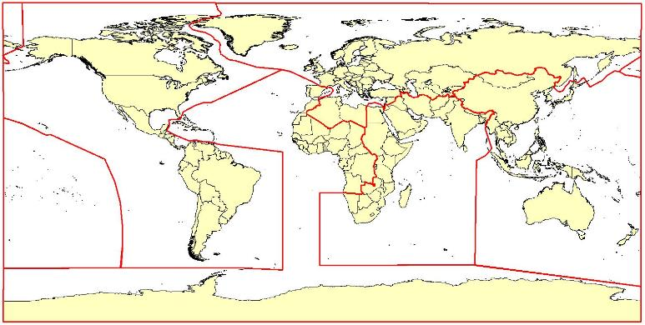
Global Partnering and Engagement

Slide 11
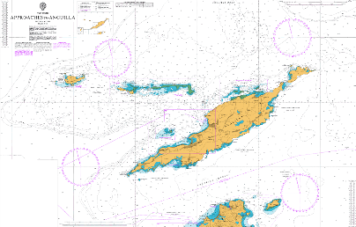
UKHO Transformation
Product focused

Slide 12
UKHO International Programmes and Training Team
Sam Harper
Head of International Programmes and Training
International Training Team
Jeff Bryant
International Training and CB Manager
David Parker
International Hydro Programmes Manager
Ian Davies
International Hydro Programmes Manager
Ken Blagdon
International Trainer
Lucy Fieldhouse
International Trainer
Derek Aldridge
International Trainer
Chris Booth
International Trainer
Hazel Newman
International Hydro Programmes Support Officer
Mel Davis
Training Assistant
International Hydro Projects Team

Slide 13
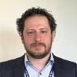
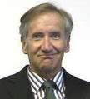
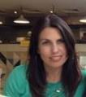
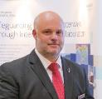
UKHO International Programmes and Training Team
Sam Harper
Head of International Programmes and Training
Jeff Bryant
International Training and CB Manager
Hazel Newman
International Hydro Programmes Support Officer
David Parker
International Hydro Programmes Manager
Ian Davies
International Hydro Programmes Manager

Slide 14
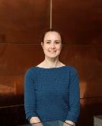
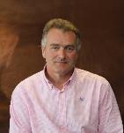
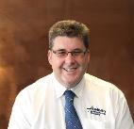
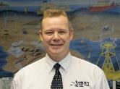
UKHO International Programmes and Training Team
Jeff Bryant
International Training and CB Manager
Ken Blagdon
International Trainer
Lucy Fieldhouse
International Trainer
Derek Aldridge
International Trainer
Chris Booth
International Trainer
Mel Davis
Training Assistant

Slide 15
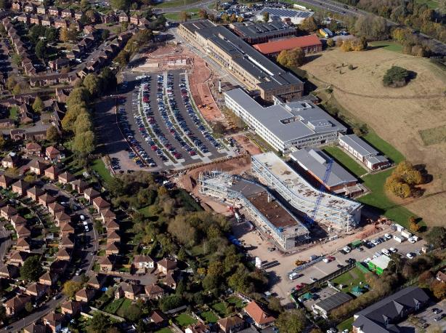
UKHO New Build

Slide 16
Thank you

