Slide 1


18th MACHC Conference
Agenda item 2.2
IRCC 9 report

Slide 2
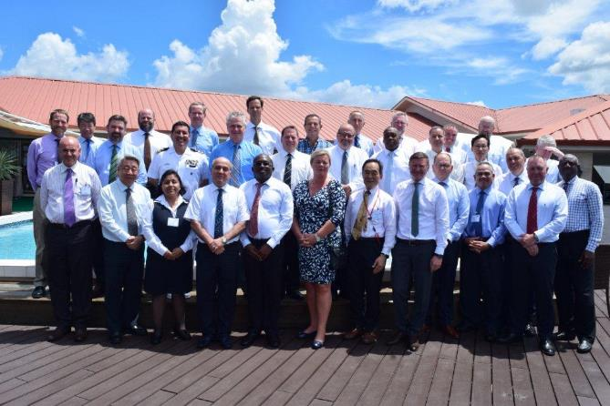
IRRC9, Paramaribo, Suriname, 12-14 June 2017

Slide 3
Content
MACHC report to IRRC8
IBSC
IRCC9 Action list
IRCC9 Work plan

Slide 4
MACHC report to IRRC8
Capacity Building Committee
Chair: Jeff Bryant (UK)
Vice Chair: Nickolas Roscher (BR)

Slide 5
MACHC report to IRRC8
Activities Completed in 2016
Training Courses
  MSI Course delivered in St Lucia August 2016
  MSDI Workshop for Spanish Speakers delivered in Mexico October 2016 (in conjunction with FOCHIAMECA)
  Tide Training Course with SWAtHC delivered in Brazil October 2016
Seminars
  Hydrographic Awareness Seminar / Satellite Bathymetry Workshop – December 2016

Slide 6
MACHC report to IRRC8
Technical Visit Planned 2017
Haiti
  Paulo Matos (BR)
  Eric Langlois (FR)
  Jim Rogers (US)

Slide 7
MACHC report to IRRC8
Marine Economic Infrastructure Program
Coordinator: Jim Rogers (US)

Slide 8
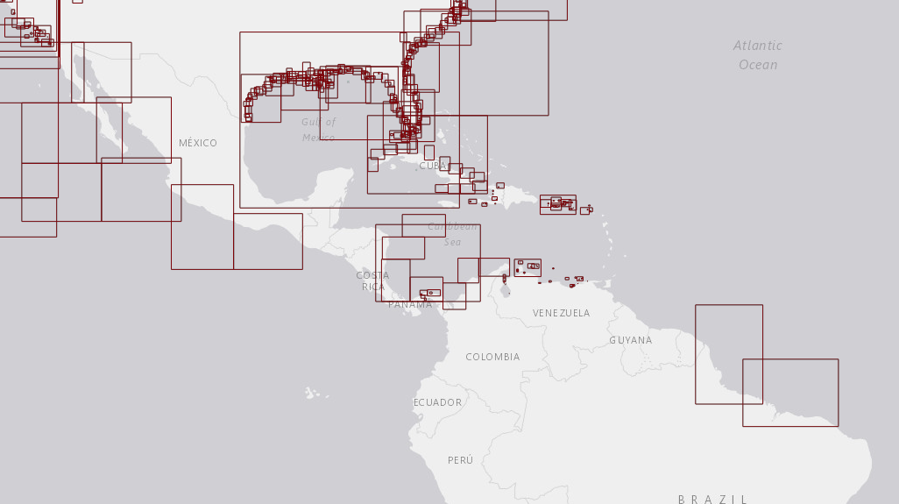
MACHC ENC Online - http://www.iho-machc.org/
MACHC report to IRRC8

Slide 9
MACHC report to IRRC8
MACHC Integrated Charting Committee
Chair: John Nyberg (US)
Vice Chair: Paulo Matos (BR)

Slide 10
MACHC ENC Availability Summary – 2016
MACHC report to IRRC8

Slide 11
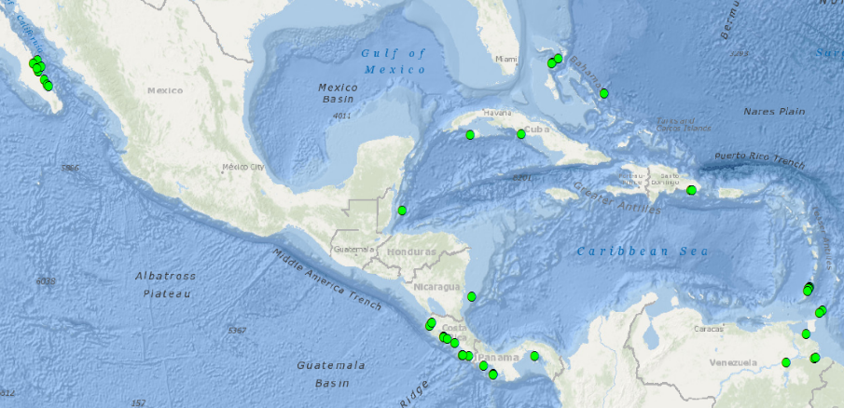
Port Analysis Evaluation - Gaps
MACHC report to IRRC8
46 out of the 373 world-wide Cruise Ship Ports/ Anchorages not covered by Band 4, 5, or 6 ENCs are located in the MACHC
Notes:
Two more Cruise Ship Ports/Anchorages identified in Summer 2015 have already been covered by new large scale ENCs since the last analysis:
* Portulano El Gran Roque, VZ500309
* Bahia de Santiago de Cuba, CU511905
Mexico and Cuba have reported plans to
fill many identified gaps

Slide 12
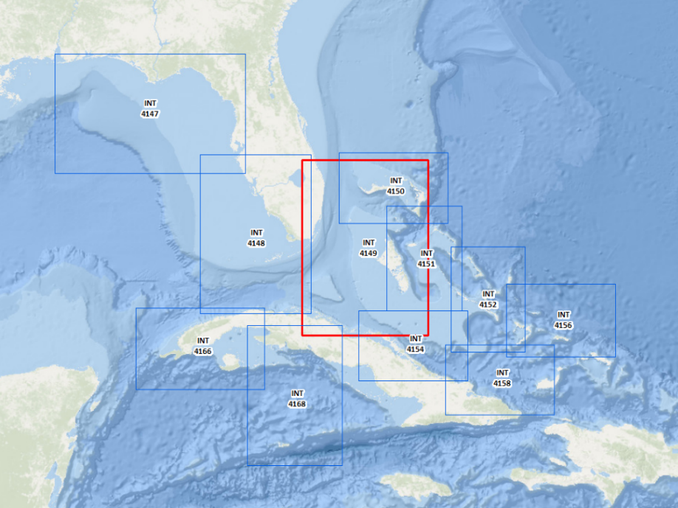
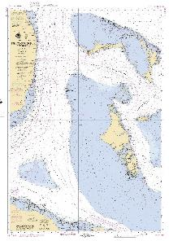
New US/Cuba/UK INT Chart 4149
MACHC report to IRRC8

Slide 13
Difficulties encountered and challenges yet to be addressed
MACHC report to IRRC8
Further developments on the use of Spanish are needed – more CB courses in Spanish
The high cost of carrying out surveys and the limits on national budgets
Full ENC coverage has not yet been achieved

Slide 14
IBSC
Standards of Competence for Hydrographic Surveyors
Endorsed draft New Editions 1.0.0 of the IHO Publications S-8A and S-8B Standards of Competence for Category "A" and Category "B" Nautical Cartographers

Slide 15
IRRC9 Action List
Filtered List of Action (1)
Relate to the MACHC region
Added column with proposed MACHC way ahead
Basis for discussion during agenda item 2.2
Focus on highlighted actions
Others for consideration, recordkeeping and updating the MACHC action list

Slide 16
IRRC9 Action List
Filtered List of Action (2)
N. | Action (Agenda item) | Resp | Deadline | Proposed MACHC action
2 | to engage with Member States in their regions to identify potential instructors to accompany MSI trainings in order to become MSI trainers and report back to IRCC | RHC Chairs | IRCC10 | New open action for Chair to coordinate
3 | to consider using Trainer for Trainers (TFT) and e-learning methods to support the development of CB Phase 1 for developing coastal States and report back to IRCC | RHC Chairs | IRCC10 | New open action for Chair to coordinate
4 | to encourage the attendance of Member States and Observers at WWNWS-SC meetings, to highlight the use of the Joint Manual on MSI to ensure correct terminology and formats are used in MSI messages, to encourage closer engagement of the National MSI Coordinators of Member States with the relevant NAVAREA Coordinator(s) and report back to IRCC | RHC Chairs | IRCC10 | Rewrite continuous action items 17.2.2.1 and 17.2.2.3 as new open action for Chair to coordinate

Slide 17
IRRC9 Action List
Filtered List of Action (3)
N. | Action (Agenda item) | Resp | Deadline | Proposed MACHC action
5 | to encourage closer coordination between NAVAREA Coordinators and Regional CB Coordinators in planning and student selection for the CB MSI training courses | RHC Chairs | IRCC10 | Completed. Is already part of standing activities of CBC
10 | to invite Member States to investigate the possibilities of fund raising and engagement in CB via national organizations and report back to the IRCC | RHC Chairs | IRCC10 | New open action for Chair to coordinate
14 | to encourage the Member States in the region to consider making all ENC data available through the RENCs (7) | RHC Chairs | Decem-ber 2017 | Already continuous action 12.3.6
15 | to encourage the work of the IHO community to increase existence of ENC schemes at regional level (7) | RHC Chairs | Decem-ber 2017 | Completed. Already part of standing MICC remit.

Slide 18
IRRC9 Action List
Filtered List of Action (4)
N. | Action (Agenda item) | Resp | Deadline | Proposed MACHC action
18 | to encourage Member States in the region to nominate RHC MSDI Ambassadors to promote MSDI and to help Member States to prepare the national reports with respect to the status of MSDI (7) | RHC Chairs | IRCC10 | Add as explicit task to MEIP coordinator activities
21 | to encourage IHO Member States to release datasets or subsets into the public domain via the IHO DCDB (7) | RHC Chairs | Septem-ber 2017 | Already open actions 17.6.4 and 17.6.5
22 | to request IHO Member States to consider reviewing data gathering restrictions within their maritime areas of jurisdiction to enable CSB activities to be undertaken (7) | RHC Chairs | September 2017 | New continuous action for Members States to act upon.
23 | to encourage IHO Member States to support the CSB initiative with positive actions, such as requiring all research vessels collect bathymetric data for late uploading, when on passage or when it does not interfere with other research activities (7) | RHC Chairs | Septem-ber 2017 | New continuous action for Members States to act upon.

Slide 19
IRRC9 Action List
Filtered List of Action (5)
N. | Action (Agenda item) | Resp | Deadline | Proposed MACHC action
29 | to encourage Member States to organize contribution of bathymetric data in shallower coastal areas to GEBCO in order to support the production of higher resolution gridded data products and report back to IRCC (7) | RHC Chairs | IRCC10 | New open action for Chair to coordinate. Also open actions 17.6.4 and 17.6.5 apply.
32 | to encourage Member States in the region to consider using satellite derived bathymetry and risk assessment methodologies in uncharted or poorly charted areas in their respective regions as a way of developing survey priority areas as part of attracting donor funding and report back to IRCC (8) | RHC Chairs | IRCC10 | New open action for Chair, supported by UKHO as chair of the Risk Assessment Group. Also open actions 17.5.14 and 17.5.2.1 to 17.5.2.3 , and continuous action 16.5.1 apply.
33 | to encourage the use of satellite derived bathymetry and risk assessment methodologies for developing survey priority areas as part of attracting donor funding using the project rationale as presented in doc. IRCC9-08C (8) | RHC Chairs | IRCC10 | New continuous action for Members States to act upon.

Slide 20
IRRC9 Action List
Filtered List of Action (6)
N. | Action (Agenda item) | Resp | Deadline | Proposed MACHC action
34 | to encourage Member States to participate in the workshop on satellite derived bathymetry sponsored by Canada in March 2018 (8) | RHC Chairs | Decem-ber 2017 | New open action for Members States to act upon.
35 | to invite Member States to provide technical resources to the DQWG and report back to IRCC (9) | RHC Chairs | IRCC10 | New open action for Chair to coordinate
36 | to note the list of events organized by other inter- governmental and stakeholders indicated in doc. IRCC9-09B, consider how the IHO might be represented in those events that are considered relevant and liaise with the IHO Secretariat for the appropriate and report back to IRCC (9) | RHC Chairs | IRCC10 | Rewrite continuous action item 16.2.211 as new open action for Chair to coordinate
37 | to encourage Member States to support the establishment of the UN-GGIM Working Group on Marine Geospatial Information (WG-MGI) by working with their national representatives to the UN-GGIM to offer interventions in favor of the WG-MGI during the next UN-GGIM meeting (10) | RHC Chairs | June 2017 | Closed. Over taken by events. UN-GGIM WG-MGI has been established

Slide 21
IRRC9 Action List
Filtered List of Action (7)
N. | Action (Agenda item) | Resp | Deadline | Proposed MACHC action
38 | to encourage Member States to attend the next UN-GGIM meeting and the UN-GGIM-MGI Side Event (10) | RHC Chairs | July 2017 | New Open action to attend the next, 2018,events.
39 | to promote the UN-GGIM in their regions (10) | RHC Chairs | Perma-nent | New continuous action for Members States to act upon.
43 | to consider using the IHO Online Registration System for their meetings and report back to IRCC (11) | RHCs | IRCC10 | New open action to use this for MACHC19
44 | to invite Member States to review entries related to their region in IHO C-55 and P-5 (Yearbook) at least annually (11) | RHC Chairs | Perma-nent | Already continuous action 17.2.1.4 (see MACHC Statutes for report format)

Slide 22
IRRC9 Work plan
Filtered work plan (1)
Relate to the MACHC region
Added Column with proposed MACHC way ahead
Basis for discussion during agenda item 2.2
Focus on highlighted actions
Others for consideration, recordkeeping and updating the MACHC action list

Slide 23
IRRC9 Workplan
Filtered Work Plan (2)
No |  | ACTIVITY | RESP. | DEADLINE | Proposed MACHC ACTION
Administration
IRCC9 04/2017 | Update and implement the IRCC List of Actions and Tasks agreed at IRCC9 |  | IRCC Members | Continuously | Integral part of Chairs responsibilities.
IRCC9 07/2017 | Provide the IRCC Chair with progress reports on the relevant tasks in the IHO 2017 Work Programme |  | RHCs and IRCC bodies | Jan 2018 | Integral part of Chairs responsibilities
IRCC9 08/2017 | Provide to the IRCC Chair the estimated values as of 31 December 2017 and target values for 31 December 2018, complemented by the comments on the difficulties encountered and suggestions for a way forward |  | RHC Chairs | Jan 2018 | Integral part of Chairs responsibilities.

Slide 24
IRRC9 Workplan
Filtered Work Plan (3)
No |  | ACTIVITY | RESP. | DEADLINE | Proposed MACHC ACTION
Outreach
IRCC9 11/2017 | Provide material to the Secretariat to promote the achievements of IRCC bodies and report to the IRCC Chair |  | IRCC Members | Dec 2017 | New continuous action for chair to coordinate
IRCC9 12/2017 | Continue to engage suspended Member States (MSs) in their region to encourage their re-admission to the IHO and report to the IRCC Chair |  | EAtHC MACHC BSHC | Dec 2017 | New open action for Chair
IRCC9 13/2017 | Contribute to the development of C-55. |  | IRCC and RHC Chairs | IRCC10 | Already continuous action 17.2.14
IRCC9 14/2017 | Contribute to monitoring and improving the global status of hydrographic surveying. |  | RHC Chairs | IRCC10 | Already covered by many open and continuous action items. Also by MICC
IRCC9 15/2017 | Contribute to improving the framework of IHO response to marine disasters. |  | RHC Chairs | IRCC10 | Already incorporated into the Statutes and as standing agenda item during MACHC.

Slide 25
IRRC9 Workplan
Filtered Work Plan (4)
No | ACTIVITY | RESP. | DEADLINE |  | Proposed MACHC ACTION
Outreach
IRCC9 16/2017 | Contribute to the development of MSDI | IRCC Members |  | IRCC10 | By MEIP coordinator
IRCC9 17/2017 | Contribute to the development of CSB | IRCC Members |  | IRCC10 | By CBC and TOR of CB WG
IRCC9 18/2017 | Encourage MSs and representatives of industry and academia to promote and to work together to ensure that the best possible use is made of Satellite Derived Bathymetry and report back to the IRCC Chair | RHC Chairs |  | Dec 2017 | New continuous action for Members States to act upon.
IRCC9 19/2017 | Consider the participation of stakeholders at the RHC conferences and report to the IRCC Chair | RHC Chairs |  | Dec 2017 | Completed. MACHC conference are open fora.
IRCC9 20/2017 | Invite GEBCO Guiding Committee / Bathymetric Regional Project Chairs to attend corresponding RHCs meetings, aiming at strengthening collaboration with a priority on improving high resolution shallow water bathymetry at the regional level and report to the IRCC Chair | RHCs, GEBCO |  | Dec 2017 | Completed. GEBCO is standing agenda item during MACHC Conference

Slide 26
IRRC9 Workplan
Filtered Work Plan (5)
No | ACTIVITY | RESP. | DEADLINE | Proposed MACHC ACTION
Outreach
IRCC9 21/2017 | continue supporting GEBCO regional projects and report back to IRCC | RHC Chairs | IRCC10 | Already open action 17.6.5
IRCC9 22/2017 | invite and encourage Member States to participate in the annual GEBCO GC meetings | GGC Chair | IRCC10 | New continuous action for Members States to act upon.
IRCC9 23/2017 | Encourage National Hydrographers to invest in English language training in order to increase the chances of their candidates being selected to Category "A" and Category "B" training courses delivered in English | RHC Chairs | IRCC10 | Already continuous action 16.2.2.11
IRCC9 24/2017 | work to reduce overlaps by applying the WEND Principles in defining approve ENC schemes | RHC Chairs | IRCC10 | Completed Part of standing MICC activities as assisted by IC-ENC.
IRCC9 25/2017 | Facilitate resolution of important inconsistencies between paper charts and ENCs and between ENCs from different producers as identified by the RENCs or otherwise | RHC Chairs | IRCC10 | Completed Part of standing MICC activities as assisted by IC-ENC.

Slide 27
IRRC9 Workplan
Filtered Work Plan (6)
No | ACTIVITY |  | RESP. | DEADLINE | Proposed MACHC ACTION
Outreach
IRCC9 26/2017 |  | Encourage MSs in their respective regions to use the Risk Assessment methodology to establish Hydrographic Survey priorities | RHC Chairs | IRCC10 | Already open actions 17.5.14 and 17.5.2.1 to 17.5.2.3 , and continuous action 16.5.1 apply
IRCC9 27/2017 |  | provide: a) an initial summary report on Technical Visits (TV) within two weeks of the visit; and b) full reports are expected within three months of completion of a TV | RHC Chairs and CB Co- ordinators | a) Two weeks after the TV b) Three months after the TV | Completed. Part of standing CBC responsibilities.
IRCC9 28/2017 |  | encourage the attendance of Member States and Observers at WWNWS-SC meetings | RHC Chairs |  | Already continuous action 17.2.2.1

Slide 28
IRRC9 Workplan
Filtered Work Plan (7)
No | ACTIVITY |  | RESP. |  | DEADLINE |  | Proposed MACHC ACTION
Outreach
IRCC9 29/2017 |  | raise awareness of the impact of e- navigation on the provision of MSI in the respective regions and to highlight the use of the Joint Manual on MSI to ensure correct terminology and formats are used in MSI messages |  | RHC Chairs |  | IRCC10 |  | Already continuous action 17.2.2.2
IRCC9 30/2017 |  | encourage closer engagement of the National MSI Coordinators of Member States with the relevant NAVAREA Coordinator |  | RHC Chairs |  | IRCC10 |  | Already continuous action 17.2.2.2
IRCC9 31/2017 |  | encourage closer coordination between NAVAREA and Capacity Building Coordinators in planning and student selection for the CB MSI training courses |  | RHC Chairs |  | IRCC10 |  | Completed. Is already part of standing activities of CBC (same as action 5)

Slide 29
IRRC9 Workplan
Filtered Work Plan (8)
No | ACTIVITY | RESP. | DEADLINE | Proposed MACHC ACTION
Outreach
IRCC9 32/2017 | invite Member States to provide following information in the National Reports to RHC meetings: the status of MSDI; plans for involvement in MSDI; and challenges facing the HO | RHC Chairs | IRCC10 | Completed by structure National report para 9 as detailed in Annex 1 tot the Statutes
IRCC9 33/2017 | in coordination with Member States, to be attentive to opportunities to raise awareness on the role of hydrography and the importance of improving mankind’s knowledge of the seas and oceans in support of the sustainable development goals, disaster risk reduction and the integrity of the oceans | RHC Chairs | IRCC10 | Already continuous action 17.2.2.4

Slide 30
Action required of IRRC10
To many actions and work plan issues
    Chair and members are inundated by things to
    Result do nothing in the end
Not effective
    Bureaucratic exercise
Need to simply
    Priorities endorsed by Council are guidelines
  ACTION FOR IRCC10: REVISIT methodology

