Slide 1
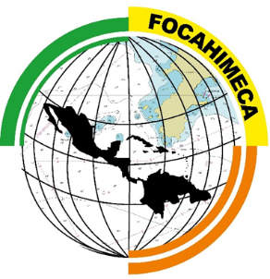
PROJECT OF STRENGTHEN HYDROGRAPHIC CAPABILITIES ON MESOAMERICA AND THE CARIBBEAN SEA (FOCAHIMECA).
Diciembre de 2016.

Slide 2
Antecedents
On April 2014, in the VI Conference of the Head of States of the Association of Caribbean States (AEC); starts the project of “Short Distance Maritime Transportation”.
On January 2015, the Secretary of the Mexican Navy authorize initiate the formalization of the FOCAHIMECA project.

Slide 3
Objectives.
To integrate joint programs of capacity through workshops and curses on topics of hydrography.
To Work on identification of sources of financial resources to promote the acquisition or construction of vessels and hydrographic equipment.
To organize training events that are scheduled in coordination with International Organizations with hydrographic and maritime competence.

Slide 4
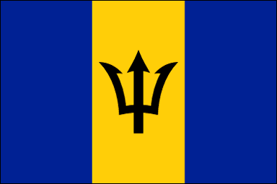
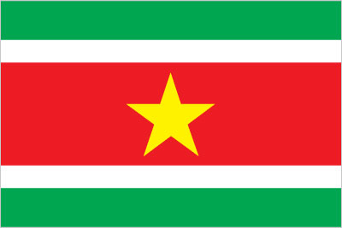
Participant Countries.
1. Antigua y Barbuda
9. Granada
17. Panamá
2. Barbados
10. Guatemala
18. República Dominicana
3. Belice
11. Guyana
19. San Kitts y Nevis
4. Colombia
12. Haití
20. San Vicente y las Granadinas
5. Costa Rica
13. Honduras
21. Saint Lucia
6. Cuba
14. Jamaica
22. Sint Maarten
7. Dominica
15. Las Bahamas
23. Surinam
8. El Salvador
16. Nicaragua
24. Trinidad y Tobago
25. Venezuela

Slide 5
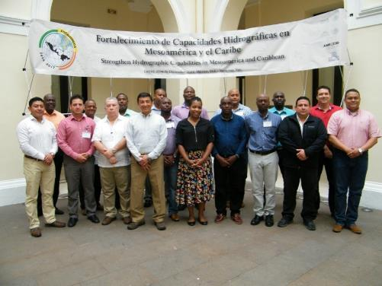
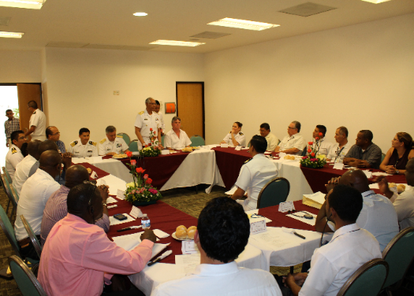
Activities.
Technical workshop on introduction of the FOCAHIMECA project to the authorities in charge of official nautical cartography of 18 countries of Mesoamerica and Caribbean Sea, held from December 1 to 4 of 2015, in México city and the port of Veracruz.
Workshop on “Shallow Water Bathymetry”, held during the “Third Hydrographic Conference” on April 27 to 29 of 2016, in Ciudad del Carmen, Campeche.

Slide 6
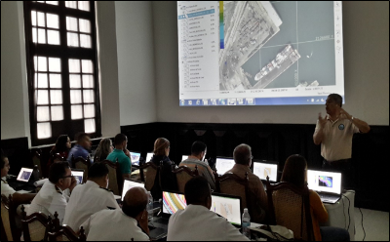
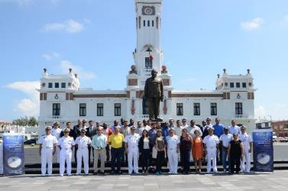
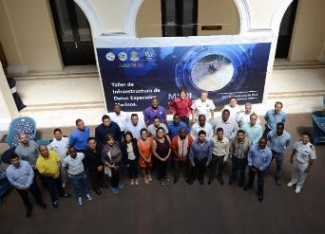
Activities.
Workshop on “Introduction to Bathymetric data Processing”, held at Veracruz from July 13 to 15, with the participation of 19 persons of the FOCAHIMECA project.
Workshop on “Maritime Spatial Data Infrastructure”, organized in conjunction with the MACHC Capacity Building Program, from October 3 to 7 in Veracruz, with the participation of 32 delegates representing maritime and hydrographic authorities from 22 countries of Mesoamerica and the Caribbean Sea, as well as a person from INEGI.

Slide 7
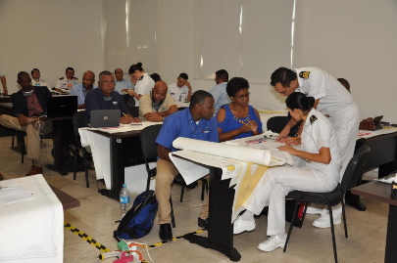
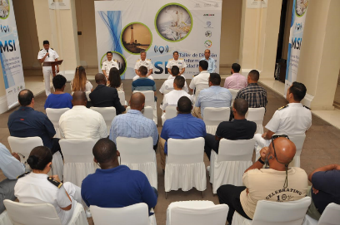
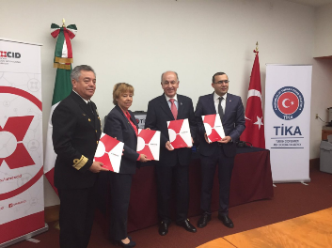
Activities.
Workshop on “Dissemination of Maritime Safety Information”, from 28 to 30 November in Veracruz, with the attendance of 19 Delegates of the FOCAHIMECA project and 01 from the Secretary of Transportation and Communication of Mexico.
Reception of hydrographic equipment donated by the Turkish Cooperation Agency (TIKA), on September 29 in coordination with the Mexican International Cooperation Agency for Development.

Slide 8
Migration to Specialty of Hydrography
Next Year, the way FOCAHIMECA project is training people from workshops to the one year long specialty of hydrography on Spanish Language.
It will be a multiannual program with the participation of 6 Delegates of the FOCAHIMECA project, until all of the countries take the course.
With this migration countries of the region will have a fully trained person to do bathymetry from acquisition of data to chart production.
AMEXCID:
Round flight ticket to Veracruz.
Scholarship
Medical Insurance
Installation expenses.
Mexican Navy:
Infrastructure.
Education.
Workshop and Practice.

Slide 9
Conclusions.
There were conducted five workshops, with a total 72 participations.
Hydrographic equipment was donated to support the FOCAHIMECA project.
With this project México expect to contribute to the aims of the IHO and the development of the hydrographic capabilities and maritime activities on the region
The training workshops provide Mexico with experience in conducting international events and strengthen the bonds of friendship with institutions that carry out hydrography in the countries of Mesoamerica and the Caribbean Sea.

Slide 10
PROYECTO DE FORTALECIMIENTO DE CAPACIDADES HIDROGRÁFICAS EN MESOAMÉRICA Y EL MAR CARIBE (FOCAHIMECA).
Diciembre de 2016.

