Slide 1

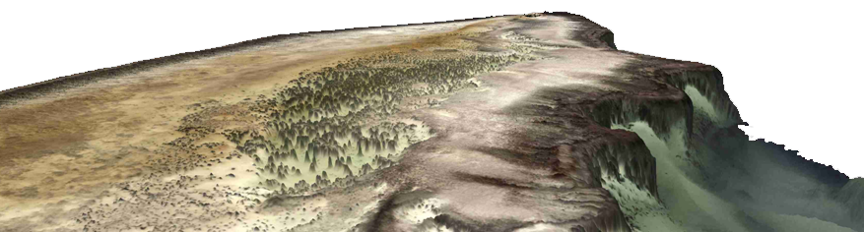
Satellite derived bathymetry
Thomas Heege
CEO
heege@eomap.de

Slide 2
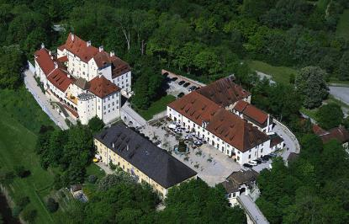
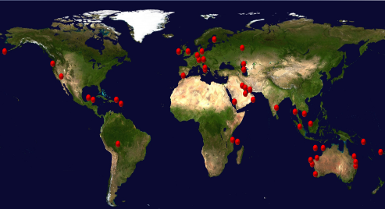

About EOMAP
Global satellite service provider for offshore and water industries
Core services: mapping & monitoring of inland, coastal and marine environments
15 years of systematic development on SDB related technologies
Headquarter in Castle Seefeld
(30min distance to Munich)
Notes:
Founded in 2006 as Spin-Off from the DLR with HQ close to Munich, DE
Since 2013 offices in Singapore, India, USA and representatives for Australia.
Approx. 20 employees including physicist, mathematics, geoinformatics or (geo)-ecologist
Core services are mapping and monitoring of coastal and marine environments
Headquarter is located in Castle Seefeld, near Munich
Several strategic partnerships as with Digital Globe
Various award winning as GMES/Copernicus Masters 2011 and 2013

Slide 3











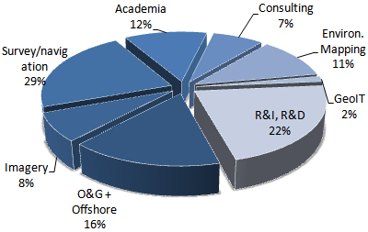
















Markets and client groups:
Blue economy

Slide 4
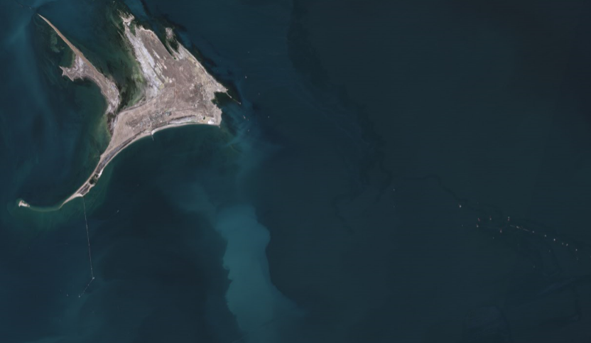
What it‘s about?

Slide 5
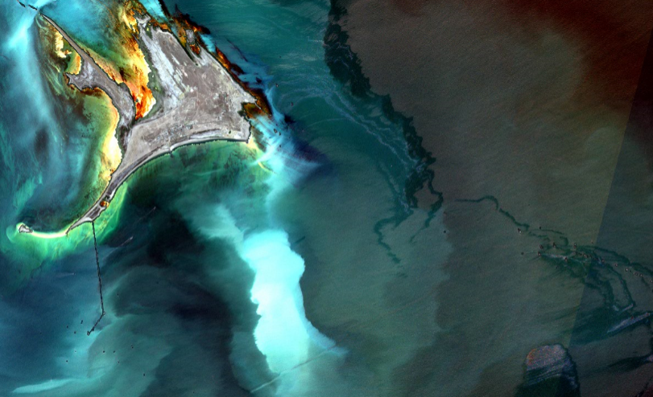
Hidden geoinformation
Seafloor
habitats
obstructions
Seastate parameters
Surface oil
coastline
bathymetry
Water column
properties
platforms
Surface oil
infrastructure
In 4 dimensions
Surface obstructions
Vessel traffic

Slide 6
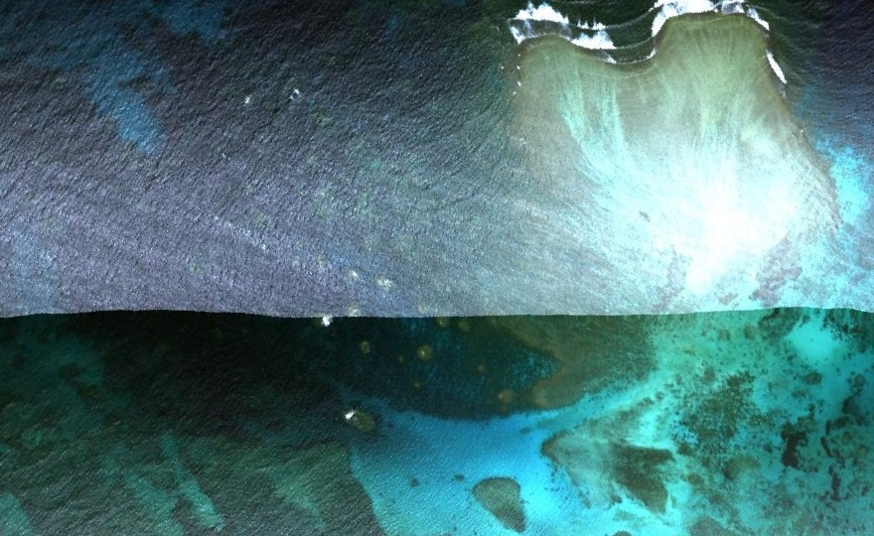
Example: Correction modul sunglitter and atmosphere
Record 1
Record 2

Slide 7
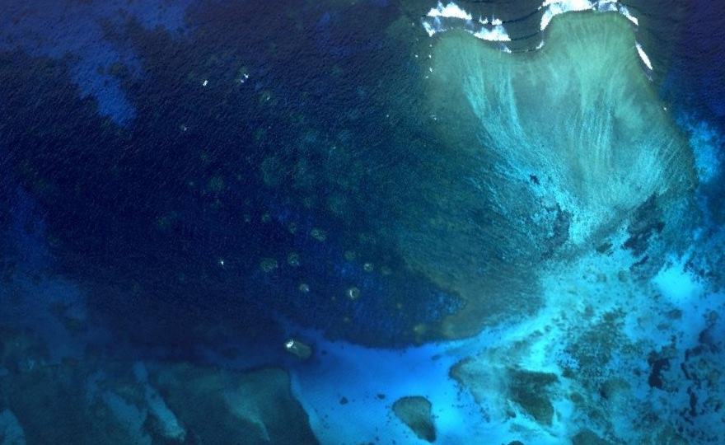
Output of the sunglitter and atmospheric correction modul

Slide 8
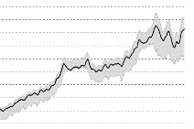
EOMAP’s physics based method
pixel = f(atm., adjacency, water surface, aborbers and backscatterers of the water column, seafloor, water depth, seastate, sun and sensor geometry, SNR ratio)
atmosphere
Subsurface reflectance
bathymetry
adjacency
sunglint
water column
Satellite radiance image
habitats

Slide 9
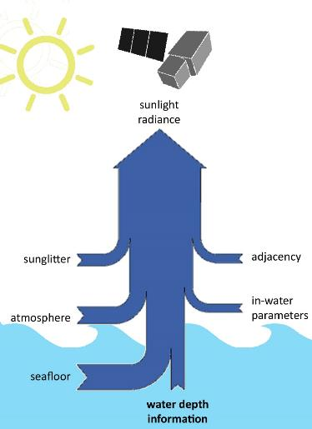
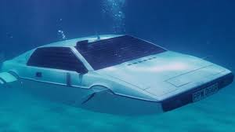

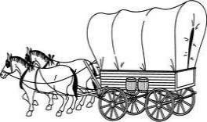
Innovation process
Approach & service: Fit for purpose?
Consistency
Reliability & QC
Independency
Capacity
Total costs
Foto: Volvo
Foto: Csaba Peter Rakoczy

Slide 10
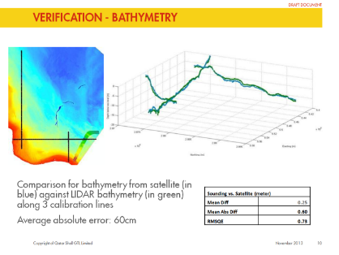
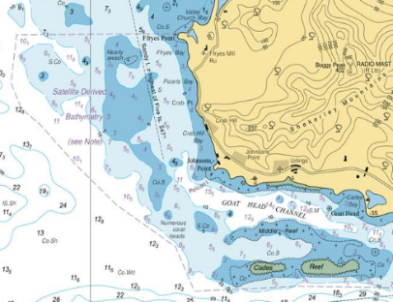
Applications & requirements
SDB for offshore industry surveys SDB for Nautical charts
e.g. Shell Qatar UKHO
Timely and deliverable reliability, accuracy, uncertainty forecast, costs, …

Slide 11
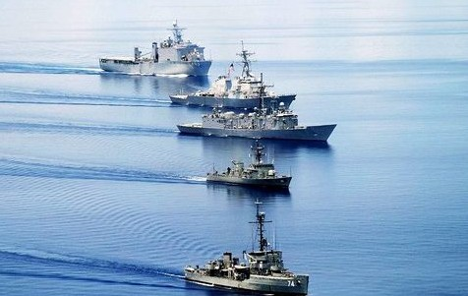

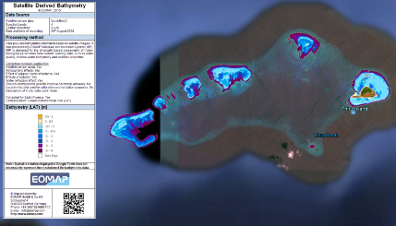
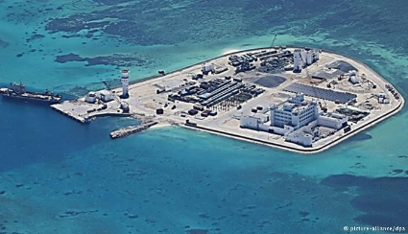
Use case South China Sea: Den Haag Courtcase
Using Very High resolution Satellite Images for Den Haag court case
Requirements: Independently of in-situ data, plausibility & transparency

Slide 12
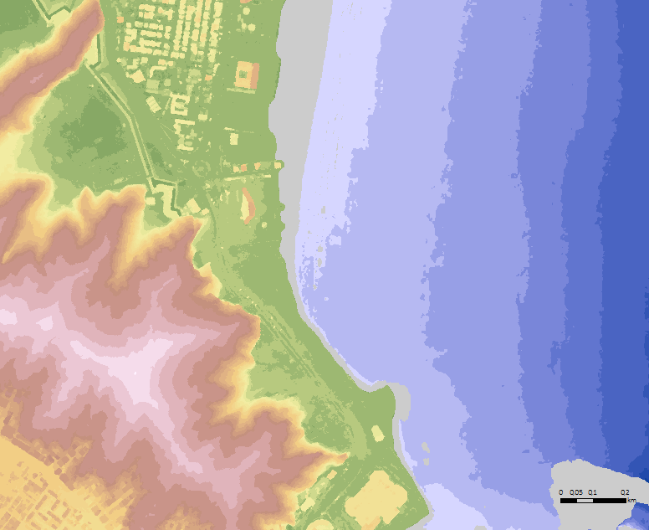
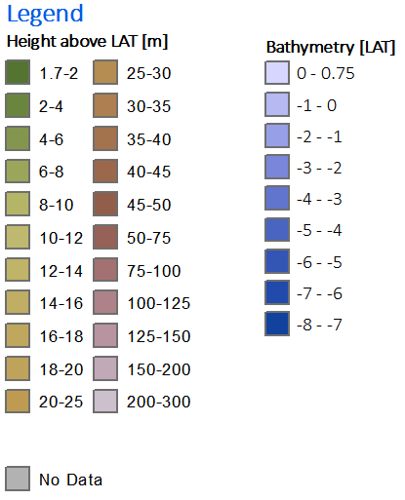
Seamless Digital Surface Model Land-Water
Using Very High resolution Satellite Images to derive land elevation and bathymetry
All elevation data were derived from satellite data, remote and rapid

Slide 13
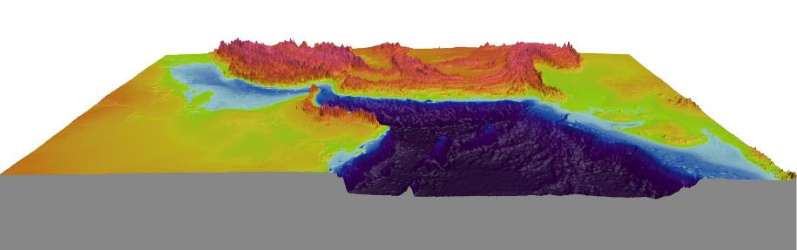
Seamless Digital Surface Model Land-Water
Cross-national
Transnational data for intergovernmental organizations,
e.g. for Tsunami modelling
Requirements: Consistency, capacity, reliability, costs, …

Slide 14
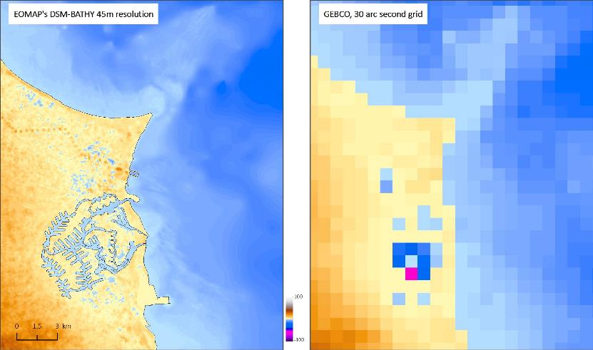
Comparison
BATHY45 vs. GEBCO

Slide 15

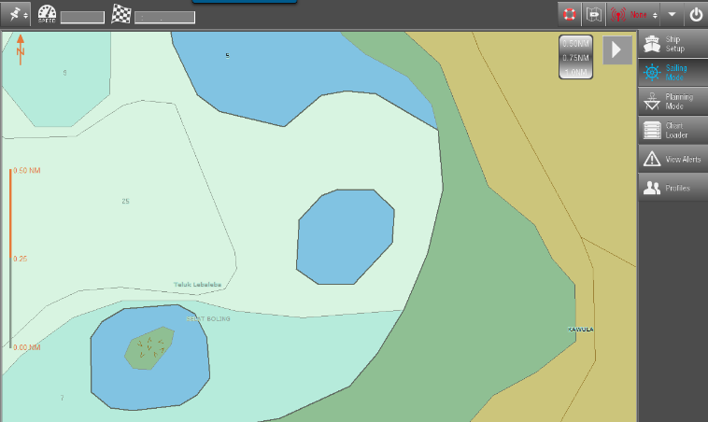
Demonstration: Updating ENCs
Edition 5, Update 2, Issues Date 20160310 ENC
Indonesia, Pulau L.: Use Bathymetry Plotter, load data, generate 3d-Model..

Slide 16
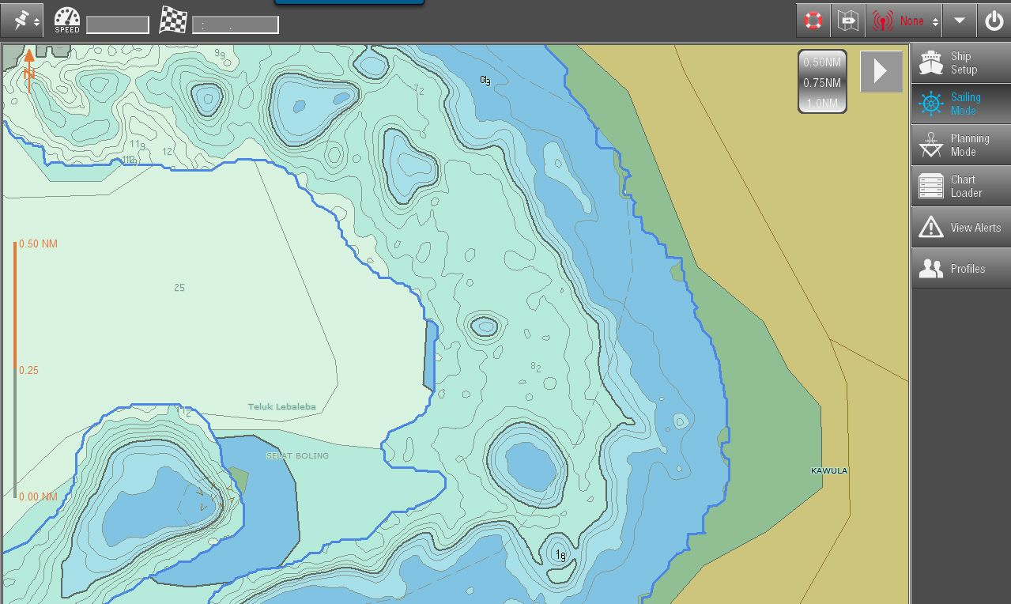
Demonstration: Updating ENCs
Increasing safety
ENC creation: ChartPlotter, 7Cs
Satellite Derived Bathymetry: 10m grid
Requirements: Consistency,
capacity, reliability, costs, …

Slide 17
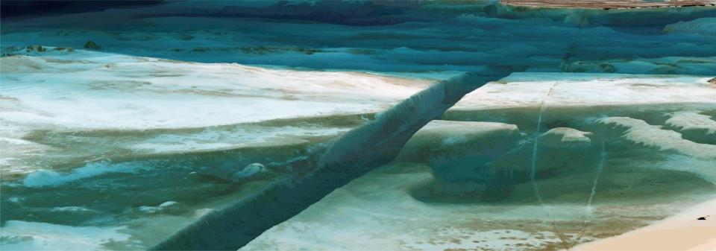
Questions?
Thomas Heege
heege@eomap.de
EOMAP GmbH & Co.KG
Schlosshof 4, 82229 Seefeld, Germany
info@eomap.com, +49 (0)8152 9986 110
Notes:
17

Slide 18
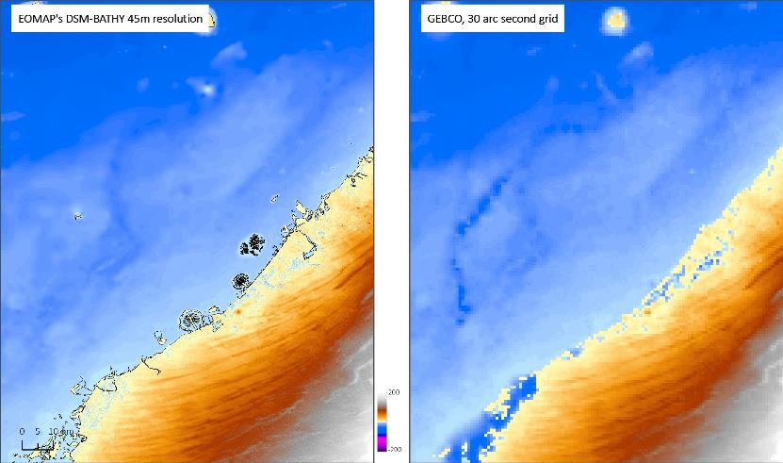
Comparison
BATHY45 vs. GEBCO

Slide 19
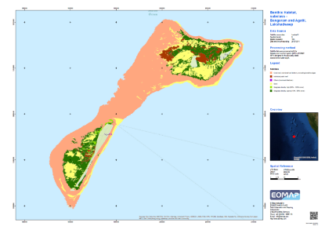
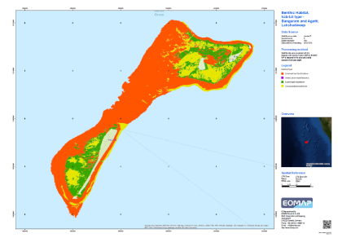
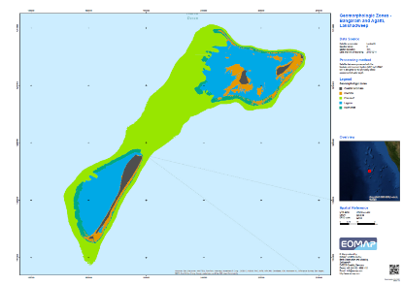
Seafloor Habitat Mapping
Integrated Coastal Zone Management India, ESA-WorldBank eoworld2
Lakshadweep region and Palk Bay
Major benthic classes
Subclasses
Geomorphology

Slide 20
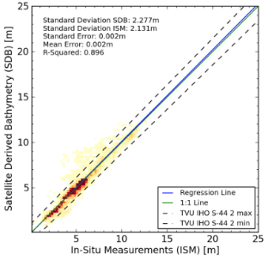
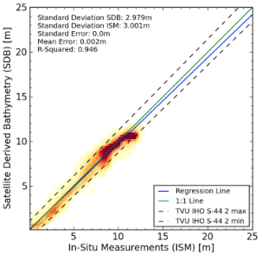
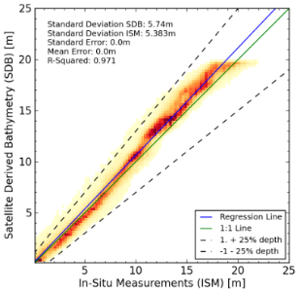
Vertical uncertainties
Kompsat-3, 0.7m
Red Sea
Validated against MBES
WorldView-2, 2m
West-Australia
Validated against Lidar
WorldView-2, 2m
Caribbean Sea
Validated against Lidar
2
Uncertainties = f(atm., adjacency, water surface, aborbers and backscatterers of the water column, seafloor, water depth, seastate, sun and sensor geometry, SNR ratio)

Slide 21
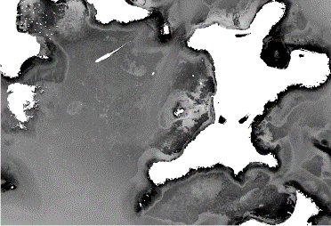
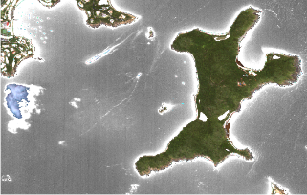
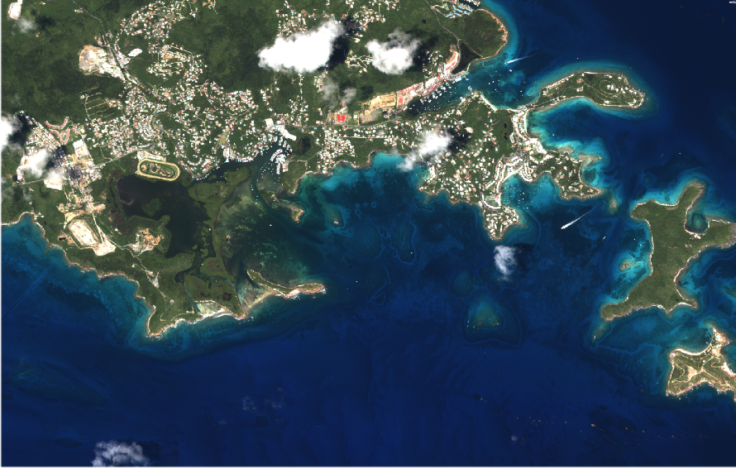
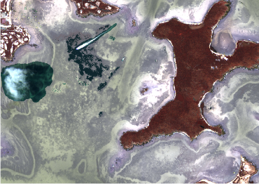
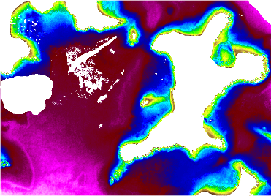
Atmosphere

Slide 22

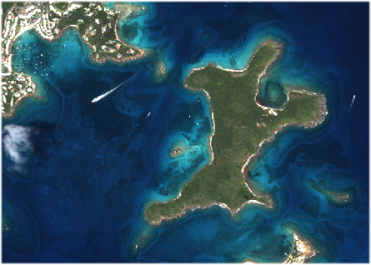
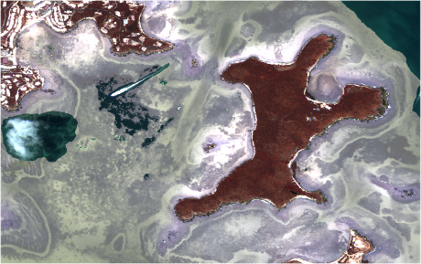

Slide 23
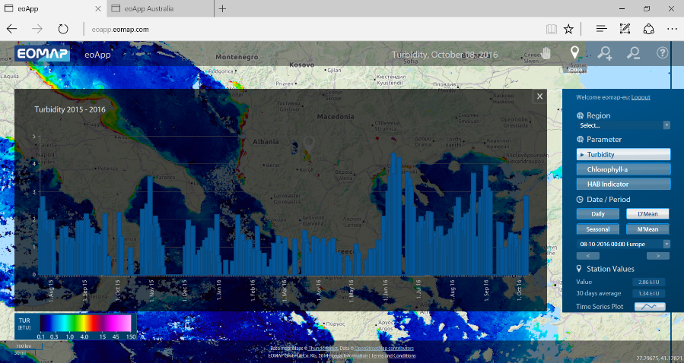
Online: actual and historic marine environmental information

Slide 24
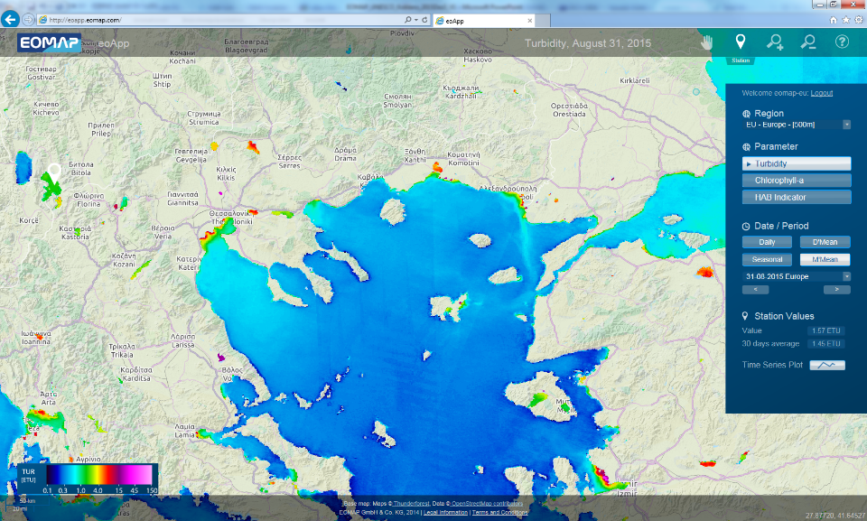
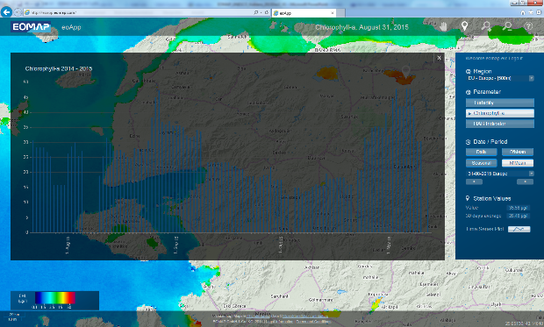
Continental monitoring & access within few hours
e.g. http://eoapp.eomap.com/

Slide 25
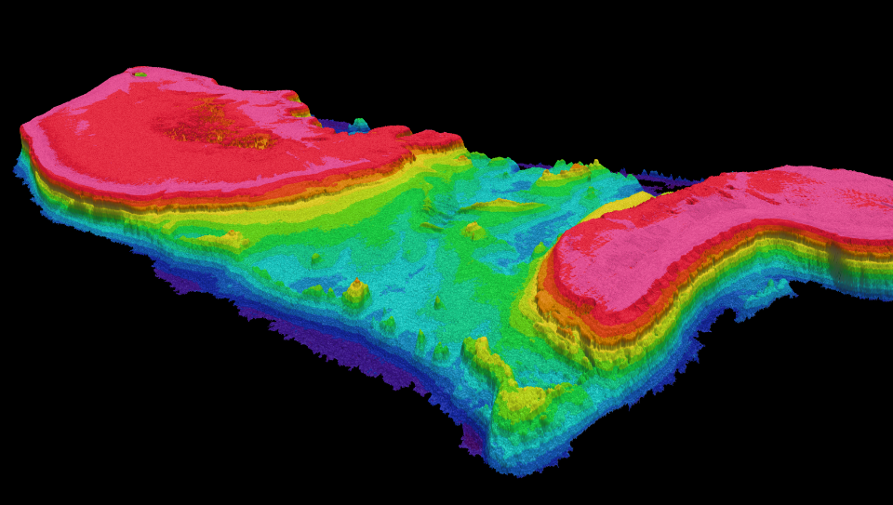
Bathymetric Grid, GBR, Australia
Satellite Derived Bathymetric Grid
2.0m grid spacing
0-25m water depth

Slide 26
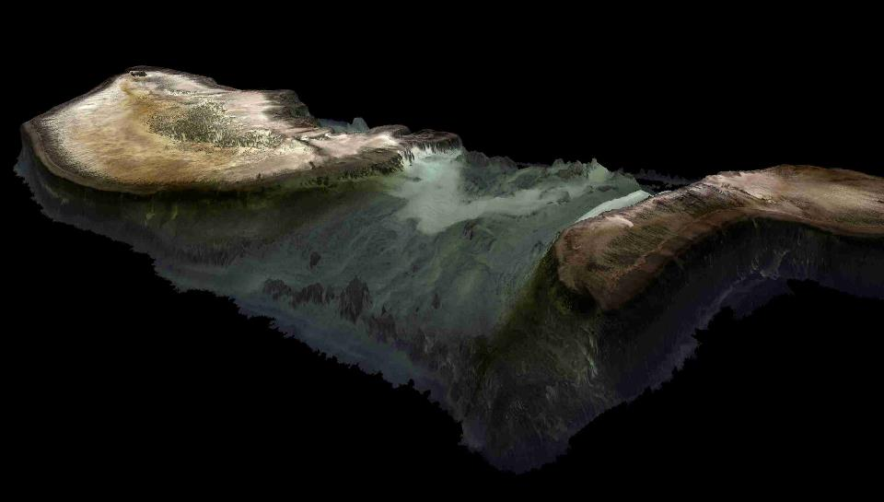
Seafloor Reflectance over Bathymetric Data, GBR, Australia
Satellite Derived Seafloor Reflectance
2.0m grid spacing

