Slide 1

MACHC 17 – 03.S2
Panama Canal Authority
Eng. Ricardo De Levante Alvarado
Supervisor, Hydrographic Unit
Engineering Division
MENU

Slide 2
MAIN TOPICS
MAIN ACHIEVEMENTS
MAIN CHALLENGES
MAIN OBSTACLES
HYDROGRAPHIC SURVEYING ACTIVITIES
CAPACITY BUILDING

Slide 3
1. MAIN ACHIEVEMENTS
THE PRODUCTION OF THE FIRST ELECTRONIC NAUTICAL CHARTS (ENCs) OF THE PANAMA CANAL
MENU
NEXT

Slide 4
ADVISORY TO SHIPPING No. A-34-2016
NEXT

Slide 5
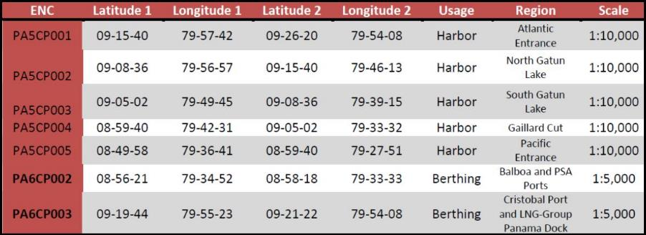
ELECTRONIC NAUTICAL CHARTS (ENCs)
CELL NAMES AND CODES
NEXT

Slide 6
ELECTRONIC NAUTICAL CHARTS (ENCs) INDEX
NEXT

Slide 7
ELECTRONIC NAUTICAL CHARTS (ENCs) DISTRIBUTION
IC-ENC IS ASSISTING THE PCA WITH THE PRODUCTION AND DISTRIBUTION OF HIGH QUALITY ENCs.
THESE NEW CHARTS ARE AVAILABLE TO SHIPPING COMPANIES THROUGH ANY OF THE EIGHT (8) VARs CHART DISTRIBUTORS OF IC-ENC.
.
MENU

Slide 8
2. MAIN CHALLENGES:
TO PRODUCE THE FIRST THREE (3) NATIONAL PAPER CHARTS OF THE PANAMA CANAL.
MENU
NEXT

Slide 9
NAUTICAL PAPER CHARTS
CELL NAMES AND CODES
NEXT

Slide 10
NAUTICAL PAPER CHARTS INDEX
MAIN

Slide 11
3. MAIN OBSTACLES:
THE PANAMA CANAL AUTHORITY (PCA) NEEDS TO VALIDATE THE NATIONAL PAPER CHARTS AND THERE IS NO TRAINED PERSONNEL IN THE PCA TO DO IT.
ALSO, THE CHARTS NEEDS TO BE DISTRIBUTED.
MENU
NEXT

Slide 12
ACTIONS TO TAKE:
TO NEGOTIATE A COOPERATIVE AGREEMENT WITH AN IHO MEMBER THAT CAN DISTRIBUTE THE PAPER CHARTS, BASED IN A FAIR ROYALTY RATE.
TO VALIDATE PAPER CHARTS BEFORE DISTRIBUTION.
NEXT

Slide 13
THINGS TO DO:
TO NEGOTIATE A COOPERATIVE AGREEMENT WITH AN IHO MEMBER THAT CAN DISTRIBUTE THE PAPER CHARTS, BASED IN A FAIR ROYALTY RATE.
TO VALIDATE PAPER CHARTS BEFORE DISTRIBUTION.
NEXT

Slide 14
FUTURE ACTIVITIES:
TO CONTINUE WITH THE PRODUCTION OF OTHER NAUTICAL PAPER CHARTS OF THE PANAMA CANAL AND TO UPDATE THE EXISTING ENCs.
MENU

Slide 15
4. HYDROGRAPHIC SURVEYING ACTIVITIES
4.1 HYDROGRAPHIC SURVEYING BOATS FLEET
4.2 MAIN HYDROGRAPHIC SURVEYING ACTIVITIES
MENU

Slide 16
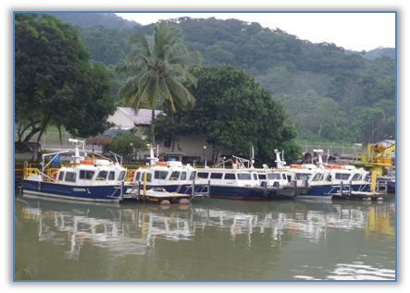
4.1 HYDROGRAPHIC SURVEYING BOATS FLEET
TEN (10) HYDROGRAPHIC SURVEY BOATS. EQUIPPED WITH SINGLE AND MULTIBEAM SYSTEMS; MAGNETOMETERS; POS MV; SIDE SCAN AND ECHOSCOPE 3D SONAR SYSTEMS.
POINT 4

Slide 17
4.2 MAIN HYDROGRAPHIC SURVEYING ACTIVITIES
4.2.1 TO VERIFY DREDGING PROGRESS, PAYMENTS AND COMPLIANCE OF DESIGN DEPTHS FOR THE EXPANSION OF THE CANAL.
4.2.2 TO INSPECT AND MONITOR CANAL LOCKS UNDERWATER STRUCTURES -102 YEARS OLD.
4.2.3 TO LOCATE UNDERWATER TREES IN FUTURE ANCHORAGES FOR NEO-PANAMAX VESSELS
4.2.4 TO UPDATE ENCs AND PAPER CHARTS
POINT 4

Slide 18
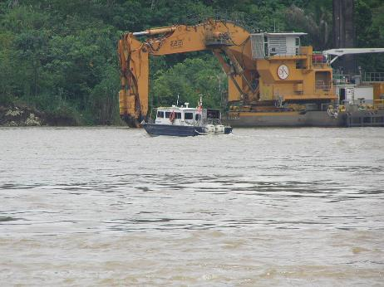
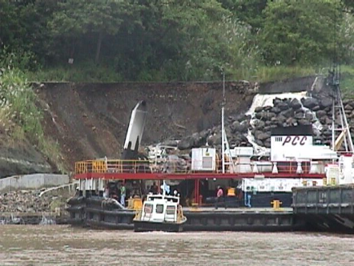
4.2.1 TO VERIFY DREDGING PROGRESS, PAYMENTS AND COMPLIANCE OF DESIGN DEPTHS IN THE NEW CHANNEL
POINT 4.2

Slide 19
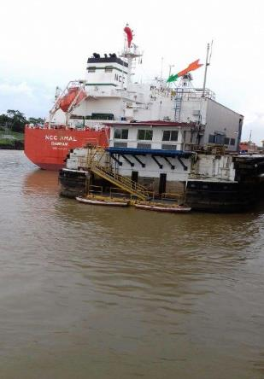
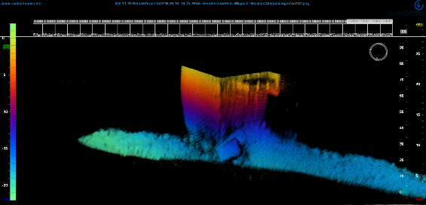
4.2.2 TO INSPECT CANAL LOCKS UNDERWATER STRUCTURES -102 YEARS OLD.
POINT 4.2

Slide 20
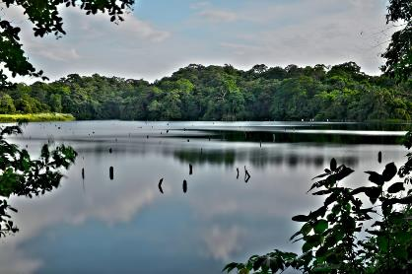
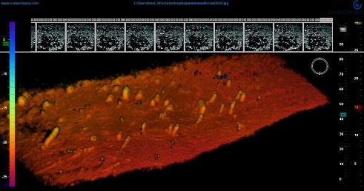
4.2.3 TO LOCATE UNDERWATER TREES FOR REMOVAL IN FUTURE ANCHORAGES FOR NEO-PANAMAX VESSELS
POINT 4.2

Slide 21
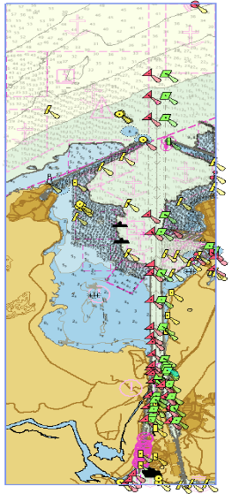
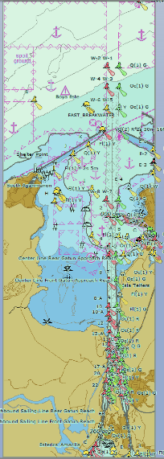
4.2.4 TO UPDATE ENCs
NEXT

Slide 22
4.2.4 TO UPDATE NAUTICAL PAPER CHARTS
POINT 4.2
MENU

Slide 23
5. CAPACITY BUILDING
MENU
NEXT

Slide 24
5.1 FACILITIES AT PANAMA CANAL AUTHORITY (PCA) FOR IN-HOUSE TRAINING.
5.2 TRAINING COURSES FOR MEMBERS OF SURVEYS SECTION STAFF IN THE DOMAIN OF HYDROGRAPHIC SURVEYING, MARINE CARTOGRAPHY AND NAUTICAL INFORMATION - 2016.
5.3 TRAINING COURSES IN SPANISH FOR MEMBERS OF THE SURVEYS SECTION STAFF IN THE DOMAIN OF HYDROGRAPHIC SURVEYING AND MARINE CARTOGRAPHY - 2017 .
5.4 SCHOLARSHIPS IN THE DOMAIN OF HYDROGRAPHIC SURVEYING – 2017.
POINT 5

Slide 25
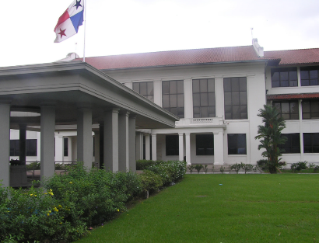
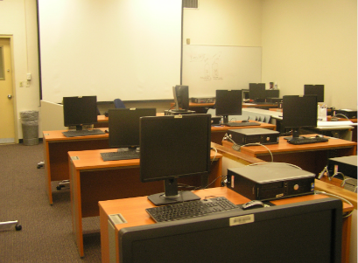
PANAMA CANAL TRAINING CENTER
(ASCANIO AROSEMENA)
INFRASTRUCTURES AND CLASSROOMS
FOR THEORETICAL TRAINING
NEXT

Slide 26
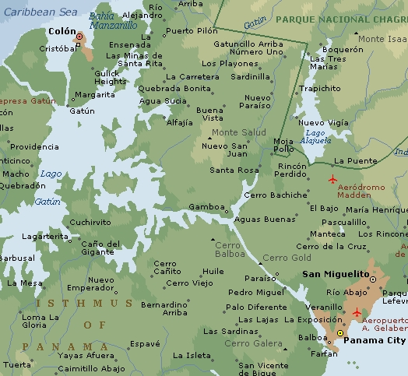

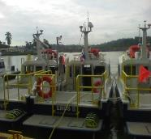
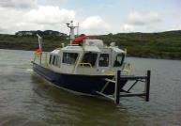

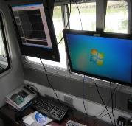
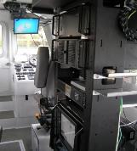


FOUR (4) HYDROGRAPHIC UNIT DOCKING FACILITIES
LOCATED NEAR THE CANAL WATERWAY
FOR FIELD TRAINING
POINT 5

Slide 27
5.2.1 IN-HOUSE TRAINING
5.2.2 LOCAL TRAINING
5.2.3 OVERSEAS TRAINING
POINT 5

Slide 28
5.2.1 IN-HOUSE TRAINING
NEXT

Slide 29
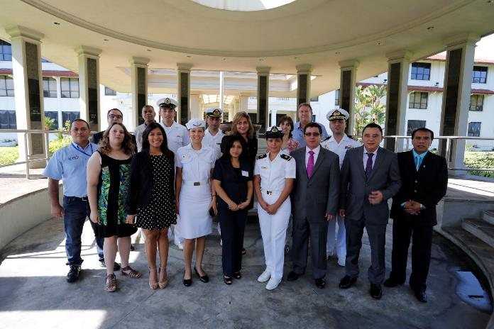
ENC VALIDATION AND VERIFICATION
THREE (3) MEMBERS OF THE PCA CARTOGRAPHIC UNIT STAFF ATTENDED THE TRAINING WORKSHOP :
Ms. Vanessa Sáiz and Sirs Rolando Calderón and Carlos Montiel.
NEXT

Slide 30
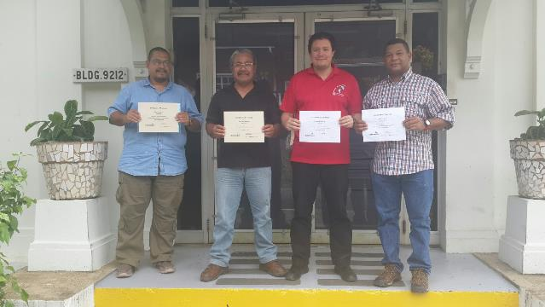
TRAINING WORKSHOP:
ECHOSCOPE 3D
COLLECTION AND ANALYSIS
FOUR (4) MEMBERS OF THE PCA HYDROGRAPHIC AND CARTOGRAPHIC UNITS STAFF ATTENDED THE WORKSHOP:
Sirs Raúl González, Juan Montenegro, Fernando Bolívar and Raúl Cedeño.
POINT 5.2.2

Slide 31
5.2.2 LOCAL TRAINING
NEXT

Slide 32
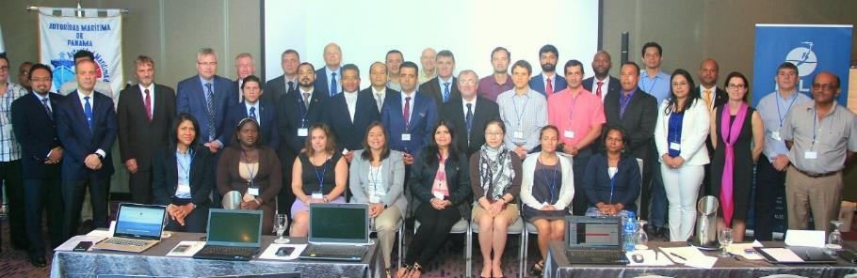
TRAINING SEMINAR:
ON THE USE OF THE IALA RISK MANAGEMENT TOOLBOX
THREE (3) MEMBERS OF THE PCA SURVEYS SECTION STAFF ATTENDED THE SEMINAR:
Sirs Fernando Bolívar, Jaime Rodríguez and Domiluis Villarreal.
NEXT

Slide 33
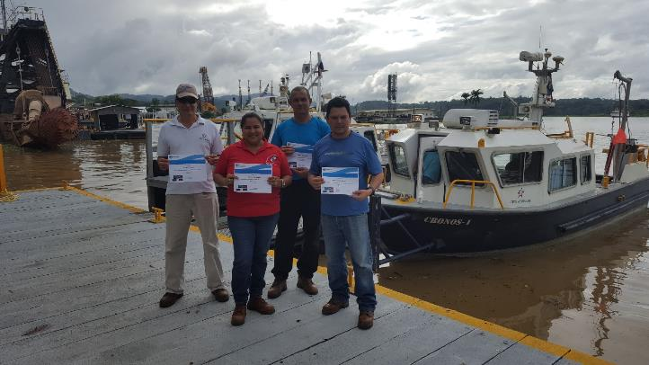
TRAINING SEMINAR:
HYPACK 2016
FOUR (4) MEMBERS OF THE PCA HYDROGRAPHIC UNIT STAFF ATTENDED THE SEMINAR:
Mr. Tomás Atencio, Ms. Delky De Sedas, Mr. Jorge González and Mr. Néstor Domínguez.
POINT 5.2.3

Slide 34
5.2.3 OVERSEAS TRAINING
NEXT

Slide 35
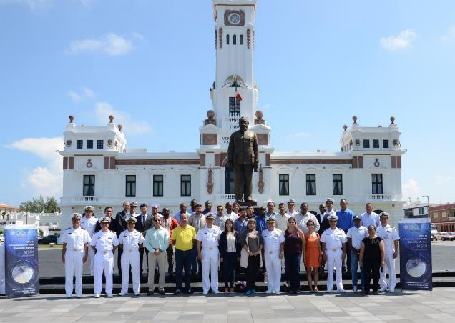
TRAINING WORKSHOP:
TALLER DE INFRAESTRUCTURAS DE DATOS ESPACIALES MARÍTIMOS (MSDI)
ONE (1) MEMBER OF THE PCA CARTOGRAPHIC UNIT STAFF ATTENDED THE WORKSHOP:
Ms. Iris De Gracia
NEXT

Slide 36
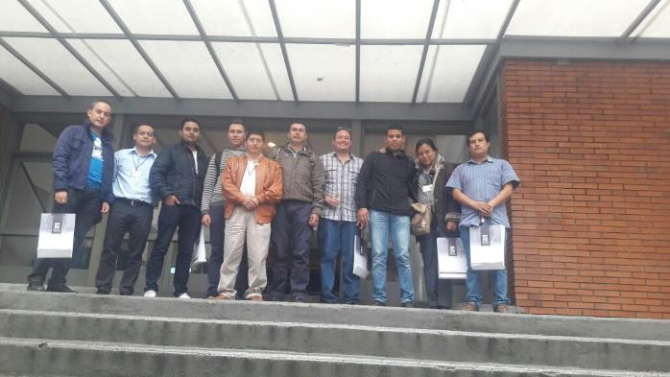
TRAINING WORKSHOP:
TALLER DE ESTÁNDARES DE INFORMACIÓN GEOGRÁFIA
ONE (1) MEMBER OF THE PCA CARTOGRAPHIC UNIT STAFF ATTENDED THE WORKSHOP:
Mr. Fernando Bolívar
POINT 5

Slide 37
FOUR (4) TRAINING COURSES IN SPANISH
WILL BE HELD AT PCA FACILITIES IN YEAR 2017.
1. KONGSBERG MULTIBEAM EM2040C WORKSHOP TRAINING. (HYPACK INTEGRATION).
2. SIDE SCAN SONAR KLEIN 3000 WORKSHOP TRAINING. (HYPACK INTEGRATION).
3. JWFISHER MAGNETOMETER PROTON 4 WORKSHOP TRAINING. (HYPACK INTEGRATION).
4. CARIS ON BOARD WORKSHOP TRAINING.
POINT 5.4

Slide 38
5.4 SCHOLARSHIPS IN THE DOMAIN OF HYDROGRAPHIC SURVEYING
POINT 5
NEXT

Slide 39
“Skilltrade Hydrographic Survey Category B Course” to be held in Netherlands.
Length of course: 26 weeks.
The scholarship was approved for one (1) nominee of PCA, who will attend the course at the first trimester of 2017 and for two (2) nominees of PCA, who will attend the course at the fourth trimester of 2017.
The scholarship is a Bilateral agreement between the SENACYT (Panamanian Institution) and PCA.
POINT 5
NEXT

Slide 40
“Especialidad Hidrográfica” to be held in Mexico.
Length of course: one (1) year.
One (1) nominee of PCA is awaiting for approval of the scholarship.
This Scholarship is an agreement between several Mexican Institutions. This training is part of FOCAHIMECA Capacity Building Project.
POINT 5
END

Slide 41
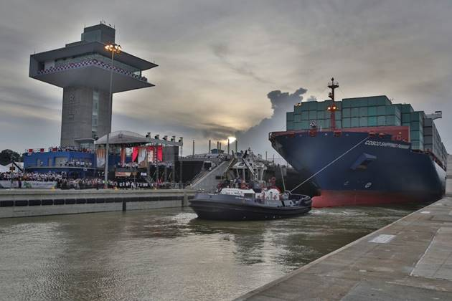

G R A C I A S
THANK YOU!
Ing. Ricardo De Levante, MBA
Teléfono: (507) 276-7155
e-mail: rdelevante@pancanal.com
@ Derechos reservados Autoridad del Canal de Panamá
Diciembre 2016
NEXT

Slide 42
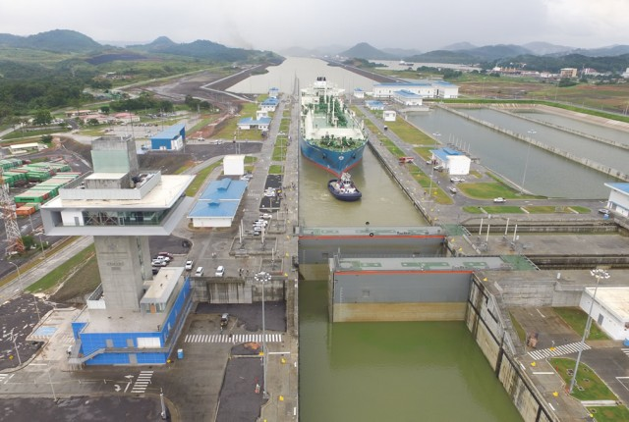
G R A C I A S
QUESTIONS??
Ing. Ricardo De Levante, MBA
Teléfono: (507) 276-7155
e-mail: rdelevante@pancanal.com
@ Derechos reservados Autoridad del Canal de Panamá
Diciembre 2016

