Slide 1
Report of the Crowdsourced Bathymetry Working Group
to IRCC 9
Evert Flier
CSBWG Member
Advisor International Affairs for the Norwegian Hydrographic Service
Evert.Flier@kartverket.no
Jennifer Jencks
CSBWG Chair
Director, IHO Data Centre for Digital Bathymetry
jennifer.jencks@noaa.gov
IRCC 9
June, 2017

Slide 2
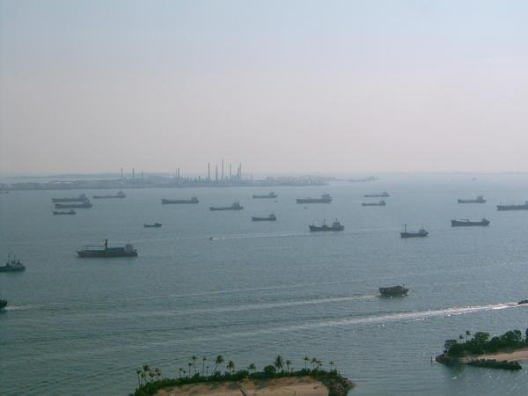
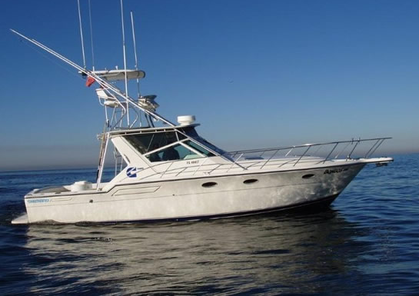
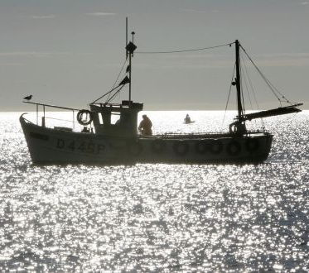
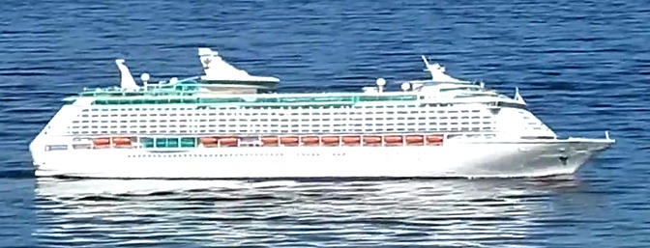
CSB Working Group Task
Prepare an IHO policy document that provides guidance on the collection of CSB data and how to include it in the global bathymetric data set
Notes:
Prepare an IHO document on policy for trusted crowdsourced bathymetry to provide guidance on the collection and assessment of CSB data inclusion in the global bathymetric data set which is maintained in the IHO Data Centre for Digital Bathymetry (DCDB).

Slide 3
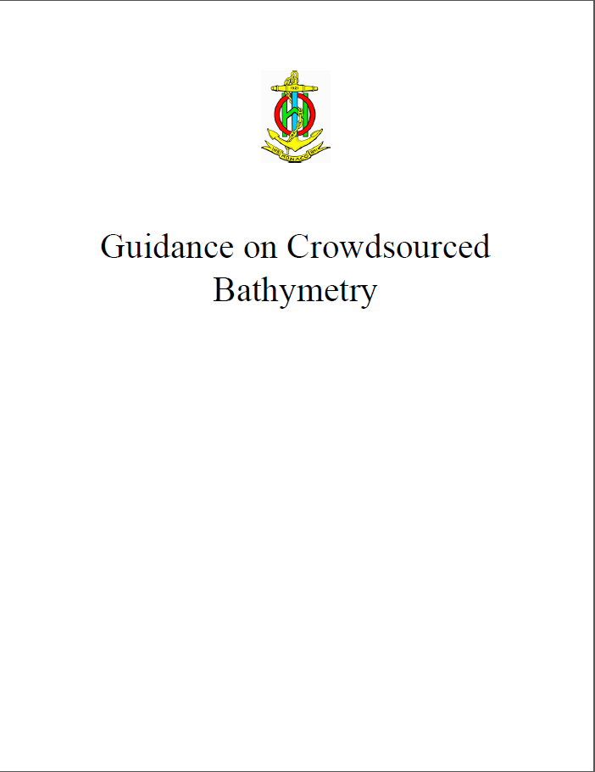
Progress on IRCC Action Item
Initial draft completed and published
Feedback Requested!
To access the document: https://www.iho.int/srv1/index.php?option=com_content&amp;view=article&amp;id=635&amp;Itemid=988&amp;lang=en
Notes:
An initial draft of the Guidance Document has been completed and made available via the IHO website to the public.

Slide 4
CSB Working Group 3rd Meeting
Hosted by the Leibniz Institute for Baltic Sea Research (IOW) in Warnemünde, Germany on 7 and 8 Nov 2016.
Attended by:
Chair of CSBWG, Ms Jennifer Jencks (USA, Director of the DCDB)
Representatives from ten Member States
Canada, Denmark, Finland, France, Germany, India, Italy, Norway, Portugal and USA
Observers and expert contributors from SevenCs and Sea-ID
Secretary General Robert Ward and Assistant Director David Wyatt represented the IHO Secretariat
Mr Serge Gosselin (Canada) was elected as vice-Chair of the WG to occupy the previously vacant position
Notes:
ADD GROUP PICTURE

Slide 5
CSB Working Group 3rd Meeting
The CSBWG received verbal reports from the Correspondence Group leads tasked with drafting specific sections of the IHO CSBGD.
Systems and Hardware - It was reported that the chapter was completed.
Metadata and Data Formats - It was reported that the chapter was mostly complete.
Uncertainty
The goal is to capture the information (metadata) required to assist in assessing an uncertainty but not to actually mandate a method to do so.
It is intended that more details will be available on more technical subjects and aspects in an appendix to the Uncertainty section.
Trusted Nodes
Focus on identifying the methods for contributing data to the DCDB.
Legal
Attempted to identify and provide insight (not advice) on 3 issues: (1) exposure to liability, (2) potential liability within various maritime zones and (3) data licensing (ownership of data)

Slide 6
CSB Working Group 3rd Meeting
Various draft sections were developed further.
General agreement that the GEBCO Cookbook provided a good model
It was agreed that an appropriate definition for IHO CSB was required and should be included in the CSBGD.
Crowdsourced bathymetry (CSB) is the collection of depth measurements from vessels, using standard navigation instruments, while engaged in routine maritime operations.
Notes:
During the meeting the various draft sections of the Guidance Document were developed further.
General agreement that the GEBCO Cookbook provided a good model to follow with each section/chapter relatively self contained.
It was agreed that an appropriate definition for IHO CSB was required and should be included in the CSBGD.
Crowdsourced bathymetry (CSB) is the collection of depth measurements from vessels, using standard navigation instruments, while engaged in routine maritime operations.

Slide 7
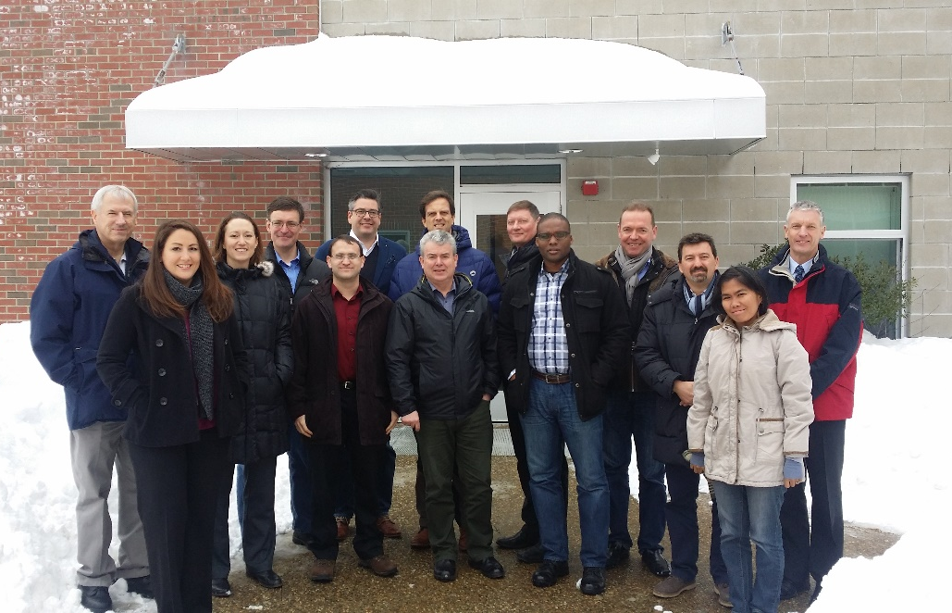
CSB Working Group 4th Meeting
Center for Coastal and Ocean Mapping & NOAA/UNH Joint Hydrographic Center University of New Hampshire, Durham, US on 13 and 14 Feb 2017.
Attended by:
Representatives from six Member States
Canada, Italy, Nigeria, Norway, Philippines and USA
Observers and expert contributors from GMATEK, Inc./World Maritime University and Sea-ID.
Secretary General Robert Ward and Assistant Director David Wyatt represented the IHO Secretariat.

Slide 8
CSB Working Group 4th Meeting
The CSBWG received verbal reports from the coordinators of Document Chapters that had been tasked with incorporating comments and finalizing specific sections of the IHO CSB Guidance Document.
Data and Metadata
Data Collection
Uncertainty
Liability
Appendices
It was agreed that an initial draft version would be circulated to IHO Member States and targeted stakeholders for their comments in preparation for the presentation of a final draft to the IRCC9.
Subject to the agreement of the IRCC, this will be followed by a formal public consultation period leading to the submission of a final proposed text to IRCC10 in 2018, consideration by the IHO Council at its 2nd meeting and subsequent adoption by the IHO Member States towards the end of 2018.

Slide 9
CSBGD Development Roadmap & Milestones:
5 May – Submit draft with report to IRCC9
1 Jul – IRCC Secretariat to formally circulate draft for MS comment
Dec 2017 - CSBWG5 meeting
Consider and incorporate external input and comments
Apr/May 2018 - Prepare Edition 1.0.0 for submission to IRCC10
Sep/Oct - Formal submission to IHO Council2/IHO Council2 approval
1 Jan 2019 - CSBGD Edition 1.0.0 released
Late 2018/early 19 - CSBWG6 meeting
Commence work on Edition 2.0.0

Slide 10
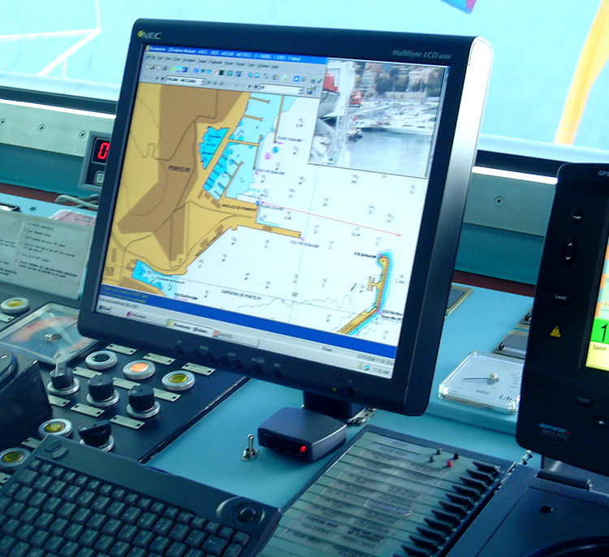
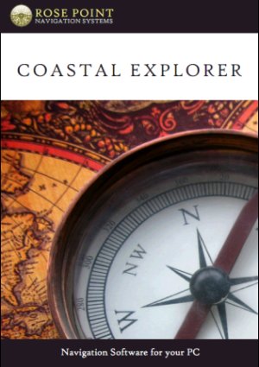
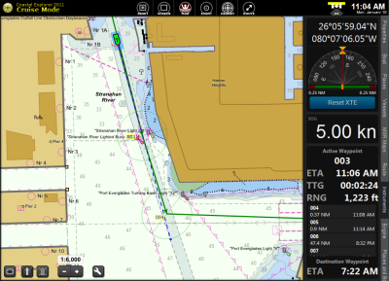
CSB Pilot Project
IHO DCDB and NOAA teamed up with Rose Point Navigation Systems
Mariners joining can log position, depth and date/time.
Mariners can choose to be anonymous or to submit metadata about vessel and equipment
A modified log file gets submitted to the DCDB
www.pcmaritime.com
www.rosepointnav.com
Notes:
Mariners are given an option to enable CSB logging - allowing a modified electronic charting system log file to record position, depth and date/time.
A modified log file gets submitted to the DCDB via HTTP post that contains a JSON metadata string

Slide 11
Problems Encountered
The CSBWG has received minimal feedback from IRCC participants on the draft of the CSB Guidance Document.
There continues to be a need to overcome a degree of skepticism on the CSB concept amid the maritime community and hydrographic organizations
Especially an overly cautious focus on potential, although untested, legal issues.
Increased awareness and information as well as stakeholder engagement/involvement should all help to overcome these reservations.

Slide 12
Conclusions and Recommendations
The continued importance of liaising with other IHO bodies, as well as appropriate engagement with industry, mariners and HOs to progress the Guidance Document, has been identified as a key enabler for the project.
It is also noted the significant progress achieved in such a short period of time since CSBWG initiated its mandate.

Slide 13
Actions requested of IRCC
Note the CSBWG3 and CSBWG4 meeting reports;
Circulate the draft CSBGD for formal consultation with IHO Member States and relevant stakeholders;
Encourage IHO Member States to release datasets or subsets into the public domain via the IHO DCDB;
Request IHO Member States to consider reviewing data gathering restrictions within their maritime areas of jurisdiction to enable CSB activities to be undertaken;
Request IHO Member States to support the CSB initiative with positive actions, such as requiring all research vessels collect bathymetric data for late uploading, when on passage or when it does not interfere with other research activities;
Reappoint the WG to continue its work on the Guidance Document under the current ToRs; and
Take what other action is deemed necessary.

Slide 14
Actions requested of IRCC
Reappoint the WG to continue its work on the Guidance Document under the current ToRs;
Task the WG to investigate what it would take for HO’s to start using CSB (or External Source ) data in their official nautical charts and / or for other purposes in order to create an incentive for the mariners to contribute to collecting CSB data; and
Take what other action is deemed necessary.

Slide 15
Acknowledgements
David Wyatt (Executive secretary)
For keeping us organized and on track
Brian Calder, Adam Reed, Kenneth Himschoot, Evan Robertson (Correspondence Group/Chapter Leads)
For their hard work, enthusiasm and commitment to the project
Whitney Anderson (Editor)
For her patience and skill in making this document (and all of us) look professional
All the working group members, IHO, GEBCO, SMEs and observers whose contributions are making this possible!

