Slide 1

IRCC10
Infrastructure at the IHO Secretariat
IHO Secretariat

Slide 2
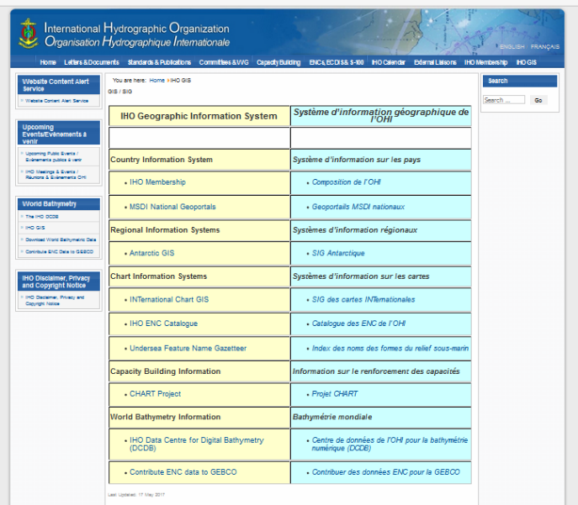
Single Interface to IHO GIS Applications

Slide 3
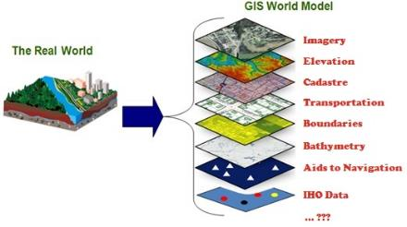
IHO GIS and Databases
avoid duplication of data and inputs
enable data visualisation
enable data fusion and analysis
provide GIS data layers for RHCs and Member States
enable publication and website updates (P-5, C-55, etc.)

Slide 4
IHO CIS Databases
Yearbook, C-55, CATZOCs
Upgrade of the database to include additional information including
the date of signature of the SOLAS Convention, when applicable
the existence of a Nominated Hydrographic Authority
the existence of an MSI Capability,
hydrographic capability, and
the identification of the Primary Charting Authority
Trainees, trainers and consultants (ongoing)

Slide 5
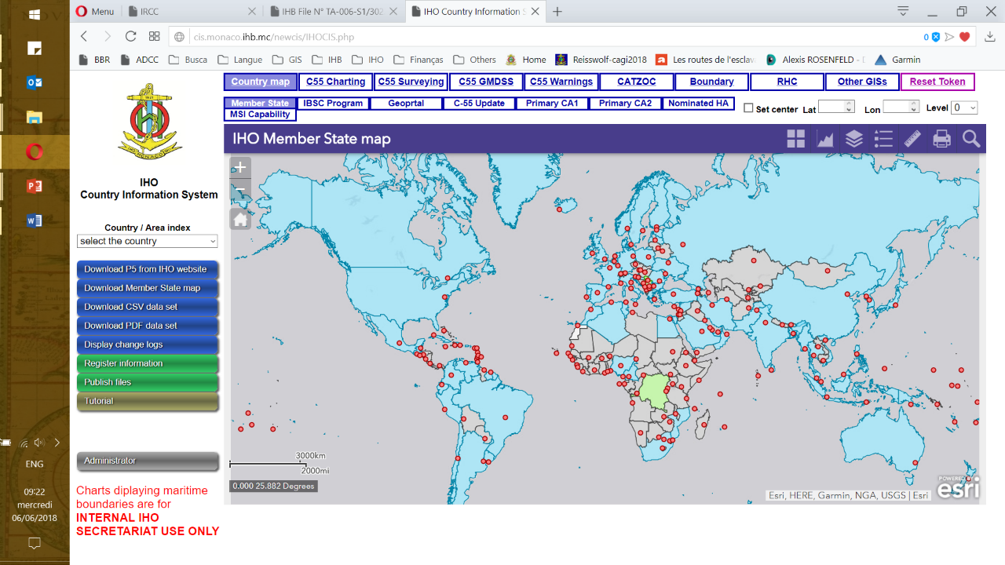
IHO GIS/CIS

Slide 6
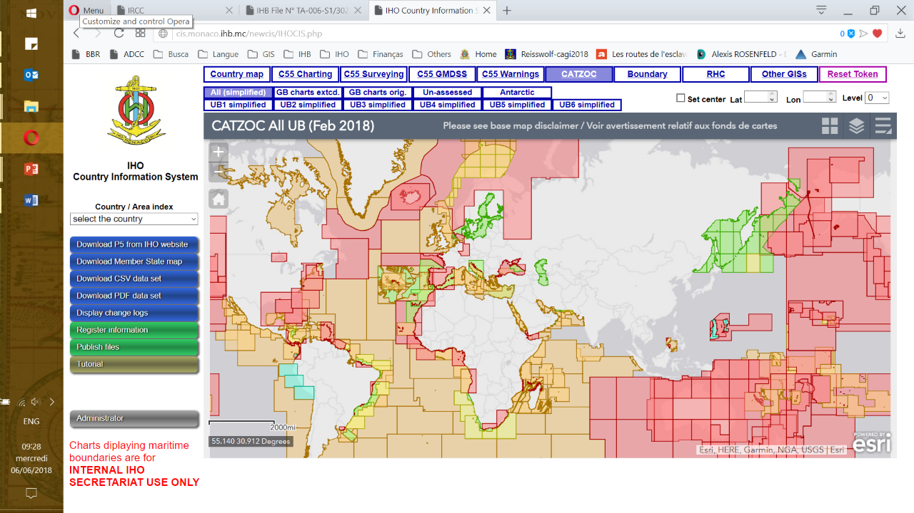
IHO GIS and Databases - C-55 …..
CATZOC

Slide 7
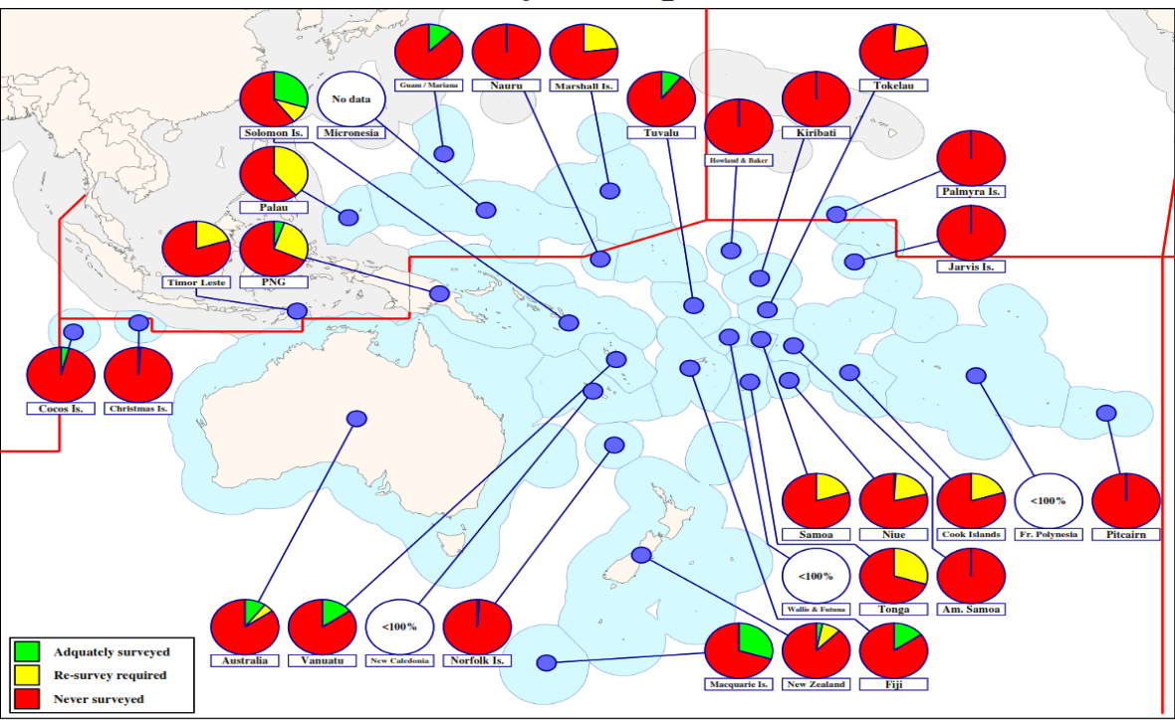
IHO GIS and Databases - C-55 …..
C-55 by country, dependencies, regions and RHCs

Slide 8
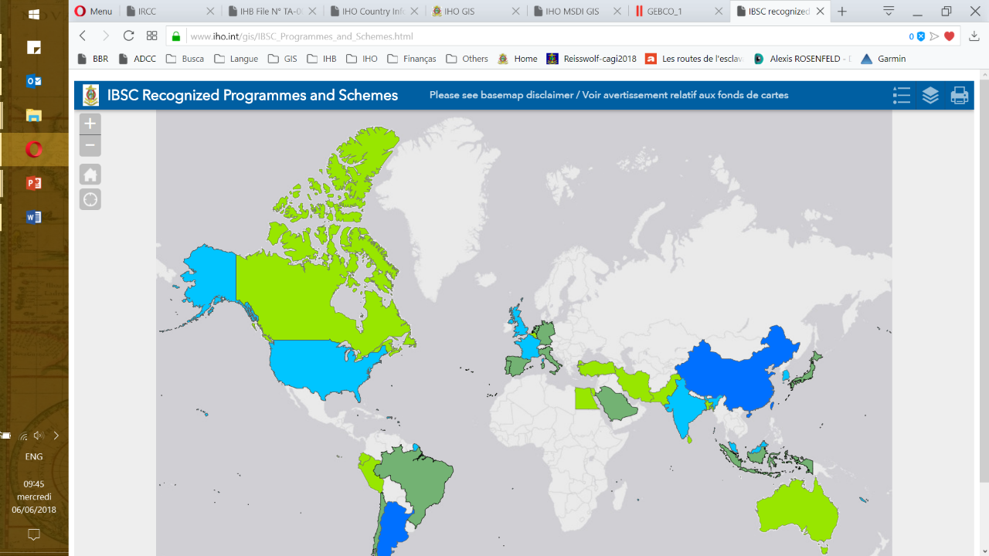
IHO GIS and Databases - C-55 …..
IBSC Recognized Programmes

Slide 9
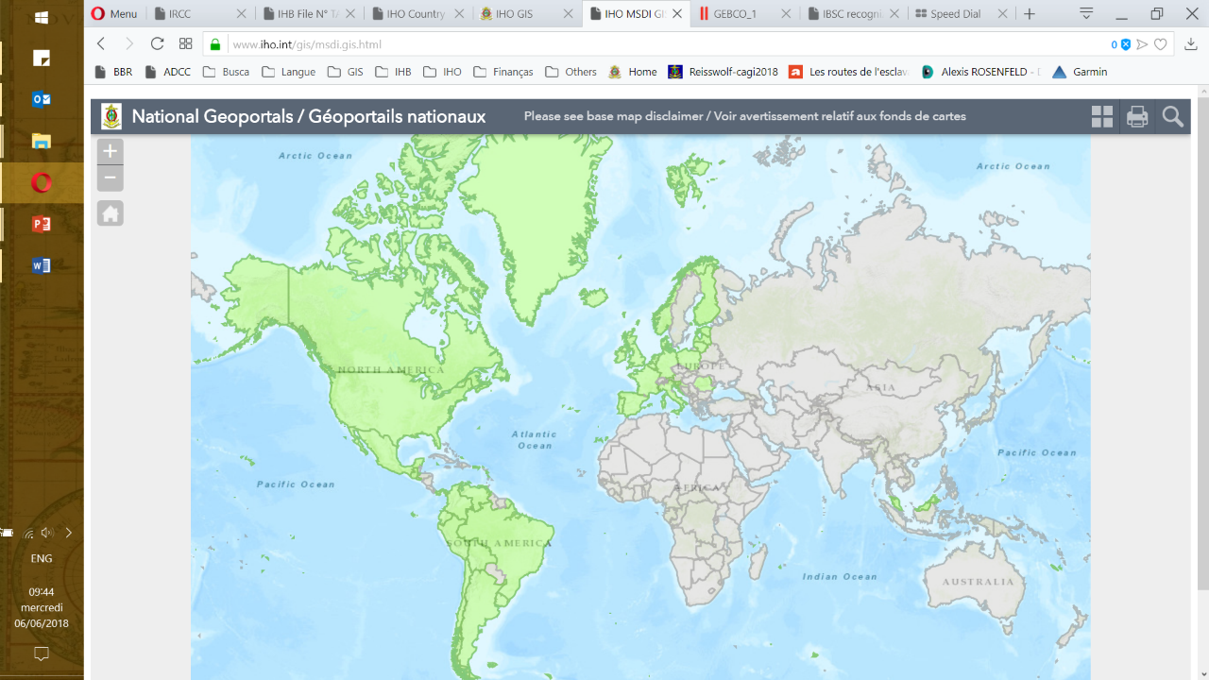
IHO GIS and Databases - C-55 …..
MSDI and SDI Portals

Slide 10
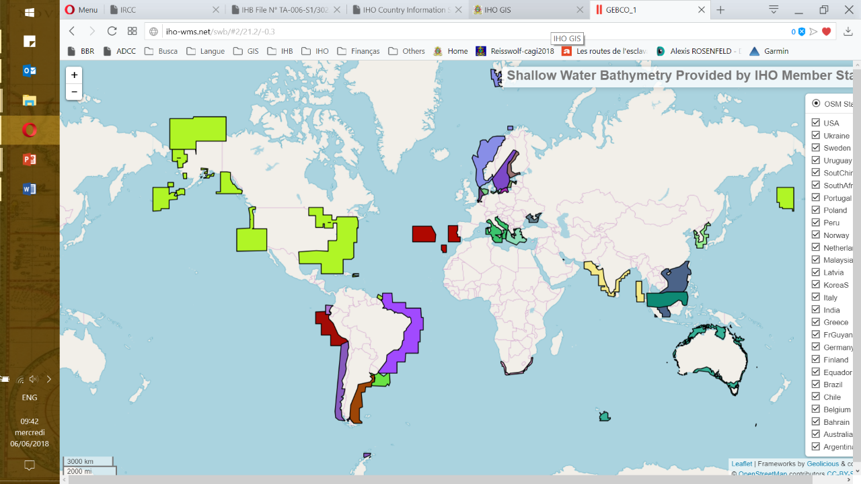
IHO GIS and Databases - C-55 …..
Shallow water bathymetry provided by Member States

Slide 11
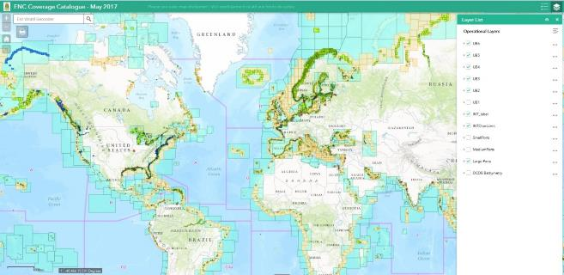
IHO ENC Catalog
Availability of ENCs

Slide 12
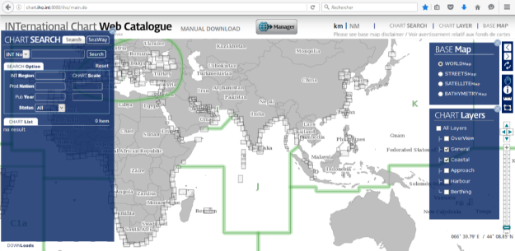
IHO INT2GIS

Slide 13
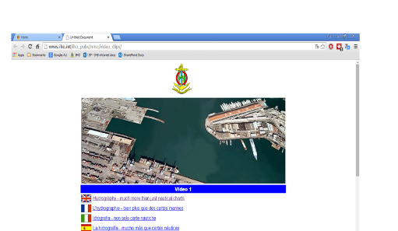
Publicity and Outreach
Web page for movies
New video: “… become a hydrographer” (Hydrography as a career)
available in English, French, Spanish, Italian, Portuguese, Japanese, Korean, etc.

Slide 14
Other developments
Other developments:
Replacement of the IHO document system to allow access also for Member States
Upgrade and update of the IHO website
IHO Capacity Building Management System

Slide 15
IHO Secretariat, here to help you! www.iho.int mustafa.iptes@iho.int alberto.neves@iho.int

