Slide 1
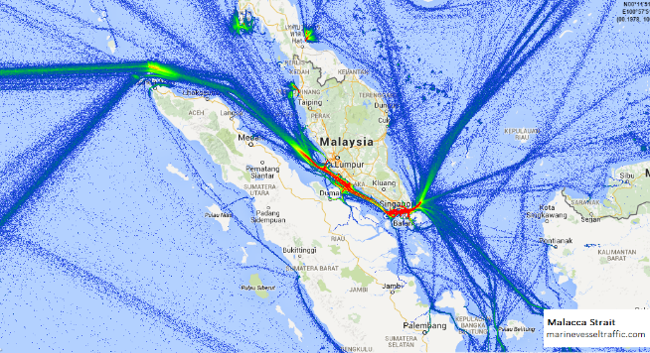
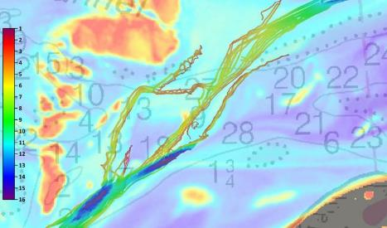
Improving ENC Quality & Coverage
NOAA Office of Coast Survey
Notes:
marinevesseltraffic.com – Malacca and Singapore Straits Vessel Traffic Density Map
NOAA Office of Coast Survey – Routes taken up the Yukon River channels generally followed the satellite-derived bathymetry data provide

Slide 2
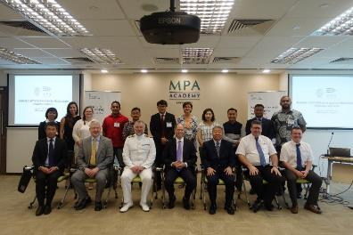
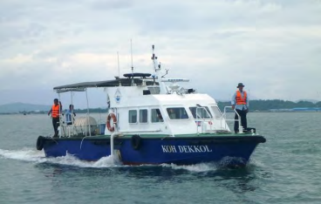
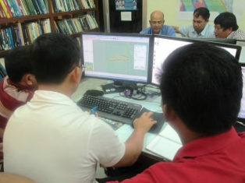
Narrowing the Knowledge Gap
Notes:
MPA – 2016 UKHO-MPA Cat B Carto Course
JICA - The Project for Productions of Integrated Digital Terrain Model and Electronic Navigational Chart in the Kingdom of Cambodia
JICA - The Project for Productions of Integrated Digital Terrain Model and Electronic Navigational Chart in the Kingdom of Cambodia

Slide 3
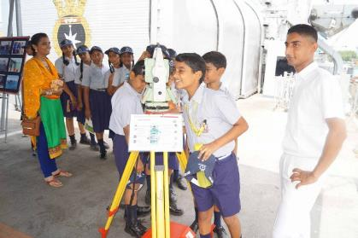
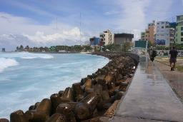
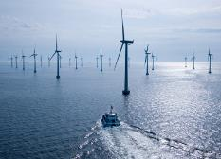
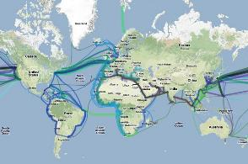
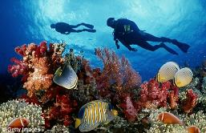
Outreach Programmes Thru Wider Use of Hydrographic Info
Notes:
Telangana Today – INS Eastern Naval Command observes World Hydrography Day. A visit by students of Navy Children School was organized onboard INS Darshak to give insight of hydrographic operations on the occasion.
Submarine cables
Coastal zone management/protection
Offshore renewable energy
Marine science & environment

