Slide 1
International Hydrographic Organization Inter Regional Coordination Committee SOUTH EAST PACIFIC REGIONAL HYDROGRAPHIC COMISSION (SEPRHC) REPORT
Commander Navy of Colombia
GUSTAVO ADOLFO GUTIÉRREZ LEONES
National Hydrographic Service of Colombia (DIMAR-CIOH)
On behalf SEPRHC (chair)
Goa, INDIA 4 - 6 June 2018

Slide 2
I. Membership
Ecuador
Colombia
INOCAR
DIMAR
PERU
Chile
DHN
SHOA

Slide 3
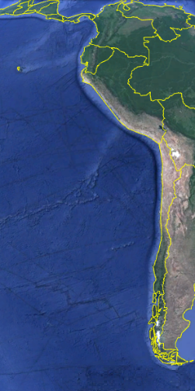
II. SEPRHC maritime scenario
Issue | Qty
Length | 8,621 Km
Countries | 5
Terminals | 17
Ports | 54
Navareas | 3
Border rivers
Fuente: Google earth

Slide 4
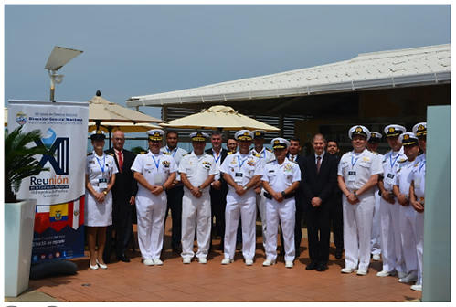
III. XIII SEPRHC Meeting 21 – 25 August 2017
Notes:
XIII SEPRHC in Cartagena de India’s August 21 to 25th 2017.
First video conference 26th February 2018.
Second video conference 3rd May 2018.

Slide 5
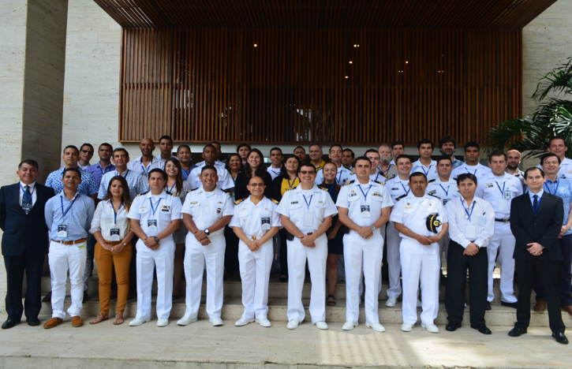
IV. Workshops
Geophysical analysis and identification of seamounts
Colombia, October 2017
Notes:
Workshop offshore surveys (geophysical analysis and identification of seamounts) - Colombia, from 23 to 27 October 2017.
New technologies.
RHC Disasters.
MSDI importance

Slide 6
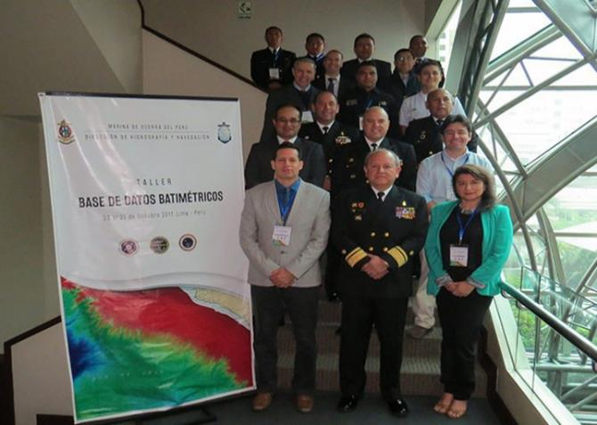
IV. Workshops
Workshop on Bathy Database
Peru, October 2017

Slide 7
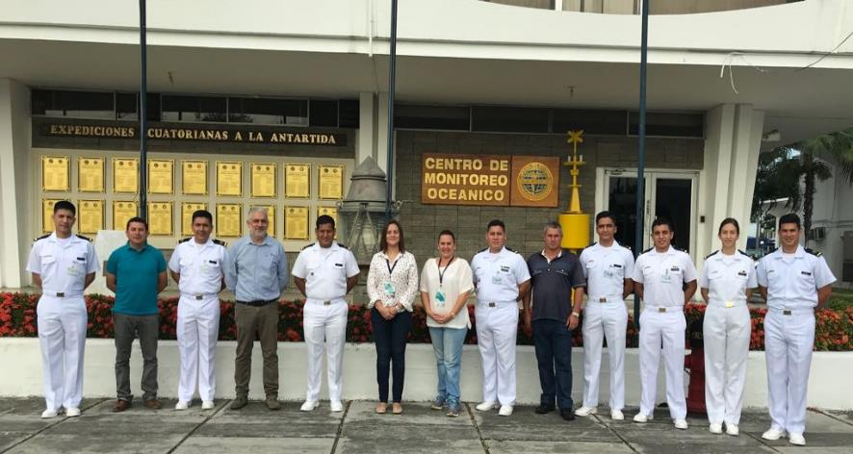
IV. Workshops
Aton Managers L1 - IALA
Ecuador, Apr – May 2018

Slide 8
V. Current SEPRHC Working Groups
TWCWG
- Ecuador and Peru
- Colombia has the intention
SPRWG
- Chile, Ecuador and Colombia
MARITIME DISASTERS
- On going.

Slide 9
VI. Status of IRCC actions (See Appendix A)
N | Action | Responsible | Deadline | SEPRHC status
4 | The use of the Joint Manual on MSI | RHC Chairs | IRCC10 | Ongoing.
5 | Coordination between NAVAREA Coordinators and Regional CB Coordinators to the MSI training courses. | RHC Chairs | IRCC10 | Planned for 2019

Slide 10
VI. Status of IRCC actions (See Appendix A)
N | Action | Responsible | Deadline | SEPRHC status
10 | Fund raising and engagement in CB via national organizations. | RHC Chairs | IRCC10 | Revision of agreement among the navies.
18 | Nominate RHC MSDI Ambassadors to promote MSDI. | RHC Chairs | IRCC10 | Colombia is candidate to this role.
32 | Satellite derived bathymetry and risk assessment methodologies. | RHC Chairs | IRCC10 | Ongoing Lidar Workshop planned for Ecuador, October, 2018

Slide 11
VII. SEPRHC cooperation with stakeholders
Active cooperation between SEPRHC, SWAtHC and MACHC.
The relationship among navies is strong a continuous.
The SEPRHC explore more efficient relationship with the some universities in the region to support the CB activities.
Notes:
Active cooperation in capacity building is in place between SEPRHC, SWAtHC and MACHC. The projects submitted to the CBSC always consider the participation three Hydrographic Commissions. Spanish speakers
Member states are involved with other intergovernmental organizations related to maritime and navigation safety like IOC, IALA and IMO.
Under the agreements between navies there are a lot of cooperation in capacity building among hydrographic services.
In particular, Colombia has received assessorial in Antarctic expedition of Ecuador, Peru and Chile.
The Antarctic Treaty is another organization that the four members state works together
In the SEPRHC have been adopted one measure when occur natural disasters occur. The HS establish coordination's with other institute of respective government.
After XIII SEPRHC, is highlight MS compromise to support Panama.

Slide 12
VII. Conclusions
The SEPRHC will continue working in the tasks and commitments signed in the XIII SEPRHC act. Every two months the advances are reviewed through video conferences.
The Commission continue work in consistency with the IRCC and CBSC work plans.

Slide 13
VII. Achievements and lessons learned
The CB promoted by IHO trough CBSC has been very important for our region.
The cooperation among the navies is excellent.
The need of SEPRHC members states to participate actively in the IHO bodies and WG´s continues to be promoted.
Notes:
The SEPRHC gives thanks to CBSC by the continuous support in Capacity Building. The close relation between MS permit the easy communicates, share the information and work early.
This cooperation has been critical to promoting an understanding of respective national directions, hydrographic priorities and interests, and resulting opportunities for collaboration and mutual assistance.

Slide 14
VII. Actions Required of IRCC
The IRCC is invited to:
a. Note this report.

Slide 15
International Hydrographic Organization Inter Regional Coordination Committee SOUTH EAST PACIFIC REGIONAL HYDROGRAPHIC COMISSION (SEPRHC) Thanks
Commander Navy of Colombia
GUSTAVO ADOLFO GUTIÉRREZ LEONES
National Hydrographic Service of Colombia (DIMAR-CIOH)
On behalf SEPRHC (chair)
Goa, INDIA 4 - 6 June 2018

