Slide 1
USCHC Report
U.S.-Canada Hydrographic Commission
IRCC10, GOA India
June 04, 2018
Rear Admiral Shepard M. Smith (USA)
Dr. Genevieve Bechard (Canada)

Slide 2
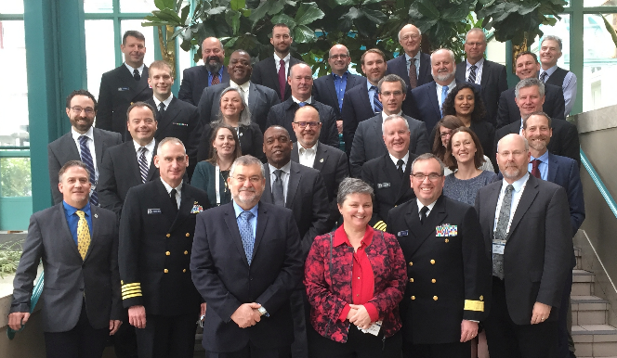
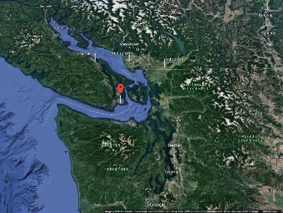
USCHC-41
March 26, 2018 in Victoria, British Columbia, Canada
Welcome Dr. Geneviève Béchard, Dominion Hydrographer, Chair USCHC-41
Welcome IHO Director Abri Kampfer
Robust participation (30+)

Slide 3
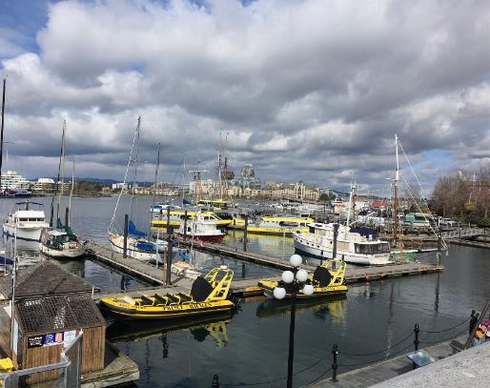
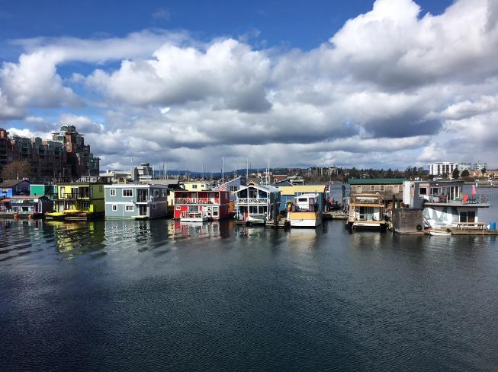
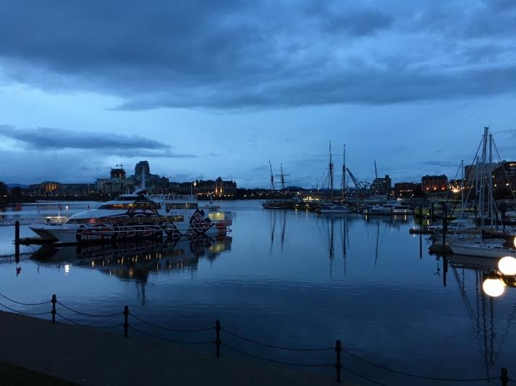
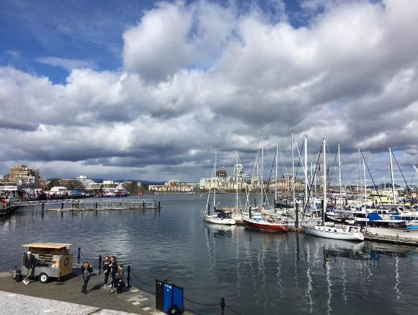
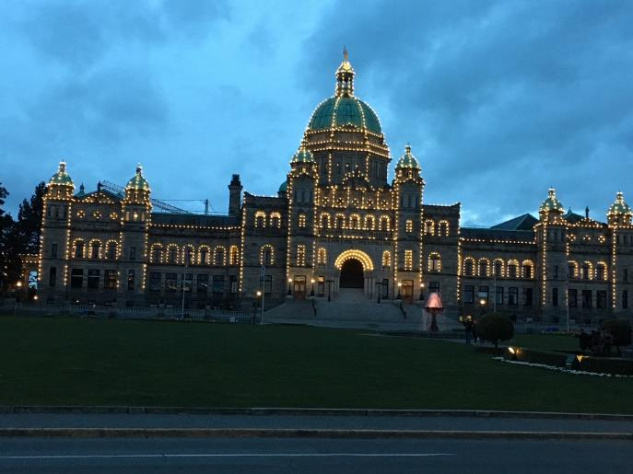
Victoria, a Beautiful City

Slide 4
Notable DEVELOPMENTS since ircc-9
Continued implementation of Canada Ocean Protection Plan
Released the U.S. National Charting Plan (November 2017)
Seabed 2030
Supported S-100 + series of data standards
NOAA Precision Navigation Initiative ??
CA and U.S. shared lessons learned in development of unmanned systems
USCHC representative to the CBSC: Calvin Martin (USA)

Slide 5
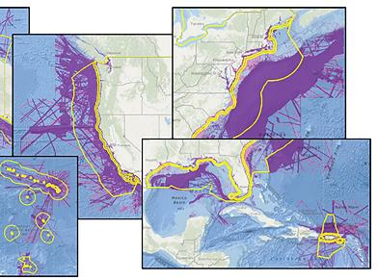
Seabed 2030
U.S. Gap Assessment completed (U.S. waters)
Definition of "mapped" - equal to 1 sounding in a 100m cell with data collected between 1960 to present.
For details see “USCHC41-5Dii” presentation, IRCC Reference paper “Assessing Sounding Density for a Seabed 2030 Initiative”¹ (Meredith Westington²)
Canada
Is making plans to contribute to Seabed 2030
-Has not completed a Gap Assessment similar to the U.S.
-Has generated a 100m non-navigation grid of its bathymetry
U.S. coastal waters and EEZ | % of U.S. waters “mapped” (2018) | U.S. waters “mapped” (sq nm) with modern surveys (>1960) | Total area: EEZ and state/coastal waters (2018, sq nm)
Grand Total | 41% | 1,490,100 | 3,592,000
https://www.eiseverywhere.com/ehome/chc-nsc2018/711593/
Meredith.Westington@noaa.gov
Notes:
We did not generate any bathymetric grid from the data; only a coverage grid. (Andy)
I think it's super important to tell folks that the 41% represents a definition of "mapped" that is equal to 1 sounding in a 100m cell with data collected between 1960 to present. Maybe note verbally that this number changes to 34% if we require at least 3 soundings to consider an area "mapped". The CHC presentation and paper are located here. Maybe use the 41% figure from the CHC materials on your slide? On the square nautical miles number, I think the more interesting part is the total number (the 3.5 million figure and not the math showing what 41% of 3.5 million is). We often say that we're responsible for 3.4 million square nautical miles of EEZ, but 41% represents U.S. waters, which is the EEZ plus coastal/Great Lakes waters. (Meredith)
Add a statement about what "mapped" means--at least 1 sounding since 1960 in a 100-m square. I would stay away from the 3 or more soundings, since we haven't settled on using that number officially. (Andy)

Slide 6
Evolving chart advisory Committee
USCHC Chart Advisory Committee under consideration to be rescoped as the “Hydrographic Geospatial Products and Services Committee”
Draft Terms of Reference under review
Focus expanded to include:
Dynamic services such as real-time tides and currents
MSDI
Grid-based ENC scheme in trans-boundary waters

Slide 7
Strategic Planning
Canadian Hydrographic Service 2018-2028 Strategic Directions and Quality Policy released (January 2018)
http://www.charts.gc.ca/documents/help-aide/strategicdirections-orientationsstrategiques-eng.pdf
NOAA
National Charting Plan published November 2017 (https://nauticalcharts.noaa.gov/publications/docs/national-charting-plan.pdf )
Unmanned Systems Roadmap published 2017 https://ocsdata.ncd.noaa.gov/HSRP/documents/meeting-docs/2017/September%202017-Portsmouth%20NH/other-docs/Executive%20Summary%20of%20OCS%20Autonomous%20Systems%20Roadmap.pdf
Office of Coast Survey Strategic Plan (2015-2019) will be renewed this year.
CA and U.S. participating on the IHO Council SPRWG

Slide 8
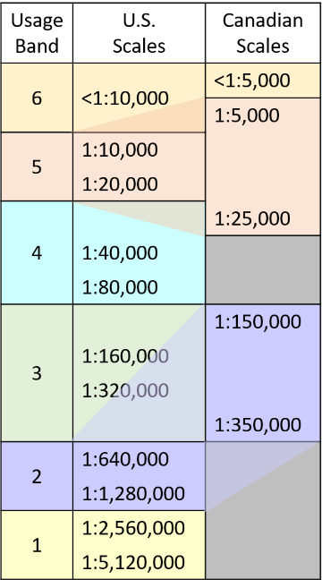
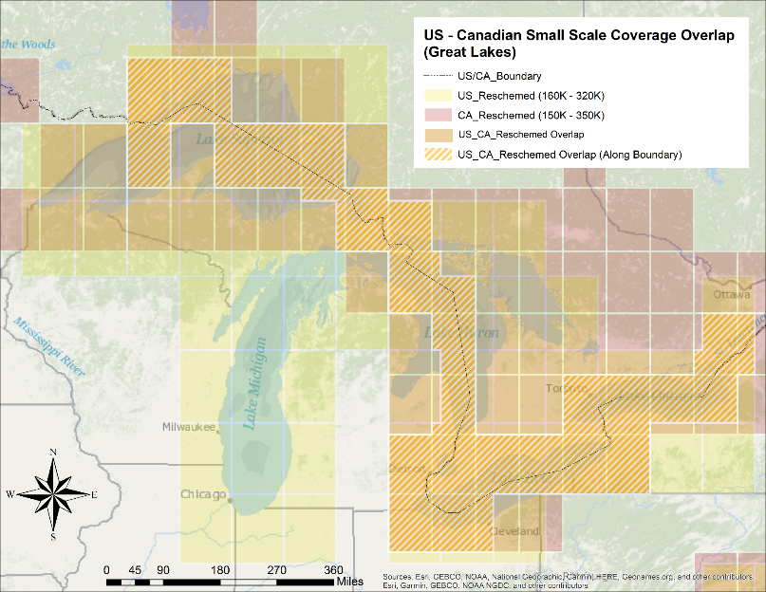
CHS and NOAA looking to rescale ENCs: transboundary implications?
Initial impact study: Great Lakes region. Graphic is for illustration purposes only

Slide 9
Ocean Protection Plan
Dave Prince, CHS
Notes:
Dave Prince (CA HoD) can speak to this particular slide

Slide 10
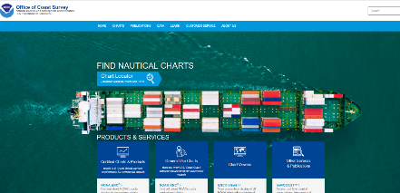
Communications (NOAA)
Revamped website--
nauticalcharts.noaa.gov
coastsurveycommunications@noaa.gov
NOAAcharts
13,869 followers
NOAAcharts
12,300 followers
Quarterly newsletter
>2000 subscribers
noaacoastsurvey@
wordpress.com
450 followers

Slide 11
Technical Exchange OpportunitiES
Remote Sensing Workshop
September 2018 in Ottawa, Canada
Further information: rene.chenier@dfo-mpo.gc.ca
Chart Adequacy Workshop
July annually in Silver Spring, Maryland, USA
Approximately a dozen students for one week, held at NOAA with GEBCO and UKHO support
Invitation to CBSC to nominate two candidates for 2019
Further information: shachak.peeri@noaa.gov
Other: please see national reports on the USCHC website
Active now: University of Mississippi, University of New Hampshire, NOAA CAT B

Slide 12
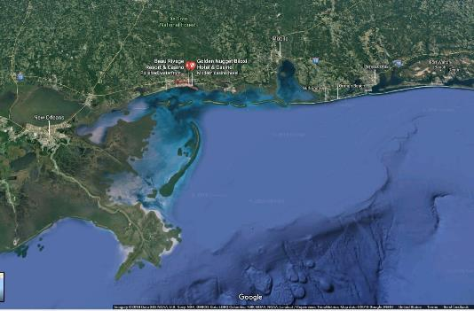
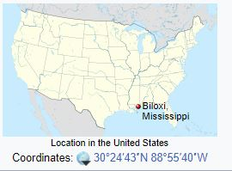
USCHC-42 Biloxi, Mississippi, USA
March 18, 2019
In conjunction with U.S. Hydro March 19-22, 2019
http://ushydro2017.thsoa.org/about/

