Slide 1
Report of the Italian Hydrographic Institute Guidance on Data Quality Aspects: How IT allocates CATZOC values
Hydrographic Services and Standards Committee
DQWG

Slide 2
Introduction
Italian ENC portfolio consists of about 260 cells
Italian ENC production process has changed
ENCs were digitalized from paper charts
use digital data or raw data
about 50% of our ENC portfolio includes ENCs produced by digitalization
the Italian general rules about the value of CATZOC on ENCs were changed, based on several factors.

Slide 3
Analysis/Discussion
The ENC production process:
ENCs derived by digitalization:
ZOC= B or C
(value downgraded to include errors introduced in the digitalization process)
ENCs produced from digital data or row data:
ZOC = A1, A2, B, or C in accordance with the parameters described in the ZOC table
(We do not downgrade the CATZOC value due to generalization process)

Slide 4
Analysis/Discussion
2. The S-57 Feature object used to encode the sea area:
UNSARE:
Up to Now → ZOC = U (SWs and RENC)
In Future → no M_QUAL object should cover the UNSARE object
if UNSARE object includes bathymetric features → ZOC = D
DRGARE:
regularly maintained → ZOC = A1
not regularly maintained → ZOC = D

Slide 5
Analysis/Discussion
DEPARE:
bathymetric data are available → ZOC = A1, A2, B, or C (No downgrade due to generalization process)
blank area covered by larger scale ENCs → ZOC D plus CTNARE
no survey data are available and the sea area is included between the coastline and the outer limit of the surveyed area (either 0-2m or 0-5m):
adjoining survey is ZOC equal to A1 or A2 → ZOC = D
adjoining survey is ZOC equal to B or C → ZOC = B or C

Slide 6
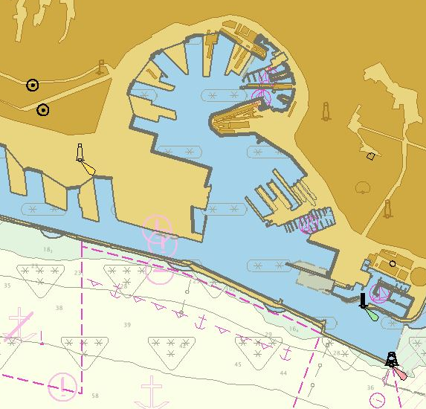
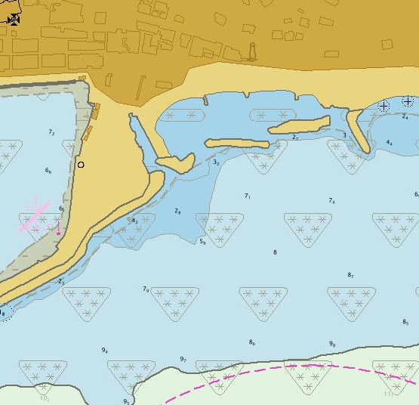
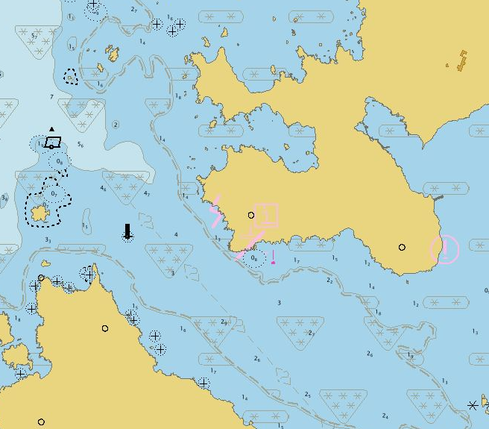
Analysis/Discussion
Blank area covered by larger scale ENCs
No survey data available - sea area included between the coastline and the outer limit of the surveyed area (either 0-2m or 0-5m)

Slide 7
Analysis/Discussion
3. The Usage Band:
UB 1(overview) and 2 (general):
ZOC= D
UB 3 (coastal), 4 (approach), 5 (harbour) and 6 (berthing):
ZOC = A1, A2, B, or C in accordance with the parameters described in the ZOC table
(We do not downgrade the CATZOC value due to generalization process)

Slide 8
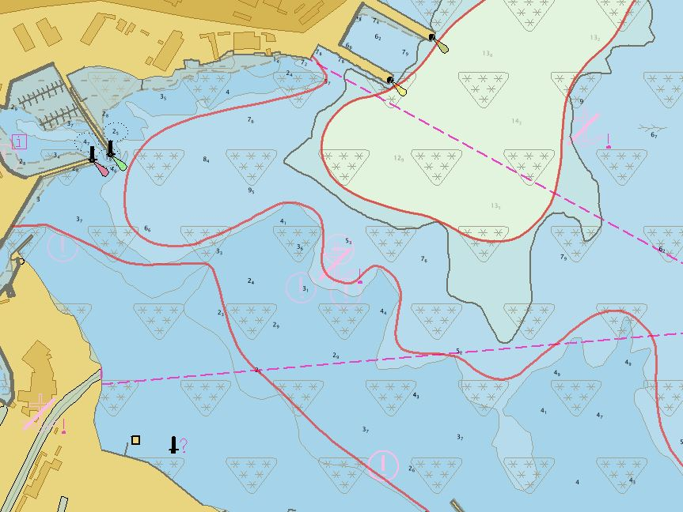
Analysis/Discussion
It is worth noting:
CATZOC values are not downgraded due to the passage of time
CATZOC values are sometime downgraded due to the instability of bathymetry
CATZOC values are not downgraded due to the generalization to a smaller scale.

Slide 9
Conclusions
Common rules on CATZOC value assessment have to be defined
It is important to define a common operational approach on the following situations:
ZOC values in UNSARE;
How to downgrade CATZOC values due to the passage of time and the instability of bathymetry;
How to downgrade CATZOC value due to the generalization to smaller scales;
How to use CATZOC to assess the DEPARE included between the coastline and the outer limit of the surveyed area.

Slide 10
Action requested of DQWG
The DQWG Members are invited to:
note and discuss this paper;
provide feedback.

