Slide 1
CBSC16
Goa, India, 30 May - 1 June 2018
C-55 Developments
IHO Secretariat

Slide 2
Status of C-55
The IHO Publication C-55 Status of Hydrographic Surveying and Nautical Charting Worldwide was initially developed as an Excel spreadsheet and presented as a static document in pdf format (around 2011).

Slide 3
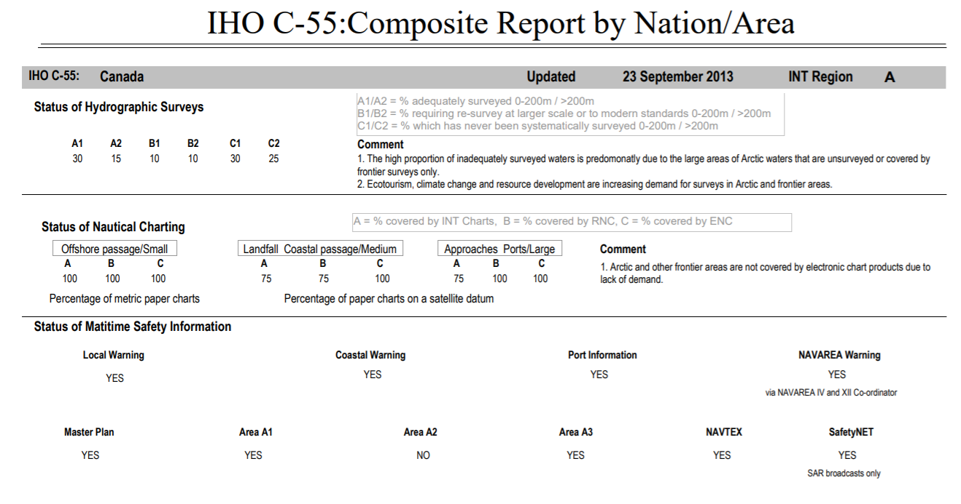

Slide 4
Status of C-55
The current version of C-55 is a live database, part of the IHO Country Information System (CIS). But still presented in PDF format:
www.iho.int/download > C-55

Slide 5
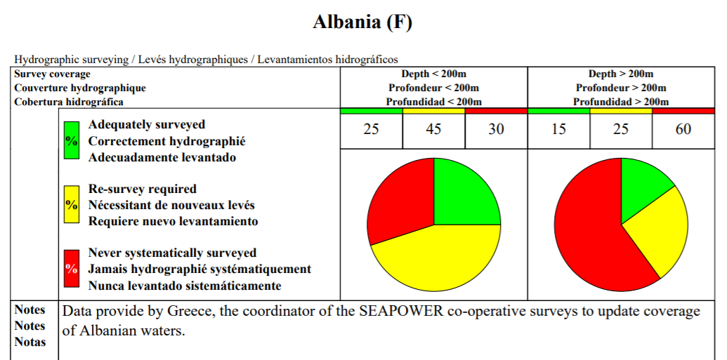

Slide 6
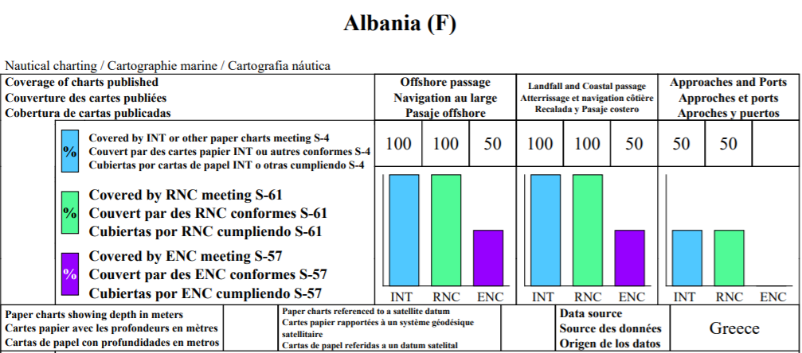

Slide 7
Status of C-55
Points to consider:
1) Is the current version of C-55 fit for purpose?
2) Is there a need for a GIS version of C-55?
3) If so, which format?
4) Within a risk assessment framework?
5) Informal assessment or an objective assessment based on CATZOC (see doc. CBSC16-08.3B)

Slide 8
Actions requested of CBSC:
The CBSC is invited to:
note this report
take any action as appropriate

Slide 9
IHO Secretariat, here to help you! www.iho.int alberto.neves@iho.int

