Slide 1
International Hydrographic Organization Capacity Building Subcommittee SOUTH EAST PACIFIC REGIONAL HYDROGRAPHIC COMISSION (SEPRHC) REPORT
Commander Navy of Colombia
GUSTAVO ADOLFO GUTIÉRREZ LEONES
National Hydrographic Service of Colombia (DIMAR-CIOH)
On behalf SEPRHC (chair)
Goa, INDIA 30th April – 1th June 2018
Notes:
Good morning dear Mr. Chair and distinguished members participating in the CBSC meeting. My name is Gustavo Gutiérrez, Commander of Colombia Navy, and I am here at your disposal and on behalf of Sout Est Pacific Regional Hydrographic Commission chair.

Slide 2
Agenda
I
Introduction
II
Capacity Building Activities
III
Proposed 2019-20 Cap. Building Programmes
IV
Achievements and Lessons Learned
V
Conclusions
VI
Action Required of CBSC
Notes:
We are goint to follow the next agenda.

Slide 3
I. Introduction
04 Member States.
Chair: Colombia.
01 Observer State (Panama).
Notes:
We are a small hydrographic commission, because is integrated only by four members states and we have the privilege of have to Panamá as observer state. Nevertheless, in this region there are more than 8500 of Coast, we have more than 71 between terminals and ports and 3 NAVAREAS among other aspects. In this way and considering the increase of maritime activities in our region, the capacity building program of IHO is a great help to try provide each time better hydrographic products and services.

Slide 4
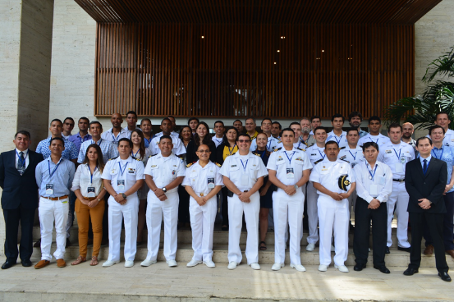
Introduction
South East Pacific Regional Hydrographic Commission (SEPRHC) attended two events on the second semester of 2017:
Notes:
I take advantage this opportunity to thank to IHO CBSC for the unconditional Support for this hydrographic commission, without doubt its has been a valuable Support to promote the maritime development in our region, and this is the feel of all members of this hydrographic commission.

Slide 5
II. Capacity Building Activities
SEPRHC CB Activities since CBSC15
IHO-Funded CB activities
S/N | Title | Venue | Date | Status
1 | Workshop on MSDI implementation | Colombia | Sept 2018 | Planned Not founded yet
2 | Workshop on LIDAR technology and methodology | Ecuador | Oct 2018 | Planned ROK
Notes:
For this year in the Capacity Building Working Plan are including two workshop. The first one about MSDI is planned to be develop in Colombia and the Second one of LIDAR is planned to be development in Ecuador. This last workshop like you can see in the slide have financial resources assigned. In the MSDI workshop we don't have economic resources yet, but we as Commission chair hope help with some resources to impulse this workshop, that is very important for our region. The specific proposal Will be to presented to all distinguished members in the point 9.1 of the meeting agenda.

Slide 6
II. Capacity Building Activities
Non IHO-Funded CB activities
S/N | Title | Venue | Date | Status
1 | Aids to Navigation Level 1 Manager Course | Colombia | 2017 | Completed
2 | Two days CB sponsor by CO during XIII SEPRHC | Colombia | 2017 | Completed
3 | AtoN Managers L1 Course | Ecuador | 2018 | Completed
4 | Aids to Navigation Level 1 Manager Course | Colombia | 2018 | Planned
5 | BAP Carrasco. Research on board | Perú | 2018 | Planned
6 | BAP Carrasco. Research on board | Perú | 2019 | Planned
7 | BAP Carrasco. Research on board | Perú | 2020 | Planned
Notes:
About the NON IHO FOUNDED CB ACTIVITIES, the countries continue working in organize and develop CB events. For example you can see in the slide two workshops developed in Colombia, Ecuador finished some days ago the AtoN workshop with a duration of 1 month, and with Peru we have a great opportunity to take advantage the new research ship BAP Carrasco to conduct hydrographic surveys specially in polar areas. These invitations has been send from Peru to the Commission members to participate in this methodology and with the possibility of work the same for the next three years.

Slide 7
III. Proposed 2019-20 Capacity Building Activities
SEPRHC activities
S/N | Title | Venue | Date | Status
1 | Workshop on Law of the Sea | Colombia | 2019 | Planned
2 | Workshop on MSDI implementation | Colombia | 2019 | Planned
3 | Workshop "Quality Control of ENC productions" | Ecuador | 2019 | Planned
4 | Workshop Tsunami inundations mapping | TBA | 2020 | Planned
5 | Workshop Satellite Derived Bathymetry | TBA | 2020 | Planned
6 | Workshop Crowd-sourced Bathymetry | TBA | 2020 | Planned
7 | Workshop on Antarctic Charts | TBA | 2020 | Planned
Notes:
About the SEPRHC activities we are planning some activities for the next two years like you can see in the slide. We are considering aspects in law of the sea, MSDI, ENC production, Tsunami, Satellite Derived Bathymetry, CSB, and Antarctic Charts.

Slide 8
IV. Achievements and Lessons Learned
The Hydrographic Service must involucrate other stakeholders interested.
Notes:
Aware of the importance to show the capacity building program to promote the hydrographic development in our region, we need improve the relationship with the other stakeholders different to the member states, like universities, industry, NGO´s, among others, looking for new information about current needs and potential financial sources.

Slide 9
V. Conclusions
Capacity Building activities sponsored by IHO and organized by the SEPRHC are fundamentals to increase and standardize.
It´s necessary continue working to strong the CBWP-IHO and this way continue promote the maritime development of our countries.
Notes:
It´s important consider that each day there are more hydrographic requirements, from National and international organizations, and other agencies. Then is very important strengthen this program.

Slide 10
VI. Action required of CBSC16
The CBSC is invited to take note of this report.
The SEPRHC respectfully requests consider the approval of resources to carry out the MSDI implementation workshop.

Slide 11
International Hydrographic Organization Capacity Building Subcommittee SOUTH EAST PACIFIC REGIONAL HYDROGRAPHIC COMISSION (SEPRHC) Thanks
Commander Navy of Colombia
GUSTAVO ADOLFO GUTIÉRREZ LEONES
National Hydrographic Service of Colombia (DIMAR-CIOH)
On behalf SEPRHC (chair)
Goa, INDIA 30th April – 1th June 2018

