Slide 1
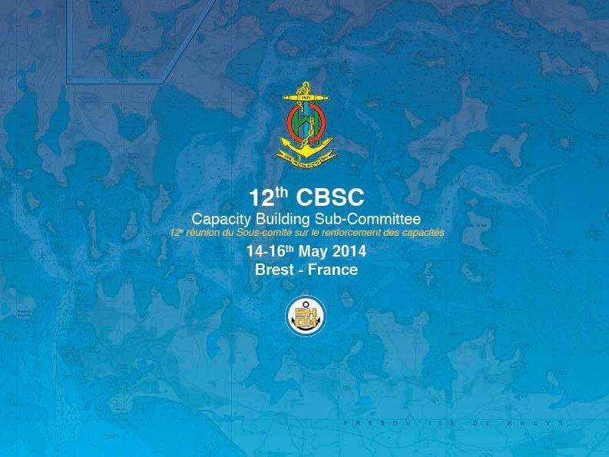
EAtHC Report
Item 05.1F – Summary report on CB activities
CBSC15 – Paramaribo (Surinam) – June 2017

Slide 2
Plan
EAtHC CB overview and self-assessment
Past EAtHC CB projects
Ongoing EAtHC CB projects
EAtHC self-Assessment (procedure 11)
EAtHC 3-y Work Plan (2019-2021)

Slide 3
EAtHC CB overview
Current challenges in CB (WCA sub-region):
increasing maritime activities in the African sub-region, making urgent to increase hydrographic capabilities;
the need to improve the maritime geospatial knowledge in the African sub-region;
To improve the access to relevant training for the sub-region;
difficulty, in some cases, to put into practice the training received, due to the lack of equipment.

Slide 4
Procedure 11: EAtHC self-assessment
N. | Coastal State/Territory | NHC/NHCC | Phase 1 | Phase 2 | Phase 3 | Last TV | IMSAS
5 | Angola | 0 | 2 | 1 | 3 |  | 2022
19 | Benin | 0 | 2 | 1 | 3 |  | 2020
29 | Cabo Verde | 0 | 2 | 1 | 3 | 2003 | May 2017
31 | Cameroon | 0 | 2 | 1 | 3 | 2011 | 2020
39 | Congo | 0 | 2 | 1 | 3 |  | 2018
42 | Côte d'Ivoire | 0 | 2 | 1 | 3 |  | Feb 2016
48 | Democratic Republic of the Congo | 0 | 2 | 1 | 3 |  | May 2017
56 | Equatorial Guinea | 0 | 2 | 1 | 3 |  | 2018
62 | France | 2 | 4 | 4 | 4 |  | 2021
63 | Gabon | 0 | 2 | 1 | 3 | 2003, 2012 | Apr 2017
64 | Gambia | 0 | 2 | 1 | 3 |  | Feb 2017
67 | Ghana | 2 | 2 | 1 | 3 | 2003 | Jan 2017
71 | Guinea | 1 | 2 | 1 | 3 | 2003 | Jul 2016
72 | Guinea-Bissau | 0 | 2 | 1 | 3 | 2003, 2012 | NA (C113)
98 | Liberia | 0 | 2 | 1 | 3 | 2016 | 2020
110 | Mauritania | 0 | 2 | 1 | 3 | 2003 | Apr 2016
117 | Morocco | 1 | 2 | 2 | 3 |  | 2022
127 | Nigeria | 2 | 2 | 2 | 3 | 2003 | Jun 2016
139 | Portugal | 2 | 4 | 4 | 4 |  | Apr 2016
151 | Sao Tome and Principe | 0 | 2 | 1 | 3 |  | 2018
153 | Senegal | 2 | 2 | 1 | 3 | 2003 | Jul 2016
156 | Sierra Leone | 0 | 2 | 1 | 3 | 2003 | 2018
164 | Spain | 2 | 4 | 4 | 4 |  | 2020
177 | Togo | 1 | 2 | 1 | 3 |  | Feb 2016
187 | United Kingdom | 2 | 4 | 4 | 4 |  | 2020
189 | United States of America | 2 | 4 | 4 | 4 |  | 2021

Slide 5
WWNWS8 meeting (Alesund – Sept 2016)
Invitation for CB coordinators to attend WWNWS8 in Alesund (Norway) in September 2016.
Dedicated CB sessions to address faced challenges and inform about WWNWS and CBSC work and action.
Challenges faced by WWNWS in terms of MSI training:
Expected lack of experienced instructors in EN/FR
Growing demand as a Phase 1 course
Current lack of trainers in other languages
E-learning seen as a good tool but not as the miracle solution to address MSI. Need to be combined with practical session in a blended approach.
Good emphasis on the need to increase liaison between CB and NAVAREA Coordinators.

Slide 6
TV to Cabo Verde (A-09)
2016: Cabo Verde requested support to IHO in the frame of their forthcoming IMAS (IMO Member State Audit Scheme) visit.
2017: An extraordinary submission was submitted and approved by the CBSC and integrated in the updated 2017 CB work program. The visit was conducted from 27 to 31 of March 2016
Visiting Team: Shom (H. Dolou) + IHPT (A. Peiriço)
Report delivered in May 2017 to IHO Secretariat.

Slide 7
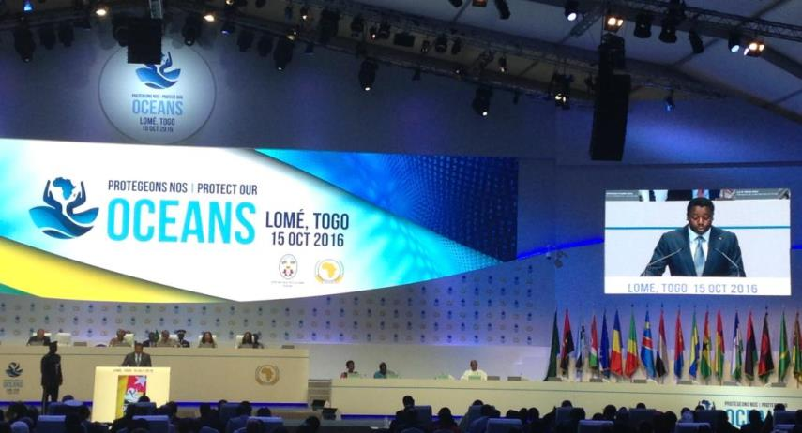
MOWCA High level visit (A-09)
11-15 October 2016 (Lomé – Togo): Extraordinary Summit of the AU Assembly on Maritime Security, Safety and Development.

Slide 8
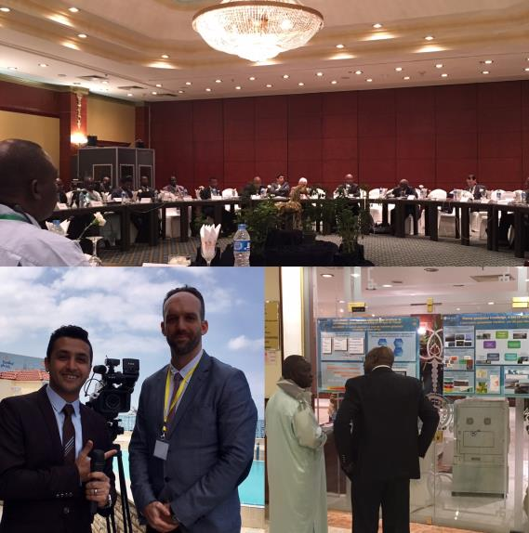
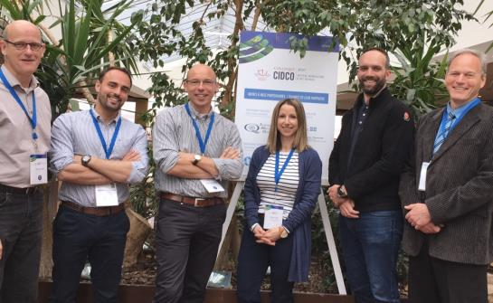
HydroMAOC study follow-up

Slide 9
E-learning MSI experimentation
IHO/Shom/CIDCO project initiated in 2016,
Experiment how e-learning could improve the access to maritime safety information knowledge (MSI)
Step1: develop francophone e-learning materials based on regular maritime safety information academic course
➔ e-learning platform delivered in April 2017
Step2: 5 weeks tutored session (May 15 – June 16)
➔ Kick-off on May 15th with 13 trainees from Cote d’Ivoire, Gabon, Guinée, Togo, Haiti, Comoros, IALA, IHO.

Slide 10
The CBSC in invited to
Take note of that report

Slide 11
Questions?
Merci pour votre attention
Thank you for your attention

